Slide 1


Phonotactic Language Recognition using i-vectors and Phoneme Posteriogram Counts
Luis Fernando D’Haro,
Ondřej Glembek, Oldřich Plchot,
Pavel Matejka, Mehdi Soufifar,
Ricardo Cordoba, Jan Černocký

Slide 2
Content
Introduction
Steps to create Joint-Posteriogram n-gram counts
Subspace Multinomial Models
  i-vectors
Results on LRE-2009
Conclusions and Future work

Slide 3
Introduction
Current main approaches to LID
  Acoustic-based: i-vectors, JFA, SVMs, or GMMs
  Phonotactic
Phonotactic systems:
  PRLM, PPRLM: LMs created using different phonetic ASR
  Lattice-based soft-counts: Created from phone lattices
    Zero counts (i.e. data sparseness)
    Limited by the number of phonemes and n-gram order
    Dimensionality reduction: PCA or n-gram selection
  Using i-vectors through Subspace Multinomial Models (SMMs)
    We propose a new feature vector that performs better than soft-counts

Slide 4
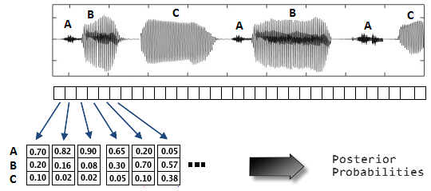
1. Compute Posterior Probabilities
In the example, we consider only three phonemes and bigrams. In our experiments, they were 33 and we used trigrams.

Slide 5
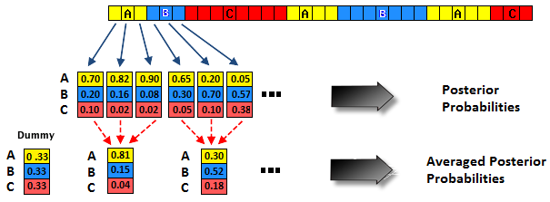
2. Compute Posterior Probs
Find the phoneme boundaries using Viterbi algorithm
  Can be seen as incorporation of a-priori information
Average the posterior probs over the phone boundaries
  Smoothes the posterior probs and avoids the high-correlation of within-phoneme posteriors

Slide 6
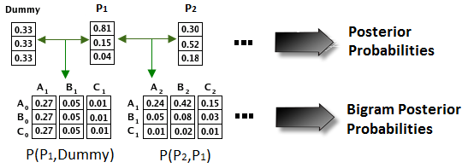
3. Create N-gram Posterior Probs
Outer product with the posteriogram of the previous phones
Assume that the frames of the averaged posteriogram are statistically independent,
  Therefore we have joint probabilities for sequences of phonemes

Slide 7
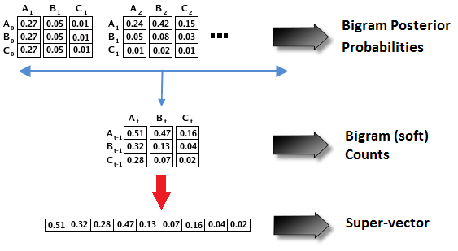
4. N-gram Counts via N-gram Posterior Probs
Sum up all matrices to obtain n-gram soft counts
Obtain feature super-vector for creating next the phonotactic i-vectors using SMMs

Slide 8
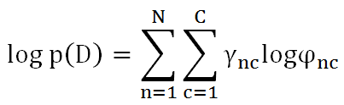
Subspace Multinomial Models
Allows extraction of low-dimensional vectors of coordinates in total variability subspace (i.e. i-vectors)
The log-likelihood of data D for a multinomial model with C discrete events is determined by
Where γ_{nc} is the count for n-gram event c at utterance n, and φ_{nc} is the probability of a multinomial distribution deﬁned by the subspace model

Slide 9

i-vectors from SMM
Where t_{c} is the c-th row of subspace matrix T (Extractor), and w_{n} is the i-vector
An i-vector for a single utterance is estimated numerically by maximizing the likelihood (ML)
Matrix T is trained numerically using ML by iteratively optimizing T and re-estimating the i-vectors for all training utterances
Then we use these i-vectors as feature input for training a discriminative LID classifier
  Multiclass logistic regression

Slide 10
Experimental Setup
NIST LRE 2009 database
  50K segments for training (~119h), 38K segments for dev (~153h) and 31K sentences for test (~125h)
  23 languages, test on 3, 10, and 30 s conditions
  Results given using C_{avg} metric
Acoustic i-vector system
  7 MFCC + 49 SDCs, CMN/CVN, 2048 Gaussians -> i-vectors of 400 dimensions
Comparisons with:
  Lattice-based soft-counts with i-vectors (size 600)
  Lattice-based soft-counts with PCA (reduction to 1000 dimensions)
Fusion: Multiclass logistic regression
  Acoustic and Phonotactic

Slide 11
Results on NIST LRE 2009
30 s
10 s
Vertical-axes in logarithm
3 s

Slide 12
Conclusions and Future Work
Advantages of the new features
  Avoid data sparseness (i.e. robustness)
  Results outperforms a similar system based on lattice soft-counts with i-vectors
    8,16% relative on 30 s condition
  Fusion with acoustic i-vectors are also better
    10% relative on 30 s condition
Future Work: Apply discriminative n-gram selection techniques to reduce the vector size
  Avoids low frequency n-gram counts
  Allows using high n-gram orders

Slide 13
…Thanks for your attention...
Comments or Questions?

