Slide 1
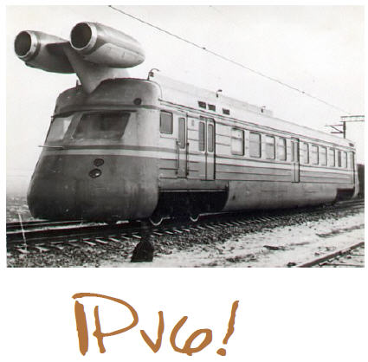
Deploying IPv6 - practical problems from the campus perspective
Tomáš Podermański, tpoder@cis.vutbr.cz
Matěj Grégr, igregr@fit.vutbr.cz

Slide 2










The Brno University of Technology
http://www.vutbr.cz
One of the largest universities in the Czech Republic
Founded in 1899, 110th anniversary was recently celebrated
20,000 students and 2,000 employees
9 faculties
6 other organizational units
Dormitory for 6,000 students

Slide 3
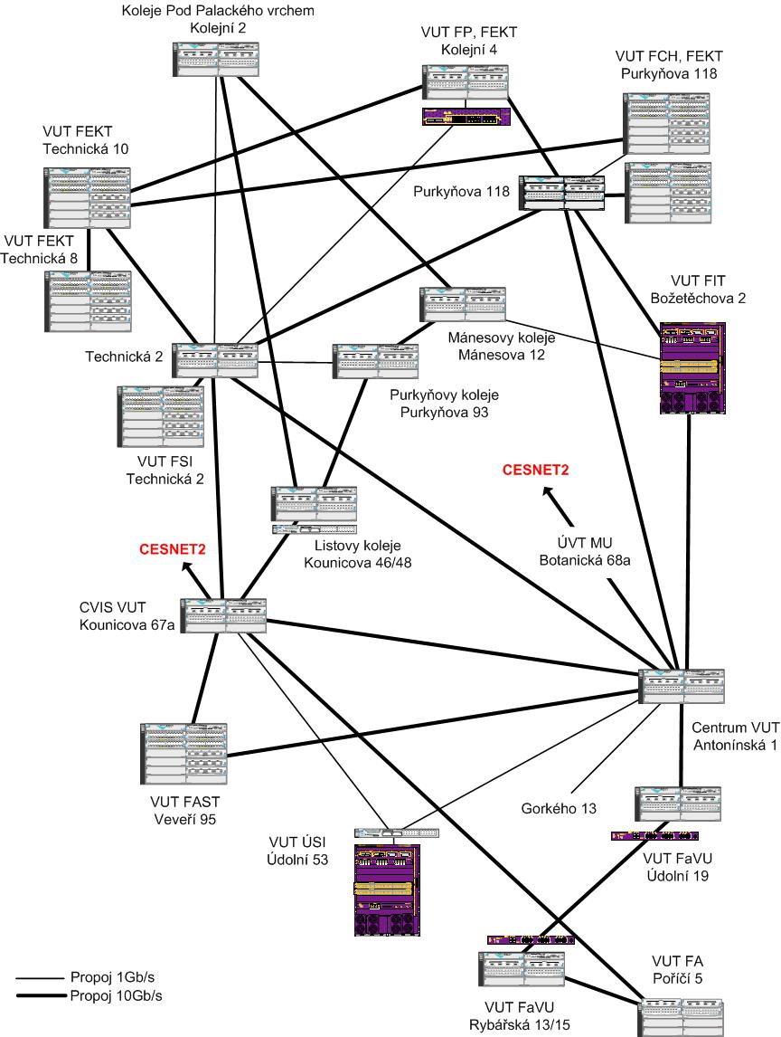
Layer 3 network
Core of the network
    Based on 10Gb/s ethernet
    Basic L3 services
  OSPF and OSPFv3
  multicast - PIM/SM
External connectivity
Two 10Gb/s lines connecting the core to CESNET (BGP, BGP4+)
Basic filtering (SMTP, NetBios, 445/Microsof DS)
Locality & sub-campuses
Two 10Gb/s lines to the core
More complex firewalls configurations are dependend on local administrators

Slide 4
At the beginning (2008) we thought…
IPv4 address space will be exhausted very soon
  We have to do something
IPv6 is here more than 13 years
  It should be mature enough
We have been buying devices with IPv6 support for years
  The hardware is prepared. There is only little configuration needed.
The Microsoft products starts supporting IPv6 by default. UNIX-like systems supports IPv6 for years
  The major used platform is prepared
So, where could be a problem ?

Slide 5
Autoconfiguration & address assignment

Slide 6
DHCP, DHCPv6 & SLAAC
 | DHCPv6 | SLAAC | DHCP (v4)
Handle default route to a client |  | ✔ | ✔
Handle address of DNS servers to a client | ✔ | *[1] | ✔
Privacy extension or EUI64 address created by a client |  | ✔
Assignment IP address based on client’s MAC address |  |  | ✔
Assignment IP address based on client’s DUID address | ✔
Brand new autoconfiguration mechanisms
  Router advertisement (doesn’t contain address of DNS servers)
    [1] There is an extension RFC 6016 but is not widely implemented yet
  DHCPv6 (doesn’t contain default route option)
    There is an draft draft-ietf-mif-dhcpv6-route-option-03 but not accepted yet
Privacy extensions
  IPv6 addresses are created by hosts randomly
  IPv6 addresses are periodically changed (every day, once a week)
DUID in DHCPv6 request instead of MAC address
  DUID is not predictable created randomly when the OS is installed
  Impossible to tie address management with existing systems

Slide 7
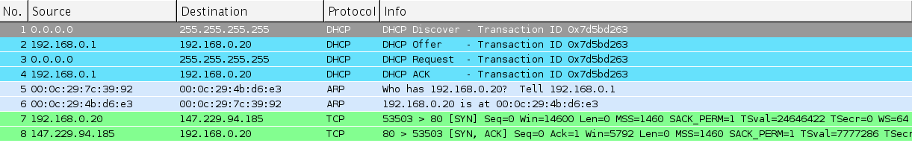
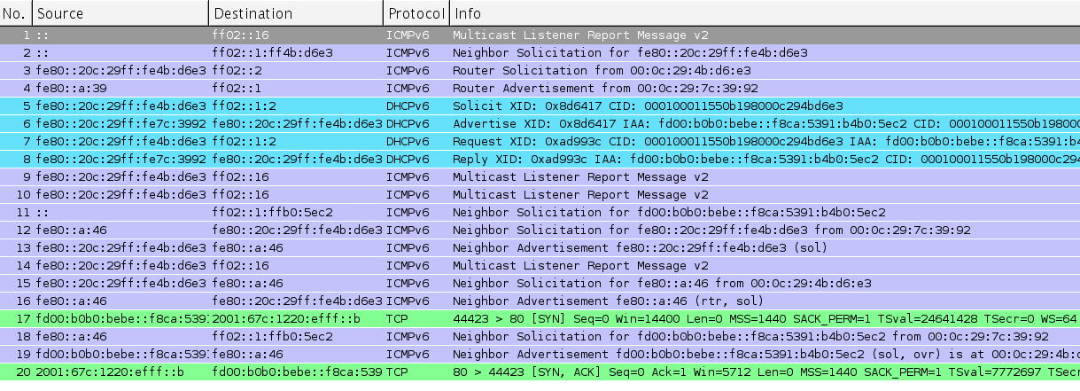
Autoconfiguration IPv4 x IPv6
IPv4 – DHCP, ARP
HTTP trafic
IPv6 – DAD, RS/RA, DHCPv6, MLDv2, ND
HTTP trafic

Slide 8
Autoconfiguration features
 | DHCPv6 | SLAAC | RFC 6106 | SEND | DHCP (v4)
Windows XP |  | ✔ |  | Only experimental version not ready to use in production enviroment | ✔
Windows Vista / 7 / 8 | ✔ | ✔ |  |  | ✔
MAC OSX | ✔ | ✔ |  |  | ✔
MAC OSX prior to Lion (2011) |  | ✔ |  |  | ✔
Linux | ✔ | ✔ | ✔ |  | ✔
Android |  | ✔ |  |  | ✔
Windows phone |  |  |  |  | ✔
iOS (iPhone, iPad, iPod) |  | ✔ |  |  | ✔
Chose SLAAC ?
  All devices supporting IPv6 will be able to use IPv6
  Privacy extensions => troubles with tracking, accounting, security incidents and access to privileges services (based on address)
  How to handle address of DNS servers ?
Choose DHCPv6 ?
  Not supported by all platforms => many clients will not have access to IPv6 network
  Needs to solve problem with DUID and its relation to users' device/identity
  How to handle default route ?
Catch XXII ?

Slide 9
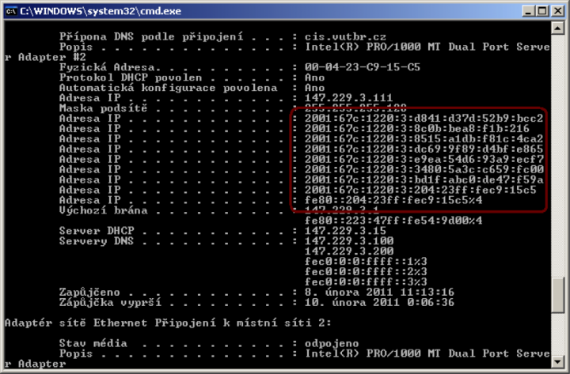
Privacy extensions enabled ①

Slide 10
Solution: gathering information from the network
IP address ➔ MAC address: neighbor cache (NC), arp table
IP address ➔DHCPv6 DUID: Lease db on DHCPv6 server
  eg. http://metanav.uninett.no/
MAC address ➔ Switch port: forwarding database (FDB)
MAC address ➔ Login : radius server
A system that can collect proper information has to be deployed
radius
NC, ARP
Lease DB
FDB
IP address
DHCP DUID
MAC address
Switch port
Login ID

Slide 11
First hop security

Slide 12
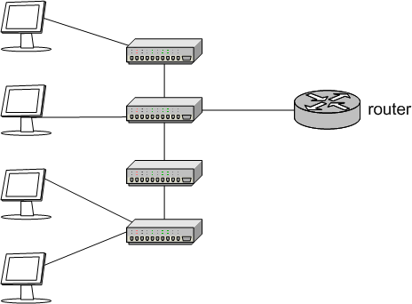
First hop security
Hosts connected on within one subnet
router
switches

Slide 13
Where and why is first hop security important
“Stealing” IP address assigned to another device
Source IP address spoofing
Source MAC address spoofing
ARP poisoning
Rogue DHCP server
  Trojan.Flush.M,
  Trojan:W32/DNSChanger
The trend is to build and operate “flat” networks
2 or 4 C-blocks joined into one subnet

Slide 14
First hop security
Hosts connected on within one subnet
Access ports
router
switches

Slide 15
First hop security in IPv4
 | DHCP snooping | ARP inspection, ARP protection | IP source guard, dynamic IP lockdown | All together
Rogue DHCP server | ✔ |  |  | ✔
ARP poisoning |  | ✔ |  | ✔
Forces users to use DHCP |  | ✔ | ✔ | ✔
Source IPv4 address spoofing |  |  | ✔ | ✔
Source MAC address spoofing |  |  | ✔ | ✔
Require support on access port | ✔ | ✔ | ✔ | ✔
IPv4 autoconfiguration = DHCP + protection on switches
  DHCP snooping
    Blocking DHCP answers on access port
    Building binding database (MAC-IP) related to access port
  Dynamic ARP protection/ARP inspection
    MAC-IP address database based on DHCP leases
    Checking content of ARP packets on client access port
  Dynamic lock down, IP source guard
    The MAC-IP database is used for inspection of client source MAC and IP address.

Slide 16
First hop security threats in IPv6
Neighbor cache spoofing
  Very similar to ARP spoofing
  The spoofed address can be kept in the NC longer
DoS - Duplicate Address Detection (DAD)
  Nodes usually create own address (EUI 64, Privacy Extensions)
  Optimistic DAD – “sorry, the address is mine, choose another one”
Neighbor Cache table overload
  Big address space (64 bits – 1.8e+19 address)
  Many records in the NC for non existing clients
Rogue Router Advertisement
  I am a router for this network – use me as a default router
  The real router is not a valid anymore – zero lifetime
Rogue DHCPv6 Server
  I am a DHCPv6 sever for this network. Use my options (DNS)

Slide 17
Rogues IPv6 routers
Flooding IPv6 hosts with Router Advertises
thc-toolkit (http://thc.org/thc-ipv6/):
All Windows Vista/7 boxes will freeze
Other platforms will have problems with IPv6 connectivity
The problem is known for more than 3 years – no patch/update yet.
More info:
  http://samsclass.info/ipv6/proj/flood-router6a.htm
# ./flood_router6 eth0

Slide 18
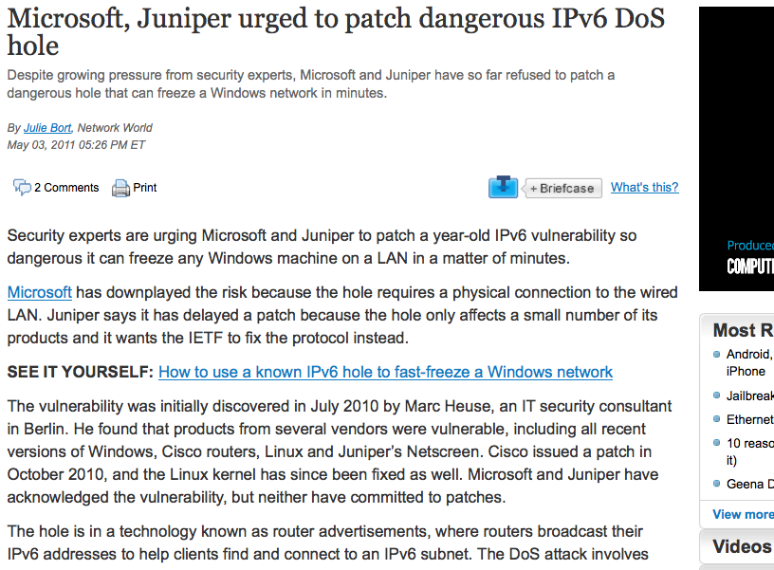

Slide 19
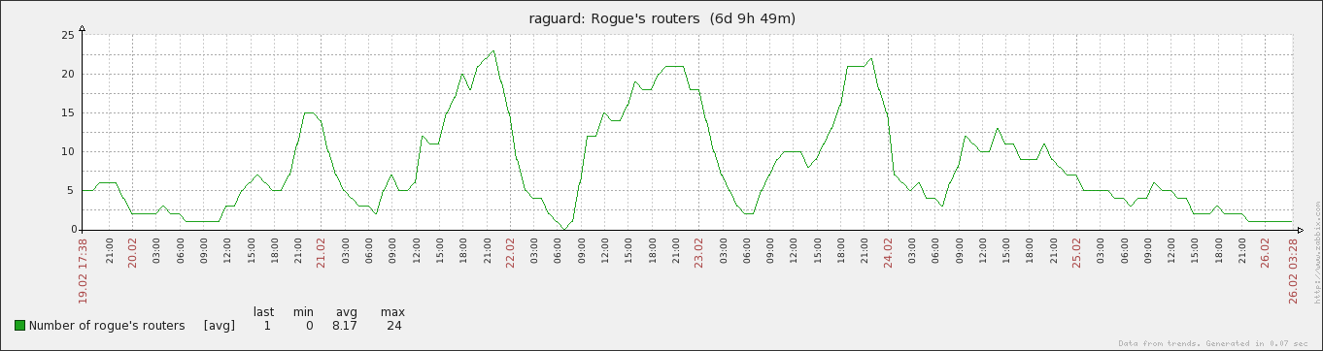
Number of rogues IPv6 routers
Usually caused by Internet Connection Sharing in Window Vista (Windows 7 treats RA much better)
Up to 20 rogue routers within network with 4000 hosts
  Similar (even worse) problem as 20 rogue DHCPv4 servers
Single host with enabled ICS can destroy IPv6 connectivity for all hosts on the subnet

Slide 20
IPv4 traffic redirection using IPv6
Port security:
MAC address security
DHCP snooping
ARP protection
Dynamic lock down
www.vutbr.cz
147.229.2.15

Slide 21
IPv4 traffic redirection using IPv6
Rouge Router Advertisement with M or O flag enabled
Rouge IPv6 Router
www.vutbr.cz
147.229.2.15

Slide 22
IPv4 traffic redirection using IPv6
Rouge DHCPv6 Server
www.vutbr.cz
147.229.2.15
DHCPv6 query (via multicast)

Slide 23
IPv4 traffic redirection using IPv6
DHCPv6 answer
DNS servers points to ME
Rouge DHCPv6 Server
www.vutbr.cz
147.229.2.15

Slide 24
IPv4 traffic redirection using IPv6
192.168.1.166
- name server
- proxy service
www.vutbr.cz
192.168.1.166

Slide 25
First hop security for IPv6
SeND (RFC 3971, March 2005)
  Based on cryptography CGA keys
  Requires PKI infrastructure
    How client obtains his own certificate?
  Can not work with
    Manually configured, EUI 64 and Privacy Extension addresses
RA-Guard, PACL (RFC 6105, February 2011)
  Dropping fake RA messages on access port (RA Snooping)
  Can be easily avoided using fragmentation and extension headers (http://tools.ietf.org/html/draft-gont-v6ops-ra-guard-evasion-01)
SAVI (draft-ietf-savi-*, divided into more drafts)
  Complex solution including source addres validation
  ND Inspection (Cisco devices) provides similar level of protection

Slide 26
First hop security for IPv6
 | RA-Guard | ACL/PACL | SAVI, ND inspection | SEND | Disabling IPv6 | Blocking IPv6
Rogue DHCPv6 server |  | ✔ | ✔ |  | ✔ | ✔
Accidently rogue router advertise | ✔ | ✔ |  | ✔ | ✔ | ✔
Intentional rouge router advertise |  |  |  | ✔ | ✔ | ✔
ND cache poisoning |  |  | ✔ | ✔ | ✔ | ✔
Source IPv6 address spoofing |  |  | ✔ | ✔ | ✔ | ✔
DAD DOS attack |  |  | ✔ |  | ✔ | ✔
Neighbour cache overload |  |  | ✔ |  | ✔ | ✔
Source MAC address spoofing |  |  | ✔ |  | ✔ | ✔
Requires support on access switches | ✔ | ✔ | ✔ |  |  | ✔
Requires support or configuration on client side |  |  |  | ✔ | ✔
Fragment reassembling or undetermined traffic option must be used (Cisco).

Slide 27
Do we really need first hop security ?
Fact: 15 years ago we did not have first hop security for IPv4 as well. We need more time while those features will be widely available for IPv6 (for good price).
but…
Today we do not build networks that will be operated in 1998.
Requirements on networks are extremely different than 15 years ago.
Today, we are building networks that should work for next 5 years!

Slide 28
Costs of IPv6

Slide 29
Cost of first hop security for IPv6
Real example: access switches for 150 users
  168 ports, 1Gb/s, non PoE
 | price per port | RA guard | PACL | SAVI, ND inspection | DHCP snooping | ARP inspection, ARP protection | IP source guard, dynamic IP lockdown
1x HP 4208-96 vl Switch (J8775B) | $58.90 |  |  |  | ✔ | ✔
3x HP 24-port Gig-T vl Module (J8768A)
1x HP 2910-48G al Switch (J9147A) | $96.23 |  |  |  | ✔ | ✔ | ✔
3x HP 2910-24G al Switch (J9145A)
1x HP 5412-96G zl Switch (J8700A) | $138.18 | ✔ | ✔ |  | ✔ | ✔ | ✔
3x HP 24-port 10/100/1000 PoE zl Module (J8702A)
1x HP 5800-48G Switch (JC105A) | $250.21 | ✔ | ✔ | ✔ | ✔ | ✔ | ✔
3x HP 5800-24G Switch (JC100A)
Installation with 150 access ports
  $96 * 150 = $14 400
  $138 * 150 = $20 700 (~ 40% higher costs)
  $250 * 150 = $37 500 (~ 160% higher costs)
Prices taken from http://www.amazon.com/ (list prices)

Slide 30
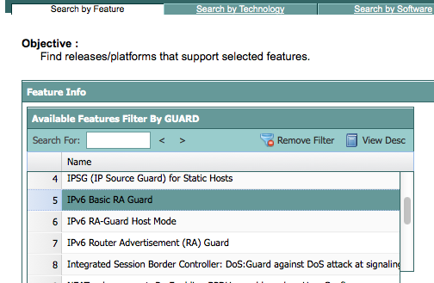
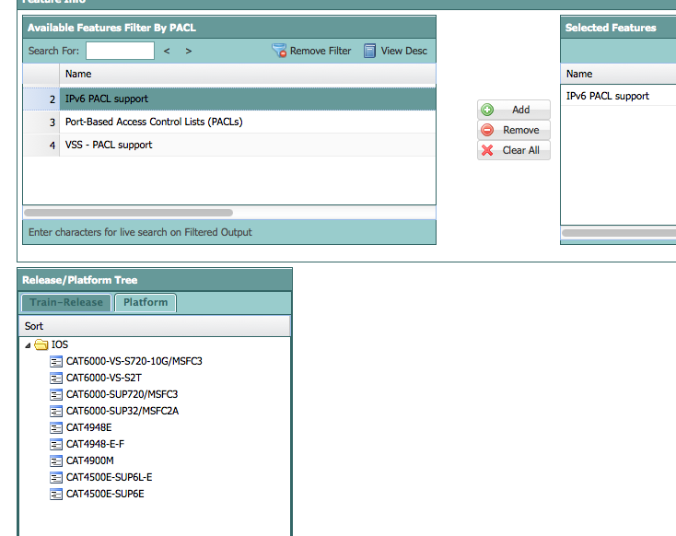

Slide 31
Other costs related to IPv6
Hardware upgrade/replacement
  Netflow probes, switches
  Many of them can be replaced as the part of “common upgrade” (but not all)
Modification/upgrade of existing systems
  Monitoring (new plugins, support for dualstack)
  Administrative tools, network IS, …
  RT system for security incidents
  Documentation of the network
Training
  Administrators, operators (users)
  Troubleshooting becomes more complicated

Slide 32
IPv6 and other priorities
Second (resilient) data center
  effects: better services stability
Move servers to virtualization platform
  effects: optimalisation of energy consumption
Moving to MPLS
  effects: new L2, L3 VPN services for customers
Upgrade core of the network to 10Gb/s
  effects: network performance for users and services
Backup connectivity to provider
  effects: better stability for external connectivity
Deploy IPv6 in the network
  Let’s do something for our future
done...
10% saved and shifted to next year
✔
distant

Slide 33
Lesson we learned with deploying IPv6

Slide 34
Lesson we learned – technical view
Some parts of IPv6 are not mature enough for a production yet
  Lack of support in applications
    Skype, ICQ, MSN, mysql, …
  Lack of support in network devices
    Access switches, Firewalls, Load balancers, IDS/IPS, VPN
  Lack of support in standards (or not implemented yet)
    DHCP failover, VRRPv3, routes over DHCPv6, PXE, …
  Some features are only in experimental versions of firmware
  IPv6 related problems are on the edge of the interest
    Flooding RA (Win 8), Rogue routers,

Slide 35
Lesson we learned – management view
Strong support from management is essential
  Human resources, budget, …
  Patience: firmware updates, more reboots, …
  IPv6 can have an impact on existing infrastructure
It is necessary to have good relationship with your hardware and software suppliers
  There probably will be many features that have never been tested before
Deploying IPv6 does not bring any short term economical benefits. We can switch IPv6 of and nobody would notice.
  but …
We can we afford to ignore IPv6 ?

Slide 36
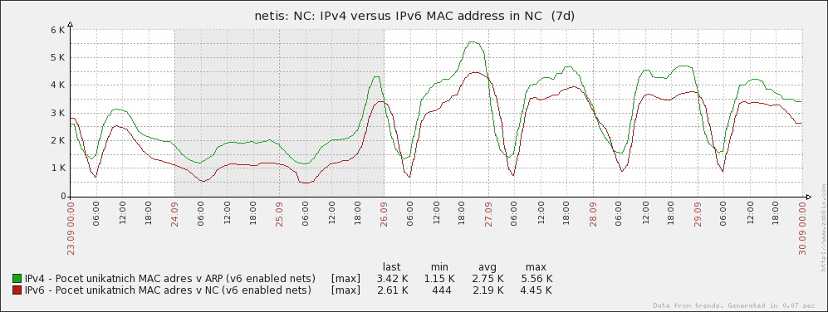
Definitely not …
total hosts
dualstack hosts
There is almost 80% of hosts on the network with IPv6 enabled by default (measured at students dormitory)
Ignoring existence of IPv6 can cause more troubles.

Slide 37
What can we do about it ? (if we can)
Start using IPv6 immediately
  We have been waiting for perfect IPv6 more than 15 years - it does not work
  Until IPv6 is used we will not discover any problem
Prefer native IPv6 connectivity (anywhere you can)
  Native IPv6 is more secure than unattended tunneled traffic !
Ask vendors and creators of standards to fix problems
  More requests escalate troubles on the vendor side
  Standardization of IPv6 is not enclosed process. Anyone can contribute or comment the standards
Stop pretending that IPv6 does not have any troubles
  IPv6 has got many problems
  Problems can not be solved by covering them
  Unreliable information led to broken trust amongst users. The naked truth is always better than the best dressed lie

Slide 38


