Slide 1

Bayesian Models in Machine Learning
Graphical Models and Inference
Lukáš Burget, Mireia Diez Sánchez
BAYa lectures, October 2024

Slide 2
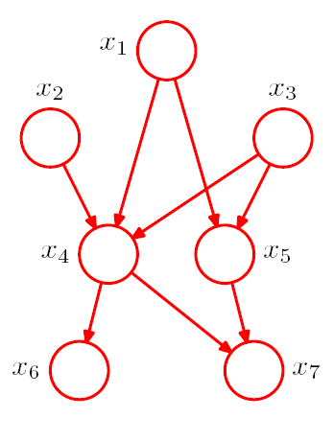
Bayesian Networks (BN)
The graph corresponds to a particular factorization of a joint probability distribution over a set of random variables
Nodes are random variables, but the graph does not say what are the distributions of the variables
The graph represents a set of distributions that conform to the factorization
It is recipe for building more complex models out of simpler probability distributions
Describes the generative process
  To generate a sample form the joint distribution, sample variables for the nodes with no incoming arcs first and then continue sampling variables conditioned on already sampled values.
Generally no closed form solutions for inferences in such models (see later)
We follow (and use examples from) Chapter 8. of C.M.Bishop: Pattern Recognition and Machine Learning

Slide 3
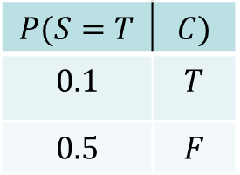

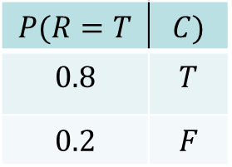
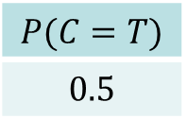



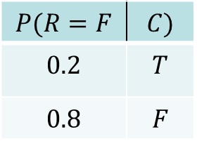

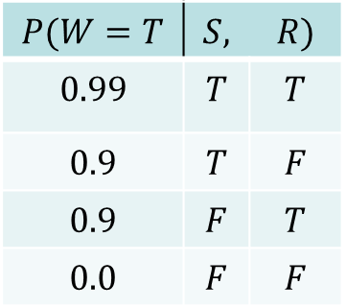
Simple BN example
$$P(C,S,R,W)=P\left(C\right)P(S|C)P(R|C)P(W|S,R)$$
$$Cloudy$$
$$P(C=T)$$
$$0.5$$
$$Sprinkler$$
$$Rain$$
$$P(S=T$$ | $$C)$$
$$0.1$$ | $$T$$
$$0.5$$ | $$F$$
$$P(R=T$$ | $$C)$$
$$0.8$$ | $$T$$
$$0.2$$ | $$F$$
$$P(R=F$$ | $$C)$$
$$0.2$$ | $$T$$
$$0.8$$ | $$F$$
$$⇒$$
$$Wet grass$$
$$P(W=T$$ | $$S,$$ | $$R)$$
$$0.99$$ | $$T$$ | $$T$$
$$0.9$$ | $$T$$ | $$F$$
$$0.9$$ | $$F$$ | $$T$$
$$0.0$$ | $$F$$ | $$F$$
Simple example with discrete binary random variable
Distributions can be described by tables with (conditional) probabilities
More practical examples will come later
Example from: Russel, Norvig: AI –A modern approach

Slide 4
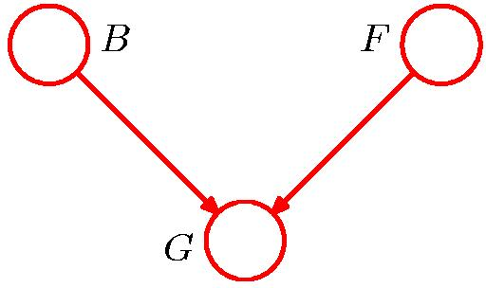
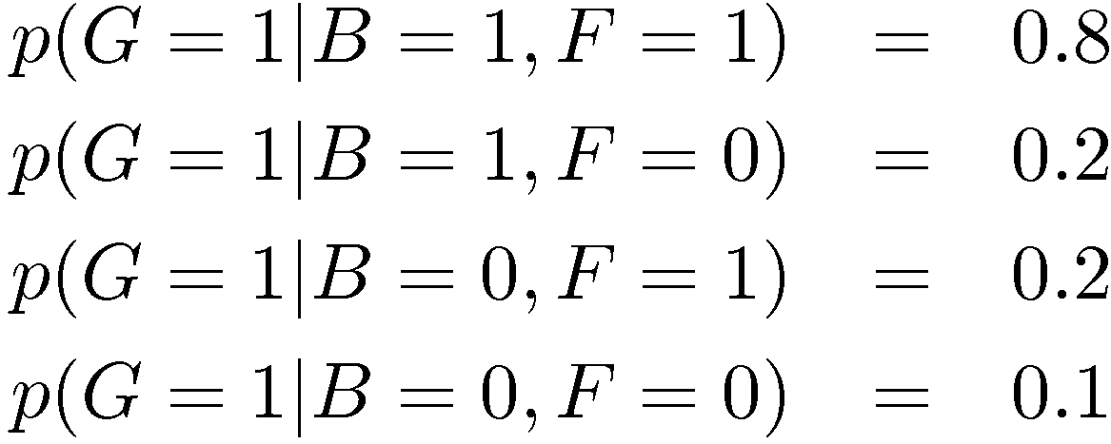
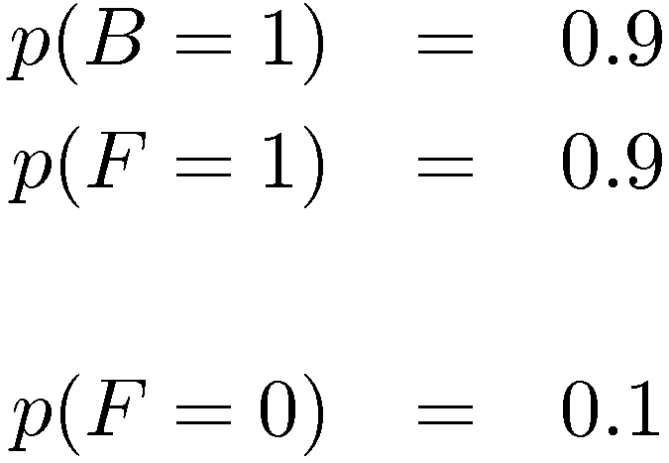
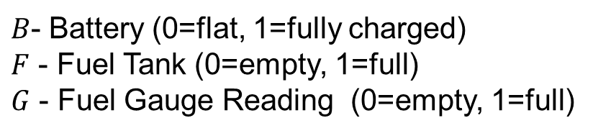
Example 2: Am I out of fuel?
$B$- Battery (0=flat, 1=fully charged)
$F$ - Fuel Tank (0=empty, 1=full)
$G$ - Fuel Gauge Reading (0=empty, 1=full)
and hence
Note that $p\left(B\right)$ and $p\left(F\right)$ are independent $⇒p\left(B,F\right)=p\left(B\right)p\left(F\right)$

Slide 5
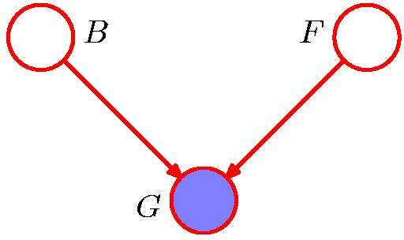
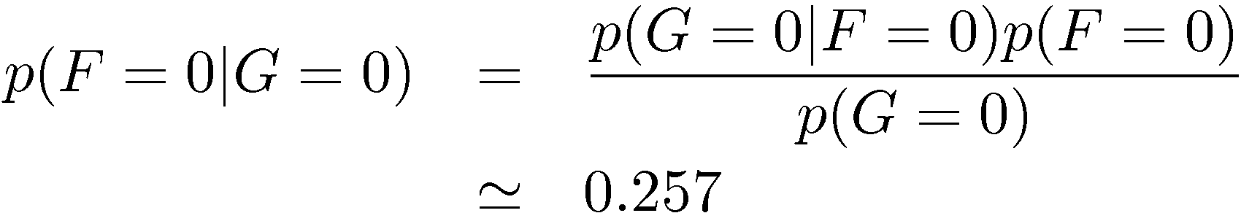
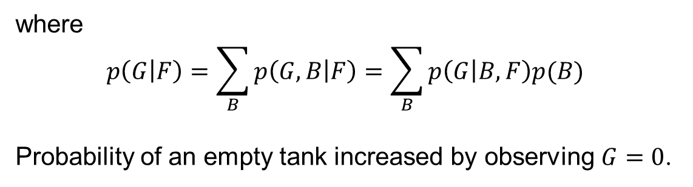
Example 2: Am I out of fuel?
Let us make some simple inference with this probabilistic model:
Bayes rule
Bayes rule
where
$$p\left(G | F\right)=\sum_{B}{p\left(G,B | F\right)}=\sum_{B}{p\left(G | B,F\right)p(B)}$$
Probability of an empty tank increased by observing $G=0$.

Slide 6
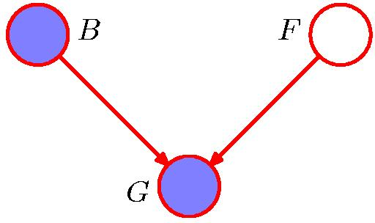
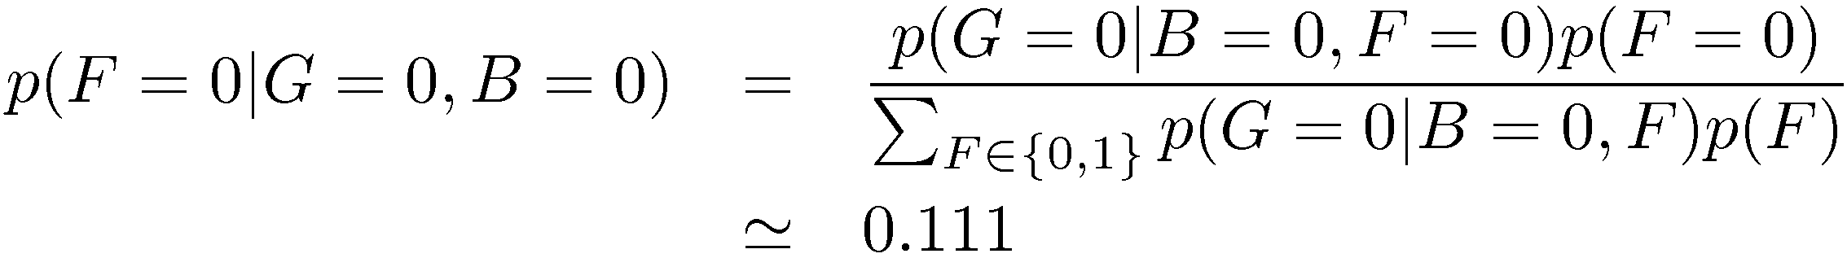
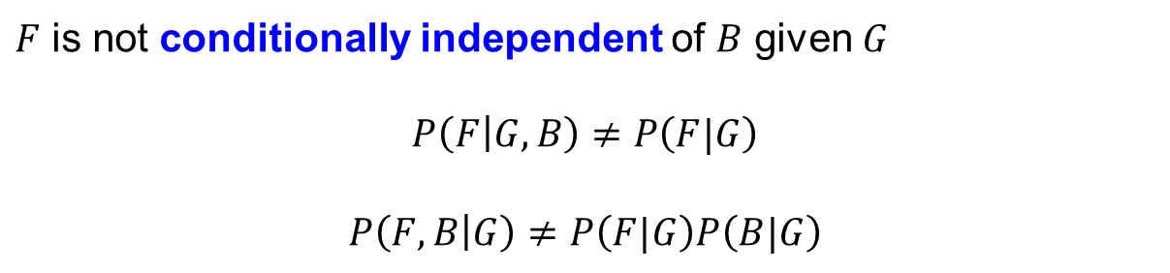
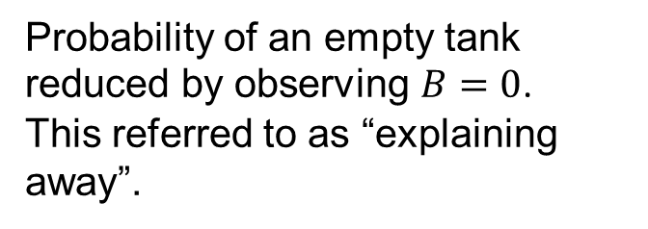
Example 2: Am I out of fuel?
Probability of an empty tank reduced by observing $B=0$.
This referred to as “explaining away”.
$F$ is not conditionally independent of $B$ given $G$
$$P\left(F | G,B\right)≠P\left(F|G\right)$$
$$P\left(F,B | G\right)≠P\left(F|G\right)P\left(B|G\right)$$

Slide 7
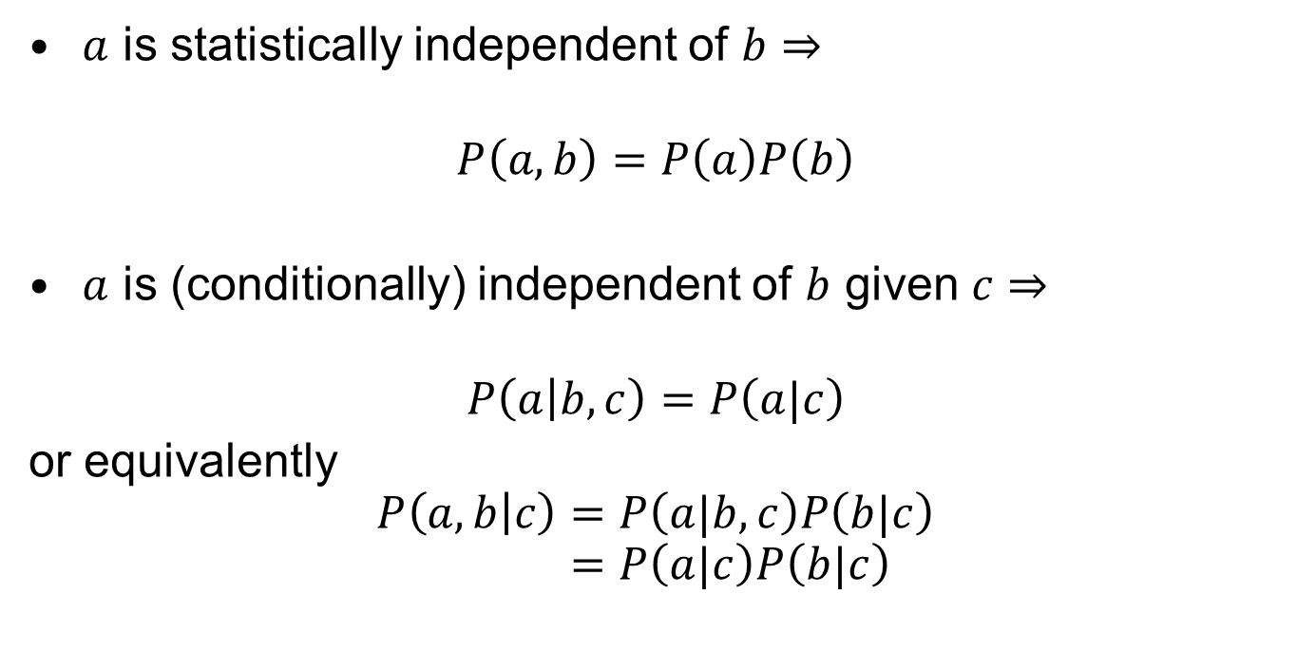
Conditional independence
$a$ is statistically independent of $b⇒$
$$P\left(a,b\right)=P\left(a\right)P\left(b\right)$$
$a$ is (conditionally) independent of $b$ given $c⇒$
$$P\left(a | b,c\right)=P\left(a|c\right)$$
or equivalently
$$P\left(a,b | c\right)=P\left(a|b, c\right)P\left(b|c\right) \\ =P\left(a|c\right)P\left(b|c\right)$$

Slide 8
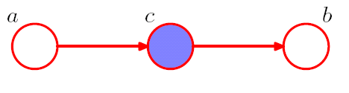
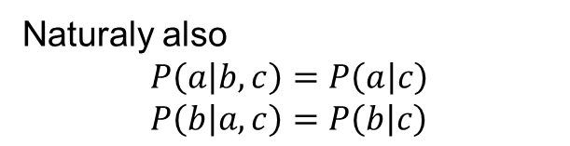
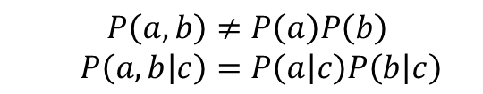
Conditional independence
Bayesian Networks allow us to see conditional independence properties.
Blue nodes corresponds to observed random variables and empty nodes to latent (or hidden) random variables
$$P\left(a,b\right)≠P\left(a\right)P\left(b\right) \\ P\left(a,b | c\right)=P\left(a | c\right)P\left(b | c\right)$$
But the opposite is true for:
Naturaly also
$$P\left(a | b,c\right)=P\left(a | c\right) \\ P\left(b | a,c\right)=P\left(b | c\right)$$

Slide 9
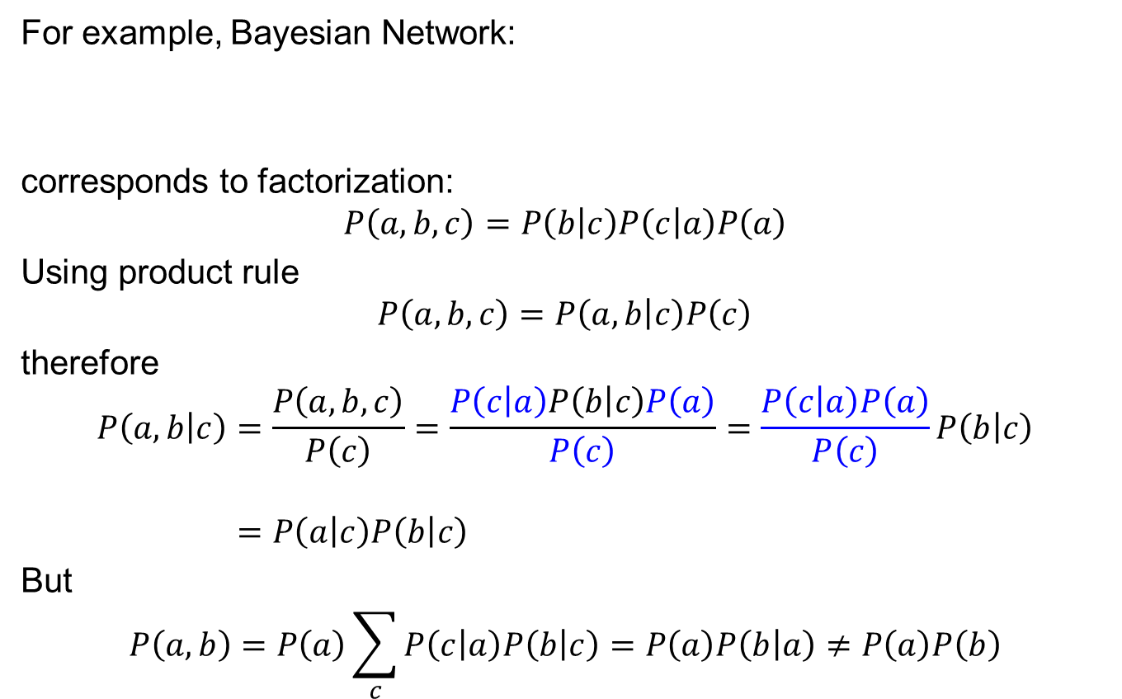
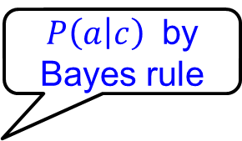
Conditional independence - proof
For example, Bayesian Network:
corresponds to factorization:
$$P\left(a,b,c\right)=P\left(b | c\right)P\left(c | a\right)P\left(a\right)$$
Using product rule
$$P\left(a,b,c\right)=P\left(a,b | c\right)P\left(c\right)$$
therefore
$$P\left(a,b | c\right)=\frac{P\left(a,b,c\right)}{P\left(c\right)}=\frac{P\left(c | a\right)P\left(b | c\right)P\left(a\right)}{P\left(c\right)}=\frac{P\left(c | a\right)P\left(a\right)}{P\left(c\right)}P\left(b | c\right) \\ =P\left(a | c\right)P\left(b | c\right)$$
But
$$P\left(a,b\right)=P\left(a\right)\sum_{c}{P\left(c | a\right)P\left(b | c\right)}=P\left(a\right)P\left(b | a\right)≠P\left(a\right)P\left(b\right)$$
$P\left(a | c\right)$ by Bayes rule

Slide 10
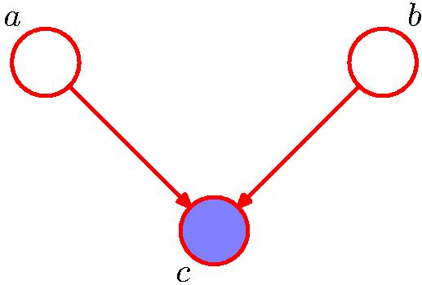
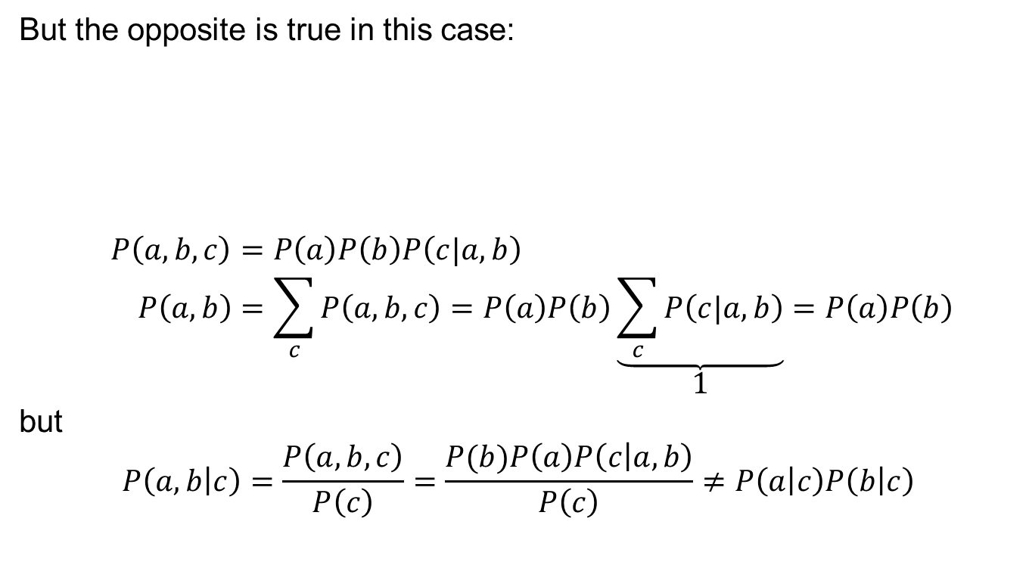
“Explaining away” effect
But the opposite is true in this case:
$$P\left(a,b,c\right)=P\left(a\right)P\left(b\right)P\left(c|a,b\right) \\ P\left(a,b\right)=\sum_{c}{P\left(a,b,c\right)}=P\left(a\right)P\left(b\right)\underset{1}{\underbrace{\sum_{c}{P\left(c|a,b\right)}}}=P\left(a\right)P\left(b\right)$$
but
$$P\left(a,b | c\right)=\frac{P\left(a,b,c\right)}{P\left(c\right)}=\frac{P(b)P\left(a\right)P\left(c | a,b\right)}{P\left(c\right)}≠P\left(a | c\right)P\left(b | c\right)$$

Slide 11
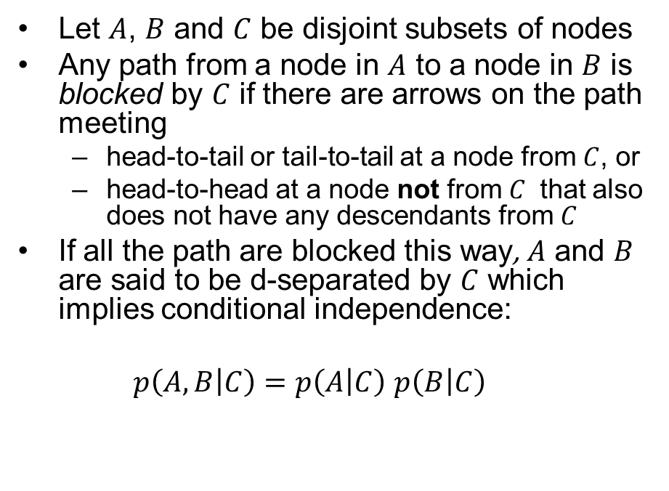
d-separation
Let $A$, $B$ and $C$ be disjoint subsets of nodes
Any path from a node in $A$ to a node in $B$ is blocked by $C$ if there are arrows on the path meeting
  head-to-tail or tail-to-tail at a node from $C$, or
  head-to-head at a node not from $C$ that also does not have any descendants from $C$
If all the path are blocked this way, $A$ and $B$ are said to be d-separated by $C$ which implies conditional independence:
$p\left(A,B | C\right)=p\left(A | C\right)$ $p\left(B | C\right)$

Slide 12
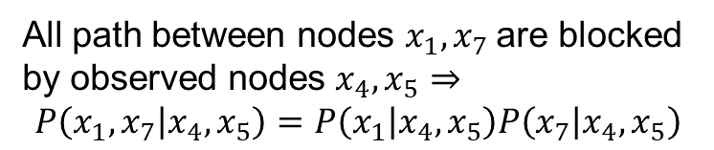
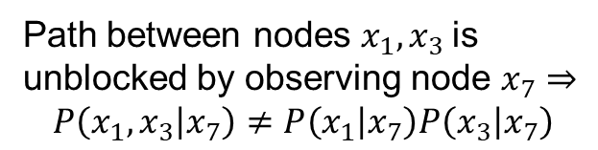
d-separation: Examples
All path between nodes $x_{1},x_{7}$ are blocked by observed nodes $x_{4},x_{5}⇒$
$$P\left(x_{1},x_{7} | x_{4},x_{5}\right)=P\left(x_{1} | x_{4},x_{5}\right)P\left(x_{7} | x_{4},x_{5}\right)$$
Path between nodes $x_{1},x_{3}$ is unblocked by observing node $x_{7}⇒$
$$P\left(x_{1},x_{3} | x_{7}\right)≠P\left(x_{1} | x_{7}\right)P\left(x_{3} | x_{7}\right)$$

Slide 13



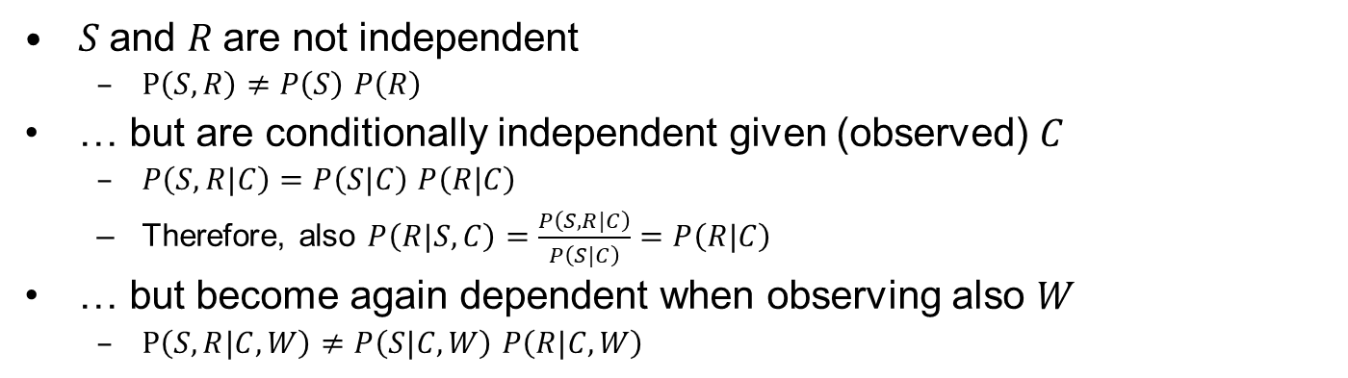









d-separation: Examples II.
$$C$$
$$C$$
$$C$$
$$S$$
$$R$$
$$S$$
$$R$$
$$S$$
$$R$$
$$W$$
$$W$$
$$W$$
$S$and $R$are not independent
  $P\left(S,R\right)≠P\left(S\right)$ $P\left(R\right)$
… but are conditionally independent given (observed) $C$
  $P\left(S,R|C\right)=P\left(S|C\right)$ $P\left(R|C\right)$
  Therefore, also $P\left(R|S,C\right)=\frac{P\left(S,R|C\right)}{P\left(S|C\right)}=P\left(R|C\right)$
… but become again dependent when observing also $W$
  $P\left(S,R|C,W\right)≠P\left(S|C,W\right)$ $P\left(R|C,W\right)$
Notes:
From product rule:
$P\left(S,R|C\right)=P\left(S|R,C\right)$ $P\left(R|C\right)$
Therefore, the conditional independency
$P\left(S,R|C\right)=P\left(S|C\right)$ $P\left(R|C\right)$
implies that
$P\left(R|S,C\right)=P\left(R|C\right)$

Slide 14
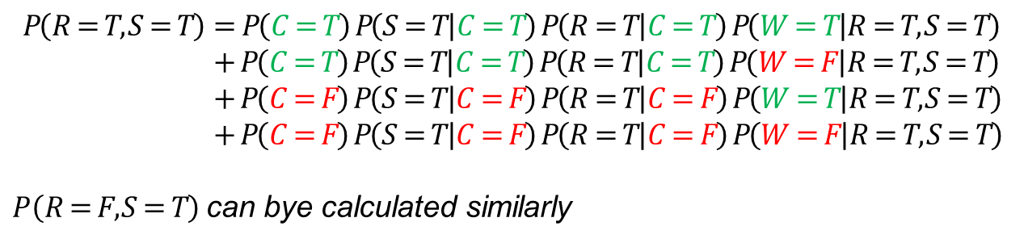

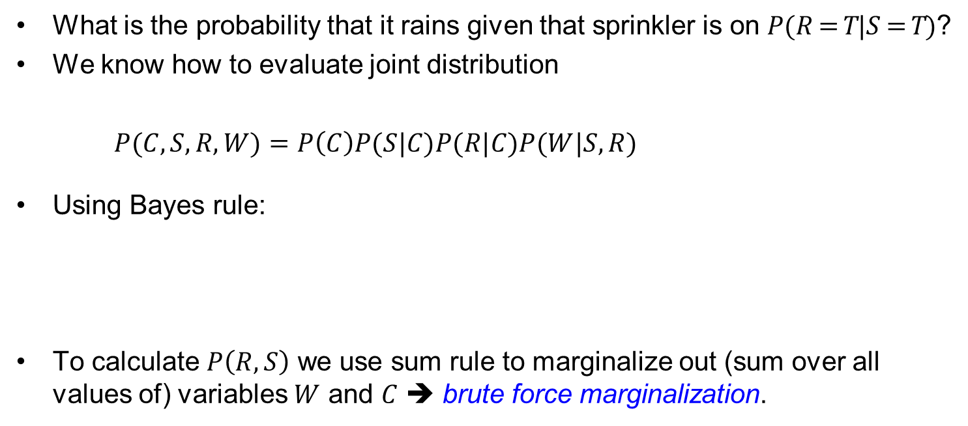



Example of inference in BN
What is the probability that it rains given that sprinkler is on $P(R=T|S=T)$?
We know how to evaluate joint distribution
$P(C,S,R,W)=P\left(C\right)P(S|C)P(R|C)P(W|S,R)$
Using Bayes rule:
To calculate $P\left(R,S\right)$ we use sum rule to marginalize out (sum over all values of) variables $W$ and $C$ ➔ brute force marginalization.
$$C$$
$$S$$
$$P\left(R=T | S=T\right)=\frac{P\left(R=T,S=T\right)}{P\left(S=T\right)}=\frac{P\left(R=T,S=T\right)}{P\left(R=T,S=T\right)+P\left(R=F,S=T\right)}$$
$$R$$
$$W$$
$$P\left(R=T,S=T\right)=P\left(C=T\right) P\left(S=T | C=T\right) P\left(R=T | C=T\right) P\left(W=T | R=T,S=T\right) \\ + P\left(C=T\right) P\left(S=T | C=T\right) P\left(R=T | C=T\right) P\left(W=F | R=T,S=T\right) \\ + P\left(C=F\right) P\left(S=T | C=F\right) P\left(R=T | C=F\right) P\left(W=T | R=T,S=T\right) \\ + P\left(C=F\right) P\left(S=T | C=F\right) P\left(R=T | C=F\right) P\left(W=F | R=T,S=T\right)$$
$P\left(R=F,S=T\right)$can bye calculated similarly

Slide 15

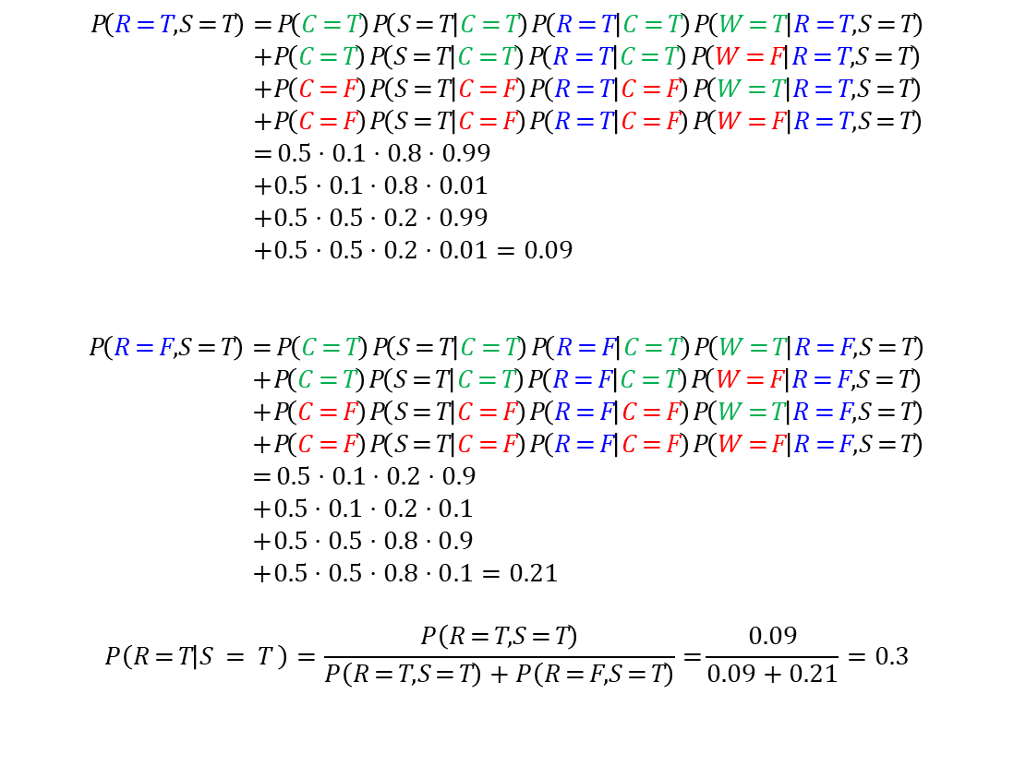

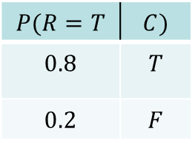

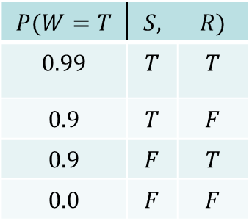

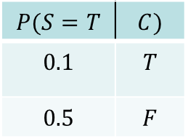
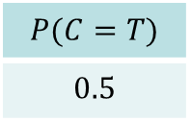
Brute force inference in BN
What is the probability that it rains given that sprinkler is on $P(R=T|S=T)$?
$$P\left(R=T,S=T\right)=P\left(C=T\right) P\left(S=T | C=T\right) P\left(R=T | C=T\right) P\left(W=T | R=T,S=T\right) \\ + P\left(C=T\right) P\left(S=T | C=T\right) P\left(R=T | C=T\right) P\left(W=F | R=T,S=T\right) \\ + P\left(C=F\right) P\left(S=T | C=F\right) P\left(R=T | C=F\right) P\left(W=T | R=T,S=T\right) \\ + P\left(C=F\right) P\left(S=T | C=F\right) P\left(R=T | C=F\right) P\left(W=F | R=T,S=T\right) \\ =0.5⋅0.1⋅0.8⋅0.99 \\ + 0.5⋅0.1⋅0.8⋅0.01 \\ + 0.5⋅0.5⋅0.2⋅0.99 \\ + 0.5⋅0.5⋅0.2⋅0.01=0.09$$
$$P\left(R=F,S=T\right)=P\left(C=T\right) P\left(S=T | C=T\right) P\left(R=F | C=T\right) P\left(W=T | R=F,S=T\right) \\ + P\left(C=T\right) P\left(S=T | C=T\right) P\left(R=F | C=T\right) P\left(W=F | R=F,S=T\right) \\ + P\left(C=F\right) P\left(S=T | C=F\right) P\left(R=F | C=F\right) P\left(W=T | R=F,S=T\right) \\ + P\left(C=F\right) P\left(S=T | C=F\right) P\left(R=F | C=F\right) P\left(W=F | R=F,S=T\right) \\ =0.5⋅0.1⋅0.2⋅0.9 \\ + 0.5⋅0.1⋅0.2⋅0.1 \\ + 0.5⋅0.5⋅0.8⋅0.9 \\ + 0.5⋅0.5⋅0.8⋅0.1=0.21$$
$$P\left(R=T | S=T\right)=\frac{P\left(R=T,S=T\right)}{P\left(R=T,S=T\right)+P\left(R=F,S=T\right)}=\frac{0.09}{0.09+0.21}=0.3$$
$$P(C=T)$$
$$0.5$$
$$P(R=T$$ | $$C)$$
$$0.8$$ | $$T$$
$$0.2$$ | $$F$$
$$C$$
$$S$$
$$R$$
$$P(S=T$$ | $$C)$$
$$0.1$$ | $$T$$
$$0.5$$ | $$F$$
$$W$$
$$P(W=T$$ | $$S,$$ | $$R)$$
$$0.99$$ | $$T$$ | $$T$$
$$0.9$$ | $$T$$ | $$F$$
$$0.9$$ | $$F$$ | $$T$$
$$0.0$$ | $$F$$ | $$F$$

Slide 16
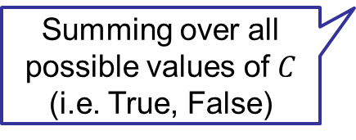
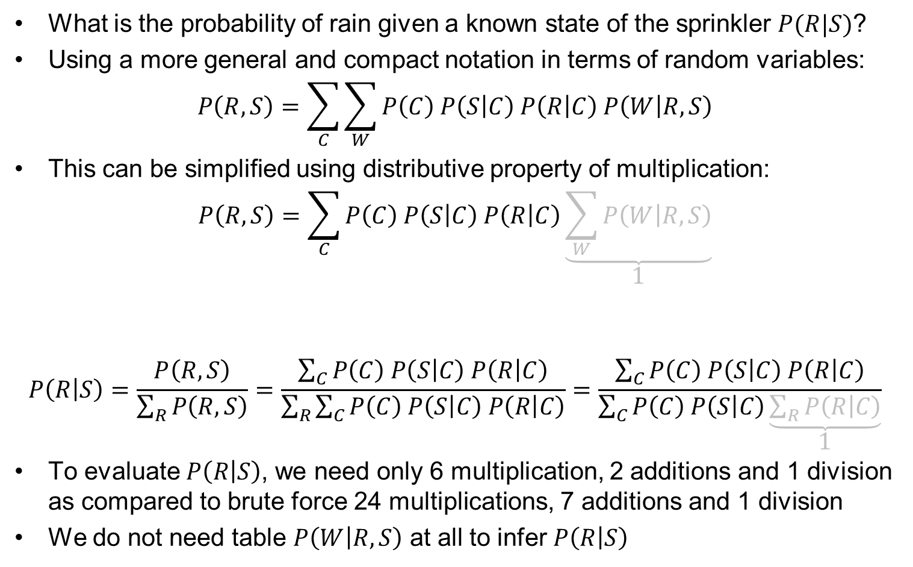
Optimized inference in BN
What is the probability of rain given a known state of the sprinkler $P(R|S)$?
Using a more general and compact notation in terms of random variables:
$$P\left(R,S\right)=\sum_{C}{\sum_{W}{P\left(C\right) P\left(S | C\right) P\left(R | C\right) P\left(W | R,S\right)}}$$
This can be simplified using distributive property of multiplication:
$$P\left(R,S\right)=\sum_{C}{P\left(C\right) P\left(S | C\right) P\left(R | C\right)\underset{1}{\underbrace{\sum_{W}{P\left(W | R,S\right)}}}}$$
$$P\left(R | S\right)=\frac{P\left(R,S\right)}{\sum_{R}{P\left(R,S\right)}}=\frac{\sum_{C}{P\left(C\right) P\left(S | C\right) P\left(R | C\right)}}{\sum_{R}{\sum_{C}{P\left(C\right) P\left(S | C\right) P\left(R | C\right)}}}=\frac{\sum_{C}{P\left(C\right) P\left(S | C\right) P\left(R | C\right)}}{\sum_{C}{P\left(C\right) P\left(S | C\right)\underset{1}{\underbrace{\sum_{R}{P\left(R | C\right)}}}}}$$
To evaluate $P\left(R | S\right)$, we need only 6 multiplication, 2 additions and 1 division as compared to brute force 24 multiplications, 7 additions and 1 division
We do not need table $P\left(W | R,S\right)$ at all to infer $P\left(R | S\right)$
Summing over all possible values of $C$ (i.e. True, False)

Slide 17




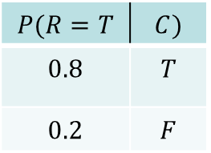
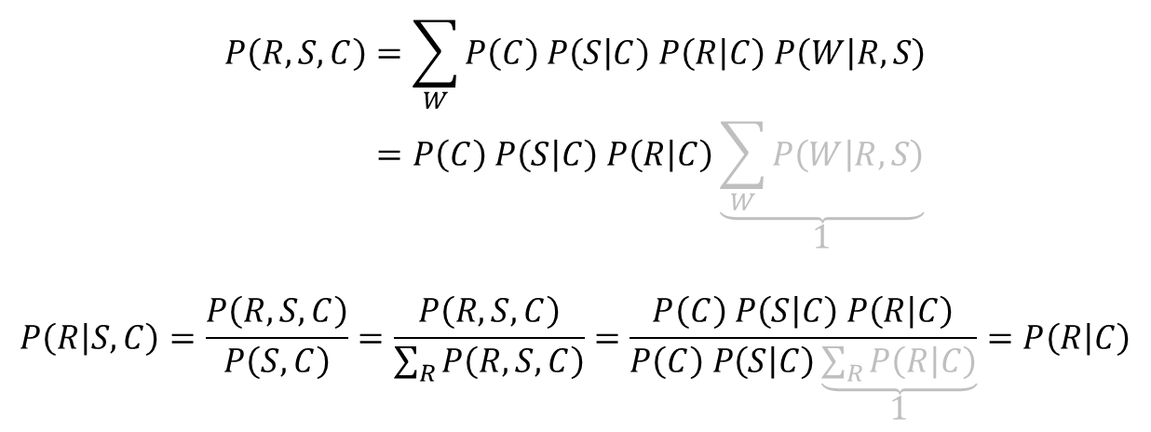
Example II.
Probability of rain given that it is cloudy, and sprinkler is on $P\left(R|C,S\right)$?
$$P\left(R,S,C\right)=\sum_{W}{P\left(C\right) P\left(S | C\right) P\left(R | C\right) P\left(W | R,S\right)} \\ =P\left(C\right) P\left(S | C\right) P\left(R | C\right)\underset{1}{\underbrace{\sum_{W}{P\left(W | R,S\right)}}}$$
$$P\left(R | S,C\right)=\frac{P\left(R,S,C\right)}{P\left(S,C\right)}=\frac{P\left(R,S,C\right)}{\sum_{R}{P\left(R,S,C\right)}}=\frac{P\left(C\right) P\left(S | C\right) P\left(R | C\right)}{P\left(C\right) P\left(S | C\right)\underset{1}{\underbrace{\sum_{R}{P\left(R | C\right)}}}}=P\left(R | C\right)$$
$$C$$
$$S$$
$$P(R=T$$ | $$C)$$
$$0.8$$ | $$T$$
$$0.2$$ | $$F$$
$$R$$
$$W$$
$R$ and $S$ are conditionally independent given $C$and therefore $P\left(R|S,C\right)=P\left(R|C\right)$
as analyzed on slide d-separation: Examples II.

Slide 18
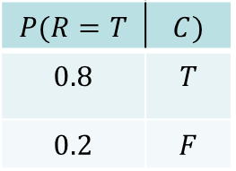
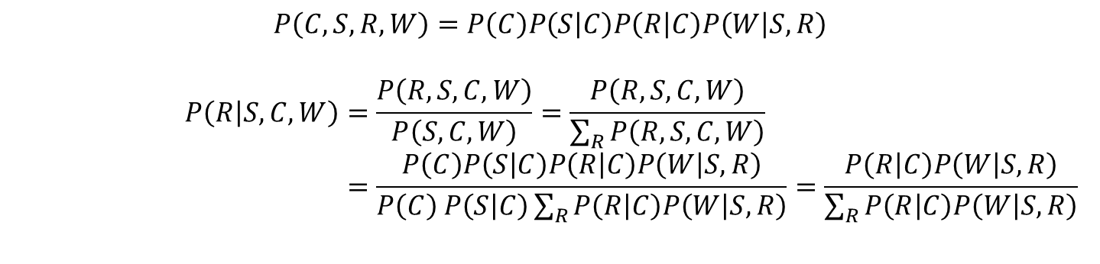
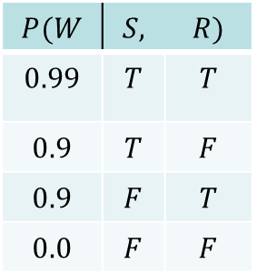
Example III.
Probability of rain given being cloudy, sprinkler on and wet grass $P\left(R|C,S,W\right)$?
$$C$$
$$P(R=T$$ | $$C)$$
$$0.8$$ | $$T$$
$$0.2$$ | $$F$$
$$S$$
$$R$$
$$P(W$$ | $$S,$$ | $$R)$$
$$0.99$$ | $$T$$ | $$T$$
$$0.9$$ | $$T$$ | $$F$$
$$0.9$$ | $$F$$ | $$T$$
$$0.0$$ | $$F$$ | $$F$$
$$W$$
$$P\left(C,S,R,W\right)=P\left(C\right)P\left(S | C\right)P\left(R | C\right)P\left(W | S,R\right)$$
$$P\left(R | S,C,W\right)=\frac{P\left(R,S,C,W\right)}{P\left(S,C,W\right)}=\frac{P\left(R,S,C,W\right)}{\sum_{R}{P\left(R,S,C,W\right)}} \\ =\frac{P\left(C\right)P\left(S | C\right)P\left(R | C\right)P\left(W | S,R\right)}{P\left(C\right) P\left(S | C\right)\sum_{R}{P\left(R | C\right)P\left(W | S,R\right)}}=\frac{P\left(R | C\right)P\left(W | S,R\right)}{\sum_{R}{P\left(R | C\right)P\left(W | S,R\right)}}$$
As analyzed before, variables $R$ and $S$ are conditionally dependent given $C$ and $W$, and therefore $P\left(R|S,C,W\right)$ depends on all the other variables

Slide 19
Examples of Bayesian Networks
Some practical examples of BN (see the following slides)
  Gaussian Mixture Model
    Simple probability density model with discrete latent variable
  Hidden Markov Model
    Dynamic BN (DBN) modeling distribution of sequences
  Probabilistic Linear Discriminant Analysis
    Example of BN with continuous latent variables

Slide 20
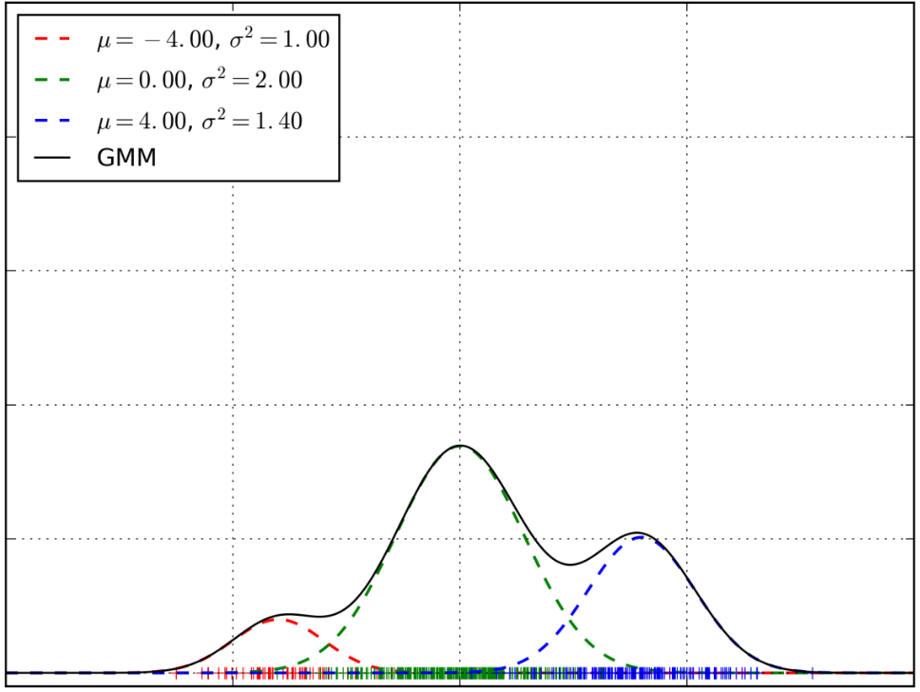

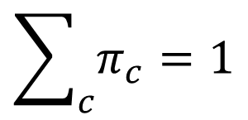

Gaussian Mixture Model (GMM)
$$p\left(x|η\right)=\sum_{c}{𝒩\left(x;μ_{c},σ_{c}^{2} \right)π_{c}}$$
→ p(x)
where
$$η=\{π_{c},μ_{c},σ_{c}^{2}\}$$
$$\sum_{c}{π_{c}}=1$$
→ x
We can see the sum above just as a function defining the shape of the probability density function
or …

Slide 21


Multivariate GMM
$$p\left(x|η\right)=\sum_{c}{𝒩\left(x;μ_{c},Σ_{c}\right)π_{c}}$$
where
$$η=\{π_{c},μ_{c},Σ_{c}\}$$
$$\sum_{c}{π_{c}}=1$$
We can see the sum above just as a function defining the shape of the probability density function
or …

Slide 22
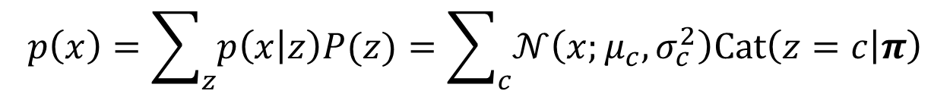
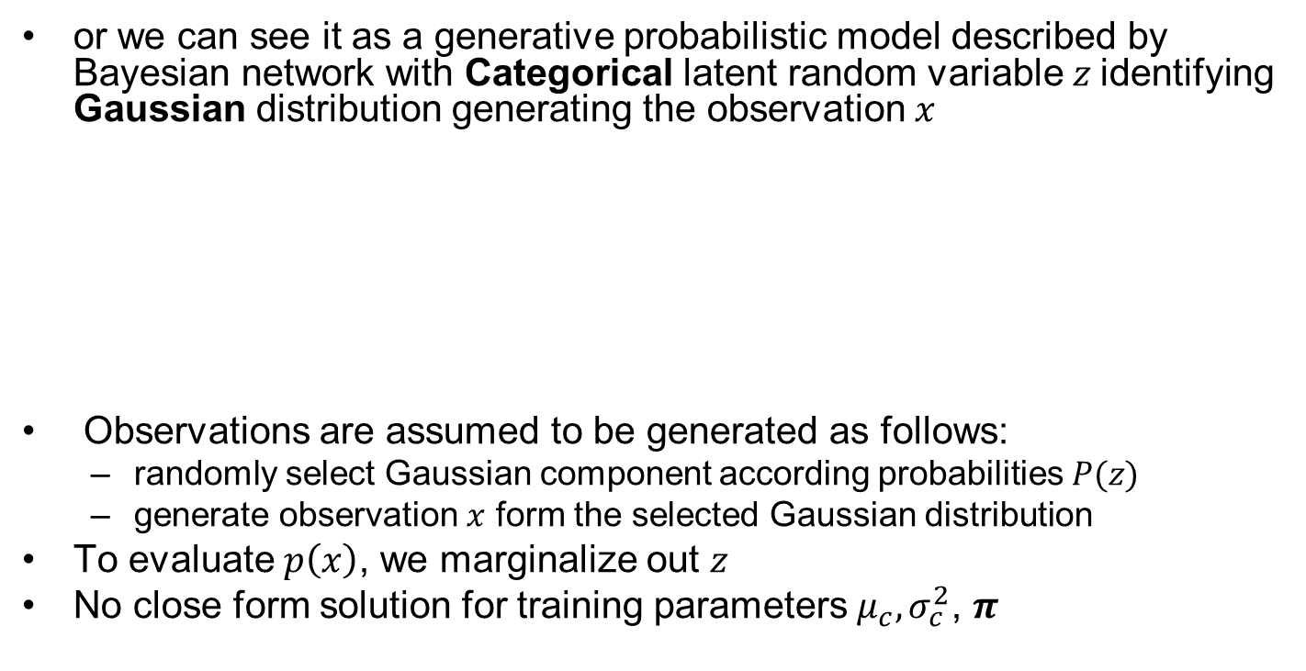



Bayesian Networks for GMM
$$p\left(x\right)=\sum_{z}{p\left(x | z\right)P(z)}=\sum_{c}{𝒩\left(x;μ_{c},σ_{c}^{2}\right)Cat\left(z=c | π\right)}$$
or we can see it as a generative probabilistic model described by Bayesian network with Categorical latent random variable $z$identifying Gaussian distribution generating the observation $x$
Observations are assumed to be generated as follows:
  randomly select Gaussian component according probabilities $P(z)$
  generate observation $x$ form the selected Gaussian distribution
To evaluate $p\left(x\right)$, we marginalize out $z$
No close form solution for training parameters $μ_{c},σ_{c}^{2}$, $π$
$$z$$
$$p\left(x,z\right)=p\left(x | z\right)P(z)$$
$$x$$

Slide 23

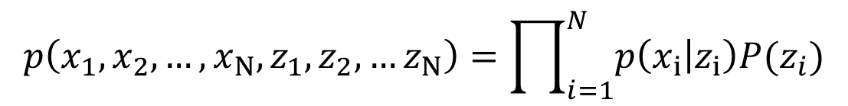
Bayesian Networks for GMM - II
Multiple observations:
z₁
z₂
z_{N-1}
z_{N}
z_{i}
or
x₁
x₂
x_{N-1}
x_{N}
x_{i}
$$i=1..N$$
$$p\left(x_{1},x_{2},…,x_{N},z_{1},z_{2},…z_{N}\right)=\prod_{i=1}^{N}{p\left(x_{i} | z_{i}\right)P(z_{i})}$$

Slide 24








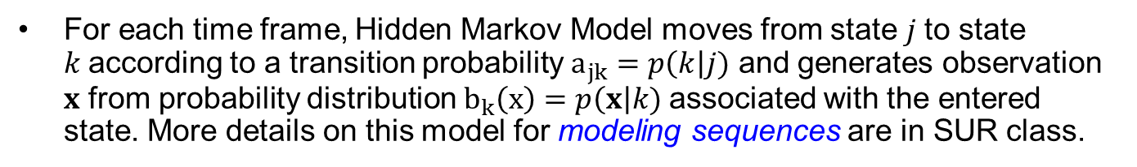

(Dynamic) BN for HMM
For each time frame, Hidden Markov Model moves from state $j$to state $k$according to a transition probability $a_{jk}=p\left(k\right|j)$ and generates observation $x$ from probability distribution $b_{k}\left(x\right)=p\left(x\right|k)$associated with the entered state. More details on this model for modeling sequences are in SUR class.
$$a_{11}$$
$$a_{22}$$
$$a_{33}$$
$$a_{12}$$
$$a_{23}$$
$$a_{3exit}$$
$$b_{1}\left(x\right)$$
$$b_{2}\left(x\right)$$
$$b_{3}\left(x\right)$$
In BN, $z_{i}$ nodes are not “HMM states”, these are random variables (one for each frame) with values saying which state we are in for a particular frame $i$
z₁
z₂
z_{N-1}
z_{N}
x₁
x₂
x_{N-1}
x_{N}
$$p\left(x_{1},x_{2},…,x_{N},z_{1},z_{2},…z_{N}\right)=P(z_{1})\prod_{i=2}^{N}{p\left(z_{i} | z_{i−1}\right)}\prod_{i=1}^{N}{p\left(x_{i} | z_{i}\right)}$$

Slide 25


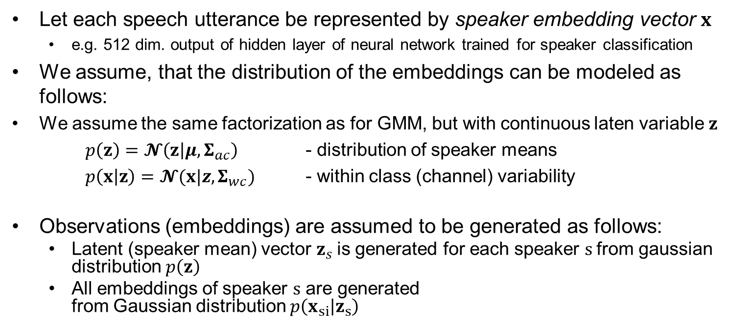











PLDA model for speaker verification
Let each speech utterance be represented by speaker embedding vector $x$
  e.g. 512 dim. output of hidden layer of neural network trained for speaker classification
We assume, that the distribution of the embeddings can be modeled as follows:
We assume the same factorization as for GMM, but with continuous laten variable $z$
$p\left(z\right)=𝓝\left(z | μ,Σ_{ac}\right)$ - distribution of speaker means
$p\left(x | z\right)=𝓝(x|z,Σ_{wc})$ - within class (channel) variability
Observations (embeddings) are assumed to be generated as follows:
  Latent (speaker mean) vector $z_{s}$is generated for each speaker $s$from gaussian distribution $p\left(z\right)$
  All embeddings of speaker $s$ are generated
  from Gaussian distribution $p\left(x_{si} | z_{s}\right)$
$$z_{s}$$
$$z_{1}$$
$$…$$
$$z_{S}$$
$$x_{11}$$
$$x_{12}$$
$$…$$
$$x_{1N_{1}}$$
$$x_{S1}$$
$$x_{S2}$$
$$…$$
$$x_{SN_{1}}$$
$$x_{Si}$$

Slide 26









PLDA model for speaker verification II
$$z$$
Same speaker hypothesis model:
$$p\left(x_{1},x_{2} | ℋ_{s}\right)=∫p\left(x_{1} | z\right)p\left(x_{2} | z\right)p\left(z\right)\text{d}z$$
Different speaker hypothesis model:
$$p\left(x_{1},x_{2} | ℋ_{d}\right)=p\left(x_{1}\right)p\left(x_{2}\right) \\ =∫p\left(x_{1} | z_{1}\right)p\left(z_{1}\right)\text{d}z_{1}∫p\left(x_{2} | z_{2}\right)p\left(z_{2}\right)\text{d}z_{2}$$
Probability that $x_{1},x_{2}$ comes from the same speaker:
$$p\left(ℋ_{s} | x_{1},x_{2}\right)=\frac{p\left(x_{1},x_{2} | ℋ_{s}\right)P\left(ℋ_{s}\right)}{p\left(x_{1},x_{2} | ℋ_{s}\right)P\left(ℋ_{s}\right)+p\left(x_{1},x_{2} | ℋ_{d}\right)P\left(ℋ_{d}\right)}$$
where $P\left(ℋ_{s}\right)=1−P\left(ℋ_{d}\right)$ is prior probability same speaker hypothesis
Usually, log likelihood ratio verification score is used
  More positive more likely $x_{1},x_{2}$ are from the same speaker
$$x_{1}$$
$$x_{2}$$
$$z_{1}$$
$$z_{2}$$
$$x_{1}$$
$$x_{2}$$
$$s= \log{\frac{p\left(x_{1},x_{2} | ℋ_{s}\right)}{p\left(x_{1},x_{2} | ℋ_{d}\right)}}$$

Slide 27






Markov Random Fields
Undirected graphical model
Directly describe the conditional independence property
  On the example: $P\left(x_{1},x_{4}\right|x_{2}, x_{3})=P\left(x_{1}\right|x_{2}, x_{3}) P\left(x_{4}\right|x_{2},x_{3})$
  $x_{1}$and $x_{4}$are independent given $x_{2}$and $x_{3}$ as there is no path
  from $x_{1}$ to $x_{4}$ not leading through either $x_{2}$ or $x_{3}$.
Subsets of nodes where all nodes are connected with each other are called cliques (see green and blue examples)
The outline in blue is Maximal clique, where no more nodes can be added
When factorizing distribution described by MRF, variables not
connected by link must not appear in the same factor $⇒$lets make factors corresponding to (Maximal) cliques.
$$x_{1}$$
$$x_{2}$$
$$x_{3}$$
$$x_{4}$$

Slide 28







MRF - factorization
Joint probability distribution over all random variables x can be expressed as normalized product of potential functions $ψ_{C}(x_{c})$, which are positive valued functions of subsets of variables $x_{c}$ corresponding to maximal cliques $C$
It is useful to express the potential functions in terms of energy functions $E(x_{C})$ ➔ sum of $E(x_{C})$terms instead of product of $ψ_{C}(x_{c})$ terms.
$$p\left(x\right)=\frac{1}{Z} \prod_{C}{ψ_{C}(x_{c})}$$
$$Z=\sum_{x}{\prod_{C}{ψ_{C}(x_{c})}}$$
$ψ_{C}\left(x_{c}\right)=exp\left\{−E\left(x_{C}\right)\right\}$
$$x_{1}$$
$$x_{2}$$
For our example:
$$P\left(x_{1},x_{2},x_{3},x_{4}\right)=\frac{1}{Z}ψ_{1,2,3}\left(x_{1},x_{2},x_{3}\right)ψ_{2,3,4}\left(x_{2},x_{3},x_{4}\right) \\ =\frac{1}{Z}\exp\left\{−E\left(x_{1},x_{2},x_{3}\right)−E\left(x_{2},x_{3},x_{4}\right)\right\}$$
$$x_{3}$$
$$x_{4}$$

Slide 29





Checking the conditional independence
$$P\left(x_{1},x_{2},x_{3},x_{4}\right)=\frac{1}{Z}ψ_{1,2,3}\left(x_{1},x_{2},x_{3}\right)ψ_{2,3,4}\left(x_{2},x_{3},x_{4}\right) \\ P\left(x_{2},x_{3}\right)=\sum_{x_{1},x_{4}}{\frac{1}{Z}ψ_{1,2,3}\left(x_{1},x_{2},x_{3}\right)ψ_{2,3,4}\left(x_{2},x_{3},x_{4}\right)} \\ P\left(x_{1},x_{4} | x_{2},x_{3}\right) =\frac{P\left(x_{1},x_{2},x_{3},x_{4}\right)}{P\left(x_{2},x_{3}\right)} \\ =\frac{\frac{1}{Z}ψ_{1,2,3}\left(x_{1},x_{2},x_{3}\right)ψ_{2,3,4}\left(x_{2},x_{3},x_{4}\right)}{\sum_{x_{1},x_{4}}{\frac{1}{Z}ψ_{1,2,3}\left(x_{1},x_{2},x_{3}\right)ψ_{2,3,4}\left(x_{2},x_{3},x_{4}\right)}} \\ =\frac{ψ_{1,2,3}\left(x_{1},x_{2},x_{3}\right)}{\sum_{x_{1}}{ψ_{1,2,3}\left(x_{1},x_{2},x_{3}\right)}}\frac{ψ_{2,3,4}\left(x_{2},x_{3},x_{4}\right)}{\sum_{x_{4}}{ψ_{2,3,4}\left(x_{2},x_{3},x_{4}\right)}} \\ =P\left(x_{1} | x_{2},x_{3}\right)P\left(x_{4} | x_{2},x_{3}\right)$$
$$x_{1}$$
$$x_{2}$$
$$x_{3}$$
$$x_{4}$$

Slide 30




BN vs MRF
Some of the probability distributions that can be represented using Bayesian Network cannot be fully represented as Markov Random Field and vice versa
But often we can convert one to the other – see next side
We mainly introduce MRF (and later Factor Graph) to present more general class of inference algorithm (see later)
MRF whose statistical independence property cannot be represented by BN
BN whose (explain away) statistical independence property cannot be represented by MRF
$$x_{1}$$
$$x_{2}$$
$$x_{3}$$
$$x_{4}$$

Slide 31

Example: HMM as MRF
z₁
z₂
z_{N-1}
z_{N}
x₁
x₂
x_{N-1}
x_{N}
$$p\left(x_{1},x_{2},…,x_{N},z_{1},z_{2},…z_{N}\right)=\frac{1}{Z}\prod_{i=2}^{N}{\tilde{ψ}\left(z_{i},z_{i−1}\right)}\prod_{i=1}^{N}{ψ\left(x_{i},z_{i}\right)}$$
For
$$Z=1 \\ \tilde{ψ}\left(z_{2},z_{1}\right)=p\left(z_{2} | z_{1}\right)p\left(z_{1}\right) \\ \tilde{ψ}\left(z_{i},z_{i−1}\right)=p\left(z_{i} | z_{i−1}\right) \\ ψ\left(x_{i},z_{i}\right)=p\left(x_{i} | z_{i}\right)$$
We recover the factorization for HMM:
$$p\left(x_{1},x_{2},…,x_{N},z_{1},z_{2},…z_{N}\right)=P(z_{1})\prod_{i=2}^{N}{p\left(z_{i} | z_{i−1}\right)}\prod_{i=1}^{N}{p\left(x_{i} | z_{i}\right)}$$

Slide 32







Flashback: (Dynamic) BN for HMM
(slide from SUR class)
For each time frame, Hidden Markov Model moves from state $j$to state $k$according to a transition probability $a_{jk}=p\left(k\right|j)$ and generates observation $x$ from probability distribution $b_{k}\left(x\right)=p\left(x\right|k)$associated with the entered state. More details on this model for modeling sequences are in SUR class.
$$a_{11}$$
$$a_{22}$$
$$a_{33}$$
$$a_{12}$$
$$a_{23}$$
$$a_{3exit}$$
$$b_{1}\left(x\right)$$
$$b_{2}\left(x\right)$$
$$b_{3}\left(x\right)$$
In BN, $z_{i}$ nodes are not “HMM states”, these are random variables (one for each frame) with values saying which state we are in for a particular frame $i$
z₁
z₂
z_{N-1}
z_{N}
x₁
x₂
x_{N-1}
x_{N}
$$p\left(x_{1},x_{2},…,x_{N},z_{1},z_{2},…z_{N}\right)=P(z_{1})\prod_{i=2}^{N}{p\left(z_{i} | z_{i−1}\right)}\prod_{i=1}^{N}{p\left(x_{i} | z_{i}\right)}$$

Slide 33






Inference on a chain
Now, we will be interested in carrying out efficient inference in MRFs
As a first example, we consider simple MRF with chain topology
Let all $N$variables $x_{i}$ are discrete with $K$ states
Each $ψ_{i,j}\left(x_{i},x_{j}\right)$ is represented by $K×K$table $⇒\left(N−1\right)K^{2}$ parameters
We would like to find marginal probability of variable $x_{n}$
$$x_{1}$$
$$x_{2}$$
$$x_{N−1}$$
$$x_{N}$$
$$P\left(x\right)=P\left(x_{1},x_{2}, …,x_{N}\right)=\frac{1}{Z}ψ_{1,2}\left(x_{1},x_{2}\right)ψ_{2,3}\left(x_{2},x_{3} \right)…ψ_{N−1,N}\left(x_{N−1},x_{N} \right)$$
$$P\left(x_{n}\right)=\sum_{x_{1}}{…}\sum_{x_{n−1}}{\sum_{x_{n+1}}{…}}\sum_{x_{N}}{P\left(x\right)}$$
Brute force marginalization has complexity $O(K^{N})$

Slide 34



Inference on a chain II.
$$P\left(x_{n}\right)=\sum_{x_{1}}{…}\sum_{x_{n−1} }{\sum_{x_{n+1 }}{…}}\sum_{x_{N }}{\frac{1}{Z}ψ_{1,2}\left(x_{1},x_{2}\right)ψ_{2,3}\left(x_{2},x_{3} \right)…ψ_{N−1,N}\left(x_{N−1},x_{N} \right)}$$
$$P\left(x_{n}\right)=\frac{1}{Z}\left[\sum_{x_{n−1}}{ψ_{n−1,n}\left(x_{n−1},x_{n} \right)…}\left[\sum_{x_{2}}{ψ_{2,3}\left(x_{2},x_{3} \right)}\left[\sum_{x_{1}}{ψ_{1,2}\left(x_{1},x_{2}\right)}\right]\right]…\right]$$
$$\left[\sum_{x_{n+1}}{ψ_{n,n+1}\left(x_{n},x_{n+1} \right)…}\left[\sum_{x_{N}}{ψ_{N−1,N}\left(x_{N−1},x_{N} \right)}\right]…\right]$$
Complexity can be reduced to $O(NK^{2})$ by rearranging the sums using distributive property of multiplication.

Slide 35



Inference on a chain III.
$$P\left(x_{n}\right)=\frac{1}{Z}\overset{α\left(x_{n}\right)}{\overbrace{\left[\sum_{x_{n−1}}{ψ_{n−1,n}\left(x_{n−1},x_{n} \right)…\overset{α\left(x_{3}\right)}{\overbrace{\left[\sum_{x_{2}}{ψ_{2,3}\left(x_{2},x_{3} \right)}\overset{α\left(x_{2}\right)}{\overbrace{\left[\sum_{x_{1}}{ψ_{1,2}\left(x_{1},x_{2}\right)}\right]}}\right]}}}…\right]}}$$
$$\underset{β\left(x_{n}\right)}{\underbrace{\left[\sum_{x_{n+1}}{ψ_{n,n+1}\left(x_{n},x_{n+1} \right)…}\underset{β\left(x_{N−1}\right)}{\underbrace{\left[\sum_{x_{N}}{ψ_{N−1,N}\left(x_{N−1},x_{N} \right)}\right]}}…\right]}}$$
Recursive formulas:
$$P\left(x_{n}\right)=\frac{1}{Z}α\left(x_{n}\right)β\left(x_{n}\right) \\ α\left(x_{n}\right)=\sum_{x_{n−1}}{ψ_{n−1,n}\left(x_{n−1},x_{n} \right)α\left(x_{n−1}\right)} \\ β\left(x_{n}\right)=\sum_{x_{n+1}}{ψ_{n,n+1}\left(x_{n},x_{n+1} \right)β\left(x_{n+1}\right)} \\ α\left(x_{1}\right)=β(x_{N})=1$$

Slide 36











Inference on a chain IV.
Marginals for ALL variables can be obtained at once with the same $O(NK^{2})$ complexity, by recursively calculating all $α(x_{n})$ and $β(x_{n})$ for all the nodes (i.e. for all $n=1..N$) and then calculating
Vectors $α\left(x_{n}\right)$ and $β\left(x_{n}\right)$ can be thought as messages passed from node to node. We will use this abstraction later
Same inference could be done for continuous random variables just by replacing sums with integrals (if the integrals are tractable).
$$P\left(x_{n}\right)=\frac{1}{Z}α\left(x_{n}\right)β\left(x_{n}\right)$$
$$x_{1}$$
$$x_{n−1}$$
$$x_{n}$$
$$x_{n+1}$$
$$x_{N}$$
$$α\left(x_{n−1}\right)$$
$$α\left(x_{n}\right)$$
$$β\left(x_{n}\right)$$
$$β\left(x_{n+1}\right)$$

Slide 37


Factor graphs (FG)
Bipartite graph, with variable nodes $x_{i}$connected only to factor nodes $f_{j}$ and vice versa.
Like MRF, but with explicitly specified factors (or potential functions)
$$P\left(x\right)=\frac{1}{Z}\prod_{s}{f_{s}\left(x_{s}\right)}$$
$$P\left(x\right)=P\left(x_{1},x_{2}, x_{3}\right)=\frac{1}{Z}f_{a}\left(x_{1},x_{2}\right)f_{b}\left(x_{1},x_{2} \right)f_{c}\left(x_{2},x_{3} \right)f_{d}\left(x_{3}\right)$$

Slide 38




MRF to FG
$$p\left(x\right)=\frac{1}{Z} ψ\left(x_{1},x_{2},x_{3}\right)$$
$$p\left(x\right)=\frac{1}{Z} f\left(x_{1},x_{2},x_{3}\right)$$
$$p\left(x\right)=\frac{1}{Z}f_{a}\left(x_{1},x_{2},x_{3}\right)f_{b}\left(x_{2},x_{3} \right)$$
MRF can be converted to FG
Since FG is more explicate, different factor graphs can correspond to the same MRF
$$p\left(x\right)=\frac{1}{Z}f_{a}\left(x_{1},x_{2}\right)f_{b}\left(x_{1},x_{3} \right)f_{c}\left(x_{2},x_{3} \right)$$

Slide 39


FG representations
For discrete variables,
factors can be represented as K-dimensional tables of values
x₂
x₃
x₁
x₂
x₃
x₁
x₁
x₂
x₃
The joint probability can be obtained as
the broadcasted elementwise product of the factors and normalized to sum to one.

Slide 40



BN to FG
BN can be also converted to FG, but such graph does not necessarily describe all the conditional independence properties
  e.g. the explain away property of the BN from this example is not directly seen from the resulting factor graphs
Again, different FGs can be constructed for the same BN to capturing more or less details about the original factorization.
$$f\left(x_{1},x_{2},x_{3}\right)= \\ p\left(x_{1}\right)p\left(x_{2}\right)p\left(x_{3}|x_{1},x_{2}\right)$$
$f_{a}\left(x_{1}\right)=$ $p\left(x_{1}\right)$
$f_{b}\left(x_{2}\right)=$ $p\left(x_{2}\right)$
$f_{c}\left(x_{1},x_{2},x_{3}\right)=$ $p\left(x_{3}|x_{1},x_{2}\right)$
$$p\left(x\right)=p\left(x_{1}\right)p\left(x_{2}\right)p\left(x_{3}|x_{1},x_{2}\right)$$

Slide 41
FG with Tree topology
Efficient inference algorithms exists for FG with tree topology
Even if the original BN or MRF is not tree, it can be often represented by FG with tree topology
E.g. FG for HMM is tree
z₁
z₂
z₃
z₄
x₁
x₂
x₃
x₄

Slide 42














Belief Propagation
Also known as sum-product message passing algorithm
Algorithm for exact inference in FG (or MRF) with (poly)tree topology
We are interested in obtaining the marginal probability of some $x_{n}$
$$P\left(x_{n}\right)=\sum_{x\backslash x_{n}}{P\left(x\right)}$$
$x\backslash x_{n}$ - set of all variables excluding variable $x_{n}$
$$x_{4}$$
$$f_{b}$$
$$x_{2}$$
We already know that joint probability
$$P\left(x\right)= P\left(x_{1},x_{2},…x_{N}\right)= \frac{1}{Z}\prod_{s}{f_{s}\left(x_{s}\right)}$$
$x_{s}$- set of variables nodes that are neighbors of factor node $f_{s}$
$$f_{a}$$
$$x_{1}$$
$$x_{5}$$
$$f_{g}$$
$$f_{d}$$
$$f_{e}$$
$$x_{3}$$
$$f_{c}$$
$$x_{6}$$
We will assume only discrete variables. For continuous, sum would be replaced by integral

Slide 43

























Belief Propagation - algorithm
The marginal probability for $x_{n}$can be efficiently calculated as
$$P\left(x_{n}\right)= \frac{1}{Z}\prod_{s∈ne\left(x_{n}\right)}{μ_{f_{s}→x_{n}}\left(x_{n}\right)}$$
where $ne\left(x_{n}\right)$ is a set of factor nodes neighboring with variable node $x_{n}$ and $μ_{f_{s}→x_{n}}\left(x_{n}\right)$ is so-called message send from factor node $f_{s}$ to variable node $x_{n}$. Like $P\left(x_{n}\right)$, each $μ_{f_{s}→x_{n}}\left(x_{n}\right)$ is function of variable $x_{n}$ and can be recursively evaluated as
$$μ_{f_{s}→x_{n}}\left(x_{n}\right)=\sum_{x_{s}\backslash x_{n}}{f_{s}\left(x_{s}\right)}\prod_{m∈ne\left(f_{s}\right)\backslash x_{n}}{μ_{x_{m}→f_{s}}\left(x_{m}\right)}$$
where $x_{s}$is set of variables that are neighbors of factor node $f_{s}$, $ne\left(f_{s}\right)\backslash x_{n}$ is set of variable nodes neighboring with factor $f_{s}$ node excluding $x_{n}$ and $μ_{x_{m}→f_{s}(x_{m})}$ is message send from variable node $x_{m}$to factor node $f_{s}$.
$$μ_{x_{m}→f_{s}(x_{m})}=\prod_{l∈ne\left(x_{m}\right)\backslash f_{s}}{μ_{f_{l}→x_{m}}(x_{m})}$$
$$μ_{x_{4}→f_{b}}\left(x_{4}\right)=1$$
$$x_{4}$$
$$f_{b}$$
$$x_{2}$$
$$μ_{x_{2}→f_{a}}\left(x_{2}\right)$$
$$μ_{f_{a}→x_{1}}\left(x_{1}\right)$$
$$f_{a}$$
$$x_{1}$$
$$μ_{f_{d}→x_{1}}\left(x_{1}\right)$$
$$x_{5}$$
$$f_{g}$$
$$f_{d}$$
$$μ_{f_{c}→x_{3}}\left(x_{3}\right)$$
$$=f_{c}(x_{3})$$
$$f_{e}$$
$$x_{3}$$
$$f_{c}$$
$$x_{6}$$
We choose $x_{n}$ as a tree root
We start from the leaves
Once a node obtains messages from all its children, it sends message to its parent.
When root obtains all the messages, $P\left(x_{n}\right)$ is evaluated
$$μ_{f→x}\left(x\right)=f(x)$$
$$μ_{x→f}\left(x\right)=1$$
$$f$$
$$x$$
$$x$$
$$f$$

Slide 44





Belief Propagation – derivation I
Factors in $F_{a}\left(x_{1},X_{1a}\right)$
$X_{1a}=\left\{x_{2},x_{3},x_{4},x_{5}\right\}$
Let’s consider node $x_{n}$as a root node
$$P\left(x\right)=\frac{1}{Z}\prod_{s}{f_{s}\left(x_{s}\right)}=\frac{1}{Z}\prod_{s∈ne(x_{n})}{F_{s}\left(x_{n},X_{ns}\right)}$$
$$x_{4}$$
$$f_{b}$$
$$x_{2}$$
$$x_{1}$$
$ne\left(x_{n}\right)$ - set of factor nodes that are neighbors of variable node $x_{n}$
$X_{ns}$ - variables in the subtree connected to $x_{n}$ via the factor node $f_{s}$
$F_{s}\left({x_{n}, X}_{s}\right)$ - product of all the factors in the group associated with factor $f_{s}$
$$f_{a}$$
$$x_{5}$$
$$f_{g}$$
$$f_{d}$$
$$f_{e}$$
$$x_{3}$$
$$f_{c}$$
$$x_{6}$$
Factors in $F_{d}\left(x_{1},X_{1d}\right)$
$X_{1d}=\left\{x_{6}\right\}$
For our example:
$$P\left(x\right)=\frac{1}{Z}\underset{F_{a}\left(x_{1},X_{1a}\right)}{\underbrace{f_{a}\left(x_{1},x_{2},x_{3}\right)f_{b}\left(x_{2},x_{4},x_{5}\right)f_{e}\left(x_{5}\right){f_{g}\left(x_{2}\right)f}_{c}\left(x_{3}\right)}}\underset{F_{d}\left(x_{1},X_{1d}\right)}{\underbrace{f_{d}\left(x_{1},x_{6}\right)}}$$

Slide 45









Belief Propagation – derivation II
$$P\left(x_{n}\right)=\sum_{x\backslash x_{n}}{P\left(x\right)} \\ =\frac{1}{Z}\sum_{x\backslash x_{n}}{\prod_{s∈ne(x_{n})}{F_{s}\left(x_{n},X_{ns}\right)}} \\ =\frac{1}{Z}\prod_{s∈ne(x_{n})}{\sum_{X_{ns}}{F_{s}\left(x_{n},X_{ns}\right)}} \\ = \frac{1}{Z}\prod_{s∈ne\left(x_{n}\right)}{μ_{f_{s}→x_{n}}\left(x_{n}\right)}$$
Factors in $F_{a}\left(x_{1},X_{1a}\right)$
$X_{1a}=\left\{x_{2},x_{3},x_{4},x_{5}\right\}$
$$x_{4}$$
$$f_{b}$$
$$x_{2}$$
$$x_{1}$$
Factors in $F_{d}\left(x_{1},X_{1d}\right)$
$X_{1d}=\left\{x_{6}\right\}$
$$f_{a}$$
$$x_{5}$$
$$f_{g}$$
$$f_{d}$$
$$μ_{f_{a}→x_{1}}\left(x_{1}\right)$$
$$f_{e}$$
$$x_{3}$$
$$f_{c}$$
$$x_{6}$$
Product of all the factors in the subtree connected to $x_{n}$ through factor node $f_{s}$ with all the variables other than $x_{n}$ marginalized (summed) out
For our example:
$$p\left(x_{1}\right)=\frac{1}{Z}\sum_{x_{2}}{…\sum_{x_{6}}{F_{a}\left(x_{1},X_{1a}\right)}}F_{d}\left(x_{1},X_{1d}\right) \\ =\frac{1}{Z}\left[\sum_{x_{2},x_{3},x_{4},x_{5}}{F_{a}\left(x_{1},X_{1a}\right)}\right]\left[\sum_{x_{6}}{F_{d}\left(x_{1},X_{1d}\right)}\right]$$
Factors in $F_{a}\left(x_{1},X_{1a}\right)$ only depend on variables $x_{2},x_{3},x_{4},x_{5}$

Slide 46









Belief Propagation – derivation III
Factors in${ G}_{2}\left(x_{2},X_{a2}\right)$
$X_{a2}=\{x_{4},x_{5}\}$
$$μ_{f_{s}→x_{n}}\left(x_{n}\right)=\sum_{X_{ns}}{F_{s}\left(x_{n},X_{ns}\right)} \\ =\sum_{X_{ns}}{f_{s}\left(x_{s}\right)} \prod_{m∈ne\left(f_{s}\right)\backslash x_{n}}{ G_{m}\left(x_{m},X_{sm}\right)} \\ =\sum_{x_{s}\backslash x_{n}}{f_{s}\left(x_{s}\right)}\prod_{xm∈ne\left(f_{s}\right)\backslash x_{n}}{\sum_{X_{sm}}{G_{m}\left(x_{m},X_{sm}\right)}} \\ =\sum_{x_{s}\backslash x_{n}}{f_{s}\left(x_{s}\right)}\prod_{m∈ne\left(f_{s}\right)\backslash x_{n}}{μ_{x_{m}→f_{s}}\left(x_{m}\right)}$$
$$x_{4}$$
$$f_{b}$$
$$x_{2}$$
$$μ_{x_{2}→f_{a}}\left(x_{2}\right)$$
$$f_{a}$$
$$x_{1}$$
$$x_{5}$$
$$f_{g}$$
$$f_{d}$$
$$μ_{f_{a}→x_{1}}\left(x_{1}\right)$$
$$f_{e}$$
$$x_{3}$$
$$f_{c}$$
$$x_{6}$$
Factors in${ G}_{3}\left(x_{3},X_{a3}\right)$
$X_{a3}=\{\}$
$X_{ns}$ - variables in the subtree connected to $x_{n}$ via the factor node $f_{s}$
$X_{sm}$ - variables in the subtree connected to $f_{s}$via the variable node $x_{m}$ (excluding $x_{m}$)
$$μ_{f_{a}→x_{1}}\left(x_{1}\right)=\sum_{x_{2},x_{3}}{f_{a}\left(x_{1},x_{2},x_{3}\right)}\left[\underset{μ_{x_{2}→f_{a}}\left(x_{2}\right) }{\underbrace{\sum_{x_{4},x_{5}}{\underset{G_{2}(x_{2},X_{a2})}{\underbrace{f_{b}\left(x_{2},x_{4},x_{5}\right)f_{e}\left(x_{5}\right)f_{g}\left(x_{2}\right)}}}}}\right]\underset{μ_{x_{3}→f_{a}}\left(x_{3}\right)}{\underbrace{\underset{G_{3}\left(x_{3},X_{a3}\right)}{\underbrace{f_{c}\left(x_{3}\right)}}}}$$

Slide 47






















Belief Propagation
Message evaluation example
$$x_{2}$$
$$μ_{x_{2}→f_{a}}\left(x_{2}\right)$$
$$μ_{f_{a}→x_{1}}\left(x_{1}\right)=\underset{x_{2},x_{3}}{∑}{f_{a}\left(x_{1},x_{2},x_{3}\right)}μ_{x_{2}→f_{a}}\left(x_{2}\right) μ_{x_{3}→f_{a}}\left(x_{3}\right)$$
$$f_{a}$$
$$x_{1}$$
$$μ_{x_{3}→f_{a}}\left(x_{3}\right)$$
With discrete variables,
the messages are a vectors
$$μ_{f_{a}→x_{1}}\left(x_{1}\right)$$
$$x_{3}$$
$$f_{a}\left(x_{1},x_{2},x_{3}\right)$$
$$x_{2}$$
$$x_{2}$$
$$x_{3}$$
$$x_{3}$$
1
2
$$μ_{f_{a}→x_{1}}\left(x_{1}=1\right)=$$
$$μ_{f_{a}→x_{1}}\left(x_{1}=2\right)=$$
67
69.5
$$x_{1}$$
$$x_{1}$$
$$\underset{x_{2},x_{3}}{∑}$$
$$f_{a}\left(x_{1},x_{2},x_{3}\right)μ_{x_{2}→f_{a}}\left(x_{2}\right) μ_{x_{3}→f_{a}}\left(x_{3}\right)$$
$$μ_{x_{2}→f_{a}}\left(x_{2}\right)$$
$$μ_{x_{3}→f_{a}}\left(x_{3}\right)$$

Slide 48





Belief Propagation – derivation IV
Factors in${ F}_{b}\left(x_{2},X_{2b}\right)$
$X_{2b}=\{x_{4},x_{5}\}$
$$x_{4}$$
$$μ_{f_{b}→x_{2}}\left(x_{2}\right)$$
$$μ_{x_{m}→f_{s}(x_{m})}= \sum_{X_{sm}}{ G_{m}(x_{m},X_{sm})} \\ = \sum_{X_{sm}}{ \prod_{l∈ne\left(x_{m}\right)\backslash f_{s}}{F_{l}\left(x_{m},X_{ml}\right)}} \\ =\prod_{l∈ne\left(x_{m}\right)\backslash f_{s}}{ \sum_{X_{ml}}{{ F}_{l}\left(x_{m},X_{ml}\right)}} \\ =\prod_{l∈ne\left(x_{m}\right)\backslash f_{s}}{μ_{f_{l}→x_{m}}(x_{m})}$$
$$f_{b}$$
$$x_{2}$$
$$μ_{x_{2}→f_{a}}\left(x_{2}\right)$$
$$f_{a}$$
$$x_{1}$$
$$x_{5}$$
$$f_{g}$$
$$f_{d}$$
$$f_{e}$$
$$x_{3}$$
$$f_{c}$$
$$x_{6}$$
Factors in${ F}_{g}\left(x_{2},X_{2g}\right)$
$X_{2g}=\{\}$
$$μ_{x_{2}→f_{a}}\left(x_{2}\right)=\underset{μ_{f_{b}→x_{2}}(x_{2})}{\underbrace{\left[\sum_{x_{4},x_{5}}{\underset{F_{b}(x_{2},X_{2b})}{\underbrace{f_{b}\left(x_{2},x_{4},x_{5}\right)f_{e}\left(x_{5}\right)}}}\right]}}\underset{μ_{f_{g}→x_{2}}(x_{2})}{\underbrace{\underset{F_{g}(x_{2},X_{2g})}{\underbrace{f_{g}\left(x_{2}\right)}}}}$$

Slide 49













Belief Propagation - algorithm
$$x_{4}$$
The marginal probability for $x_{n}$can be efficiently calculated as
$$P\left(x_{n}\right)= \frac{1}{Z}\prod_{s∈ne\left(x_{n}\right)}{μ_{f_{s}→x_{n}}\left(x_{n}\right)}$$
where $ne\left(x_{n}\right)$ is a set of factor nodes neighboring with variable node $x_{n}$ and $μ_{f_{s}→x_{n}}\left(x_{n}\right)$ is so-called message send from factor node $f_{s}$ to variable node $x_{n}$. Like $P\left(x_{n}\right)$, each $μ_{f_{s}→x_{n}}\left(x_{n}\right)$ is function of variable $x_{n}$ and can be recursively evaluated as
$$μ_{f_{s}→x_{n}}\left(x_{n}\right)=\sum_{x_{s}\backslash x_{n}}{f_{s}\left(x_{s}\right)}\prod_{m∈ne\left(f_{s}\right)\backslash x_{n}}{μ_{x_{m}→f_{s}}\left(x_{m}\right)}$$
where $x_{s}$is set of variables that are neighbors of factor node $f_{s}$, $ne\left(f_{s}\right)\backslash x_{n}$ is set of variable nodes neighboring with factor $f_{s}$ node excluding $x_{n}$ and $μ_{x_{m}→f_{s}(x_{m})}$ is message send from variable node $x_{m}$to factor node $f_{s}$.
$$μ_{x_{m}→f_{s}(x_{m})}=\prod_{l∈ne\left(x_{m}\right)\backslash f_{s}}{μ_{f_{l}→x_{m}}(x_{m})}$$
$$μ_{x_{4}→f_{b}}\left(x_{4}\right)=1$$
$$f_{b}$$
$$x_{2}$$
$$μ_{x_{2}→f_{a}}\left(x_{2}\right)$$
$$μ_{f_{a}→x_{1}}\left(x_{1}\right)$$
$$f_{a}$$
$$x_{1}$$
$$μ_{f_{d}→x_{1}}\left(x_{1}\right)$$
$$x_{5}$$
$$f_{g}$$
$$x_{3}$$
$$f_{d}$$
$$μ_{f_{c}→x_{3}}\left(x_{3}\right)$$
$$=f_{c}(x_{3})$$
$$f_{e}$$
$$f_{c}$$
$$x_{6}$$
We choose $x_{n}$ as a tree root
We start from the leaves
Once a node obtains messages from all its children, it sends message to its parent.
When root obtains all the messages, $P\left(x_{n}\right)$ is evaluated
$$μ_{f→x}\left(x\right)=f(x)$$
$$μ_{x→f}\left(x\right)=1$$
$$f$$
$$x$$
$$x$$
$$f$$

Slide 50

BP solving all marginals at once
Once root obtains all the messages, we can keep sending messages from the root towards to the leaves
This way, all variable nodes obtain messages from the neighboring factor nodes ➔ we can efficiently calculate marginals $P\left(x_{n}\right)$ for all the variables
  It takes only 2x more time than calculating marginal for one node
  ➔ the same computational complexity
  It does not matter which node is selected as the root

Slide 51

BP with observed variables
So far, we have assumed that all the variables are unobserved.
We can also calculate marginal probability of any $x_{n}$ given a set observed of variables $x_{C}$:
$$P\left(x_{n}|x_{C}\right)∝P\left(x_{n},x_{C}\right)=\sum_{x\backslash \{x_{n},x_{C}\} }{P\left(x\right)}∝\sum_{x\backslash \{x_{n},x_{C}\} }{\prod_{s}{f_{s}\left(x_{s}\right)}}$$
In our example with 6 random variables, we may wish to evaluate:
$P\left(x_{1}|x_{3},x_{4}\right)∝P\left(x_{1},x_{3},x_{4}\right)=\sum_{x_{2} }{\sum_{x_{5} }{\sum_{x_{6} }{P\left(x_{1},x_{2},x_{3},x_{4},x_{5},x_{6}\right)}}}$
where the observed variables $x_{3},x_{4}$ have known fixed values.
We solve the same problem as before for marginals $P\left(x_{n}\right)$, except that we do not sum over the observed variables ➔ We can use the same efficient BP algorithm except that the sums are removed for the observed variables and the factors are evaluated with the given values of the observed variables
Make sure that the resulting $P\left(x_{1}|x_{3},x_{4}\right)$is properly normalized distribution!

Slide 52













Marginal distribution of set of variables
We can also easily calculate joint marginal distribution for subset of variables $x_{s}$belonging to one factor $f_{s}$ (e.g. $P\left(x_{1},x_{2},x_{3}\right)$ in our example):
$$P\left(x_{s}\right)= \frac{1}{Z}f_{s}(x_{s})\prod_{i∈ne\left(f_{s}\right)}{μ_{x_{i}→f_{s}}\left(x_{i}\right)}$$
We cannot easily obtain joint marginal distribution for variables $x_{C}$not belonging to one factor (e.g. $P\left(x_{4},x_{5},x_{6}\right)$ in our example).
But we can use BP to efficiently evaluate such distribution for particular (observed) values of the variables $x_{C}$ (i.e. we can evaluate $P\left(x_{4},x_{5},x_{6}\right)$ for particular given values of $x_{4},x_{5},x_{6}$).
Here, we require that the factor graph is created from a Bayesian Network ➔ the factors corresponds to well normalized distributions and therefore $Z=1$
  See the slide “Example: HMM as MRF” as an example
$$P\left(x_{C}\right)=\sum_{x\backslash x_{C}}{P\left(x\right)}=\frac{1}{Z}\sum_{x\backslash x_{C}}{\prod_{s}{f_{s}\left(x_{s}\right)}}$$
BP algorithm can be used to efficiently evaluate the right
hand side for fixed values of $x_{C}$. Again, we do not sum
over possible values of $x_{C}$ in BP. Instead, we directly use the
given fixed values of $x_{C}$, when evaluating the factors.
Choosing any ${x_{n}∈x}_{C}$ as the “root” for BP, we can calculate
$P\left(x_{C}\right)$ as the product of the incoming messages evaluated at $x_{n}$
$$P\left(x_{C}\right)=\prod_{s∈ne\left(x_{n}\right)}{μ_{f_{s}→x_{n}}\left(x_{n}\right)}$$
$$x_{4}$$
$$f_{b}$$
$$x_{2}$$
$$f_{a}$$
$$x_{1}$$
$$x_{5}$$
$$f_{g}$$
$$f_{d}$$
$$f_{e}$$
$$x_{3}$$
$$f_{c}$$
$$x_{6}$$

Slide 53


Most likely values
Belief Propagation allows us to calculate the marginals $p\left(x_{n}\right)$, so for each variable $x_{n}$, we can find the value that is individually the most probable
$$x_{n}^{max}=\underset{x_{n}}{arg max}{p\left(x_{n}\right)}$$
Instead, we may want to know what are values of all the variables
$x=\left[x_{1},x_{2},…x_{N}\right]$ that have jointly the largest probability
$$x^{max}=\underset{x}{arg max}{p\left(x\right)}$$
An example where individually and jointly most probable values are different:
  Individually, the most likely values are $x=1$ and $y=1$ as $P\left(x\right)=P\left(y\right)=0.38$ are the largest marginal probabilities
  But it is impossible that $x=1$ and $y=1$ at the same time as $P\left(x=1,y=1\right)=0$
  Jointly, the most likely values are $x=4$ and $y=4$ as $P\left(x=4,y=4\right)=0.24$is the largest joint probability
$$P(x,y)$$ | $$x=1$$ | $$x=2$$ | $$x=3$$ | $$x=4$$ |  | $$P\left(y\right)$$
$$y=1$$ | 0.0 | 0.19 | 0.19 | 0.0 |  | 0.38
$$y=2$$ | 0.19 | 0.0 | 0.0 | 0.0 |  | 0.19
$$y=3$$ | 0.19 | 0.0 | 0.0 | 0.0 |  | 0.19
$$y=4$$ | 0.0 | 0.0 | 0.0 | 0.24 |  | 0.24
$$P\left(x\right)$$ | 0.38 | 0.19 | 0.19 | 0.24

Slide 54

Max-product algorithm
Sum-product algorithm (or Belief Propagation) allowed us to find marginals
$P\left(x_{n}\right)=\sum_{x\backslash x_{n}}{P\left(x\right)}=\frac{1}{Z}\sum_{x\backslash x_{n}}{\prod_{s}{f_{s}\left(x_{s}\right)}}$
efficiently by re-arranging the order of sums and products using the distributive property of multiplication over addition: $ab+ac=a(b+c)$
Similar distributive property holds also $max$ operator: $\max\left(ab, ac\right)=a max\left(b, c\right)$
which allows for the same efficient calculation of the largest joint probability
$$P\left(x^{max}\right)=\max_{x}{P\left(x\right)}=\frac{1}{Z}\max_{x}{\prod_{s}{f_{s}\left(x_{s}\right)}}$$
We use the same BP where sum is replaced with max in the messages from factor nodes to variable nodes
$$μ_{f_{s}→x_{n}}\left(x_{n}\right)=\max_{x_{s}\backslash x_{n}}{f_{s}\left(x_{s}\right)}\prod_{m∈ne\left(f_{s}\right)\backslash x_{n}}{μ_{x_{m}→f_{s}}\left(x_{m}\right)}$$
The solution is the maximum of the product of the messages arriving to the root node evaluated for the possible values of the “root” variable $x_{n}$
$$ZP\left(x^{max}\right)=\max_{x_{n}}{\prod_{s∈ne\left(x_{n}\right)}{μ_{f_{s}→x_{n}}\left(x_{n}\right)}}$$

Slide 55

Max-product algorithm II
The solution on the previous slide is the (unnormalized unless $Z=1$) maximum of the joint distribution $P\left(x^{max}\right)$
However, we usually need the most likely values
$$x^{max}=\underset{x}{arg max}{P\left(x\right)}$$
Solution: whenever $max$ operator is applied during the max-product algorithm, remember the variable values giving the maximum
  When calculating message from factor node to variable node
  $μ_{f_{s}→x_{n}}\left(x_{n}\right)=\max_{x_{s}\backslash x_{n}}{f_{s}\left(x_{s}\right)}\prod_{m∈ne\left(f_{s}\right)\backslash x_{n}}{μ_{x_{m}→f_{s}}\left(x_{m}\right)}$
  for each $x_{n}$, remember the most likely values of the other factor’s variables $x_{s}\backslash x_{n}$
  $φ_{f_{s}}\left(x_{n}\right)=\underset{x_{s}\backslash x_{n}}{arg max}{f_{s}\left(x_{s}\right)}\prod_{m∈ne\left(f_{s}\right)\backslash x_{n}}{μ_{x_{m}→f_{s}}\left(x_{m}\right)}$
  When calculating
  $ZP\left(x^{max}\right)=\max_{x_{n}}{\prod_{s∈ne\left(x_{n}\right)}{μ_{f_{s}→x_{n}}\left(x_{n}\right)}}$
  obtain also the most likely setting of the “root” variable
  $$x_{n}^{max}=\underset{x_{n}}{arg max}{\prod_{s∈ne\left(x_{n}\right)}{μ_{f_{s}→x_{n}}\left(x_{n}\right)}}$$

Slide 56














Max-product message example
$$x_{2}$$
$$μ_{x_{2}→f_{a}}\left(x_{2}\right)$$
$$μ_{f_{a}→x_{1}}\left(x_{1}\right)=\max_{x_{2},x_{3}}{f_{a}\left(x_{1},x_{2},x_{3}\right)}μ_{x_{2}→f_{a}}\left(x_{2}\right) μ_{x_{3}→f_{a}}\left(x_{3}\right)$$
$$f_{a}$$
$$x_{1}$$
$$φ_{f_{a}}\left(x_{1}\right)=\underset{x_{2},x_{3}}{arg max}{f_{a}\left(x_{1},x_{2},x_{3}\right)}μ_{x_{2}→f_{a}}\left(x_{2}\right) μ_{x_{3}→f_{a}}\left(x_{3}\right)$$
$$μ_{x_{3}→f_{a}}\left(x_{3}\right)$$
$$μ_{f_{a}→x_{1}}\left(x_{1}\right)$$
$$f_{a}\left(x_{1},x_{2},x_{3}\right)$$
$$x_{3}$$
$$x_{2}$$
$$x_{2}$$
$$x_{3}$$
$$x_{3}$$
1
2
$$μ_{f_{a}→x_{1}}\left(x_{1}=1\right)=$$
$$μ_{f_{a}→x_{1}}\left(x_{1}=2\right)=$$
9
18
$$x_{1}$$
$$x_{1}$$
$$\max_{x_{2},x_{3}}$$
$$f_{a}\left(x_{1},x_{2},x_{3}\right)μ_{x_{2}→f_{a}}\left(x_{2}\right) μ_{x_{3}→f_{a}}\left(x_{3}\right)$$
$$μ_{x_{2}→f_{a}}\left(x_{2}\right)$$
$$μ_{x_{3}→f_{a}}\left(x_{3}\right)$$
$$\underset{x_{2},x_{3}}{arg max}$$
$$φ_{f_{a}}\left(x_{1}=1\right)=$$
$$φ_{f_{a}}\left(x_{1}=2\right)=$$
$$x_{2}=3,x_{3}=2$$
$$x_{2}=2,x_{3}=4$$

Slide 57










Max-product algorithm - backtracking
Now, we have the most likely value for the root $x_{n}^{max}$
We back-propagate $x_{n}^{max}$ to each neighboring factor node $f_{s}$
Here, we evaluate the stored $φ_{f_{s}}\left(x_{n}\right)$ for $x_{n}^{max}$, which gives us the most likely values of the other factor’s variables $x_{s}\backslash x_{n}$
We back-propagate these new “most likely values” to the next factor nodes $f_{s}$ further away from the root to evaluate their functions $φ_{f_{s}}\left(x_{n}\right)$
This is repeated until we obtain the most likely values for all the variables $x^{max}$
$$x_{4}^{max}$$
$$φ_{b}\left(x_{2}\right)$$
$$x_{2}^{max}$$
$$x_{5}^{max}$$
$$φ_{f_{a}}\left(x_{1}\right)$$
$$x_{1}^{max}$$
$$x_{3}^{max}$$
$$φ_{f_{d}}\left(x_{1}\right)$$
$$x_{6}^{max}$$

Slide 58







(Dynamic) BN for HMM - flashback
For each time frame, Hidden Markov Model moves from state $j$to state $k$according to a transition probability $a_{jk}=p\left(k\right|j)$ and generates observation $x$ from probability distribution $b_{k}\left(x\right)=p\left(x\right|k)$associated with the entered state. More details on this model for modeling sequences are in SUR class.
$$a_{11}$$
$$a_{22}$$
$$a_{33}$$
$$a_{12}$$
$$a_{23}$$
$$a_{3exit}$$
$$b_{1}\left(x\right)$$
$$b_{2}\left(x\right)$$
$$b_{3}\left(x\right)$$
In BN, $z_{i}$ nodes are not “HMM states”, these are random variables (one for each frame) with values saying which state we are in for a particular frame $i$
z₁
z₂
z_{N-1}
z_{N}
x₁
x₂
x_{N-1}
x_{N}
$$p\left(x_{1},x_{2},…,x_{N},z_{1},z_{2},…z_{N}\right)=P(z_{1})\prod_{i=2}^{N}{p\left(z_{i} | z_{i−1}\right)}\prod_{i=1}^{N}{p\left(x_{i} | z_{i}\right)}$$

Slide 59


Example: BP for HMM
To evaluation an HMM, given a sequence of observations $X=\left[x_{1},x_{2}…,x_{N}\right],$we need to infer
$$p\left(X\right)=p\left(x_{1},x_{2}…,x_{N}\right)=\sum_{z_{1}}{\sum_{z_{2}}{…\sum_{z_{N}}{p\left(x_{1},x_{2}…,x_{N},z_{1},z_{2}…,z_{N}\right)}}}$$
To train an HMM using an EM algorithm (see next lesson), for every $t=1..N$, we need to infer
$$p\left(z_{t} | X\right)=\frac{p\left(z_{t},X\right)}{p\left(X\right)}=\frac{\sum_{z_{1}}{\sum_{z_{2}}{…\sum_{z_{t−1}}{\sum_{z_{t+1}}{…\sum_{z_{N}}{p\left(x_{1},x_{2}…,x_{N},z_{1},z_{2}…,z_{N}\right)}}}}}}{p(X)}$$
Forward-backward algorithm
$s$ are state ids (i.e. possible values of $z_{t}$)
$$α\left(t,s\right)=p\left(x_{t} | s\right)\sum_{s^{′}}{α\left(t−1,s^{′}\right)p\left(s | s^{′}\right)} \\ β\left(t,s\right)=\sum_{s^{′}}{β\left(t+1,s^{′}\right)p\left(x_{t+1} | s^{′}\right)p(s^{′}|s)} \\ p\left(X\right)=\sum_{s^{′}∈FinalStates}{α\left(N,s^{′}\right)} \\ p\left(z_{t}=s | X\right)=\frac{α\left(t,s\right)β\left(t,s\right)}{P\left(X\right)}$$
z₁
z₂
z_{N-1}
z_{N}
x₁
x₂
x_{N-1}
x_{N}

Slide 60




Examples: Training HMMs using EM
(slide form SUR class)
EM algorithm (see next lesson) for training of HMM uses a specific instance of BP algorithm for calculating conditional marginals $p\left(s_{t}=s | X\right)$:
$$A\left(t,s\right)=p\left(x_{t} | s\right)\sum_{s^{′}}{A\left(t−1,s^{′}\right)p(s|s^{′})}$$
$$B\left(t,s\right)=\sum_{s^{′}}{B\left(t+1,s^{′}\right)p\left(x_{t+1} | s^{′}\right)p(s^{′}|s)}$$
$$γ_{s}\left(t\right)=\frac{A\left(t,s\right)B\left(t,s\right)}{P\left(X\right)}=p\left(s_{t}=s | X\right) \\ =\frac{\sum_{S:s_{t}=s}{P\left(X,S\right)}}{P\left(X\right)}$$
s
t

Slide 61
Inference in non-tree graphs
Junction tree algorithm
  Exact inference in general graphs (not only trees or polytrees)
  Belief propagation on a modified graph where cycles are eliminated by merging nodes into single nodes
  Usually too computationally expensive and impractical
Loopy Belief Propagation
  Initialize Sum-Product algorithm so that each node has already “messages from all neighbors”
    these are only randomly initialized vectors, not real messages sent from the neighbors
  Start sending messages like in the Sum-Product algorithm
    Choose some message passing schedule
    Send messages from pending nodes that received new messages and updated their states
  Approximate inference, no guarantee to converge

