Slide 1

Bayesian Models in Machine Learning
Lukáš Burget
BAYa lectures, November 2024
Some images taken from: C. M. Bishop: Pattern Recognition and Machine Learning, Springer, 2006.

Slide 2
Frequentist vs. Bayesian
Frequentist point of view:
  Probability is the frequency of an event occurring in a large (infinite) number of trials
  E.g. When flipping a coin many times, what is the proportion of heads?
Bayesian
  Inferring probabilities for events that have never occurred or believes which are not directly observed
  Prior believes are specified in terms of prior probabilities
  Taking into account uncertainty (posterior distribution) of the estimated parameters or hidden variables in our probabilistic model.

Slide 3
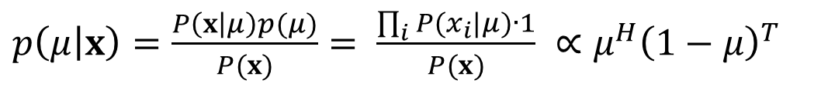

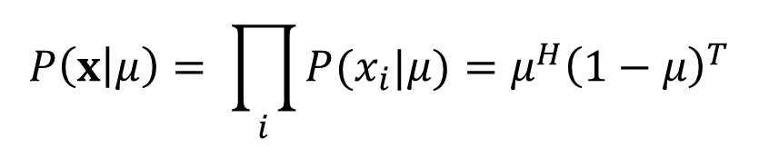
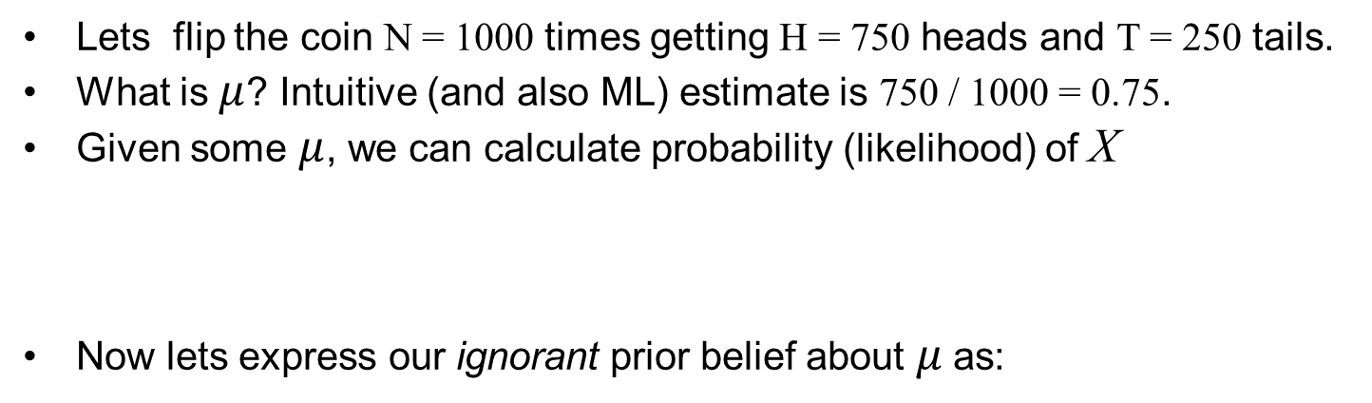
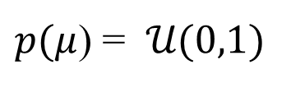

Coin flipping example
$$P\left(head | μ\right)=μ$$
$$P\left(tail | μ\right)=1−μ$$
$$x=\left[x_{1}, x_{2},x_{3},…x_{N}\right]=\left[taill, head,head,…tail\right]$$
Lets flip the coin N = 1000 times getting H = 750 heads and T = 250 tails.
What is $μ$? Intuitive (and also ML) estimate is 750 / 1000 = 0.75.
Given some $μ$, we can calculate probability (likelihood) of X
Now lets express our ignorant prior belief about $μ$ as:
$$P\left(x | μ\right)= \prod_{i}{P(x_{i}|μ)}=μ^{H}{\left(1−μ\right)}^{T}$$
$p(μ$) = 𝒰(0,1)
Then using Bayes rule, we obtain probability density function for $μ$:
$p\left(μ | x\right)=\frac{P\left(x | μ\right)p(μ)}{P(x)}= \frac{\prod_{i}{P(x_{i}|μ)}∙1}{P(x)} ∝μ^{H}{\left(1−μ\right)}^{T}$

Slide 4
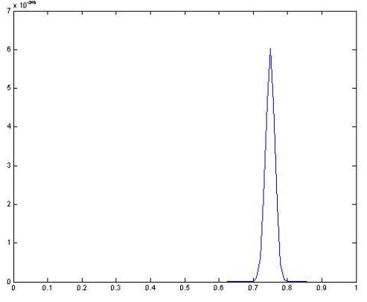

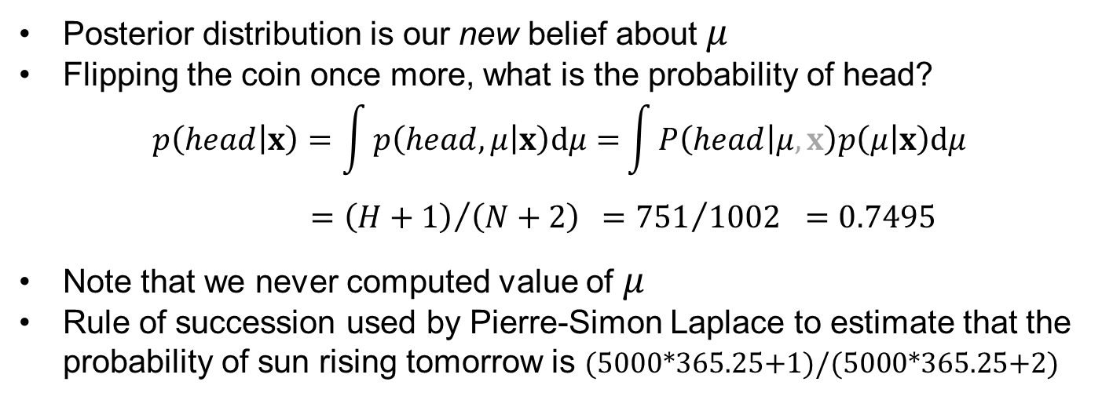


Coin flipping example (cont.)
N = 1000, H = 750, T = 250
$p\left(μ | x\right)∝μ^{H}{\left(1−μ\right)}^{T}$
$$→p(μ|X)$$
$$→μ$$
Posterior distribution is our new belief about $μ$
Flipping the coin once more, what is the probability of head?
$$p\left(head | x\right)=\int{p\left(head,μ | x\right)dμ=}\int{P\left(head | μ,x\right)p\left(μ | x\right)dμ} \\ ={\left(H+1\right)}/{\left(N+2\right)} ={751}/{1002} =0.7495$$
Note that we never computed value of$μ$
Rule of succession used by Pierre-Simon Laplace to estimate that the probability of sun rising tomorrow is (5000*365.25+1)/(5000*365.25+2)

Slide 5
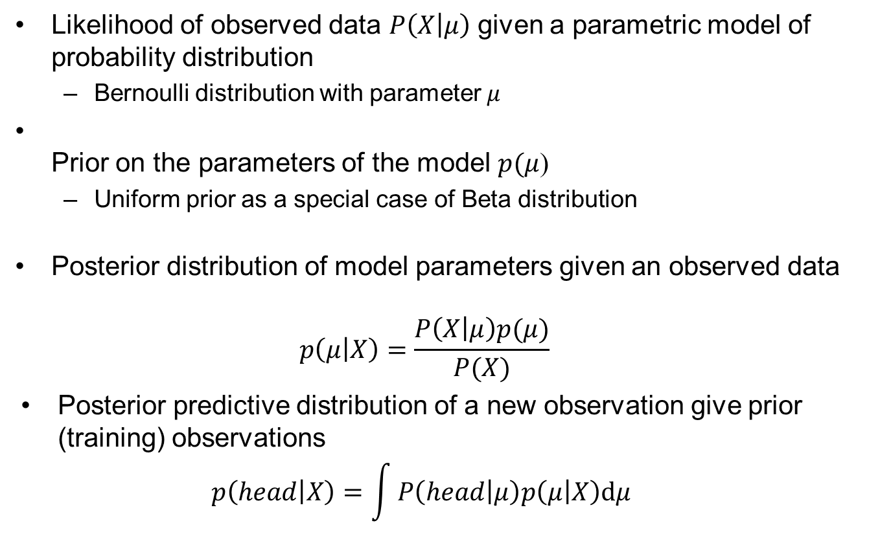
Distributions from our example
Likelihood of observed data $P\left(X | μ\right)$ given a parametric model of probability distribution
  Bernoulli distribution with parameter $μ$
Prior on the parameters of the model $p(μ$)
  Uniform prior as a special case of Beta distribution
Posterior distribution of model parameters given an observed data
$p\left(μ | X\right)=\frac{P\left(X | μ\right)p(μ)}{P(X)}$
Posterior predictive distribution of a new observation give prior (training) observations
$p\left(head | X\right)=\int{P\left(head | μ\right)p\left(μ | X\right)dμ}$

Slide 6
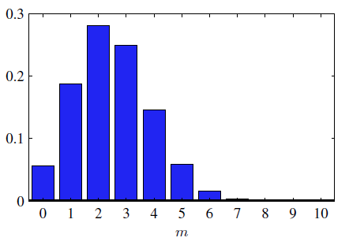
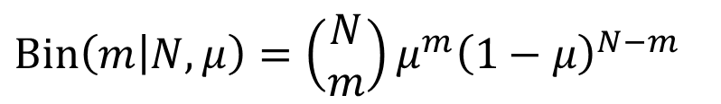

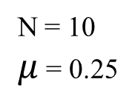
Bernoulli and Binomial distributions
$Bern\left(x | μ\right)=μ^{x}{\left(1−μ\right)}^{1−x}$
The “coin flipping” distribution is Bernoulli distribution
Flipping the coin once, what is the probability of x = 1 (head) or x = 0 (tail)
$Bin\left(m | N,μ\right)={\left(\begin{aligned}N \\ m\end{aligned}\right)μ}^{m}{\left(1−μ\right)}^{N−m}$
Related binomial distribution is also described by single probability $μ$
How many heads do I get if I flip the coin N times?
N = 10
$μ$ = 0.25

Slide 7
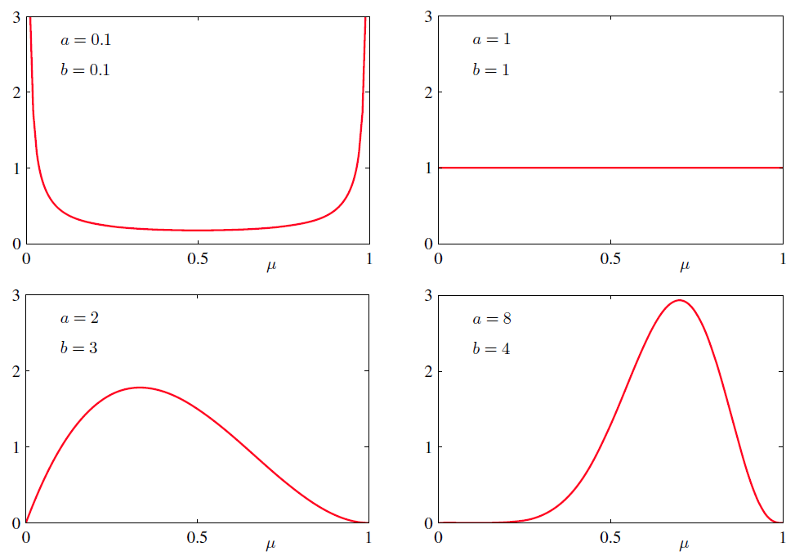
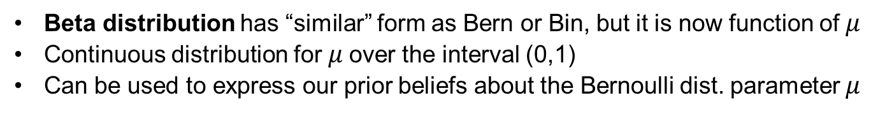
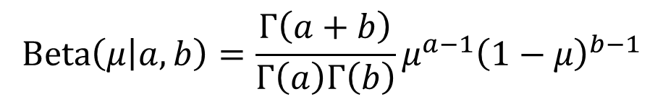
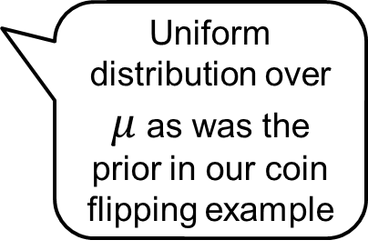
Beta distribution
Normalizing constant
$$Beta\left(μ | a,b\right)={\frac{Γ\left(a+b\right)}{Γ\left(a\right)Γ\left(b\right)}μ}^{a−1}{\left(1−μ\right)}^{b−1}$$
Beta distribution has “similar” form as Bern or Bin, but it is now function of $μ$
Continuous distribution for $μ$over the interval (0,1)
Can be used to express our prior beliefs about the Bernoulli dist. parameter $μ$
Uniform distribution over $μ$ as was the prior in our coin flipping example

Slide 8
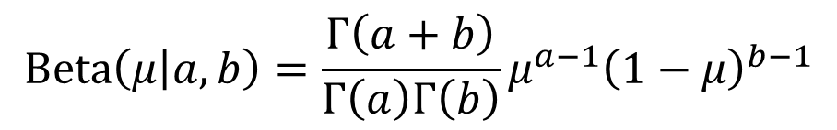
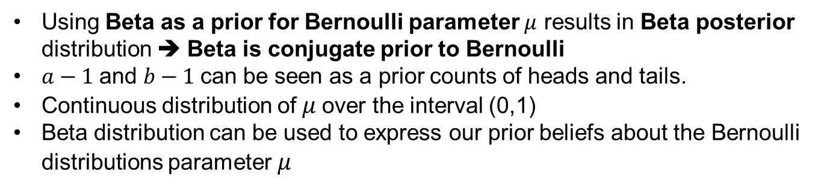
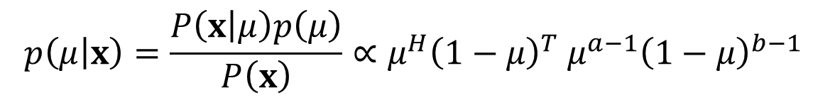
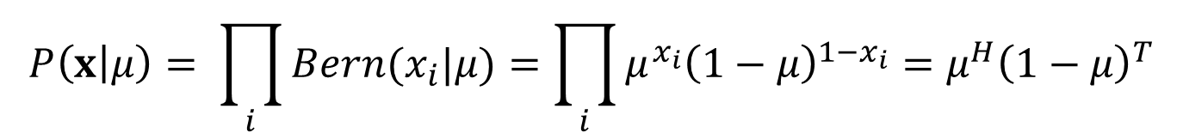
Beta as a conjugate prior
$$x=\left[x_{1}, x_{2},x_{3},…x_{N}\right]=\left[1,0,0,1,…,0\right]$$
$$P\left(x | μ\right)= \prod_{i}{Bern(x_{i}|μ)}=\prod_{i}{μ^{x_{i}}{\left(1−μ\right)}^{1−x_{i}}}=μ^{H}{\left(1−μ\right)}^{T}$$
$$Beta\left(μ | a,b\right)=\frac{Γ\left(a+b\right)}{Γ\left(a\right)Γ\left(b\right)}μ^{a−1}{\left(1−μ\right)}^{b−1}$$
Sufficient statistics
$$p\left(μ | x\right)=\frac{P\left(x | μ\right)p\left(μ\right)}{P\left(x\right)}∝μ^{H}{\left(1−μ\right)}^{T} μ^{a−1}{\left(1−μ\right)}^{b−1}$$
$=μ^{H+a−1}{\left(1−μ\right)}^{T+b−1}∝$ $Beta\left(μ | H+a,T+b\right)$
Using Beta as a prior for Bernoulli parameter $μ$ results in Beta posterior distribution ➔ Beta is conjugate prior to Bernoulli
$a−1$and $b−1$can be seen as a prior counts of heads and tails.
Continuous distribution of $μ$over the interval (0,1)
Beta distribution can be used to express our prior beliefs about the Bernoulli distributions parameter $μ$

Slide 9

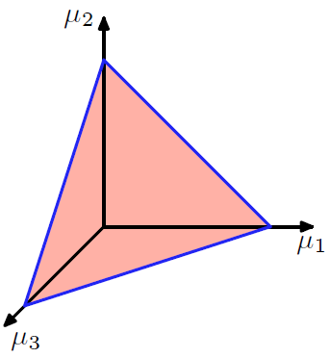

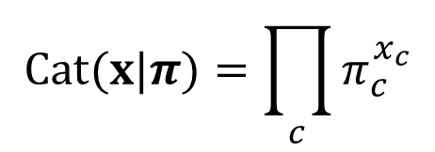




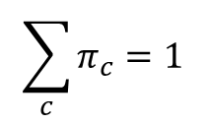

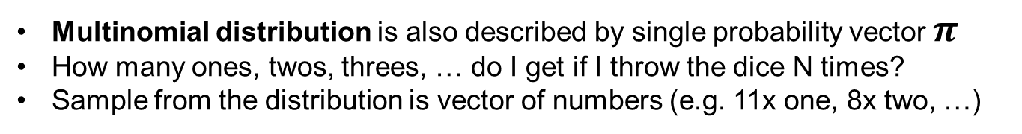

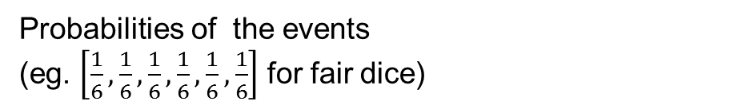
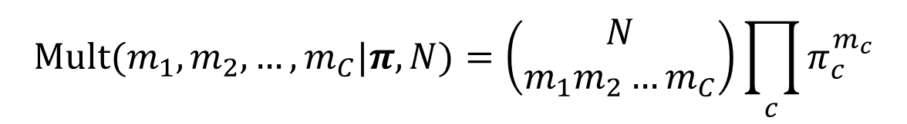
Categorical and Multinomial distribution
$$x=\left[0, 0, 1, 0, 0, 0 \right]$$
One-hot encoding of a discrete event ( on a dice)
$$π=\left[π_{1}, π_{2},…,π_{C}\right]$$
Probabilities of the events
(eg. $\left[\frac{1}{6},\frac{1}{6},\frac{1}{6},\frac{1}{6},\frac{1}{6},\frac{1}{6}\right]$ for fair dice)
$$π_{2}$$
$$C=3$$
$$Cat(x|π)=\prod_{c}{π_{c}^{x_{c}}}$$
$$\sum_{c}{π_{c}}=1$$
➔ $π$ is a point on a simplex
$$π_{1}$$
$$π_{3}$$
Categorical distribution simply “returns” the probability of a given event x
Sample from the distribution is the event (or its one-hot encoding)
$$Mult(m_{1},m_{2}, …, m_{C}|π,N)=\left(\begin{aligned}N \\ m_{1}m_{2}…m_{C}\end{aligned}\right)\prod_{c}{π_{c}^{m_{c}}}$$
Multinomial distribution is also described by single probability vector $π$
How many ones, twos, threes, … do I get if I throw the dice N times?
Sample from the distribution is vector of numbers (e.g. 11x one, 8x two, …)

Slide 10
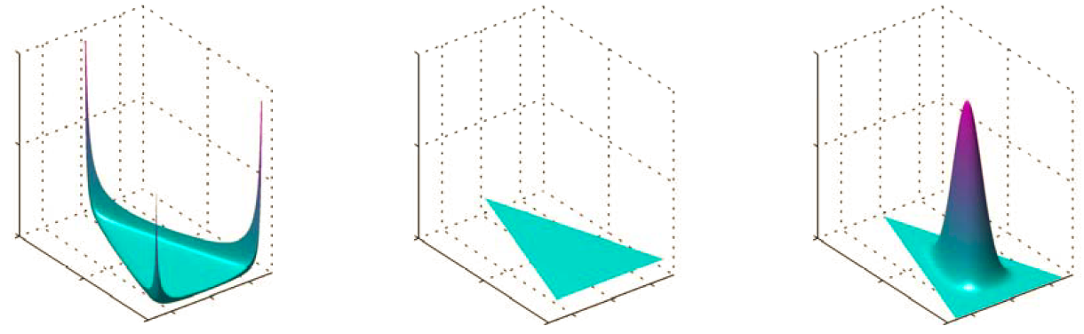


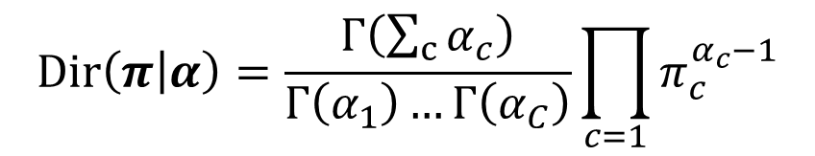

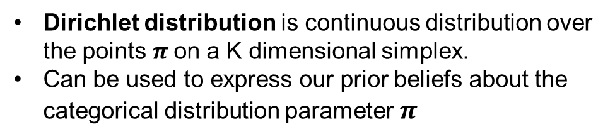

Dirichlet distribution
$$Dir\left(π | α\right)=\frac{Γ\left(\sum_{c}{α_{c}}\right)}{Γ\left(α_{1}\right)…Γ\left(α_{C}\right)}\prod_{c=1}{π_{c}^{α_{c}−1}}$$
$$π_{2}$$
$$C=3$$
Dirichlet distribution is continuous distribution over the points $π$on a K dimensional simplex.
Can be used to express our prior beliefs about the categorical distribution parameter $π$
$$π_{1}$$
$$π_{3}$$

Slide 11
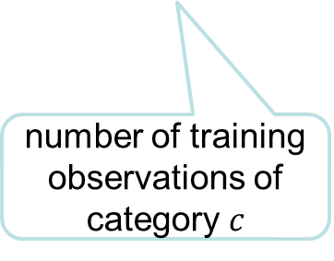
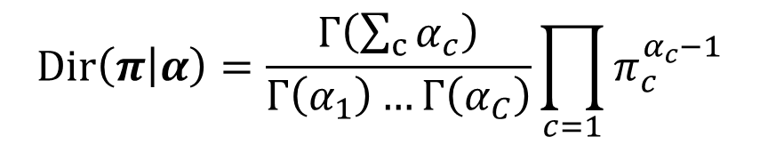
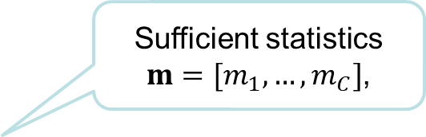
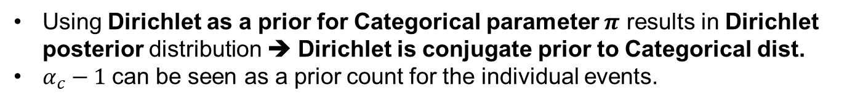
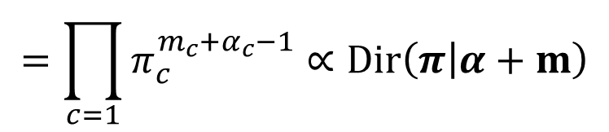
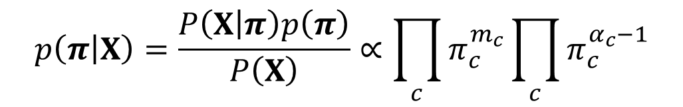
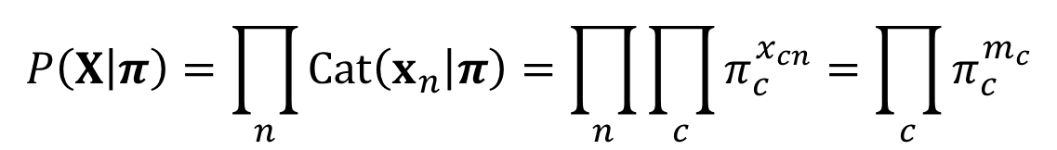
Dirichlet as a conjugate prior
$$P\left(X | π\right)=\prod_{n}{Cat\left(x_{n} | π\right)}=\prod_{n}{\prod_{c}{π_{c}^{x_{cn}}}}=\prod_{c}{π_{c}^{m_{c}}}$$
$$Dir\left(π | α\right)=\frac{Γ\left(\sum_{c}{α_{c}}\right)}{Γ\left(α_{1}\right)…Γ\left(α_{C}\right)}\prod_{c=1}{π_{c}^{α_{c}−1}}$$
number of training observations of category $c$
$$p\left(π | X\right)=\frac{P\left(X | π\right)p\left(π\right)}{P\left(X\right)}∝\prod_{c}{π_{c}^{m_{c}}}\prod_{c}{π_{c}^{α_{c}−1}}$$
Sufficient statistics
$m=[m_{1},…, m_{C}]$,
$$=\prod_{c=1}{π_{c}^{m_{c}+α_{c}−1}}∝Dir\left(π | α+m\right)$$
Using Dirichlet as a prior for Categorical parameter $π$ results in Dirichlet posterior distribution ➔ Dirichlet is conjugate prior to Categorical dist.
$α_{c}−1$can be seen as a prior count for the individual events.

Slide 12
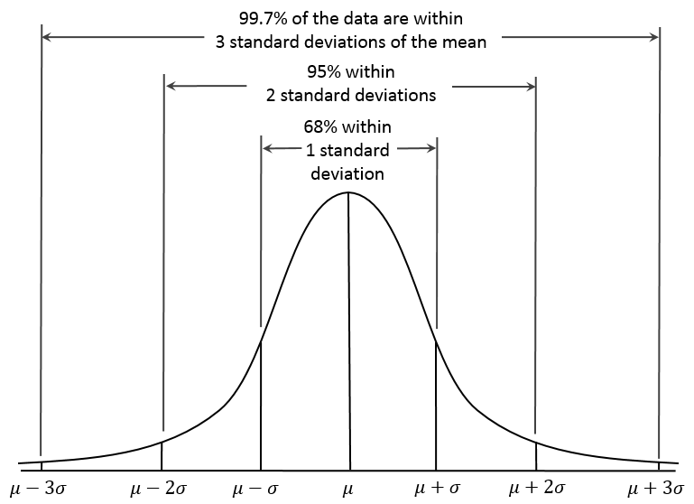
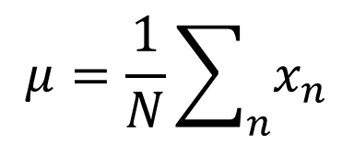
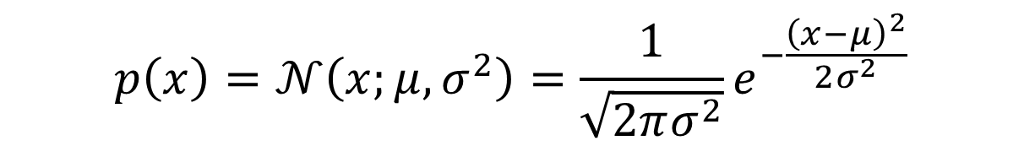
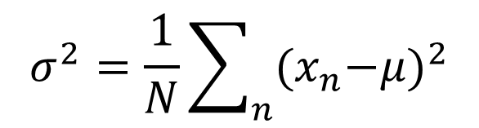
Gaussian distribution (univariate)
$$p\left(x\right)=𝒩\left(x;μ,σ^{2}\right)=\frac{1}{\sqrt{2πσ^{2}}}e^{−\frac{{\left(x−μ\right)}^{2}}{2σ^{2}}}$$
ML estimates of parameters
$$μ=\frac{1}{N}\sum_{n}{x_{n}}$$
$$σ^{2}=\frac{1}{N}\sum_{n}{{{(x}_{n}−μ)}^{2}}$$

Slide 13
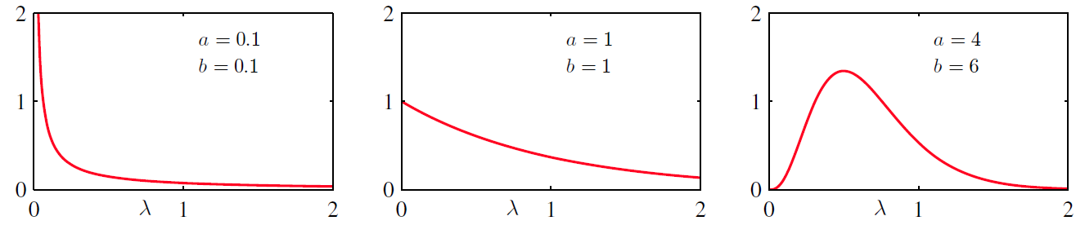
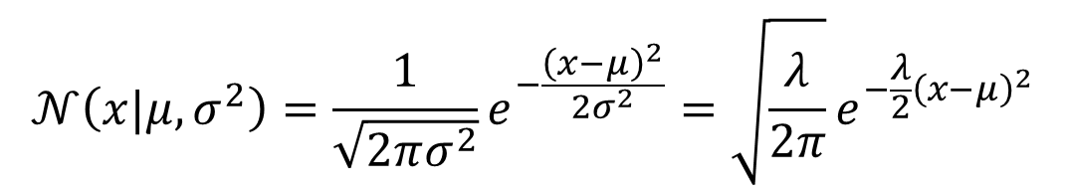
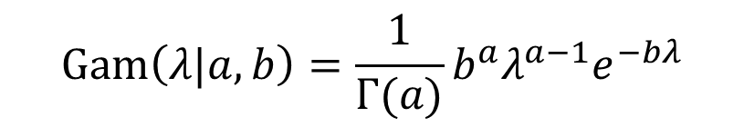
Gamma distribution
Normal distribution can be expressed in terms of precision $λ=\frac{1}{σ^{2}}$
$$𝒩\left(x|μ,σ^{2}\right)=\frac{1}{\sqrt{2πσ^{2}}}e^{−\frac{{\left(x−μ\right)}^{2}}{2σ^{2}}}=\sqrt{\frac{λ}{2π}}e^{−\frac{λ}{2}{\left(x−μ\right)}^{2}}$$
$$Gam\left(λ|a,b\right)=\frac{1}{Γ(a)}b^{a}λ^{a−1}e^{−bλ}$$
Gamma distribution d$efined for λ>0$ can be used as a prior over the precision

Slide 14
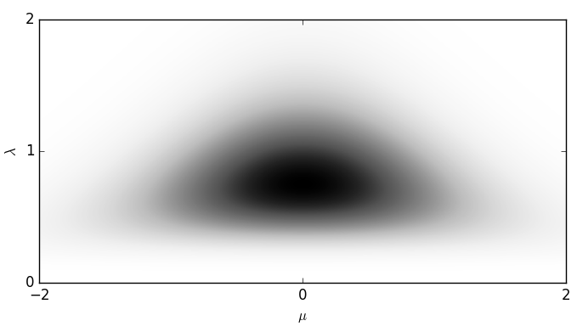

NormalGamma distribution
$$NormalGama\left(μ,λ|m,κ,a,b\right)=𝒩\left(μ|m,{\left(κλ\right)}^{−1}\right)Gam(λ|a,b)$$
Joint distribution over $μ$ and $λ$. Note that $μ$ and $λ$ are not independent.
$$m=0,κ=2,a=5,b=6$$

Slide 15



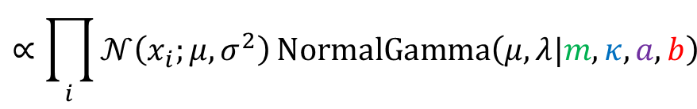
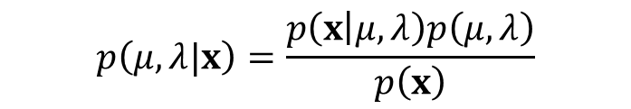
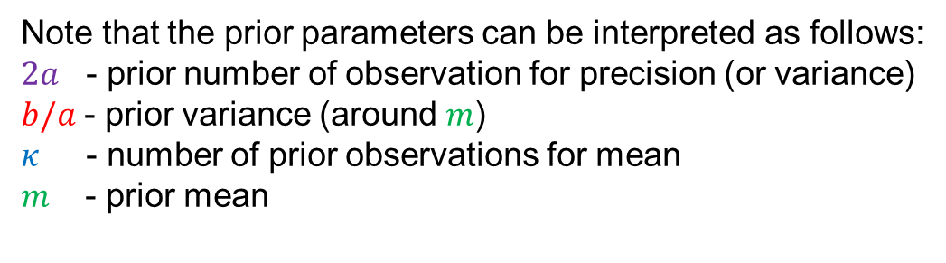
NormalGamma distribution
NormalGamma distribution is the conjugate prior for Gaussian dist.
Given observations $x=\left[x_{1}, x_{2},x_{3},…x_{N}\right]$, the posterior distribution
Defined in terms of sufficient statistics N and
$$p\left(μ,λ|x\right)=\frac{p\left(x | μ,λ\right)p\left(μ,λ\right)}{p\left(x\right)}$$
$$∝\prod_{i}{𝒩\left(x_{i};μ,σ^{2}\right)}NormalGamma\left(μ,λ|m,κ,a,b\right)$$
$$∝NormalGamma\left(μ,λ | \frac{κm+N\overline{x}}{κ+N},κ+N,a+\frac{N}{2},b+\frac{N}{2}\left(s+ \frac{κ{\left(\overline{x}−m\right)}^{2}}{κ+N}\right)\right)$$
$$\overline{x}=\frac{1}{N}\sum_{n=1}^{N}{x_{n}}$$
$$s=\frac{1}{N}\sum_{n=1}^{N}{{(x}_{n}−{\overline{x})}^{2}}$$
Note that the prior parameters can be interpreted as follows:
$2a$ - prior number of observation for precision (or variance)
$b/a$- prior variance (around $m$)
$κ$ - number of prior observations for mean
$m$ - prior mean

Slide 16
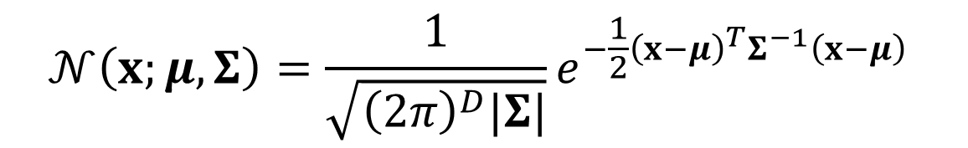

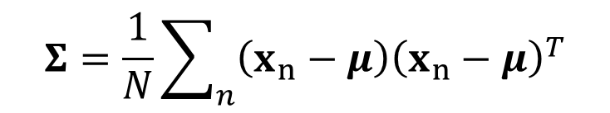

Gaussian distribution (multivariate)
$$p\left(x_{1}, …,x_{D}\right)=$$
$$𝒩\left(x;μ,Σ\right)=\frac{1}{\sqrt{{\left(2π\right)}^{D}|Σ|}}e^{−\frac{1}{2}{\left(x−μ\right)}^{T}Σ^{−1}\left(x−μ\right)}$$
ML estimates of parameters
$$μ=\frac{1}{N}\sum_{n}{x_{n}}$$
$$Σ=\frac{1}{N}\sum_{n}{{\left(x_{n}−μ\right)\left(x_{n}−μ\right)}^{T}}$$

Slide 17



Gaussian distribution (multivariate)
$$𝒩\left(x;μ,Σ\right)=\frac{1}{\sqrt{{\left(2π\right)}^{D}|Σ|}}e^{−\frac{1}{2}{\left(x−μ\right)}^{T}Σ^{−1}\left(x−μ\right)}$$
Conjugate prior is Normal-Wishart
where
is Wishart distribution and
$Λ=Σ^{−1}$

Slide 18








Exponential family
All the distributions described so far are distributions from the exponential family, which can be expressed in the following form
For example, for Gaussian distribution:
$$p(x|η)=h(x)\text{g}\left(η\right)exp\left\{η^{T}u(x)\right\}$$
$$𝒩\left(x;μ,σ^{2}\right)=\frac{1}{\sqrt{2πσ^{2}}}exp\left\{−\frac{1}{2σ^{2}}x^{2}+\frac{μ}{σ^{2}}x−\frac{μ^{2}}{{2σ}^{2}}\right\}$$
$$η=\left({μ/σ^{2} \atop −1/2σ^{2}}\right)$$
$$u(x)=\left(\begin{aligned}x \\ { x}^{2}\end{aligned}\right)$$
g$\left(η\right)=\sqrt{−\frac{2η_{2}}{2π}}exp⁡\left(\frac{η_{1}^{2}}{4η_{2}}\right)$
$$h(x)=1$$
To evaluate likelihood of set of observations:
$$\prod_{n}{𝒩\left(x_{n};μ,σ^{2}\right)}=exp\left\{−\frac{1}{2σ^{2}}\sum_{n}{x_{n}^{2} }+\frac{μ}{σ^{2}}\sum_{n}{x_{n} }−N\left(\frac{μ^{2}}{2σ^{2}}+\frac{\log\left(2πσ^{2}\right)}{2}\right)\right\}$$
$$={\text{g}\left(η\right)}^{N}exp\left\{η^{T}\sum_{n=1}^{N}{u(x_{n})}\right\}\prod_{n}{h(x_{n})}$$

Slide 19

Exponential family
For any distributions from exponential family
$$p(x|η)=h(x)\text{g}\left(η\right){\exp\left\{η^{T}u(x)\right\}}$$
Likelihood $p\left(X | η\right)$ of observed data $X=[x_{1},x_{2},…,x_{N}]$ can be evaluated using the sufficient statistics $N$ and $\sum_{n=1}^{N}{u(x_{n})}$:
$$p(X|η)={\text{g}\left(η\right)}^{N}exp\left\{η^{T}\sum_{n=1}^{N}{u(x_{n})}\right\}\prod_{n}{h(x_{n})}$$
Conjugate prior distribution over parameter $η$exists in form:
$$p\left(η | θ,ν\right)=f\left(θ,ν\right)\text{g}{\left(η\right)}^{ν}exp\left\{η^{T}θ\right\}=f\left(θ,ν\right)\exp\left\{{\left[\begin{matrix}ν \\ θ\end{matrix}\right]}^{T}\left[\begin{matrix}\ln{\text{g}\left(η\right)} \\ η\end{matrix}\right]\right\}=f\left(θ,ν\right)\exp\left\{ {\hat{θ}}^{T}v\left(η\right)\right\}$$
Posterior distribution takes the same form as the conjugate prior, and we need only the prior parameters and the sufficient stats to evaluate it:
$$p\left(η | X\right)=p\left(η | θ+\sum_{n=1}^{N}{u\left(x_{n}\right)},ν+N\right)∝{\text{g}\left(η\right)}^{N+ν}exp\left\{η^{T}\left(θ+\sum_{n=1}^{N}{u\left(x_{n}\right)}\right)\right\}$$
$θ/ν$ can be seen as a prior observation and $ν$ as a prior count of observations

Slide 20

Parameter estimation revisited
Let’s estimate again parameters $η$of a chosen $p\left(x | η\right)$distribution given some of observed data $X=\left[x_{1},x_{2},…,x_{N}\right]$
Using the Bayes rule, we get the posterior distribution
$p\left(η | X\right)=\frac{P\left(X | η\right)p\left(η\right)}{P\left(X\right)}$
We can choose the most likelihood parameters: Maximum
a-posteriori (MAP) estimate
${\hat{η}}^{MAP}=\underset{η}{arg max}{p\left(η | X\right)}=\underset{η}{arg max}{p\left(X | η\right)p\left(η\right)}$
Assuming flat (constant) prior $p\left(η\right)=const$, we obtain Maximum likelihood (ML) estimate as a special case:
${\hat{η}}^{ML}=\underset{η}{arg max}{P\left(X | η\right)}$

Slide 21

Posterior predictive distribution
We do not need to obtain a point estimate of the parameters $\hat{η}$
It is always good to postpone making hard decisions
Instead, we can take into account the uncertainty encoded in the posterior distribution $p\left(η | X\right)$ when evaluating posterior predictive probability for a new data point $x′$ (as we did in our coin flipping example)
$$p\left(x^{′} | X\right)=\int{p\left(x^{′},η | X\right)d}η=\int{p\left(x^{′} | η\right)p\left(η | X\right)d}η$$
Rather than using one most likely setting of parameters $\hat{η}$, we average over their different setting, which could possibly generate the observed data $X$
➔ this approach is robust to overfitting

Slide 22

Posterior predictive for Bernoulli
Beta prior on parameters of Bernoulli distribution leads to Beta posterior
$$p\left(μ | x\right)∝\prod_{n}{Bern\left(x_{n} | μ\right)}Beta\left(μ | a_{0},b_{0}\right)∝Beta\left(μ | a_{0}+H,b_{0}+T\right)=Beta\left(μ | a_{N},b_{N}\right)$$
The posterior predictive distribution is again Bernoulli
$$p\left(x^{′} | x\right)=\int{p\left(x^{′} | μ\right)p\left(μ | x\right)}dμ=\int{Bern(x^{′}|μ)Beta\left(μ | a_{N},b_{N}\right)}dμ=Bern\left(x^{′} | \frac{a_{N}}{a_{N}+b_{N}}\right)=Bern\left(x^{′} | \frac{a_{0}+H}{a_{0}+b_{0}+N}\right)$$
In our coin flipping example:
  $p\left(μ\right) =𝒰\left(0,1\right)=Beta\left(μ | a_{0},b_{0}\right)= Beta\left(μ | 1,1\right)$
  $p\left(μ | x\right) =Beta\left(μ | a_{N},b_{N}\right)=Beta\left(μ | a_{0}+H,b_{0}+T\right)=Beta\left(μ | 1+750,1+250\right)$
  $p\left(x^{′} | x\right)=Bern\left(x^{′} | \frac{a_{N}}{a_{N}+b_{N}}\right)={751}/{1002} =0.7495$

Slide 23

Posterior predictive for Categorical
Dirichlet prior on parameters of Categorical distribution leads to Dirichlet posterior
$$p\left(π | X\right)∝\prod_{n}{Cat\left(x_{n} | π\right)}Dir\left(π | α_{0}\right)∝Dir\left(π | α_{0}+m\right)=Dir\left(π | α_{N}\right)$$
The posterior predictive distribution is again Categorical
$$p\left(x^{′} | X\right)=\int{p\left(x^{′} | π\right)p\left(π | X\right)}dπ=\int{Cat\left(x^{′} | π\right)Dir\left(π | α_{N}\right)}dπ=Cat\left(x^{′} | \frac{α_{N}}{\sum_{c}{α_{Nc}}}\right)=Cat\left(x^{′} | \frac{α_{0}+m}{\sum_{c}{α_{0c}+m_{c}}}\right)$$

Slide 24

Student’s t-distribution
NormalGamma prior on parameters of Gaussian distribution leads to NormalGamma posterior
$$p\left(μ,λ|x\right)∝\prod_{i}{𝒩\left(x_{i};μ,σ^{2}\right)}NormalGamma\left(μ,λ|m_{0},κ_{0},a_{0},b_{0}\right)∝NormalGamma\left(μ,λ | \frac{κ_{0}m_{0}+N\overline{x}}{κ_{0}+N},κ_{0}+N,a_{0}+\frac{N}{2},b_{0}+\frac{N}{2}\left(s+ \frac{κ_{0}{\left(\overline{x}−m_{0}\right)}^{2}}{κ_{0}+N}\right)\right)=NormalGamma\left(μ,λ|m_{N},κ_{N},a_{N},b_{N}\right)$$
The posterior predictive distribution is Student’s t-distribution
$$p\left(x^{′} | x\right)=\iint{p\left(x^{′} | μ,λ\right)p\left(μ,λ | x\right) dμ dλ} \\ =\iint{𝒩\left(x^{′}|μ, λ^{−1}\right)NormalGamma\left(μ,λ|m_{N},κ_{N},a_{N},b_{N}\right) dμ dλ} \\ =St\left(x^{′}|m_{N},2a_{N},\frac{a_{N}κ_{N}}{b_{N}(κ_{N}+1)}\right)$$

Slide 25



Student’s t-distribution
$$St\left(x | μ, ν, γ\right)=\frac{Γ\left(\frac{ν}{2}+\frac{1}{2}\right)}{Γ\left(\frac{ν}{2}\right)}{\left(\frac{γ}{πν}\right)}^{\frac{1}{2}}{\left[1 +\frac{γ{\left(x −μ\right)}^{2}}{ν}\right]}^{− \frac{ν}{2} − \frac{1}{2}}$$
Gaussian distribution is a special case of Student’s with degree of freedom $ν→∞$
For the posterior $p\left(μ,λ\right|x)$, $ν=2a_{N}=2a_{0}+N$

