Slide 1
Bayesian Models in Machine Learning
Bayesian GMM for Speaker Diarization (VBx-GMM)
Lukáš Burget, Mireia Diez
BAYa lectures, December 2023

Slide 2
Speaker Diarization
What is it?
The task of automatically determining the speaker turns in a recording of a conversation or finding "who spoke when"

Slide 3
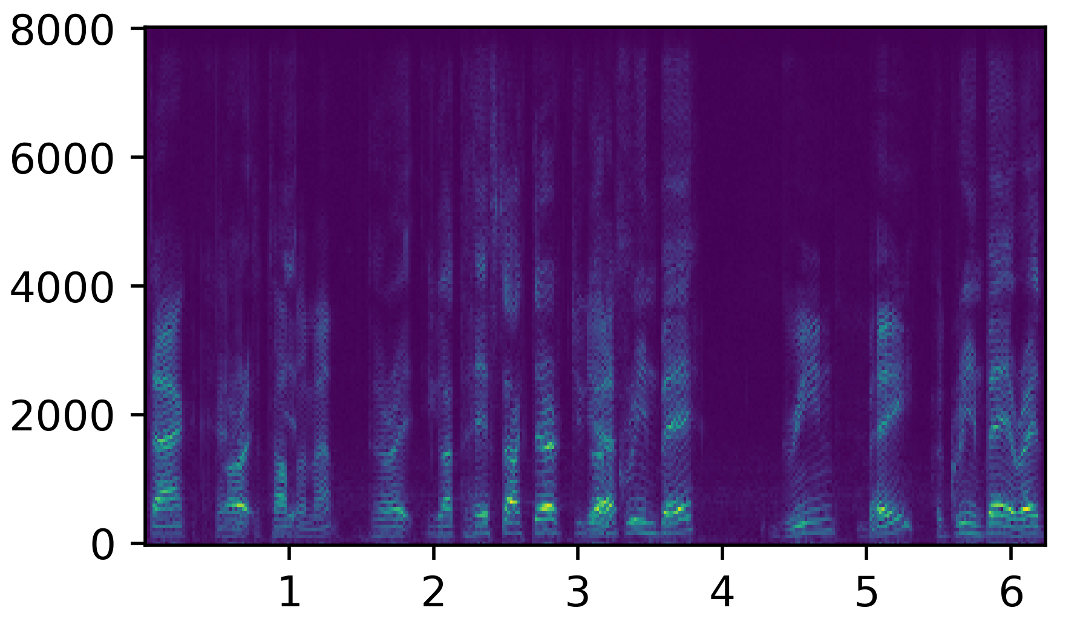
Diarization system
Classification head
Embedding extraction
x-vector
Linear layer
Trained for speaker recognition task
On single speaker utterances
x-vectors are the low-dimensionality embeddings representing the speaker characteristics of the input utterance
Different architectures for the extraction of per-frame embedding extraction: TDNN, ResNet, etc.
Several objectives can be used AAM loss, Softmax loss, etc.
Mean & standard deviation
Pooling layer
10ms
Per-frame embeddings
NN
Spectrogram

Slide 4
Diarization system
Standard / Traditional / Cascade / Module-based
1.5 s
Uniform segmentation
.
.
.
.
.
.
.
.
.
.
.
.
.
.
.
.
.
.
.
.
.
.
.
.
.
.
.
.
.
.
Embeddings
Clustering: agglomerative hierarchical clustering, spectral clustering, etc.

Slide 5
VBx Diarization
Clustering embeddings using VB inference for Bayesian HMM
Federico Landini, Ján Profant, Mireia Diez, Lukáš Burget, “Bayesian HMM clustering of x-vector sequences (VBx) in speaker diarization: Theory, implementation and analysis on standard tasks”, Computer Speech & Language, Volume 71, 2022, 101254, ISSN 0885-2308, https://doi.org/10.1016/j.csl.2021.101254.
Here we consider simplified version using only GMM, which is anyway used in practice
Uses PLDA trained on x-vectors to model:
$p\left(μ_{s}\right)=𝓝\left(μ_{s} | μ,Σ_{ac}\right)$ - distribution of speaker means
$p\left(x | μ_{s}\right)=𝓝(x|μ_{s},Σ_{wc})$ - within speaker (channel) variability
If the x-vectors from a single conversation of several speakers follows the PLDA model, they can be assumed to be distributed according to Bayesian GMM model where:
Means of the components follows prior distribution $p\left(μ_{s}\right)$
Speaker specific distributions are $\left(x | μ_{s}\right)$
Weights 𝝅 determine how much is the speaker speaking
$$μ_{s}$$
$$x_{sn}$$

Slide 6
VBx Diarization
We assume that the observed x-vectors in each conversation were generated as follows:
For each speaker $s=1…S$, mean of the speaker specific distribution was generated as
$μ_{s}\sim 𝒩\left(μ_{s}|μ, Σ_{ac}\right)$
For each x-vector $n=1…N$
$z_{n} \sim P\left(z_{n} | π\right)=Cat\left(z_{n}|π\right)$
$x_{n} \sim p\left(x_{n} | z_{n}, \{μ_{s}\}\right)=𝒩\left(x_{n}|μ_{z_{n}},Σ_{wc}\right)$
Given the “observed” x-vector sequence $x=\left[x_{1},x_{2},…,x_{N}\right]$, the task is to infer (the distribution over) $z=\left[z_{1},z_{2},…,z_{N}\right]$, which defines assignment of x-vectors (speech frames) to Gaussian components (speaker clusters).
Variational Bayes inference is used for this purpose as shown before for BHM
Component weights 𝝅 are not treated as latent variables but learned using as point estimates to maximize ELBO.
The weights of the “redundant” components converge to 0 $⇒$ It automatically determines the number of speaker in the conversation
$$π$$
z_{n}
$$μ, Σ_{ac}$$
$$μ_{s}$$
x_{n}
$$n=1.. N$$
$$s=1..S$$

