Slide 1


Automatic speech recognition
Petr Schwarz

Slide 2
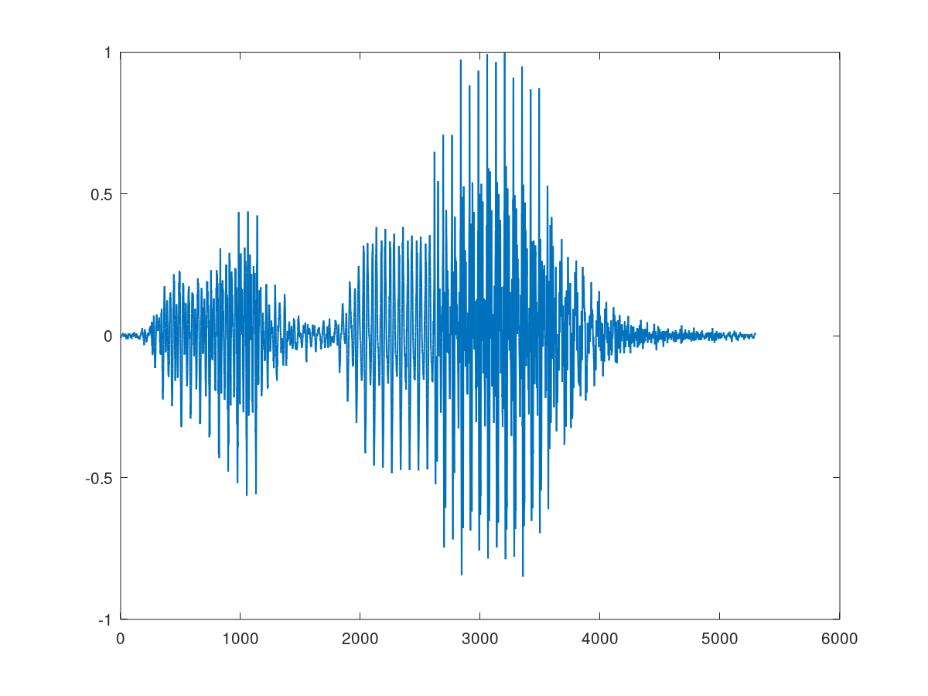
Classical system
Recognition network
Voice activity detector
Feature
extractor
Acoustic model
Decoder
Lattice processing (one-best, n-best, …)
text

Slide 3
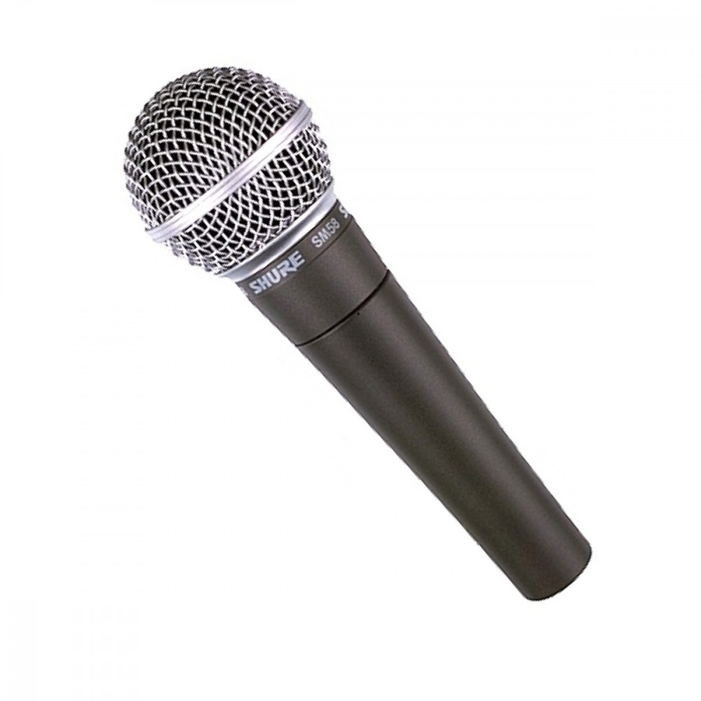
Feature extraction
A waveform is split into small chunks

Slide 4
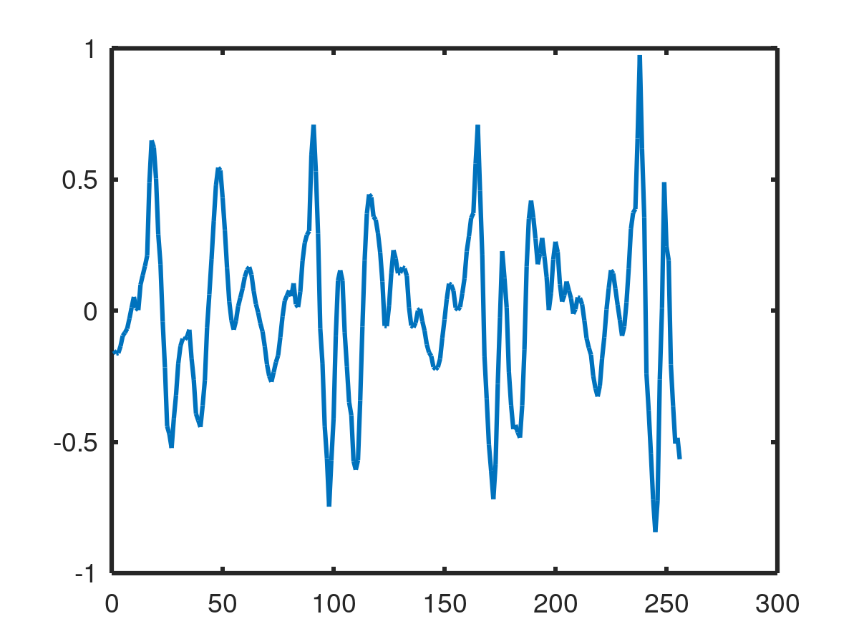
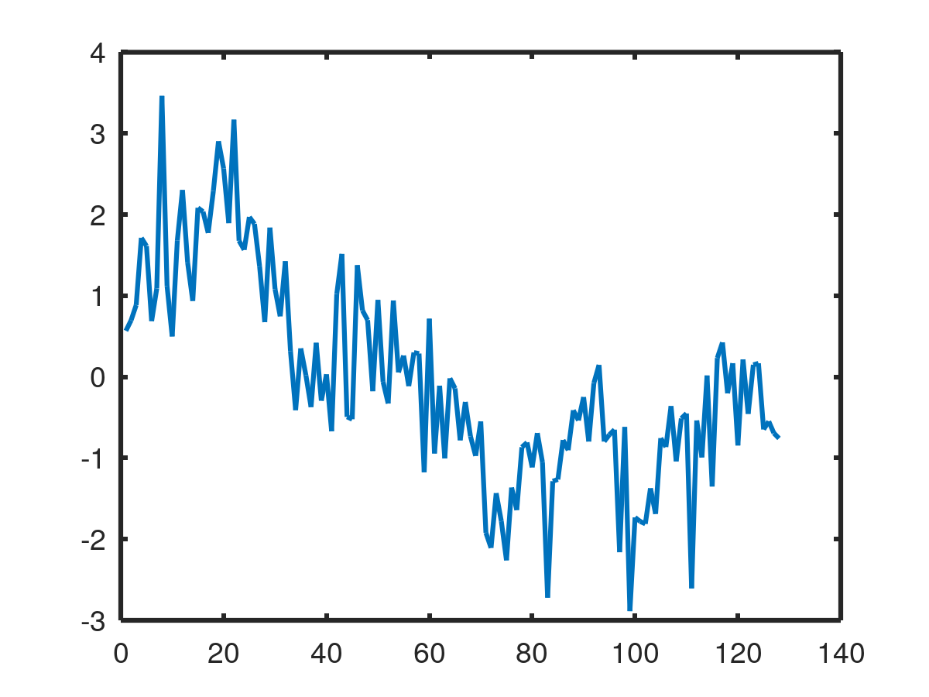
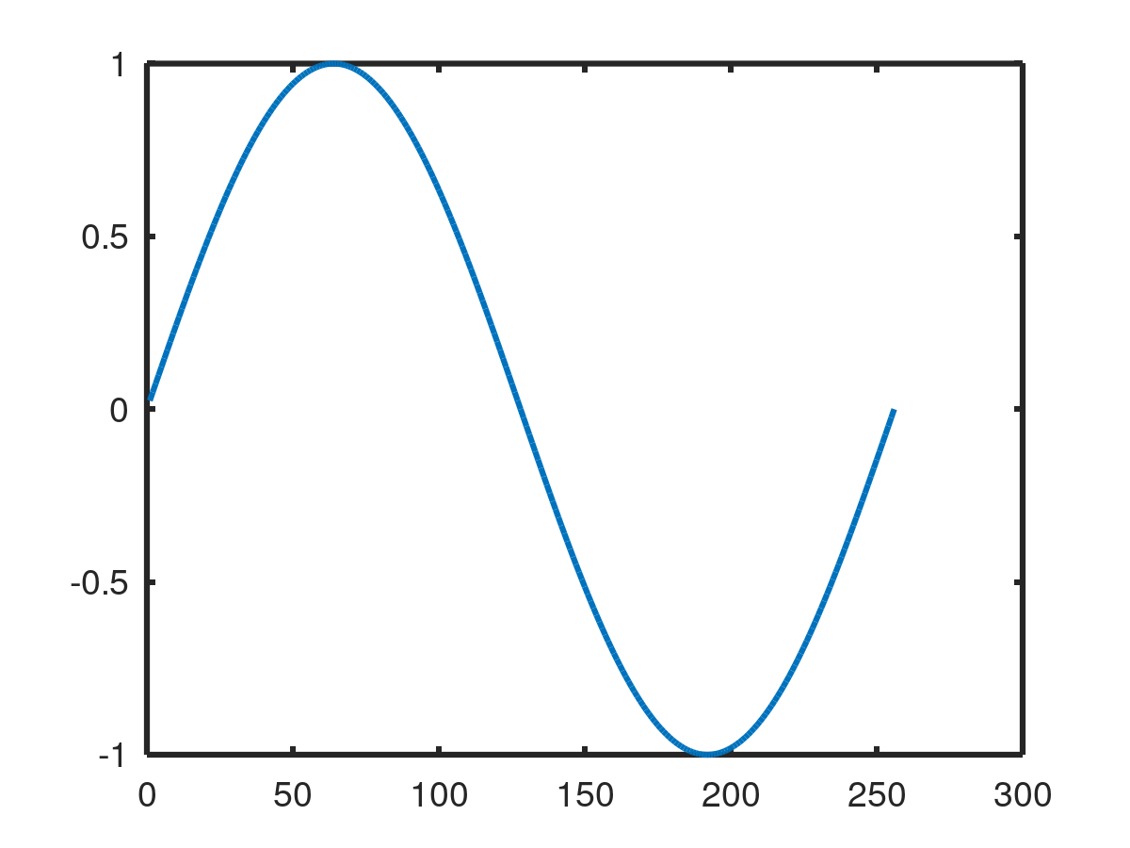
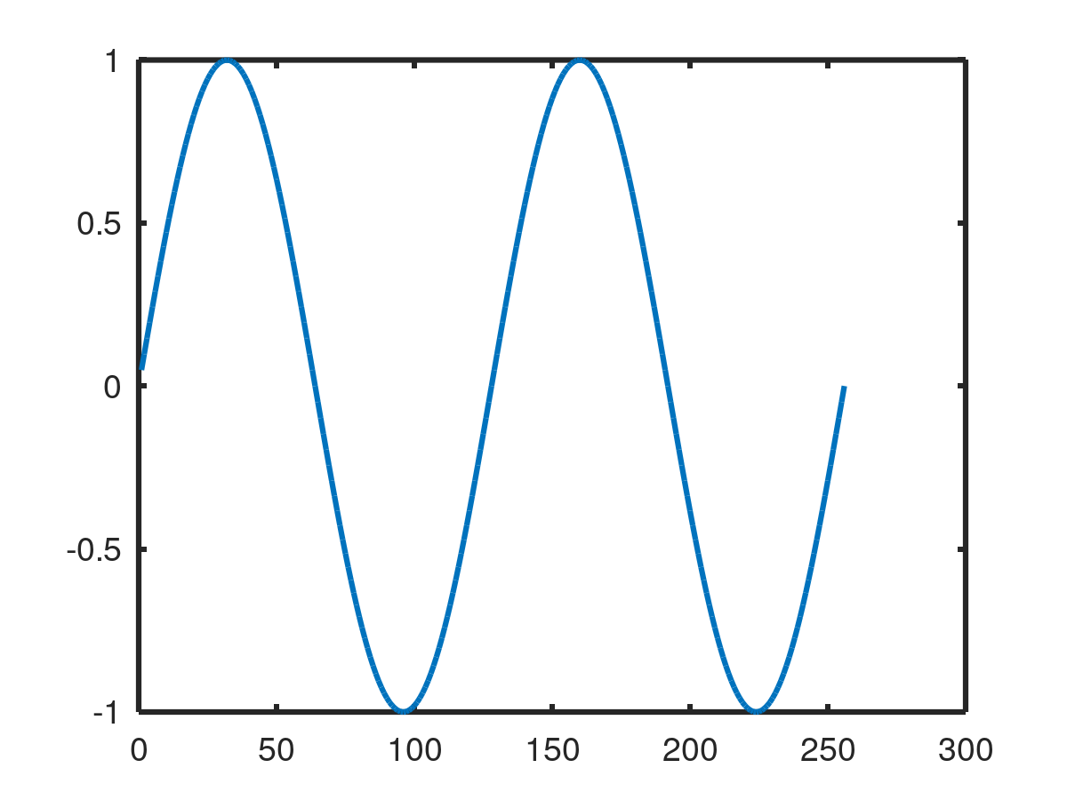
Spectral Analysis Using FFT
A waveform chunk
Spectra
v1
v2
The similarity with harmonic signal

Slide 5
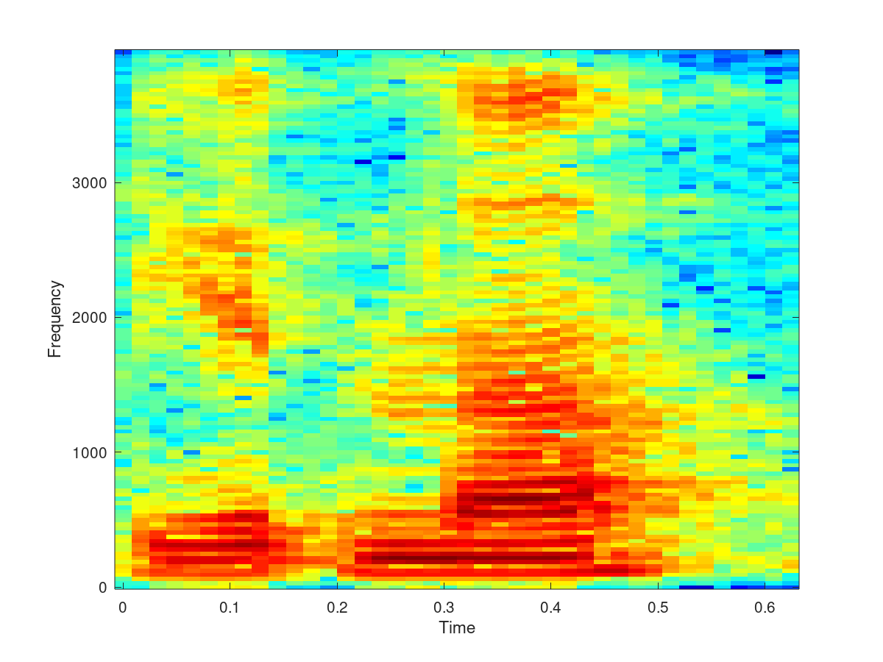
Spectrogram
5

Slide 6
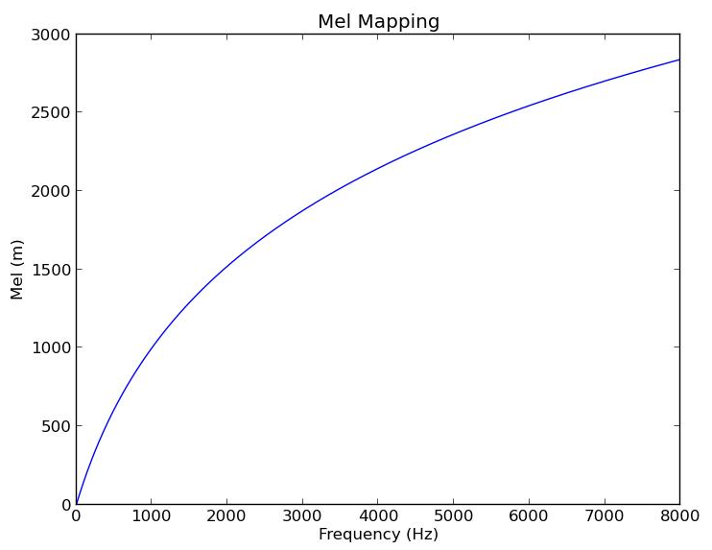
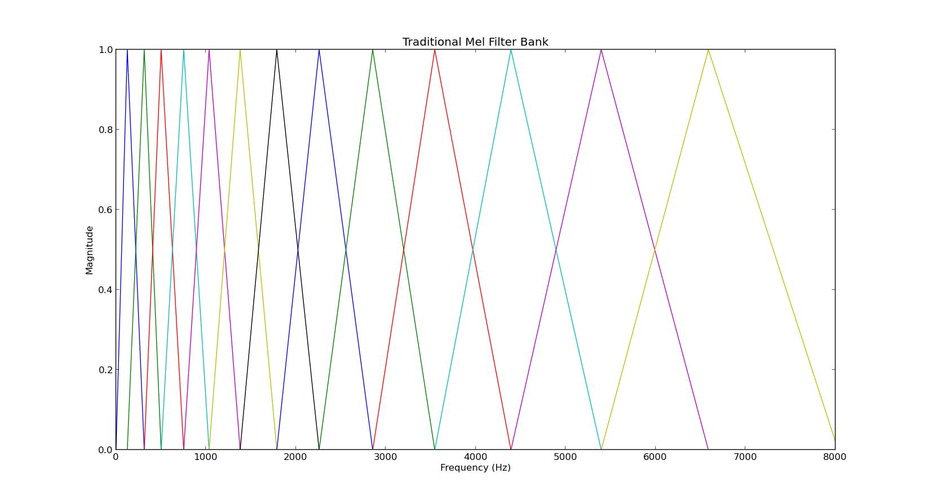
MEL Scale
Mel Frequency Energy Banks:
Based on psychoacoustic experiments to
model the unequal sensitivity of human
hearing to different frequencies
Log above 1KHz
Linear below 1KHz

Slide 7
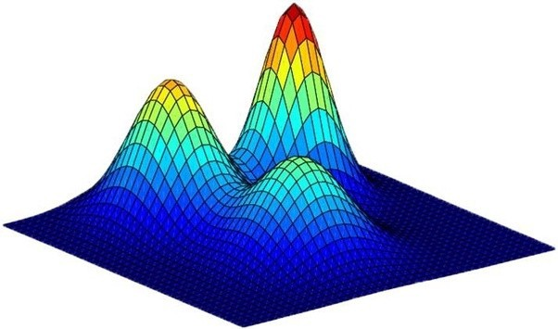
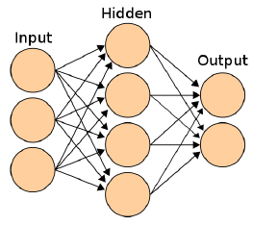
Acoustic model
Model:
Gaussian mixture model
Neural network
x1
x2
ASR system:
HMM/GMM system
HMM/NN hybrid system

Slide 8
Neural network as discriminative classifier
3 layer neural
network
b1=5
One neuron
b3=0
x1
2
b
¨4
f(x)
1
x1
w1
2
1
x2
f(x)
-2
f(x)
w2
x2
b2=8

Slide 9
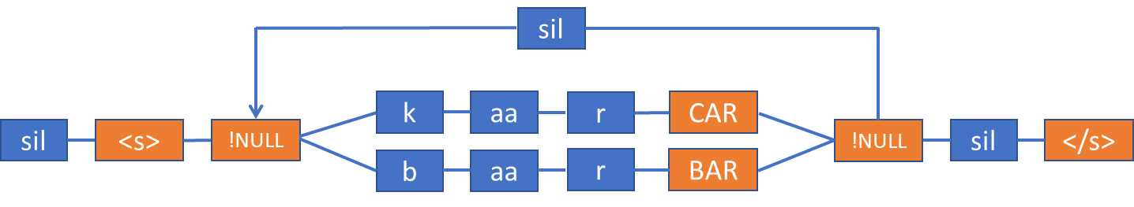
Recognition network
Is representation of what can be said
It goes to very small details, the smallest acoustic units (called states)
The smallest acoustic units are usually context dependent phones (h-a+l) split into 3 temporal parts
The graph has millions of states and millions of links
Blue are models and must correspond to units in our acoustic model
Orange states are words that are used for the output text
There are transition probabilities on links
The recognition network can be seen as one big Hidden Markov Model

Slide 10
Recognition network construction
The network is constructed using Weighted Finite State Transducers
The OpenFST toolkit is used (https://www.openfst.org)
M= H * C * L * G * means composition of transducers
G – is a finite state automata representing n-gram language model
P(goes|car) = 0.2, P(is|car) = 0.1, …
L – is transducer from words to phonemes
car -> c aa r
C – goes from phonemes to context dependent phonemes
c aa r -> ?-c+aa c-aa+r aa-r+?
H – goes from context dependent phonemes to states
c-aa+r -> c-aa+r_[1] c-aa+r_[2] c-aa+r_[3]

Slide 11
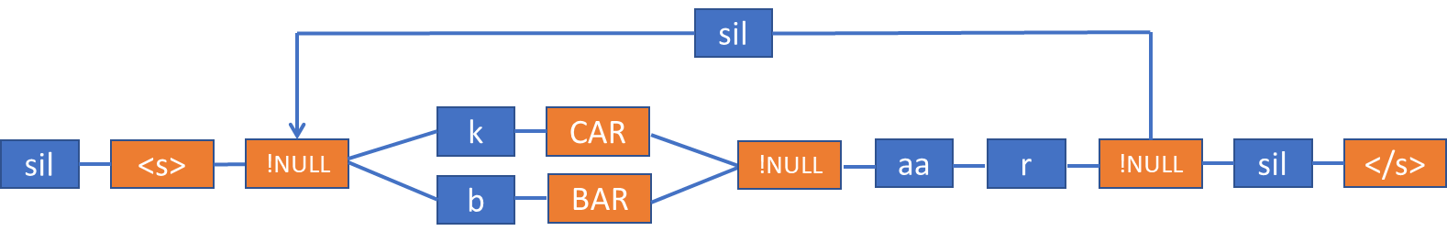
Recognition network optimization
Determinization and minimalization algorithms are used in some phases of network construction
- determinization joints the same paths from the beginning of graph
- minimization joins the same paths from the end of graph
Word states can be shifted to enable better optimization

Slide 12
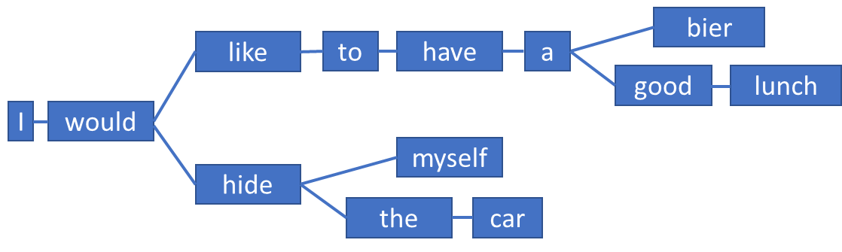
Decoder
Proposes what could be spoken (hypotheses) based on possible paths in the recognition network
Rescores the hypotheses using acoustic model scores (input to decoder) and language model scores (encoded in the recognition network)
Prunes the hypotheses to limit memory consumption (often called beam search)
The most likely hypothesis wins at the end of speech

Slide 13
Training of HMM/GMM
For HMM/GMM quite simple:
  audio features are uniformly assigned to the acoustic units
  GMMs are estimated
  new alignment of audio and acoustic units is created using GMMs
  This is repeated until we reach both good GMMs and alignment
c
aa
r

Slide 14
Training of HMM/NN
More complex because we have a discriminative classifier now:
  HMM/GMM is trained to create initial alignment
  Initial NN is trained
  New alignment of audio and acoustic units is created using NN
  NN training and re-alignment is repeated until we reach both good NN and alignment
c
aa
r

Slide 15
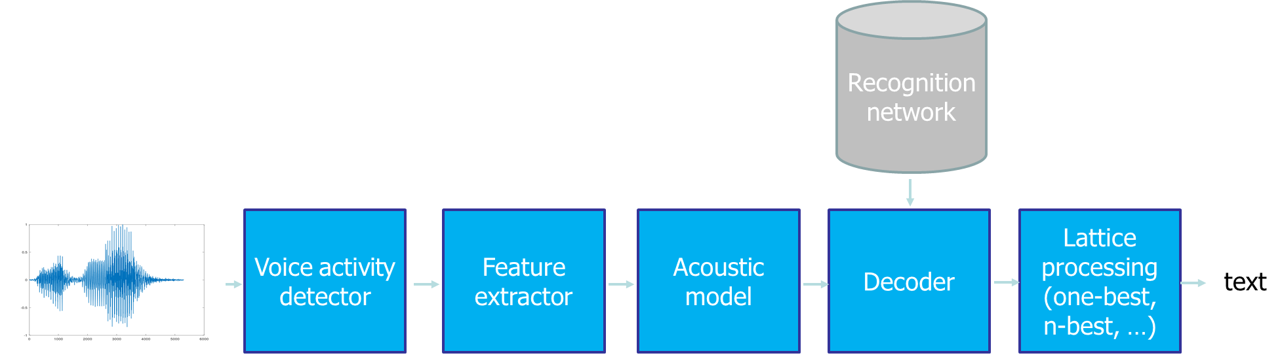
ANN/HMM system and its drawbacks
Hidden Markov Models have some assumptions that do not hold
  better sequential modeling may be needed
3-layer neural networks are not strong enough
  we may need something better
different modules are trained independently
  would be better to train all together with one objective
training of HMM/NN system is complex
  we may need something easier that does not start with HMM/GMM training

Slide 16
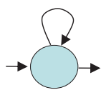
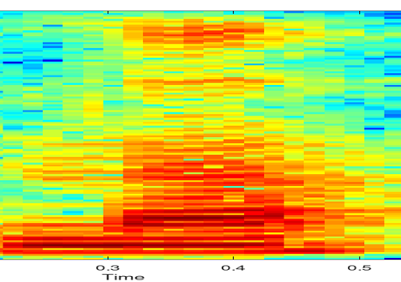
HMMs and assumption of observation independence
Hidden Markov Models assumes that the observations (speech features or frames) are statistically independent
Several frames are aligned to one state. The features of one phoneme, especially vowels are very similar. Vowels have more frames.
The assumption is not valid
We do not want this:
P(aa, t1|x1)=1
P(aa, t2|x2)=1
P(aa, t3|x3)=1
…
Vowels have higher weight in our objective function!
aa

Slide 17
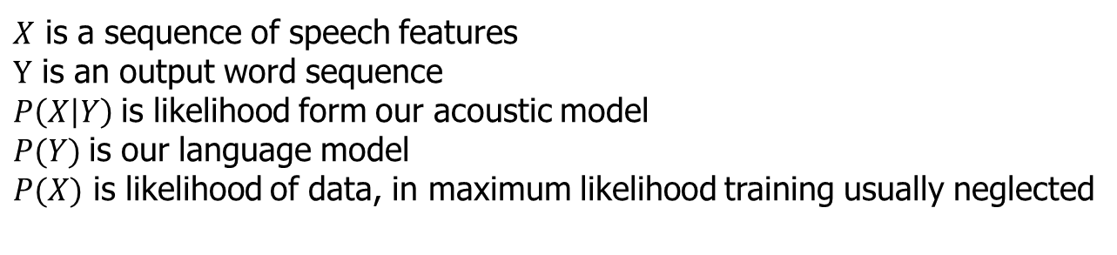
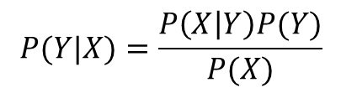


Two objective functions used in HMM/NN training
In HMM/NN hybrid, we usually use maximum likelihood for HMM alignment and cross-entropy function for NN training
In maximum likelihood training, we maximize the probability of correct sequence given the speech feature over all training sequences (have pairs of speech features and labels).
Maximum likelihood training can be used to train the whole HMM/GMM system (other objective functions exists)
Cross entropy for ANN:
This assigns one hard label (one acoustic unit) to each frame. Some acoustic units (vowels) have therefore higher weight. The solution is one objective function covering both HMM and NN parts.
$X$ is a sequence of speech features
$Y$ is an output word sequence
$P\left(X | Y\right)$is likelihood form our acoustic model
$P(Y)$is our language model
$P(X)$ is likelihood of data, in maximum likelihood training usually neglected
$$P(Y|X)=\frac{P\left(X | Y\right)P(Y)}{P(X)}$$
$$L_{ce}=−\sum_{i=1}^{n}{t_{i}log⁡(p_{i})}$$
$t_{i}$ is the true label; is $p_{i}$ NN output

Slide 18
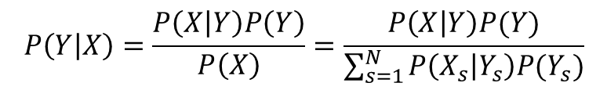
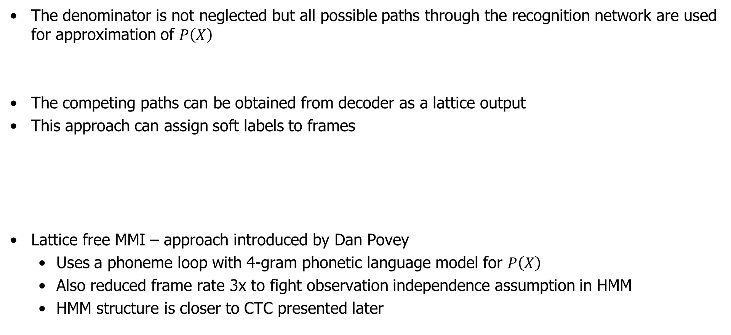
Maximum Mutual Information (MMI) objective function
The denominator is not neglected but all possible paths through the recognition network are used for approximation of $P\left(X\right)$
The competing paths can be obtained from decoder as a lattice output
This approach can assign soft labels to frames
Lattice free MMI – approach introduced by Dan Povey
  Uses a phoneme loop with 4-gram phonetic language model for $P\left(X\right)$
  Also reduced frame rate 3x to fight observation independence assumption in HMM
  HMM structure is closer to CTC presented later
$$P\left(Y | X\right)=\frac{P\left(X | Y\right)P\left(Y\right)}{P\left(X\right)}=\frac{P\left(X | Y\right)P(Y)}{\sum_{s=1}^{N}{P\left(X_{s} | Y_{s}\right)P(Y_{s})}}$$
ML+cross-entropy MMI
P(aa, t1|x1)=1 P(aa, t1|x1)=0.3
P(aa, t2|x2)=1 P(aa, t2|x2)=0.3
P(aa, t3|x3)=1 P(aa, t3|x3)=0.3
Daniel Povey, et al.: “Purely sequence-trained neural networks for ASR based on lattice-free MMI”

Slide 19
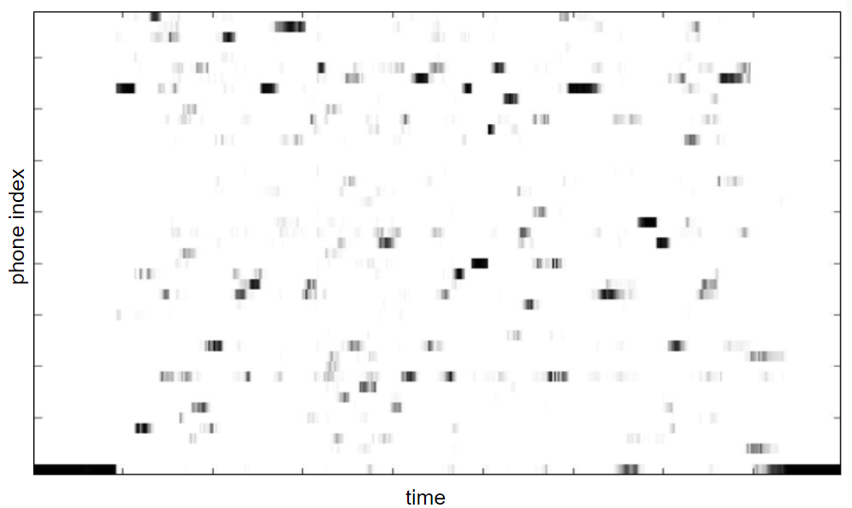
Neural network output visualization
The neural network output can be visualized. It is called posteriogram.
It will be sharp for the cross-entropy objective function
It will be less sharp for the MMI objective function
The probability will be high during the whole duration of the acoustic unit.

Slide 20
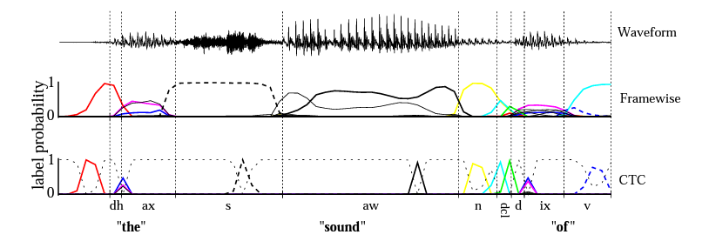
Connectionist Temporal Classification (CTC)
It is another objective function and framework for sequence classification instead of HMM/NN
It removes the need of pre-segmented training data (need of exact location of acoustic unit frames) and need of output postprocessing
The neural network informs about the acoustic unit only once during its duration by a high probability (the probability is not high during the whole duration)
Alex Graves: “Connectionist Temporal Classification: Labelling Unsegmented Sequence Data with Recurrent Neural Networks”

Slide 21
Connectionist Temporal Classification (CTC)
The neural network outputs probabilities of acoustic units and probability of a blank symbol for each frame
The blank symbol says “there is no acoustic unit at the moment”
The probability of a sequence of acoustic units is found by summing the probabilities over all possible alignments (remove repeated symbols, remove blank symbols):
a−ab− => aab
−aa−−abb => = aab
It is trained through similar Forward-Backward algorithm as HMM
There is a similarity with Lattice Free MMI (CTC does normalization per frame, LF-MMI per segment)

Slide 22
Neural network architectures
Factorized Time Delay Neural Network (more complex feed forward NN)
Recurrent Neural Network
LSTM, BLSTM
Neural networks with attentions

Slide 23
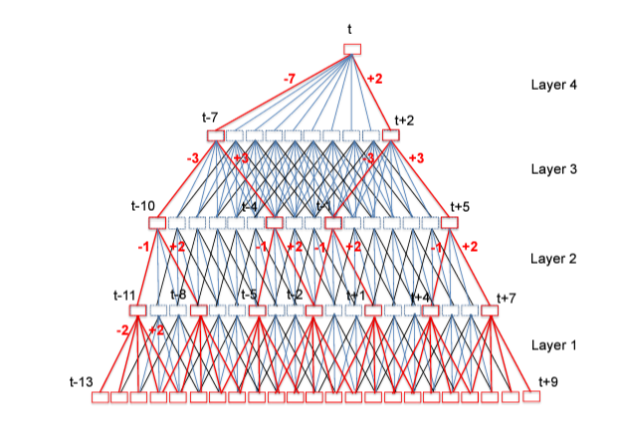
Factorized Time Delay Neural Network (TDNN-F)
The neural network sees a long temporal context
Each higher layer sees longer context
Matrix factorization is used to reduce the number of parameters and error
Vijayaditya Peddinti, at al: A time delay neural network architecture for efficient modeling of long temporal contexts “

Slide 24
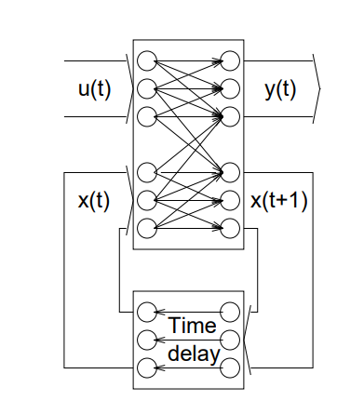
Recurrent Neural Network
Used in speech recognition for long time
Problem with Gradient Vanishing during training
How is the context information seen?
history
t=0
Tony Robinson: “The Use of Recurrent Neural Networks in Continuous Speech Recognition”

Slide 25
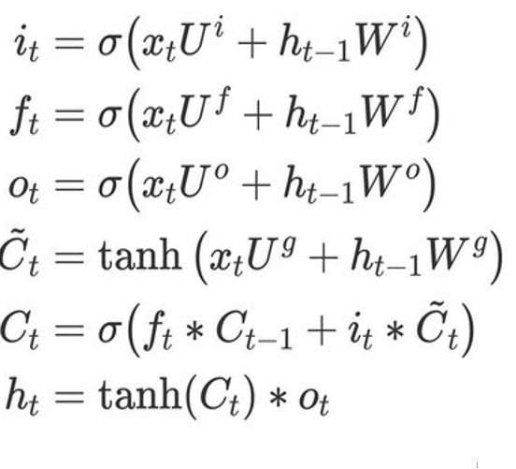
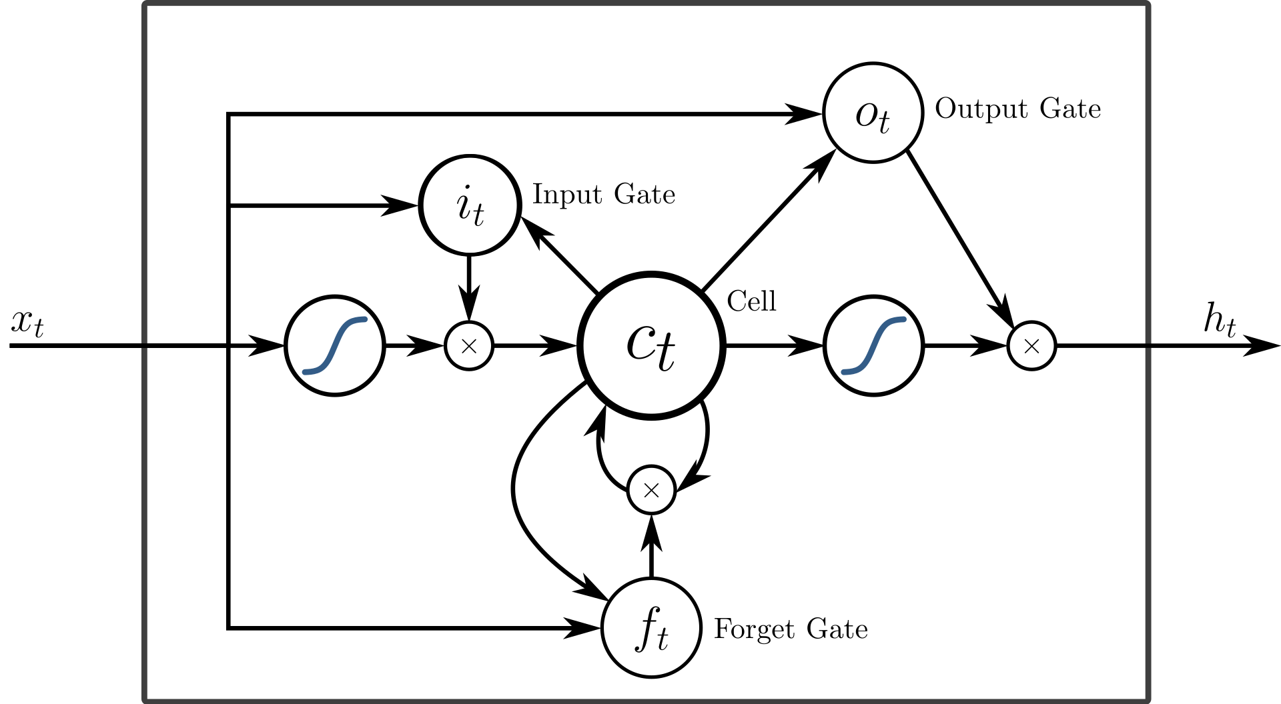
Long short-term memory (LSTM)
Can work better with longer contexts
The stored information is controlled by gates

Slide 26
Bidirectional long short-term memory (BLSTM)
The LSTM processes the data from past to the future
But if we have a recording, it is easy to change the direction
The bidirectional LSTM has one layer in forward direction and one layer in backward direction

Slide 27
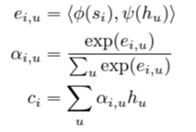
Neural networks with attentions
Can be seen as an evolution of LSTMs
Attention is a mechanism that enables us to focus on arbitrary place in the time (can be in input sequence of features, output sequence in sequence models, or both)
state vector
si
NN
Dot product
SoftMax
NN
Weights α
Weighted sum
averaged feature vector ci
with emphasized
important info
sequence of feature
vectors

Slide 28
Sequence to sequence modelling
We can use neural networks (for example RNNs) to convert one sequence of feature vectors to another
Encoder
Intermediate
representation
Decoder
Input sequence
Output sequence
X={x1,x2,…,xN}
H
Y={y1,y2,…,yM}

Slide 29
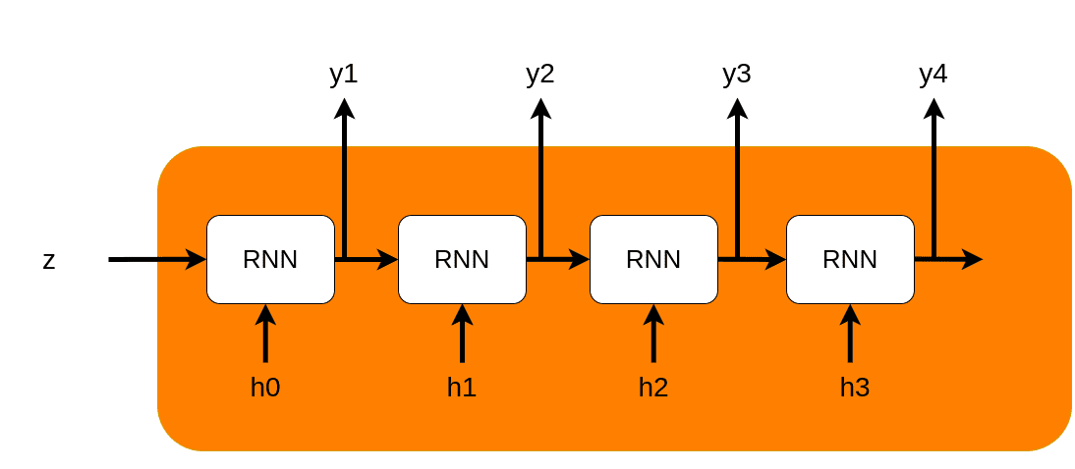
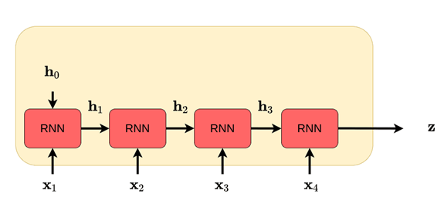
Sequence modelling
symbols
Decoder
Encoder
See https://theaisummer.com/attention/

Slide 30
Sequence to sequence modelling with attention
intermediate
representation
context vector
Encoder
Attention
Decoder
Input sequence
Output sequence
X={x1,x2,…,xN}
Y={y1,y2,…,yM}
state vector
output sequence

Slide 31
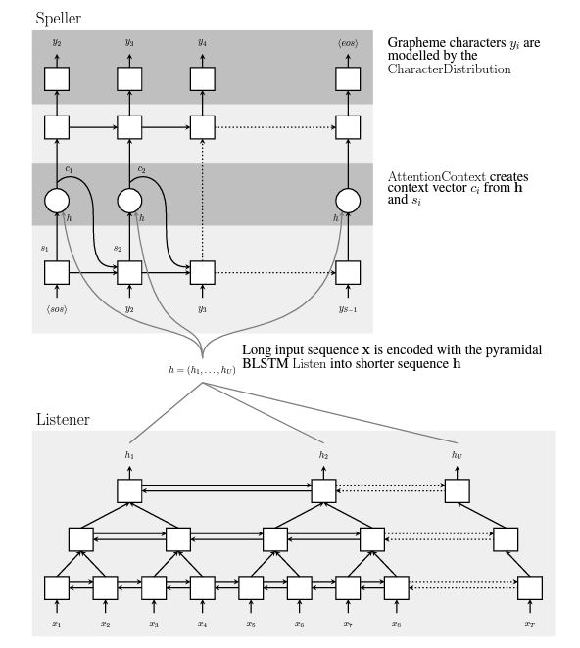

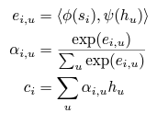
Listen, Attend and Spell ASR System
Speller produces for each output time step probability
distribution over output symbols P(yi|x,y<i)
Beam search is used to get the sequence
CharacterDistribution is MLP+SoftMax, RNN is 2 layer LSTM
The sequence is compressed to a fixed size vector
BLSTM with pyramid structure
Each higher layer reduces the resolution 2x (8x in total)
The reduction is done by vector concatenation

Slide 32
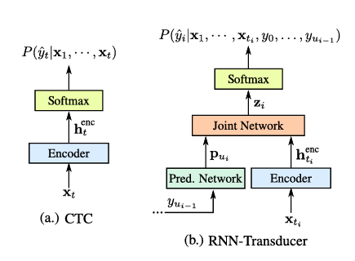
RNN-Transducer
Listen, Attend and Spell ASR System needs the whole recording for transcription
For dialog systems we need the transcript available online
Encoder (acoustic model) is 8 layers of LSTM
Prediction network (language model) is 2 layers LSTM
Joint Network is simple feed forward network
CTC like objective function is used
Beam search is used to get the word sequence
Yanzhang He, … “STREAMING END-TO-END SPEECH RECOGNITION FOR MOBILE DEVICES”

Slide 33
From phonemes to Byte pairs and World pieces
Current neural networks are strong enough to model context on the acoustic level
Context dependent phonemes and often also character to phoneme conversion are not needed any more
Neural networks are hardly usable for words – there are too may of them (few millions in Slavic languages like Czech)
Some systems work with characters
But something between characters and words may be needed
Now automatically derived units (based on character statistics) are popular
These are Byte pairs or Word pieces

Slide 34
Byte Pair Encoding (BPE)
BPE was originally a data compression algorithm that is used to find the best way to represent data by identifying the common byte pairs. It is now used in NLP to find the best representation of text using the least number of tokens.
  Add an identifier(</w>) at the end of each word to identify the end of a word and then calculate the word frequency in the text.
  Split the word into characters and then calculate the character frequency.
  From the character tokens, for a predefined number of iterations, count the frequency of the consecutive byte pairs and merge the most frequently occurring byte pairing.
  Keep iterating until you have reached the iteration limit(set by you) or if you have reached the token limit.

Slide 35
Word Piece Encoding
Introduced by Wu et al. in Google's Neural Machine Translation System: Bridging the Gap between Human and Machine Translation
WordPiece is a subword segmentation algorithm used in natural language processing. The vocabulary is initialized with individual characters in the language, then the most frequent combinations of symbols in the vocabulary are iteratively added to the vocabulary.
  Initialize the word unit inventory with all the characters in the text.
  Build a language model on the training data using the inventory from 1.
  Generate a new word unit by combining two units out of the current word inventory to increment the word unit inventory by one. Choose the new word unit out of all the possible ones that increases the likelihood on the training data the most when added to the model.
  Goto 2 until a predefined limit of word units is reached or the likelihood increase falls below a certain threshold.

Slide 36
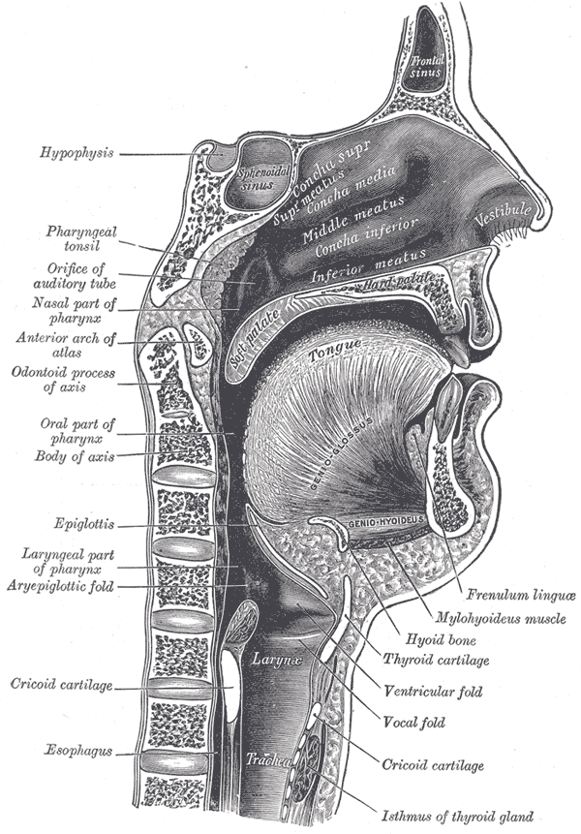
Pretraining – Wave2Vec 2.0
Audio with human transcription is very expensive to get
Can we learn something from large quantity of untranscribed speech and use it to improve the quality of speech recognizers?
=> We can learn how the human vocal tract can move and distortion of the signal during transmission between speaker and the listener
Image source: Wikipedia

Slide 37
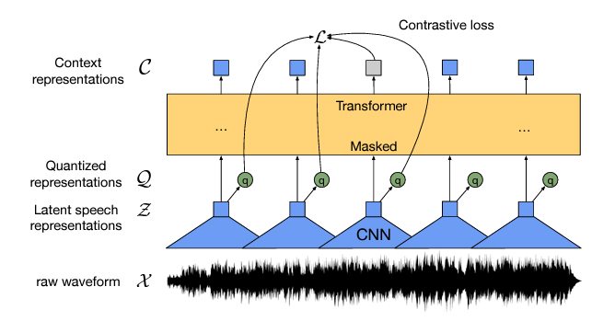


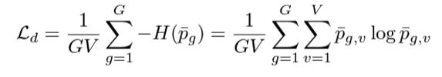
Pretraining – Wave2Vec 2.0
Loss function
Contrastive loss
Diversity loss
Learns a finite set of human vocal tract positions implicitly in a code book
The Transformer architecture is used
Convolutional networks are used as encoders
Masking is used in training similarly as in BERT

Slide 38
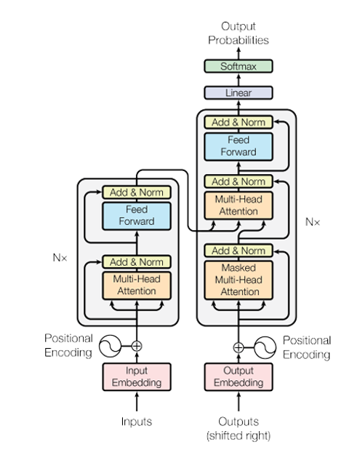
Transformer architecture

Slide 39
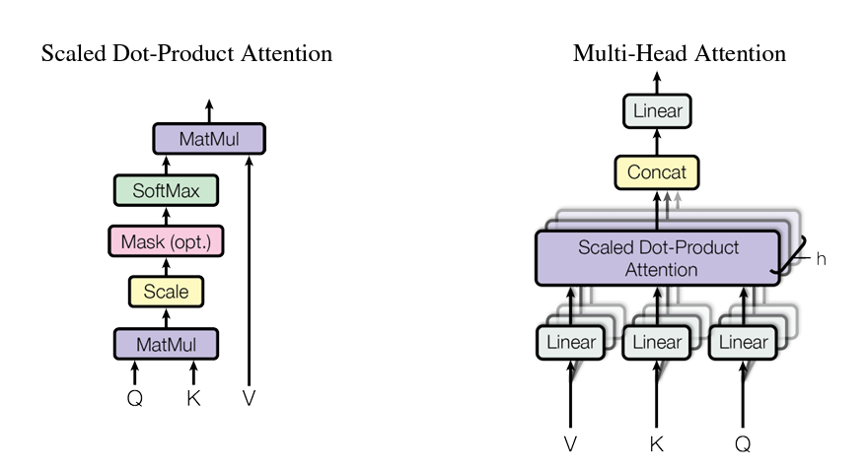


Attention in Transformers

Slide 40
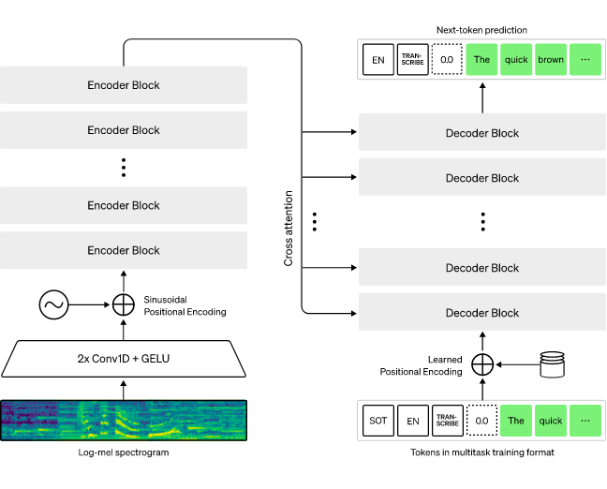
Whisper
680 000 hours of training data
97 languages
voice activity detection
language identification
transcription
translation to English
longer segments are spit into 30s chunks
per segment processing only

Slide 41
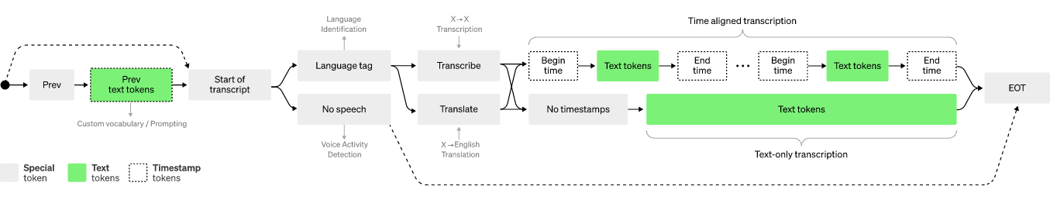
Whisper

Slide 42
Trends
Large language models (LLM)
New ASR architecture – self-supervisely trained acoustic model combined with LLMs
Shared (audio+text) representation models

Slide 43
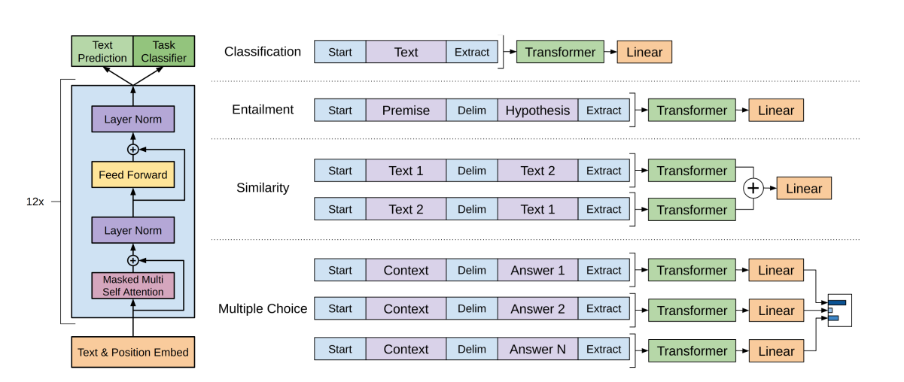
GPT - Generative Pre-trained Transformer

Slide 44

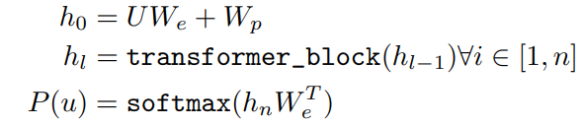





GPT - Generative Pre-trained Transformer
Unsupervised pretraining
  Corpus of tokens
  Implementation
  Objective
Supervised fine-tuning
Linear layer and Softmax added
Objective
Context vector
Adding unsupervised
criteria helps

Slide 45
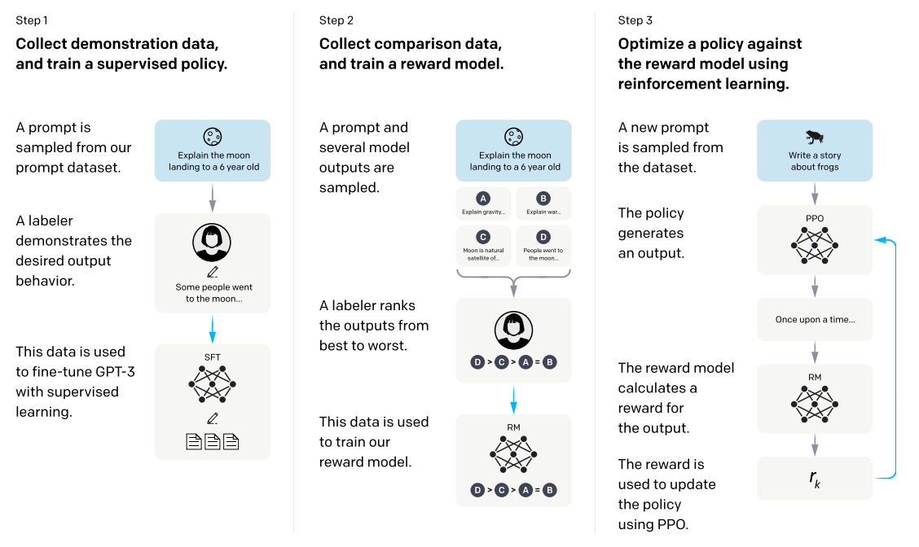
Instruct GPT / Chat GPT
Long Ouyang, et. al.: "Training language models to follow instructions with human feedback",
https://arxiv.org/abs/2203.02155

Slide 46
New ASR architecture - self supervisory trained acoustic model and LLMs
Large acoustic model is trained on some unlabeled acoustic data
Large language model is trained on some text data
Some adaptor (neural network) is trained on task specific audio data
Reaches stat-of-the-art performance
SSL trained large acoustic model
adaptor
LLM

Slide 47
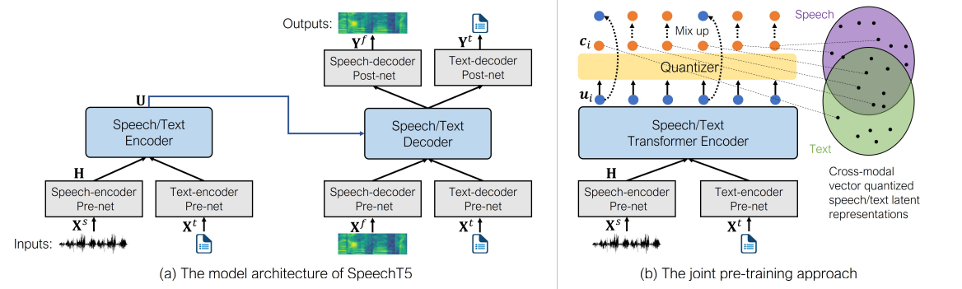
Shared (audio+text) representation models
Text and audio information is encoded to share the same semantic representation in the latent space, the representation can be multilingual
Architectures: Speech-T5 (Microsoft), LASER (Meta)
Many tasks can use the latent representation (intent recognition, sentiment analysis, named entity detection)

Slide 48
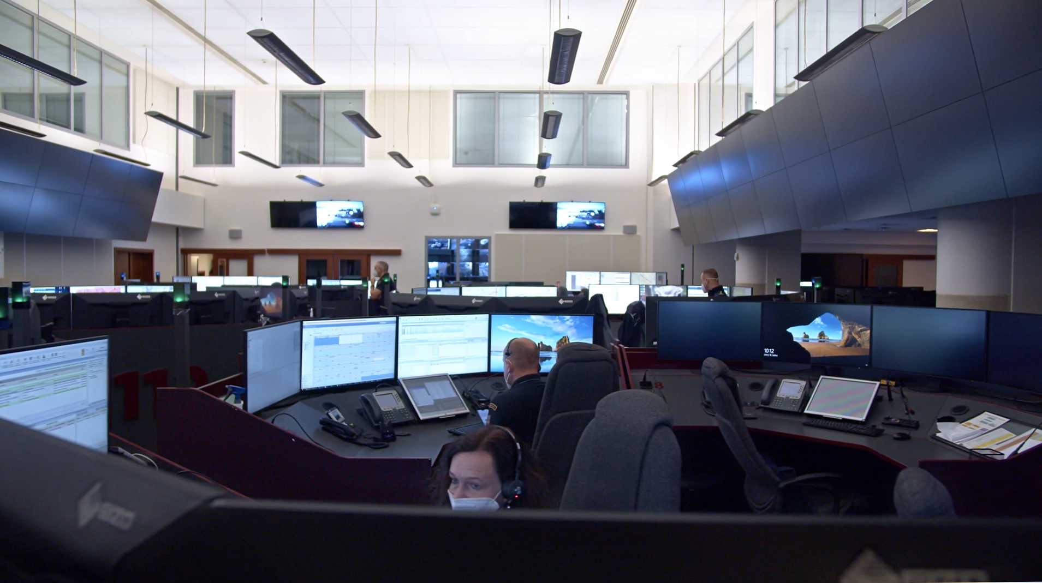
Project 112 – improve emergency lines using AI
Use case 1: The lines are overloaded during national wide natural disasters –> a voicebot can handle some repeated calls fully automatically
Use case 2: Callers tend share all the relevant info in first few seconds of calls, human operator is not capable to accept the information -> collaborate AI agent can help to the operator
Use case 3: There are more parallel calls for one emergency events, human is capable to process only one in time -> AI can help to merge information form parallel calls
Helpful technologies: Language ID, Translation, Voice biometry, Denoising

Slide 49
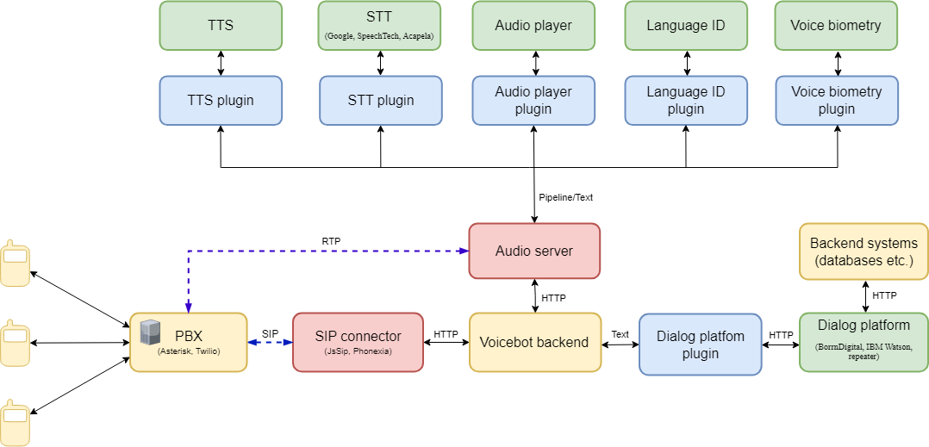
Fully open-source voice dialog platform

Slide 50

Research workshops
JSALT 2023 – how to get the dialog structure directly from data?
Brno Summer Workshop – planed for June

Slide 51
Possible diploma thesis
Extraction of key information from emergency calls using LLMs (Marek Sarvas)
Shared (audio+text) representation models instead od ASR (Dominik Bobos)
Finetuning of LLMs for target applications and tasks (using QLoRa)
Voice dialog system open-source run-time
Finetuning of ASR for emergency lines (have access to 5M of real recordings)
Work on supporting technologies (language ID, voice biometry, denoising, translation, echo cancelation …)

Slide 52
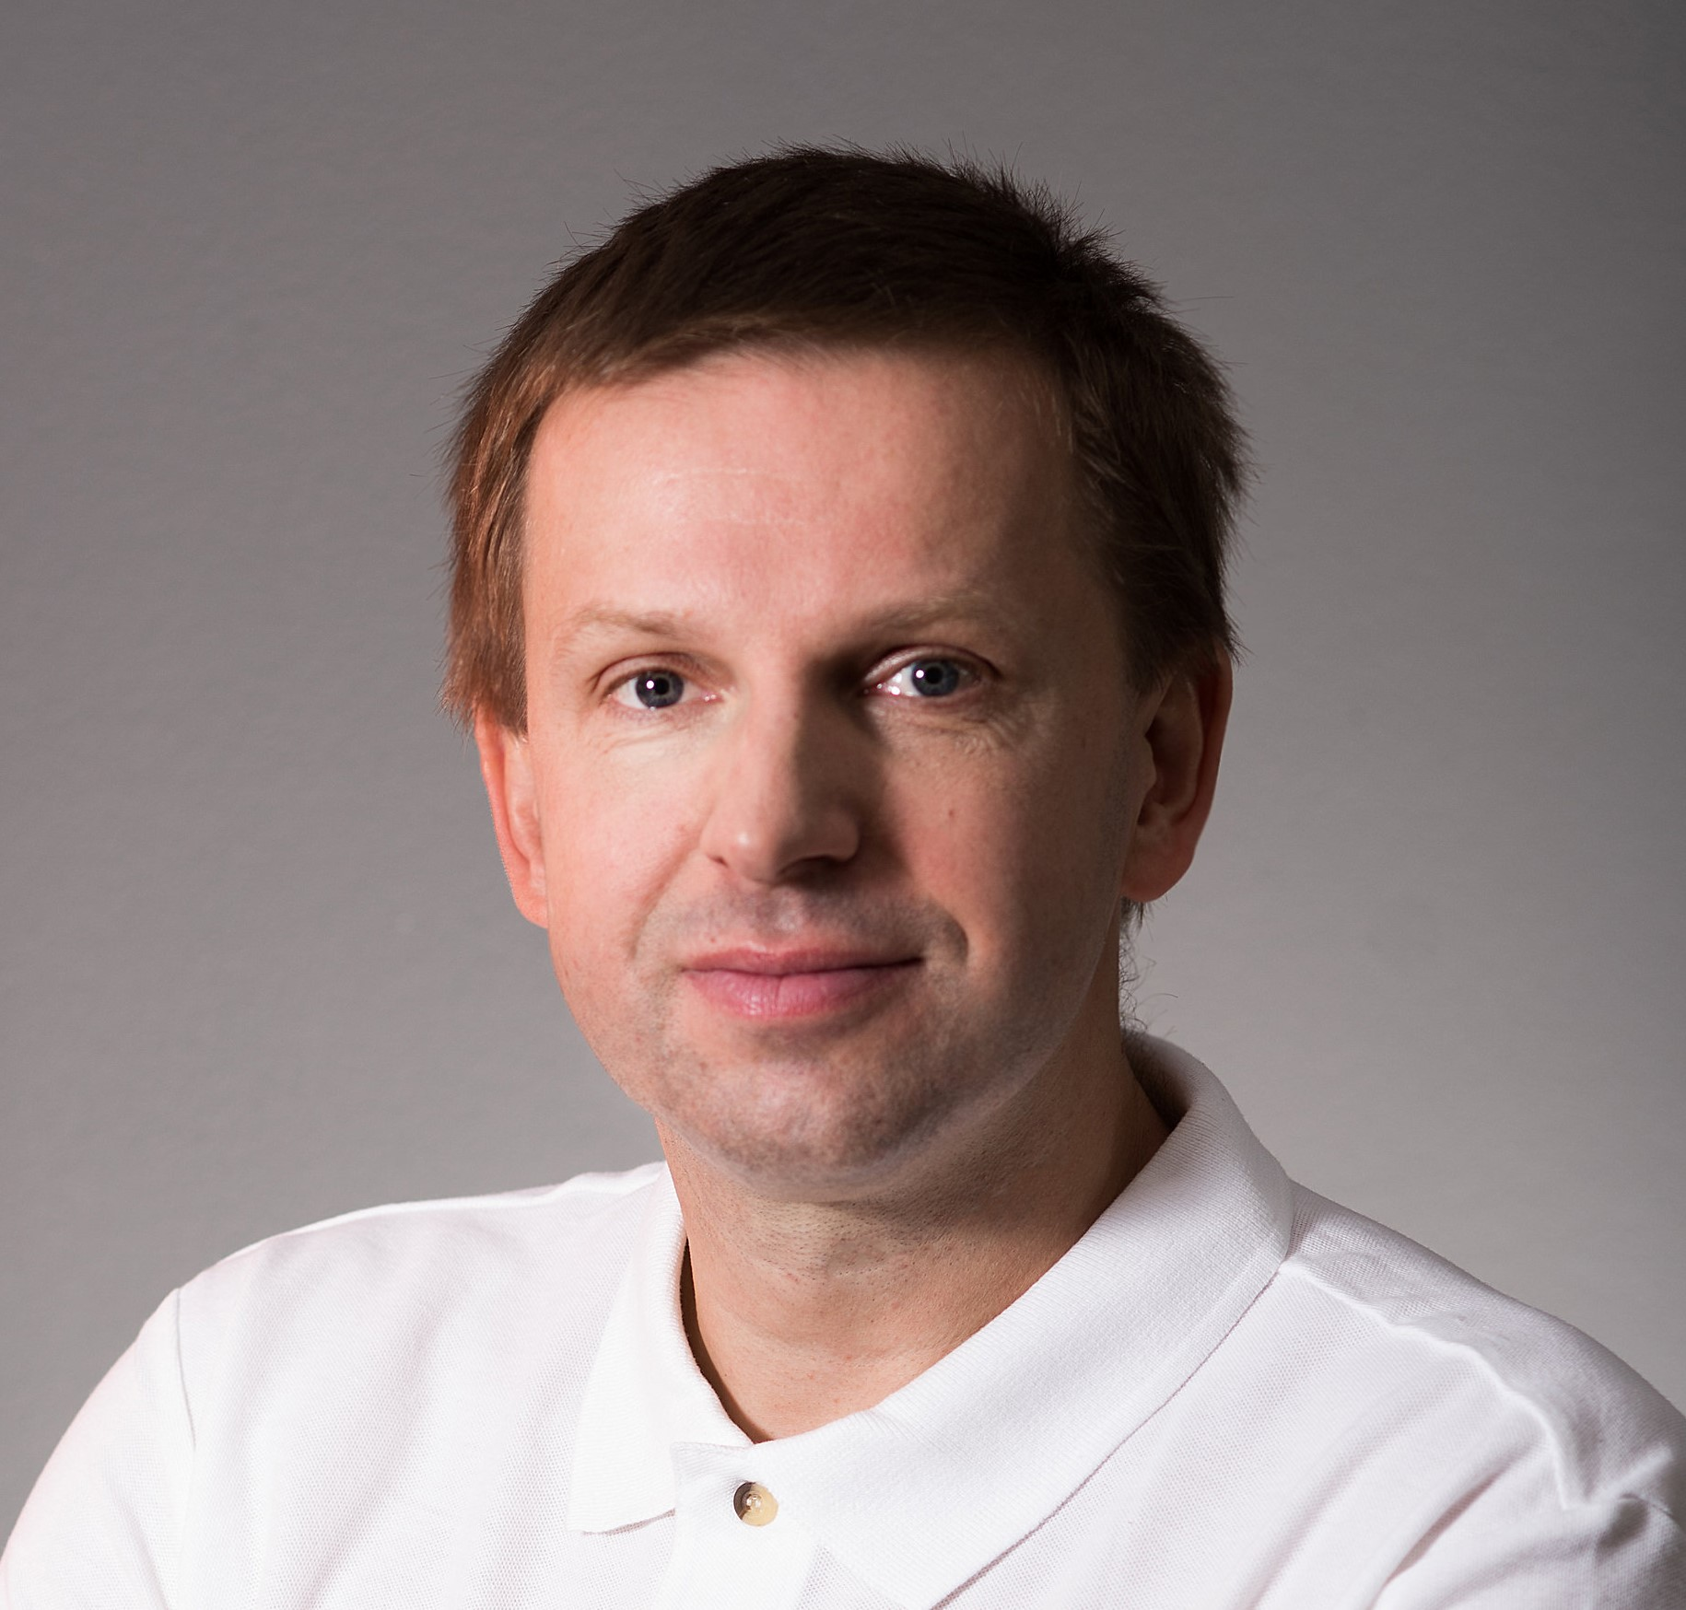
Thank you!
Petr Schwarz
schwarzp@fit.vutbr.cz

