Slide 1
Speaker Recognition
Oldřich Plchot, Pavel Matějka
Speech@FIT, Brno University of Technology, Czech Republic
{iplchot,matejkap}@fit.vutbr.cz
Brno

Slide 2
Agenda
Speaker recognition applications
  Why we need speaker recognition
  Different application domains
Background and theory
  Feature extraction
  Gaussian Mixture Modelling
  GMM-UBM base approach
  Eigen-channel compensation, JFA, PLDA
  DNN embeddings
Evaluation metrics
Score calibration and normalization
Conclusions

Slide 3
Speaker Recognition Applications
Security and defense
Forensic
Looking for suspect in quantity of audio
Waiting online for suspect
Access Control
Physical facilities
Computer networks & websites
Transaction Authentication
Telephone banking
Remote purchases
Speech Data Management
Voice mail browsing
Search in audio archives
Personalization
Voice-web/device customization
Intelligent answering machine

Slide 4
Biometrics
Biometric: a human generated signal or attribute for authenticating a person’s identity
Voice biometric can be combined with other forms to reach highest security
  Voice +
  Finger print
  Face, Iris
  Badge – your identification card
  PIN code, password
Voice is popular biometric
  Natural signal to produce
  Does not require a specialized input device
  Can be obtained remotely, without speaker assistance

Slide 5
Speech Modalities
Application dictates different speech modalities
Text-dependent
Text-independent
Recognition system knows text spoken by person
Example: fixed or prompted phrases
Used for applications with strong control over user
Knowledge of spoken text can improve system performance
Recognition system does not know text spoken by person
Example: User selected phrases, conversational speech
Used for applications with less or no control over user
More flexible system but more difficult problem
Speech recognition can provide knowledge of spoken text

Slide 6
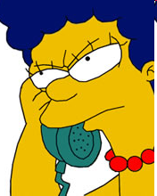
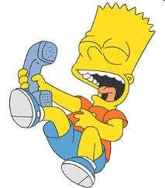
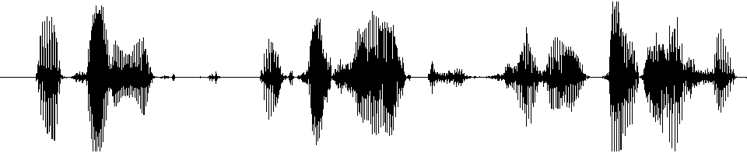
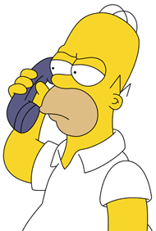
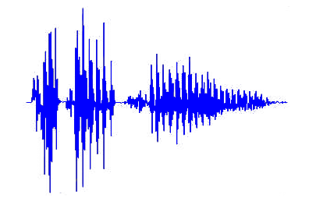
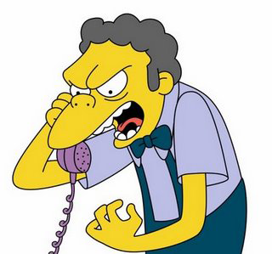
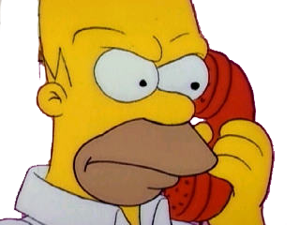
Speaker Recognition Tasks
Identification
Verification
Whose voice is this?
Is this Homer’s voice?
?
?
?
?
?
Segmentation and Clustering
Where are speaker changes? Which segments are from the same speaker?

Slide 7
Agenda
Speaker recognition applications
  Why we need speaker recognition
  Different application domains
Background and theory
  Feature extraction
  Gaussian Mixture Modelling
  GMM-UBM base approach
  Eigen-channel compensation, JFA, PLDA
Evaluation metrics
Score calibration and normalization
Conclusions

Slide 8
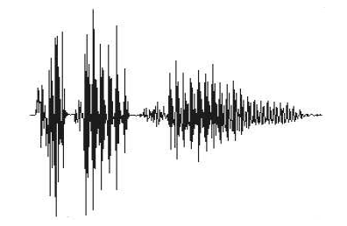
Basic structure of the system – Likelihood ratio
Speaker detection decision approaches have roots in signal detection theory
2 class Hypothesis test
H0: the speaker is not the target speaker
H1: the speaker is the target speaker
Statistic computed on test utterance S as likelihood ratio
Λ = log
Likelihood S came from speaker model
Likelihood S did not come from speaker model
Speaker
Model
S
+
Λ>0 accept
Feature
Extraction
Λ
Σ
Decision
Λ<0 reject
-
Background
Model

Slide 9
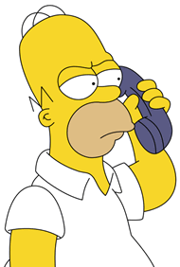
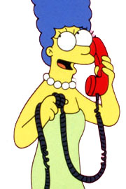
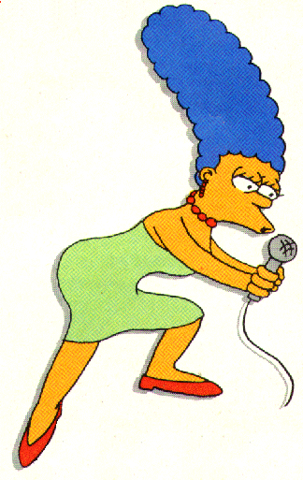

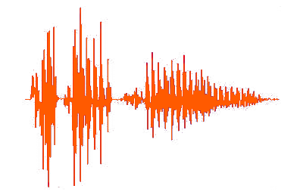
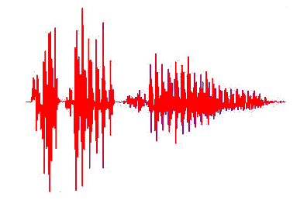
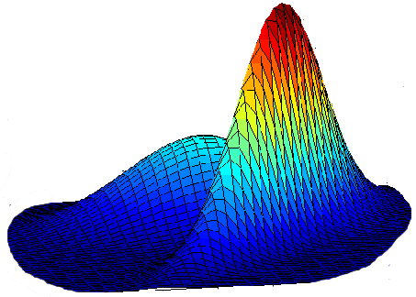
Phases of Speaker Detection System
Two distinct phases to any speaker detection system
Training phase
Homer
Feature
Extraction
Model
Training
Marge
Detection phase
Feature
Extraction
Detection
Decision
Detected
Hypothesized identity - Marge

Slide 10
Features for Speaker Recognition
Humans use several levels of perceptual cues for speaker recognition
There are no exclusive speaker identity clues
Hierarchy of Perceptual Cues
Difficult to
automatically
extract
High-level cues
(learned traits)
Semantics, idiolect, pronunciations, idiosyncrasies | Socio-economic status, education, place of birth
Prosodics, rhythm, speed intonation, volume modulation | Personality type, parental influence
Acoustic aspects of speech, nasal, deep, breathy, rough | Anatomical structure of vocal apparatus
Low-level cues
(physical traits)
Easy to
automatically
extract

Slide 11
Features for Speaker Recognition
Desirable attributes of features for an automatic system (Wolf 72)
No features has all these attributes
Features derived from spectrum of speech have proven to be the most effective in automatic systems
Occur naturally and frequently in speech
Easily measurable
Not change over time or be affected by speaker health
Not be affected by reasonable background noise nor depend on specific transmission characteristics
Not be subject to mimicry
Practical
Robust
Secure

Slide 12
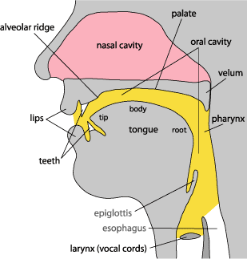

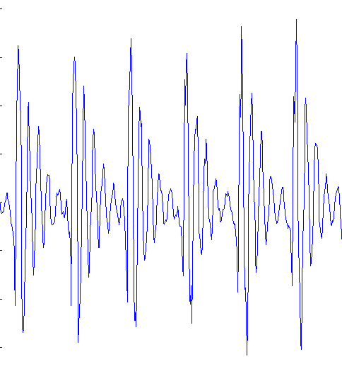
Speech production
Speech production model: anatomical structure
Glottal pulses
Time (sec)
Speech signal
Time (sec)

Slide 13
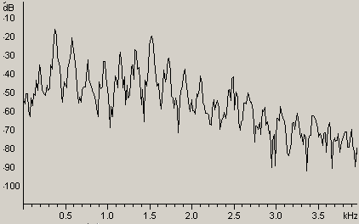
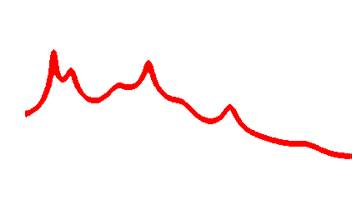
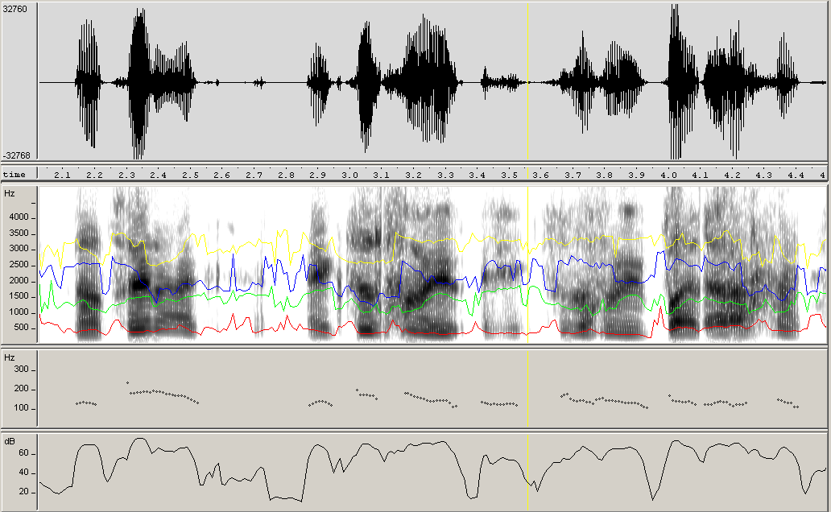
Audio Analysis
Audio
Spectrogram + formants
Pitch
Energy

Slide 14
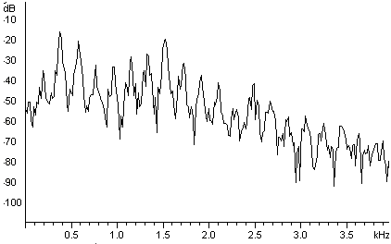
Spectral features - MFCC
20ms
10ms
-12.8
-0.3
-5.7
-22.4
8.9
6.8
…
-11.2
0.4
-4.7
-13.0
2.3
4.5
…
Short-time
FFT
Mel - Filter Bank
Log ()
Discrete Cosine Transform

Slide 15
MAP adaptation – How to create speaker model
Target speaker data
UBM
UBM model - 2 Gaussians
Speaker model adapted from UBM
  Adapted only parameters seen in target training data
  Only means adapted
  μ_{tgt} = γ μ_{trn} + (1- γ) μ_{ubm} ; γ = n/(n+r)
  n … number of target training data
  r … relevance factor – for speaker id. usually 10-19

Slide 16
Channel/session effects
The largest challenge to practical use of speaker detection systems is channel/session variability
Variability – refers to changes in channel between training and successive detection attempts
Channel/session effects encompasses several factors
  The microphones
    Carbon-button, electret, hands-free, array, …
  The acoustic environment
    Office, car, airport, street, restaurant, …
  The transmission channel
    Landline, cellular, VoIP,…
  Speaker emotion state
    Calm, nervous, stress, drunk, ill, …

Slide 17
Inter-session variability
Target speaker model
UBM
High inter-speaker variability
High inter-session variability

Slide 18
Inter-session variability compensation
Target speaker model
Test data
For recognition, move both models along the high inter-session variability direction(s) to fit well the test data
UBM
High inter-speaker variability
High inter-session variability

Slide 19

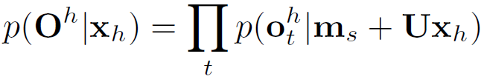
Eigenchannel adaptation for GMM
Speaker model (mean supervector) m_{s} obtained in usual way by MAP-adapting UBM
For verification, adapt speaker model (and UBM) to the channel of test utterance h by moving m_{s} in the eigenchannel subspace U to fit well the test data → find factors x_{h} maximizing likelihood of test data
The score is LLR computed using the adapted speaker model and UBM
μ₁
μ₂
μ₁
μ₂
μ₁
μ₂
m₁
m₂
m₁
m₂
m₁
m₂
u₁₁ u₁₂
u₂₁ u₂₂
u₁₁ u₁₂
u₂₁ u₂₂
u₁₁ u₁₂
u₂₁ u₂₂
u₁₃
u₂₃
u₁₃
u₂₃
u₁₃
u₂₃
x₁
x₂
x₃
=
+
N. Brümmer, Spescom DataVoice NIST 2004 system description, in Proc. NIST Speaker Recognition Evaluation 2004, Toledo, Spain, Jun. 2004
Notes:
19

Slide 20
Identifying high intersession variability directions
supervectors of speaker 1
Take recordings from many speakers each recorded under several different channel conditions. For each recording, derive supervector by MAP adapting UBM.
From each supervector, subtract mean computed over supervectors of corresponding speaker.
Find directions with the largest intersession variability using PCA (eigen vectors of the average within speaker covariance matrix).
speaker 2
speaker 3
Eigenchannel U

Slide 21


Towards Joint Factor Analysis
So far, we have considered only dimensions with high channel variability to adapt a model to the channel of a test utterance…
…how about considering high speaker variability dimensions to appropriately adapt model to a speaker?
Speaker factors
Eigenvoices
Speaker represented by low dimensional vector y_{s}
Similar to eigenvoice adaptation in ASR, but for speaker ID it is effective only together with eigenchannels
Inspiration for Povey’s Subspace GMM for LVCSR
UBM
High speaker variability
High inter-session variability

Slide 22
Towards Joint Factor Analysis (continued)
Speaker supervector
Speaker independent component
Speaker dependent component
Channel dependent component
Speaker verification:
  both speaker factors y and channel factors x are estimated on enrollment data.
  only channel factors x are updated for test data to adapt speaker model to test channel condition
Model parameters {m, V, U} are estimated on recordings of many speakers each recorded in several sessions:
  parameters {m, V, U} and speaker/channel factors y, x are iteratively re-estimated to maximize likelihood of training data
  speaker factors y are constrained to be the same for all recordings of the same speaker; different channel factors x are estimated for each recording

Slide 23

Joint Factor Analysis
So far we have limited the number of free parameters by forcing speaker model parameters μ to live in subspace defined by V and U.
Now, we move to fully probabilistic model describing distribution of μ (in the subspace)
Let y and x be random vectors with standard normal priors. Then
is Gaussian distributed with mean m and VV^{T} and UU^{T} are covariance matrices describing across-speaker and within-speaker variability, respectively (i.e. basis of V and U now also describe amounts of speaker and channel variability in their directions).
To allow μ to live outside of the subspace defined by V and U, we can optionally add one more term:
where z is again normal distributed and D is diagonal matrix describing residual speaker variability in individual dimensions (i.e. we have applied factor analysis to model variability of speaker model parameters μ).
P. Kenny et al.: A Study of Inter-Speaker Variability in Speaker Verification IEEE TASLP, July 2008.

Slide 24
Quiz
Lets make a small quiz, for better imagination what is the channel effect
I chose different modality since it is easier to show it on – face recognition from picture
Speech quiz will come later in the talk

Slide 25
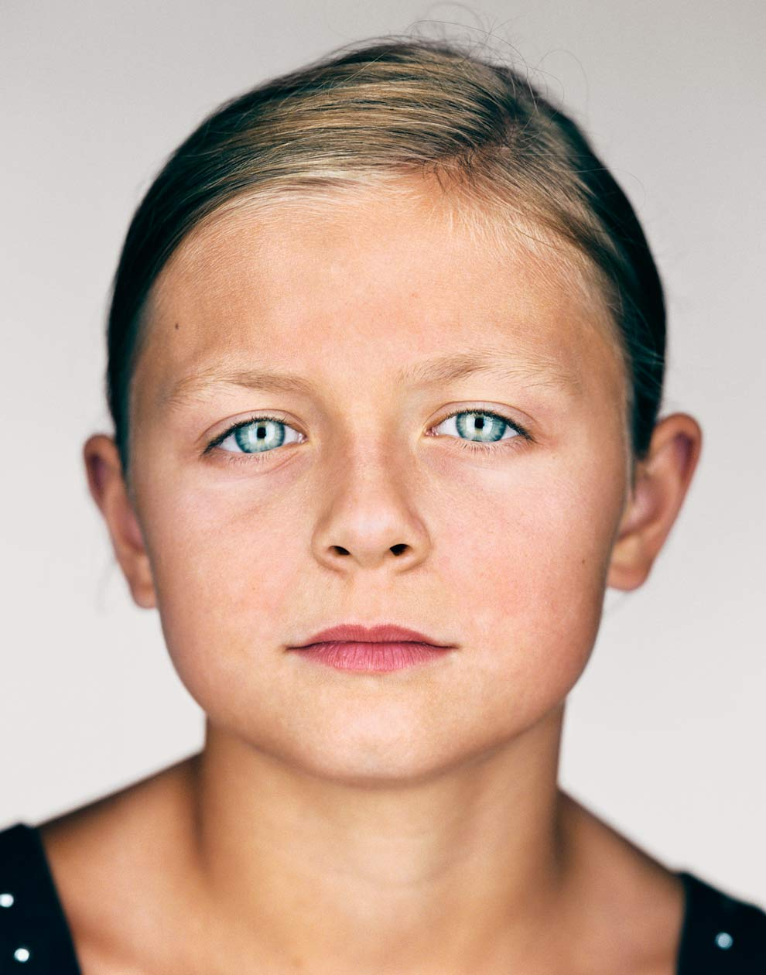
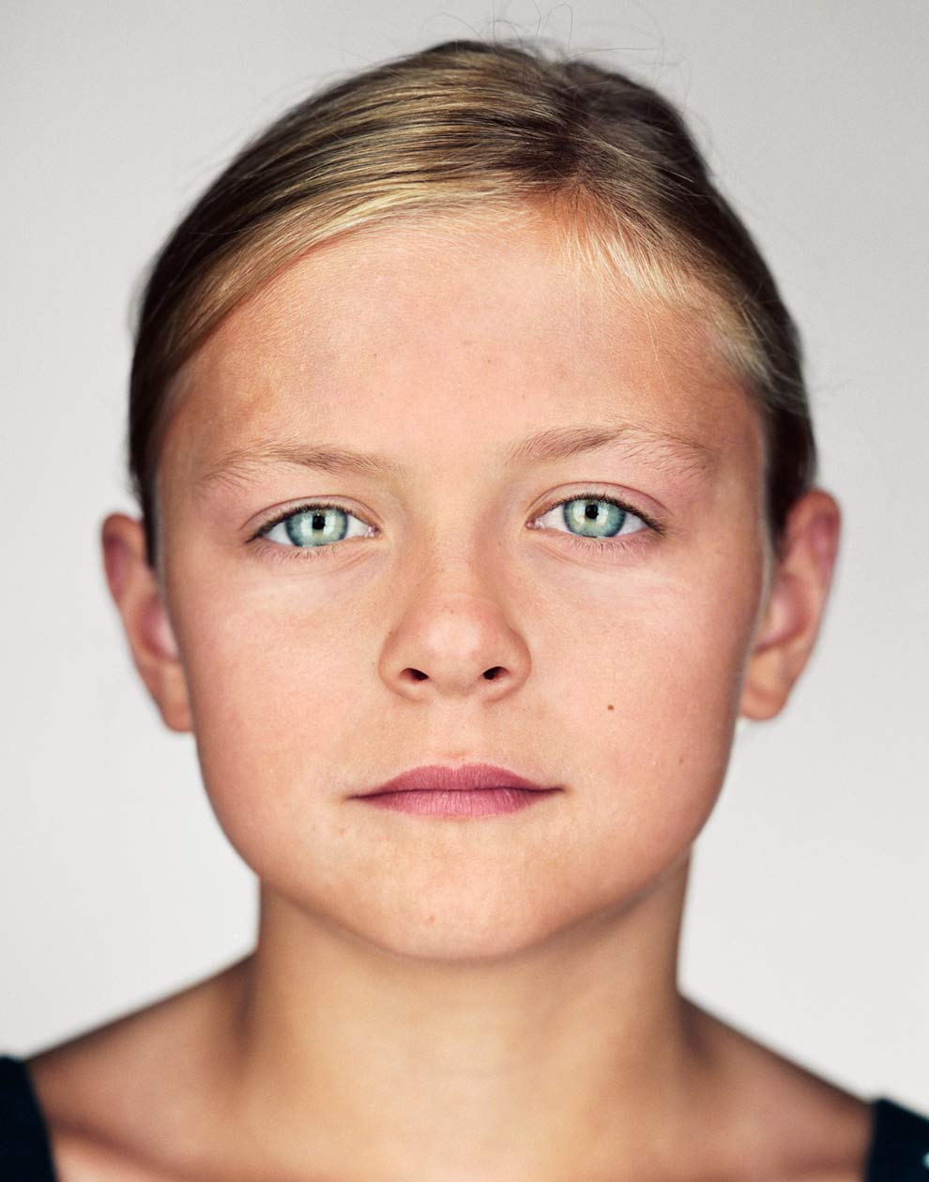
Quiz - Is this a same person?
Is this a same person?
Emily
Kate
http://ngm.nationalgeographic.com/2012/01/twins/schoeller-photography#/5

Slide 26
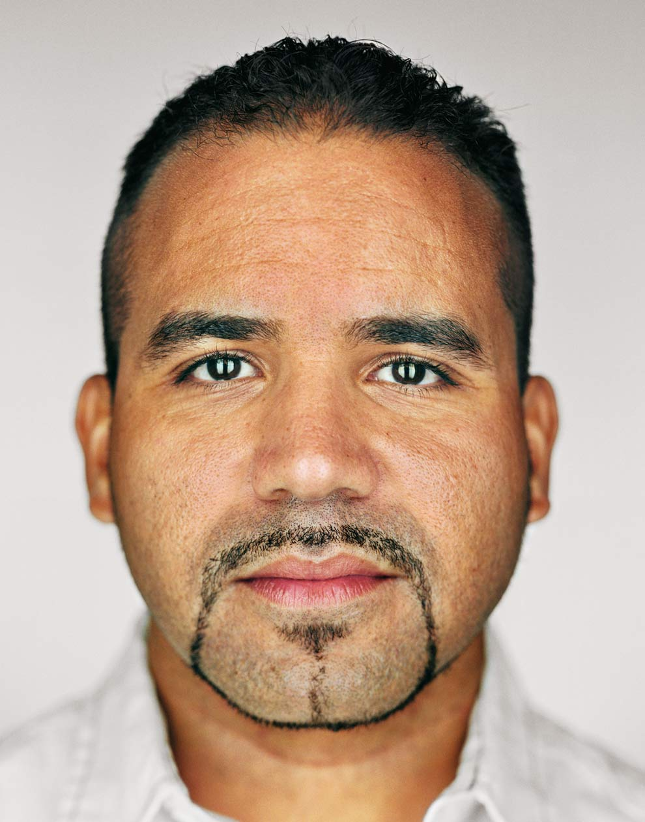
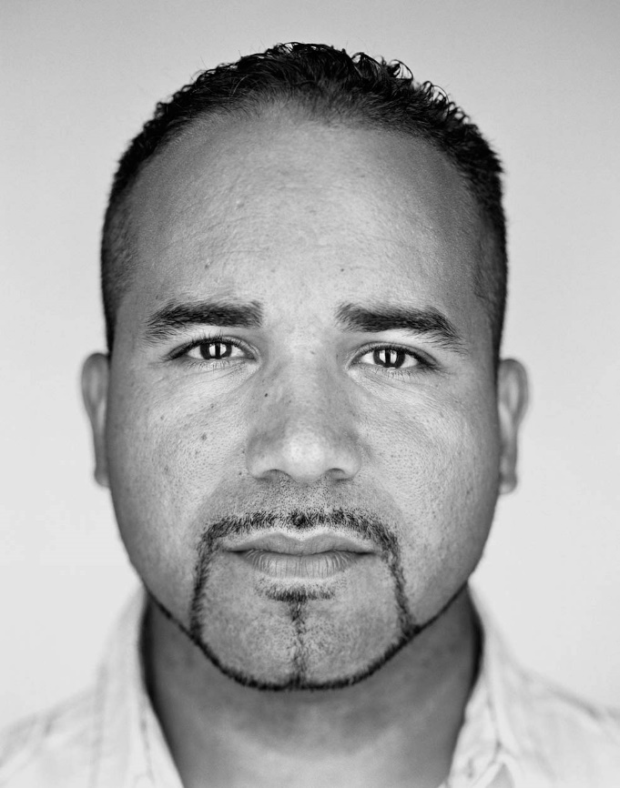
Quiz - Is this a same person?
Lets add one dimensional “channel” effect.
Eurides
Ramon
http://ngm.nationalgeographic.com/2012/01/twins/schoeller-photography#/3

Slide 27
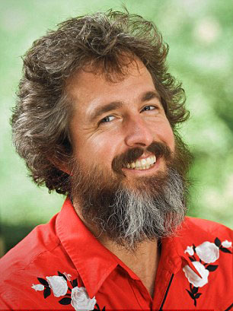
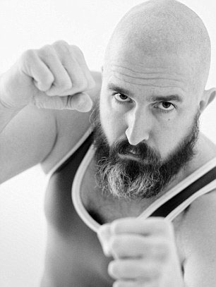
Quiz - Is this a same person?
Lets make it real.
Gordon
Gordon
http://www.dailymail.co.uk/news/article-2173486/How-different-man-look-Hilarious-portraits-photographer-Gordon-Stettinius-lesson-bad-taste.html

Slide 28
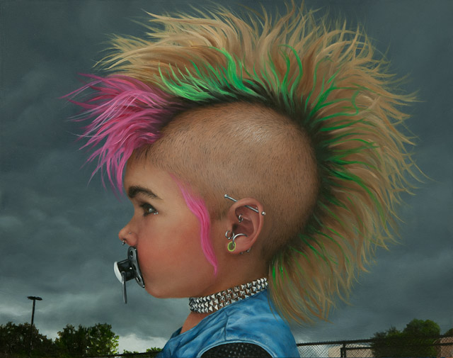
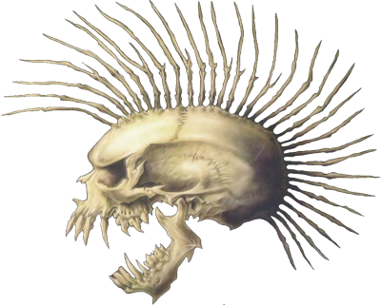
Quiz - Is this a same person?
And even harder – Aging effect – Case for experts only.
????
????
Sorry, I’m NOT that big experts.

Slide 29
Transition to i-vectors
Eigen-{voice,channel} adaptation – compensating for speaker and channel variability, moving the model parameters in the subspace of given variability
Joint Factor Analysis – representing also the speaker variability in a sub-space
Both techniques identify the low-dimensional subspace(s) which are important for modeling
Use only the notion of representing the recording by fixed-length low-dimensional vector => i-vectors
Channel compensation still to be done in the i-vector space.

Slide 30
Eigenchannel adaptation for GMM
Allows to move mean supervector in the directions with large channel variability
Mixture weights and covariance matrices are fixed.
Eigenchannels
UBM or MAP-adapted speaker model
Channel factors
μ₁
μ₂
μ₁
μ₂
μ₁
μ₂
m₁
m₂
m₁
m₂
m₁
m₂
u₁₁ u₁₂
u₂₁ u₂₂
u₁₁ u₁₂
u₂₁ u₂₂
u₁₁ u₁₂
u₂₁ u₂₂
u₁₃
u₂₃
u₁₃
u₂₃
u₁₃
u₂₃
+
μ
x₁
x₂
x₃
=
+
+
μ
+
μ
Notes:
30

Slide 31
Eigenchannel adaptation for GMM
μ₁
μ₂
μ₁
μ₂
μ₁
μ₂
m₁
m₂
m₁
m₂
m₁
m₂
u₁₁ u₁₂
u₂₁ u₂₂
u₁₁ u₁₂
u₂₁ u₂₂
u₁₁ u₁₂
u₂₁ u₂₂
u₁₃
u₂₃
u₁₃
u₂₃
u₁₃
u₂₃
x₁
x₂
x₃
=
+
Notes:
31

Slide 32
Eigenchannel adaptation for GMM
μ₁
μ₂
μ₁
μ₂
μ₁
μ₂
m₁
m₂
m₁
m₂
m₁
m₂
u₁₁ u₁₂
u₂₁ u₂₂
u₁₁ u₁₂
u₂₁ u₂₂
u₁₁ u₁₂
u₂₁ u₂₂
u₁₃
u₂₃
u₁₃
u₂₃
u₁₃
u₂₃
x₁
x₂
x₃
=
+
Notes:
32

Slide 33
Eigenchannel adaptation for GMM
μ₁
μ₂
μ₁
μ₂
μ₁
μ₂
m₁
m₂
m₁
m₂
m₁
m₂
u₁₁ u₁₂
u₂₁ u₂₂
u₁₁ u₁₂
u₂₁ u₂₂
u₁₁ u₁₂
u₂₁ u₂₂
u₁₃
u₂₃
u₁₃
u₂₃
u₁₃
u₂₃
x₁
x₂
x₃
=
+
Notes:
33

Slide 34
Eigenchannel adaptation for GMM
μ₁
μ₂
μ₁
μ₂
μ₁
μ₂
m₁
m₂
m₁
m₂
m₁
m₂
u₁₁ u₁₂
u₂₁ u₂₂
u₁₁ u₁₂
u₂₁ u₂₂
u₁₁ u₁₂
u₂₁ u₂₂
u₁₃
u₂₃
u₁₃
u₂₃
u₁₃
u₂₃
x₁
x₂
x₃
=
+
Notes:
34

Slide 35
Eigenchannel adaptation for GMM
μ₁
μ₂
μ₁
μ₂
μ₁
μ₂
m₁
m₂
m₁
m₂
m₁
m₂
u₁₁ u₁₂
u₂₁ u₂₂
u₁₁ u₁₂
u₂₁ u₂₂
u₁₁ u₁₂
u₂₁ u₂₂
u₁₃
u₂₃
u₁₃
u₂₃
u₁₃
u₂₃
x₁
x₂
x₃
=
+
Notes:
35

Slide 36
Eigenchannel adaptation for GMM
μ₁
μ₂
μ₁
μ₂
μ₁
μ₂
m₁
m₂
m₁
m₂
m₁
m₂
u₁₁ u₁₂
u₂₁ u₂₂
u₁₁ u₁₂
u₂₁ u₂₂
u₁₁ u₁₂
u₂₁ u₂₂
u₁₃
u₂₃
u₁₃
u₂₃
u₁₃
u₂₃
x₁
x₂
x₃
=
+
Notes:
36

Slide 37
Eigenchannel adaptation for GMM
μ₁
μ₂
μ₁
μ₂
μ₁
μ₂
m₁
m₂
m₁
m₂
m₁
m₂
u₁₁ u₁₂
u₂₁ u₂₂
u₁₁ u₁₂
u₂₁ u₂₂
u₁₁ u₁₂
u₂₁ u₂₂
u₁₃
u₂₃
u₁₃
u₂₃
u₁₃
u₂₃
x₁
x₃
x₂
=
+
Notes:
37

Slide 38
Eigenchannel adaptation for GMM
μ₁
μ₂
μ₁
μ₂
μ₁
μ₂
m₁
m₂
m₁
m₂
m₁
m₂
u₁₁ u₁₂
u₂₁ u₂₂
u₁₁ u₁₂
u₂₁ u₂₂
u₁₁ u₁₂
u₂₁ u₂₂
u₁₃
u₂₃
u₁₃
u₂₃
u₁₃
u₂₃
x₁
x₂
=
+
x₃
Notes:
38

Slide 39
Eigenchannel adaptation for GMM
μ₁
μ₂
μ₁
μ₂
μ₁
μ₂
m₁
m₂
m₁
m₂
m₁
m₂
u₁₁ u₁₂
u₂₁ u₂₂
u₁₁ u₁₂
u₂₁ u₂₂
u₁₁ u₁₂
u₂₁ u₂₂
u₁₃
u₂₃
u₁₃
u₂₃
u₁₃
u₂₃
x₁
x₃
x₂
=
+
Notes:
39

Slide 40
Eigenchannel adaptation for GMM
μ₁
μ₂
μ₁
μ₂
μ₁
μ₂
m₁
m₂
m₁
m₂
m₁
m₂
u₁₁ u₁₂
u₂₁ u₂₂
u₁₁ u₁₂
u₂₁ u₂₂
u₁₁ u₁₂
u₂₁ u₂₂
u₁₃
u₂₃
u₁₃
u₂₃
u₁₃
u₂₃
x₁
=
+
x₂
x₃
Notes:
40

Slide 41
Current verification approach
  Given a example recording of a speakers, detect recordings of the same speaker.
  Given a pair of recordings (trial), decide whether these are recordings of the same speaker or two different speakers.
Feature
Extraction
training
Feature
Extraction
enrollment recording
Speaker
Model
Speaker
Model
Feature
Extraction
Feature
Extraction
Decision
Decision
Universal Background
Model
test recording
Universal Background
Model
Feature
Extraction
Same Speaker
Hypothesis
Feature
Extraction
Speaker
Model
recording 1
Decision
Decision
Feature
Extraction
Different Speakers Hypothesis
Feature
Extraction
Different Speakr Model
recording 2

Slide 42

iVectors – low-dimensional recording representation
The main idea is to transform large utterance-specific GMM supervector into a small subspace while retaining most of the variability
iVector extractor is model similar to JFA
  with single subspace T ➔ easier to train
  no need for speaker labels ➔ the subspace can be trained on large amount of unlabeled recordings
low-dimensional (typically 200-600 dimensions)
i-vector is information rich
  contains information about speaker, language, emotion, … and also channel ➔ needs to be considered by the following classifier.
We assume standard normal prior for factors i.
Estimate the i-vector -- MAP point estimate of i, for every recording
Dehak, N., et al., Support Vector Machines versus Fast Scoring in the Low-Dimensional Total Variability Space for Speaker Verification, In Proc Interspeech 2009, Brighton, UK, September 2009

Slide 43

Probabilistic Linear Discriminant Analysis (PLDA)
What would be now the appropriate probabilistic model for verification?
  i-vector still contains channel information ➔ our model should consider both speaker and channel variability, just like in JFA.
Natural choice is simplified JFA model with only single Gaussian. Such model is known as PLDA and is described by familiar equation:
However, this equation now describes directly the variability of observed data – i-vectors (not variability of mean supervectors like in JFA).
Parameters μ, V, U and diagonal covariance matrix of residual noise vector є can be estimated using EM algorithm.
Notes:
43

Slide 44
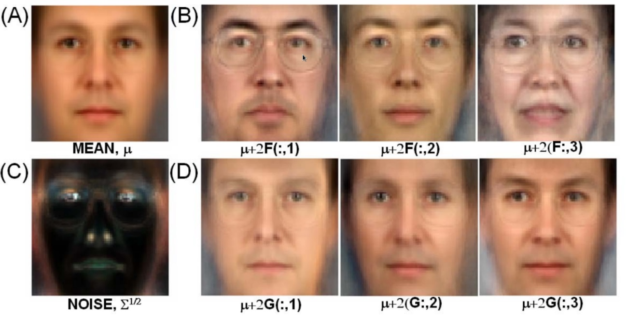
PLDA continued
  PLDA has nice interpretation in face verification where it was introduced by Simon J.D. Prince
  Each face image i can be constructed by adding
    (A) mean face μ
    (B) linear combination of basis V corresponding to between-individual variability (moving from μ in these directions gives us images that look like different people)
    (D) linear combination of basis U corresponding to within-individual variability (moving from μ in these directions gives us images that look like the same person under different condition – e.g. lighting)
    (C) residual noise vector є
Picture taken from: S.J.D. Prince and J.H. Elder, “Probabilistic linear discriminant analysis for inferences about identity,” ICCV, 2007
Notes:
44

Slide 45
PLDA based verification
Verification based on Bayesian model comparison
Compare likelihoods for two hypothesis:
    H_{s} – both recordings come from the same speaker
    H_{d} – recordings come from different speakers
Feature
Extraction
Same Speaker
Model
Feature
Extraction
Speaker
Model
recording 1
Decision
Decision
Feature
Extraction
Different Speakers Model
Feature
Extraction
Different Speakr Model
recording 2
It is symmetrical problem
We do not need to train explicitly the speaker model and compare to each test recording which was done before
Scoring with PLDA is FAST!!

Slide 46
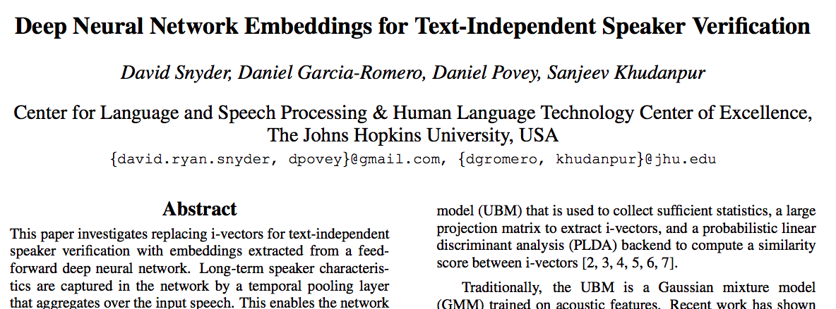
Embeddings for Speaker Recognition
David Snyder et al., INTERSPEECH 2017

Slide 47
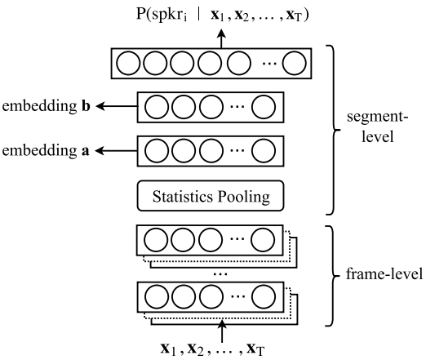
Embeddings - architecture
DNN architecture:
  7 layers before pooling
  Time-delay architecture (TDNN)
  Stats: mean and std
  Embeddings: 512 and 300
  Softmax output: 4733 speakers
  Trained with samples between 2 and 10 seconds
  Kaldi (GPU)

Slide 48
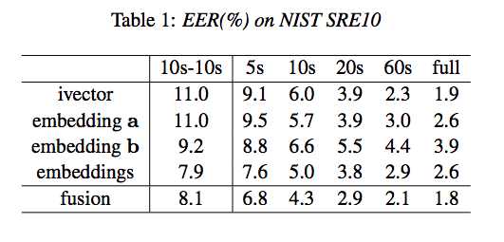
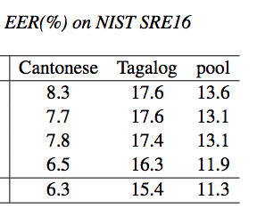
Embeddings - results
Results on NIST SRE’10 and SRE’16
Best results:
  Concatenate embeddings a and b
  Especially, on short durations

Slide 49
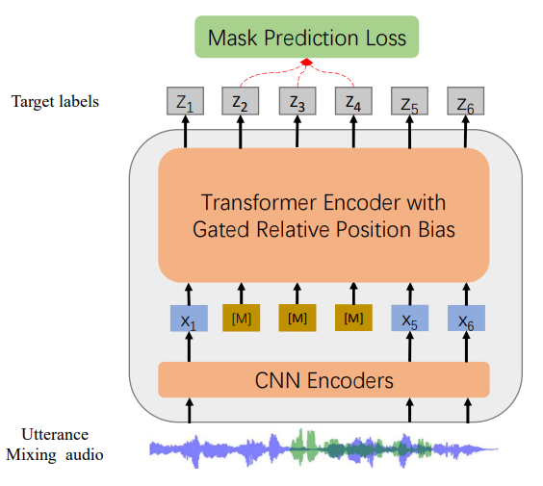
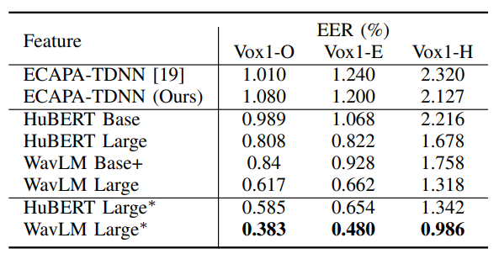
Pre-trained models
Models trained on LARGE datasets and saved – others use it for further experiments
  Data: 100k+ hours of audio or 45TB of text
  Expenses: ~100+ GPU years, ~ 4M USD
    2048 GPU A100 each with 80MB RAM – training time ~1+ month
Picture and table taken from paper: WavLM: Large-Scale Self-Supervised Pre-Training for Full Stack Speech Processing

Slide 50
Quiz
Lets make another quiz, now with speech modality
The data come from NIST SRE HASR 2012 challenge
HASR = Human assisted speaker recognition
20 trials = pairs of recording to be judge if they come from the same or different speaker
One is telephone speech, second interview recorded by microphone on the table
I will present 3 trials – files with duration of 10sec
  Original duration was more then 2 minutes

Slide 51
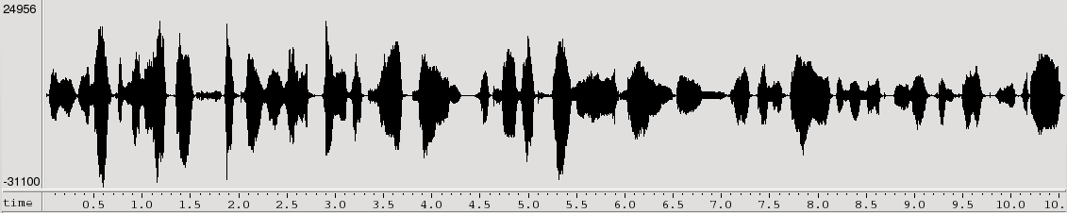

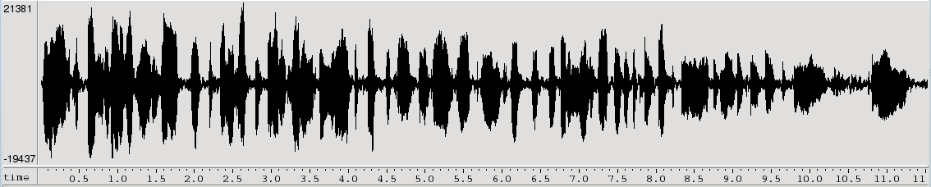
Quiz - Is this a same person?
Does these 2 recordings come from the same person?
SAME
Automatic system gives LLR=3.97
Audio excerpts come from NIST HASR 2012 trial 02

Slide 52
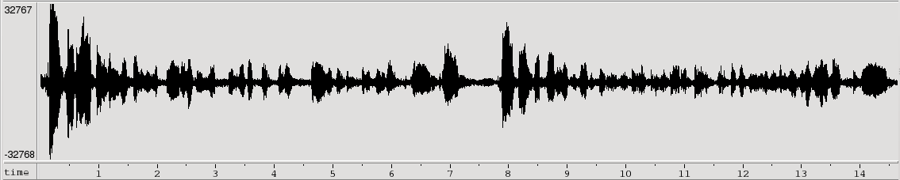
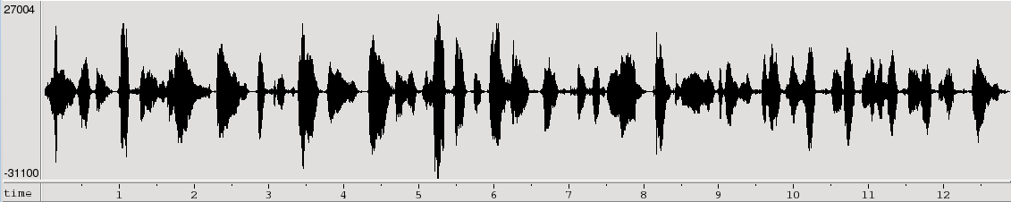
Quiz - Is this a same person?
Does these 2 recordings come from the same person?
Different
Automatic system gives LLR=2.50
Audio excerpts come from NIST HASR 2012 trial 04

Slide 53
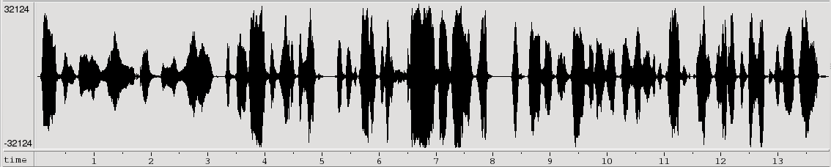
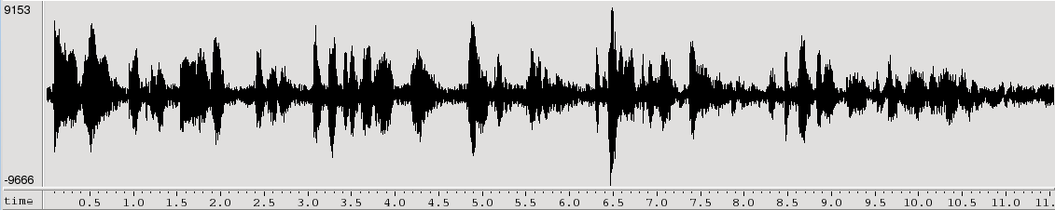
Quiz - Is this a same person?
Does these 2 recordings come from the same person?
SAME
Automatic system gives LLR=1.3
Audio excerpts come from NIST HASR 2012 trial 18

Slide 54
Agenda
Speaker recognition applications
  Why we need speaker recognition
  Different application domains
Background and theory
  Feature extraction
  Gaussian Mixture Modelling
  GMM-UBM base approach
  Eigen-channel compensation, JFA, PLDA
  DNN embeddings
Evaluation metrics
Score calibration and normalization
Conclusions

Slide 55
Evaluation Metric
There are two types of errors
  MISS: incorrectly rejected a target trial
  It was target trial, but system said it is not
  also known as a false reject
  FALSE ALARM: incorrectly accept a non-target trial
  It was not target trial, but system said it is
  also known as a false accept
The performance of a detection system is measure of the trade-off between these two errors – is controlled by adjustment of the decision threshold
In an evaluation, N_{target} target-trials (test speaker = model speaker) and N_{non-target} non-target trials (test speaker != model speaker) are conducted and error probabilities are estimated at given threshold
# target trials scores < thr
# non-target trials scores > thr
Pr(miss|thr)=
Pr(false alarm|thr)=
N_{target}
N_{non-target}

Slide 56
Does the system work well ?
We need some (lots of) data – pairs model speaker – test speaker (we call these pairs trials).
  Target-trials (test speaker = model speaker)
  Non-target-trials (test speaker ≠ model speaker)
We run them through the system and record the scores
We need to set the detection threshold
score
reject
accept

Slide 57
True accept
☺
score
reject
accept

Slide 58
True reject
☺
score
reject
accept

Slide 59
False alarm
☹
score
reject
accept

Slide 60
Miss
☹
score
reject
accept

Slide 61
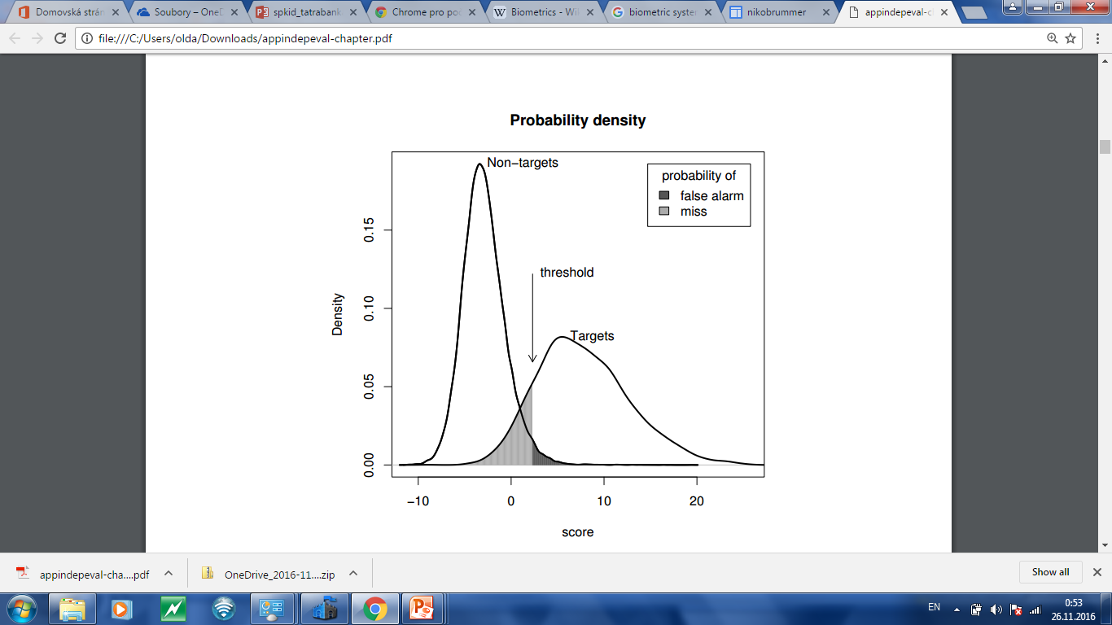
Single threshold, two types of error
False accept
False reject

Slide 62
DET – Detection Error Tradeoff
Decreasing
threshold
Better
performance

Slide 63
Comparison of different SRE techniques
NIST SRE 2010, tel-tel (cond. 5)
Baseline (relevane MAP)
Eigenchannel adapt.
JFA
iVector+PLDA
iVector+PLDA – tuned system
Additional significant recent improvements obtained with:
  full covariance UBM
  additional iVector pre-processing (LDA dim. reduction, length normalization,…)

Slide 64
DET – Detection Error Tradeoff
Bank transfer
You do not want to let someone play with your account
Equal Error Rate (EER) = operating point of the system where it makes the same number of false alarms and misses
High Security
EER
Equal Error Rate
Police/CIA/FBI
Do not want to miss the
terrorist’ call
Balance
High convenience

Slide 65
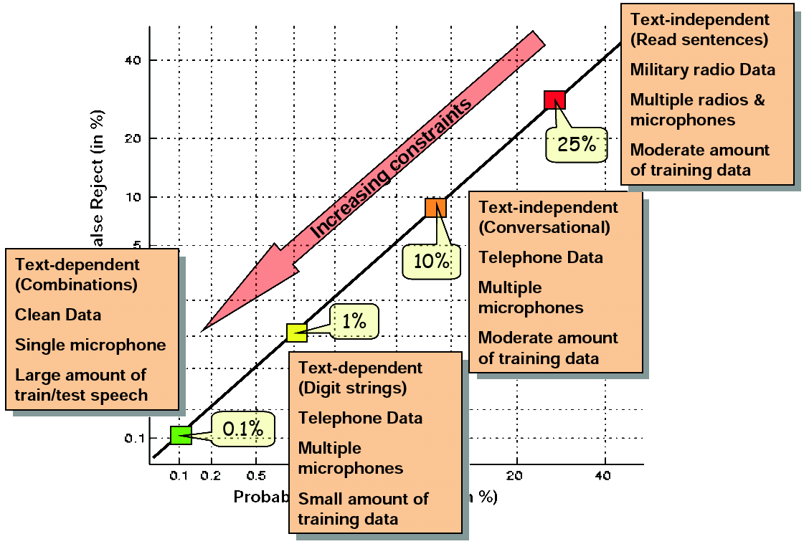
Performance Survey – Range of performances
Copied from JHU 08 summer workshop
presentation of Douglas A. Reynolds
from MIT. Thank you Doug.

Slide 66
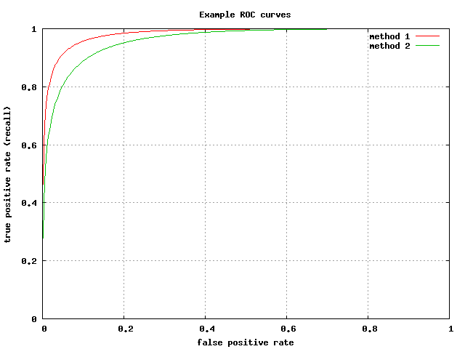
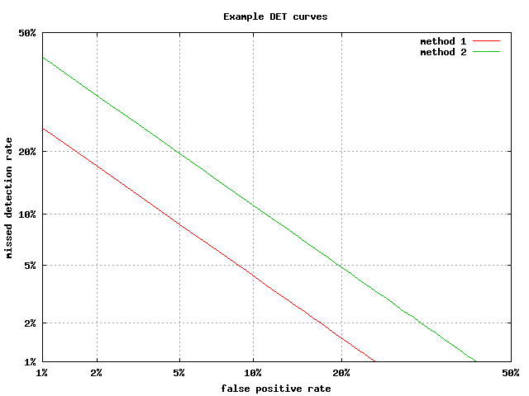
ROC curve vs DET curve

Slide 67

NIST Evaluations
„I'm better than the other guys“ – not relevant unless the same data and evaluation metrics for everyone.
National Institute of Standard and Technology
NIST - agency of US Government.
Its Speech group organizes regular evaluations of speech technologies
ALL participating sites receive the same data and have limited time to submit results – objective comparison !
Results and system details are discussed at a workshop

Slide 68
NIST Evaluation - Speech@FIT
Speech@FIT extensively participate in NIST evaluations:
  Speech Transcription 2005, 2006, 2007, 2009
  Language Recognition 2003, 5, 7, 9, 11, 15, 17
  Speaker Recognition 1998, 1999, 2006, 2008, 10, 12, 16, 18, 19, 20, 21
  Spoken term detection 2006
Why are we doing this ?
We believe that evaluations are really advancing the state of the art

Slide 69
Agenda
Speaker recognition applications
  Why we need speaker recognition
  Different application domains
Background and theory
  Feature extraction
  Gaussian Mixture Modelling
  GMM-UBM base approach
  Eigen-channel compensation, JFA, PLDA
  DNN embeddings
Evaluation metrics
Score calibration and normalization
Conclusions

Slide 70
Score Calibration
We want a probabilistic interpretation of scores
  Performing calibration often results in such scores
Well calibrated scores have the same meaning on different sets and different systems – we can directly compare the numbers
Calibration does not change system discriminability – it is usually only linear transformation
Given the calibrated scores, we can set the threshold analytically for the desired operating point (application)

Slide 71
Score presentation
Discrimination
Level
Presentation
Level
Report
Interpretation
Generally it is expected that systems produce scores (ideally log likelihood ratios):
  > 0 … more positive higher confidence it is the speaker
  < 0 … more negative higher confidence it is not the speaker
Eventually, the score is converted to a hard decision by thresholding.
Moving the threshold changes the proportion of the two error rates (pmiss, pfa)

Slide 72
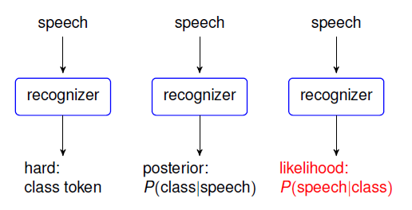

Scores/system outputs
posterior probability
likelihood
prior probability of class (here usually target trial)
Evidence

Slide 73

Scores
The output of the recognizer is usually a score, which reflects the confidence of the system (ideally for SRE log-likelihood ratio).
Higher value reflects a higher confidence for same-speaker hypothesis and lower value for different-speaker hypothesis.
Eventually, the score is converted to a hard decision by thresholding.
Moving the threshold changes the proportion of the two error rates (pmiss, pfa)

Slide 74
Discriminability of the system
Non-Target score distribution
Target score
distribution
EERthr
Score
Miss probability
False alarm

Slide 75

Calibrating the scores
Provided scores are often not very nice LLR
Calibration task is to transform the scores in such a way that we get LLR and therefore we can set ideal threshold (for given operating point)
Problems often arise from the dataset shift (typically development data vs target, evaluation data)
Usually a simple transformation f(s) (monothonic increasing) is enough to calibrate:
Parameters a and b can be found by optimizing a cross entropy objective over a supervised development set by the means of logistic regression – discriminative approach

Slide 76
Calibration
-2.5
0
2
Miss-calibrated system because of different channel, language, noise, reverberation ….

Slide 77
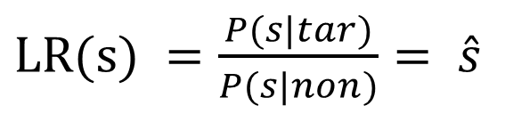
Likelihood ratio
Non-Target score distribution
Target score
distribution
P(s|tar)
P(s|non)
Score

Slide 78
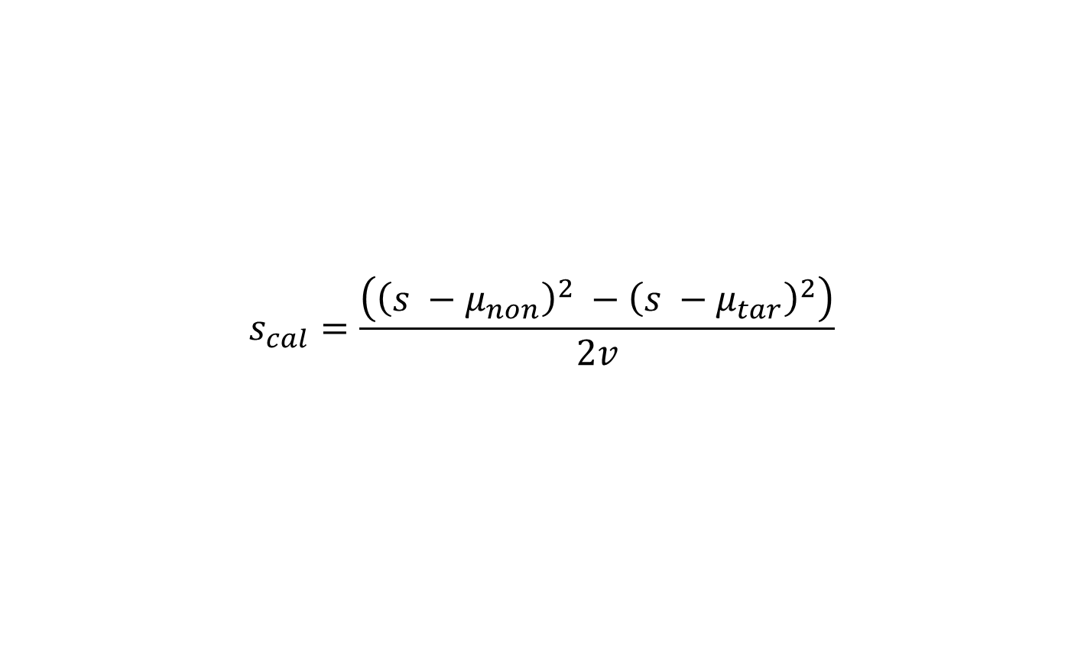
Linear score calibration (generative)
Mean of the target scores from calibration set
mean of the non-target scores from calibration set
Variance of all scores from the calibration set
Calibrated score

Slide 79
Generative Score Calibration
-4.5
0
Score

Slide 80
Generative Score Calibration
-4.5
0
5
Score
It is for good interpretation of the scores – it has probabilistic meaning
If I have LR/LLR then the meaning of the score is same on different sets
Do not need this for system discriminability – in ranking I do not need this
Can set threshold analytically given the operation point and costs of errors

Slide 81

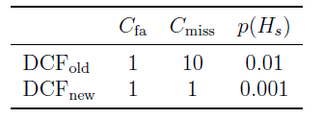
Detection Cost Function (DCF)
Defined by NIST as a metric for evaluating the verification systems, which focuses on a particular operation point of interest.
It is designed to consider the overall costs based on the two types of detection errors.
Setting for NIST SRE2008 and 2010

Slide 82

Measuring calibration loss
DCF (actual) is computed from the actual hard decisions.
Threshold for making decisions is often set by evaluator
NIST also computes a minimum possible DCF
The difference between the act-DCF and min-DCF is referred to as a calibration loss.
Calibration task is to transform the scores in such a way that we get least errors at the given operating point

Slide 83



Analytically setting the threshold
If the scores are well-calibrated LLR, user can set the threshold analytically to make an optimal, cost-ffective Bayes decision
Analytical and optimal threshold for the scores (LLRs) is then

Slide 84
Score normalization
Non-Target score distributions
0
Score
It unifies the score distribution across speakers – mean and variance !!!
We can then set one threshold for all speakers together.
By unifying the score distribution it can improve discriminability of the system – it can change the order of scores on a given test set

Slide 85

Error rates with different technologies

Slide 86
Conclusions
Over the past decade
  error rates have decreased 5 times or more thanks to advances in channel compensation techniques
  the new techniques have resulted in massive speed-ups
    x-vector is extracted for each recording (about 100 times faster than RT)
    With x-vectors, billions of verification trials can be tested in few seconds
Embedding paradigm opened new direction:
  Easy transfer of audio footprint without its content
  Easier adaptation of the system to target/customer data
  Application to other problems such as identification of language, emotion, age, gender, music, ...
Channel distortion is still the big issues for correct recognition
  Calibration and score normalization is necessary for practical systems
For more details talk to anybody from Speech@FIT

Slide 87
Thanks for your attention
and
I hope you enjoyed it ;)

