Slide 1
Speaker Recognition
Pavel Matějka, Oldřich Plchot
Speech@FIT, Brno University of Technology, Czech Republic
matejkap@fit.vutbr.cz
Brno
2015

Slide 2
Agenda
Speaker recognition applications
  Why we need speaker recognition
  Different application domains
Into the acoustic Speaker recognition systems
  GMM-UBM
  GMM-UBM + channel compensation
  JFA
  i-Vector+PLDA
2 competitions
Conclusion

Slide 3
Biometrics
Biometric: a human generated signal or attribute for authenticating a person’s identity
Voice biometric can be combined with other forms to reach highest security
  Voice +
  Finger print
  Face, Iris
  Batch – your identification card
  PIN code, password
Voice is popular biometric
  Natural signal to produce
  Does not require a specialized input device
  Can be obtained remotely, without speaker assistance

Slide 4
Speaker Recognition Applications
Security and defense
Forensic
Looking for suspect in quantity of audio
Waiting online for suspect
Access Control
Physical facilities
Computer networks & websites
Transaction Authentication
Telephone banking
Remote purchases
Speech Data Management
Voice mail browsing
Search in audio archives
Personalization
Voice-web/device customization
Intelligent answering machine

Slide 5
Speech Modalities
Application dictates different speech modalities
Text-dependent
Text-independent
Recognition system knows text spoken by person
Example: fixed or prompted phrases
Used for applications with strong control over user
Knowledge of spoken text can improve system performance
Recognition system does not know text spoken by person
Example: User selected phrases, conversational speech
Used for applications with less or no control over user
More flexible system but more difficult problem
Speech recognition can provide knowledge of spoken text

Slide 6
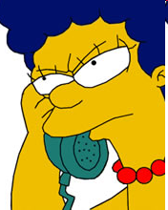
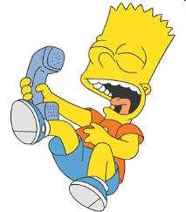
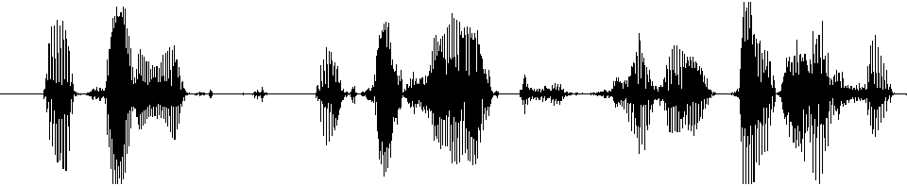
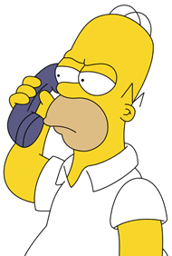
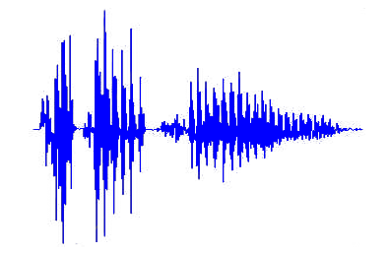
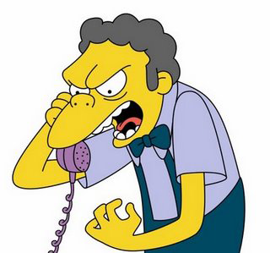
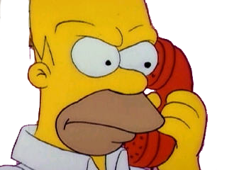
Speaker Recognition Tasks
Identification
Verification
Whose voice is this?
Is this Homer’s voice?
?
?
?
?
?
Segmentation and Clustering
Where are speaker changes? Which segments are from the same speaker?

Slide 7
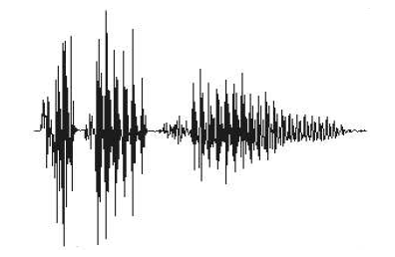
Basic structure of the system – Likelihood ratio
Speaker detection decision approaches have roots in signal detection theory
2 class Hypothesis test
H0: the speaker is not the target speaker
H1: the speaker is the target speaker
Statistic computed on test utterance S as likelihood ratio
Λ = log
Likelihood S came from speaker model
Likelihood S did not come from speaker model
Speaker
Model
S
+
Λ>0 accept
Feature
Extraction
Λ
Σ
Decision
Λ<0 reject
-
Background
Model

Slide 8
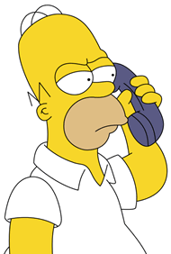
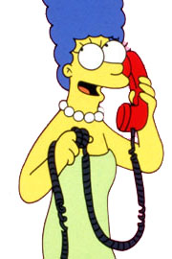
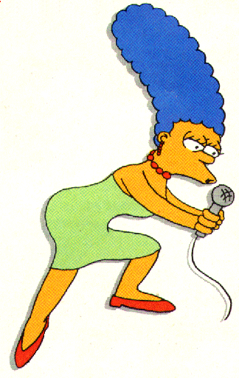

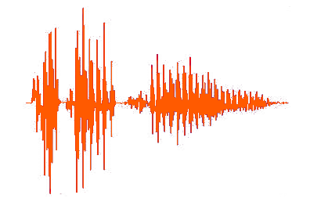
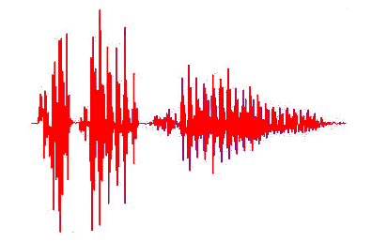
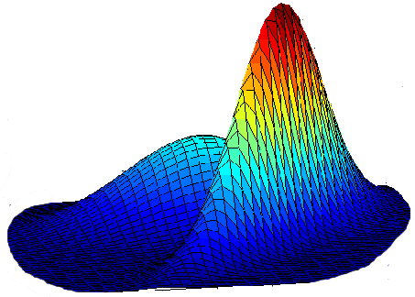
Phases of Speaker Detection System
Two distinct phases to any speaker detection system
Training phase
Homer
Feature
Extraction
Model
Training
Marge
Detection phase
Feature
Extraction
Detection
Decision
Detected
Hypothesized identity - Marge

Slide 9
Features for Speaker Recognition
Humans use several levels of perceptual cues for speaker recognition
There are no exclusive speaker identity clues
Hierarchy of Perceptual Cues
Difficult to
automatically
extract
High-level cues
(learned traits)
Semantics, idiolect, pronunciations, idiosyncrasies | Socio-economic status, education, place of birth
Prosodics, rhythm, speed intonation, volume modulation | Personality type, parental influence
Acoustic aspects of speech, nasal, deep, breathy, rough | Anatomical structure of vocal apparatus
Low-level cues
(physical traits)
Easy to
automatically
extract

Slide 10
Features for Speaker Recognition
Desirable attributes of features for an automatic system (Wolf 72)
No features has all these attributes
Features derived from spectrum of speech have proven to be the most effective in automatic systems
Occur naturally and frequently in speech
Easily measurable
Not change over time or be affected by speaker health
Not be affected by reasonable background noise nor depend on specific transmission characteristics
Not be subject to mimicry
Practical
Robust
Secure

Slide 11
Evaluation Metric
There are two types of errors
  MISS: incorrectly rejected a target trial
  It was target trial, but system said it is not
  also known as a false reject
  FALSE ALARM: incorrectly accept a non-target trial
  It was not target trial, but system said it is
  also known as a false accept
The performance of a detection system is measure of the trade-off between these two errors – is controlled by adjustment of the decision threshold
In an evaluation, N_{target} target-trials (test speaker = model speaker) and N_{non-target} non-target trials (test speaker != model speaker) are conducted and error probabilities are estimated at given threshold
# target trials scores < thr
# non-target trials scores > thr
Pr(miss|thr)=
Pr(false alarm|thr)=
N_{target}
N_{non-target}

Slide 12
DET – Detection Error Tradeoff
Decreasing
threshold
Better
performance

Slide 13
DET – Detection Error Tradeoff
Bank transfer
You do not want to let someone play with your account
Equal Error Rate (EER) = operating point of the system where it makes the same number of false alarms and misses
High Security
EER
Equal Error Rate
Police/CIA/FBI
Do not want to miss the
terrorist’ call
Balance
High convenience

Slide 14
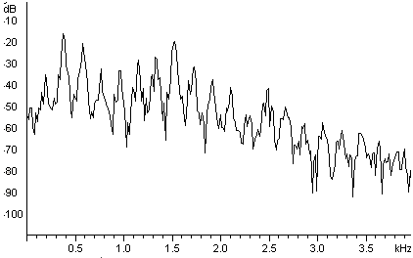
Spectral features - MFCC
20ms
10ms
-12.8
-0.3
-5.7
-22.4
8.9
6.8
…
-11.2
0.4
-4.7
-13.0
2.3
4.5
…
Short-time
FFT
Mel - Filter Bank
Log ()
Discrete Cosine Transform

Slide 15
Relevance MAP adaptation – creating speaker model
Target speaker data
UBM
Speaker model adapted from UBM-GMM
Only means are adapted using relevance MAP adaptation
μ^{ML} – UBM mean vector μ^{UBM} ML retrained on enrollment data
γ_{c} – occupation counts for c^{th} components
τ – relevance factor (typically between 10 and 20)
Corresponds to point MAP estimates of means using an ad-hoc prior
Mixture weights and covariance matrices are copied from UBM

Slide 16
Session variability in model parameter space
Example: single Gaussian model with 2D features
Target speaker model
UBM
High speaker variability
High inter-session variability

Slide 17
Eigenchannel adaptation – Single Gaussian
Speaker model is obtained using standard relevance MAP adaptation
For verification, move both models along the high inter-session variability direction(s) to better fit the test data (e.g. in ML sense)
Target speaker model
Test data
UBM
High speaker variability
High inter-session variability

Slide 18
Eigenchannel adaptation for GMM
Allows to move mean supervector in the directions with large channel variability
Mixture weights and covariance matrices are fixed.
Eigenchannels
UBM or MAP-adapted speaker model
Channel factors
μ₁
μ₂
μ₁
μ₂
μ₁
μ₂
m₁
m₂
m₁
m₂
m₁
m₂
u₁₁ u₁₂
u₂₁ u₂₂
u₁₁ u₁₂
u₂₁ u₂₂
u₁₁ u₁₂
u₂₁ u₂₂
u₁₃
u₂₃
u₁₃
u₂₃
u₁₃
u₂₃
+
μ
x₁
x₂
x₃
=
+
+
μ
+
μ
Notes:
18

Slide 19
Eigenchannel adaptation for GMM
μ₁
μ₂
μ₁
μ₂
μ₁
μ₂
m₁
m₂
m₁
m₂
m₁
m₂
u₁₁ u₁₂
u₂₁ u₂₂
u₁₁ u₁₂
u₂₁ u₂₂
u₁₁ u₁₂
u₂₁ u₂₂
u₁₃
u₂₃
u₁₃
u₂₃
u₁₃
u₂₃
x₁
x₂
x₃
=
+
Notes:
19

Slide 20
Eigenchannel adaptation for GMM
μ₁
μ₂
μ₁
μ₂
μ₁
μ₂
m₁
m₂
m₁
m₂
m₁
m₂
u₁₁ u₁₂
u₂₁ u₂₂
u₁₁ u₁₂
u₂₁ u₂₂
u₁₁ u₁₂
u₂₁ u₂₂
u₁₃
u₂₃
u₁₃
u₂₃
u₁₃
u₂₃
x₁
x₂
x₃
=
+
Notes:
20

Slide 21
Eigenchannel adaptation for GMM
μ₁
μ₂
μ₁
μ₂
μ₁
μ₂
m₁
m₂
m₁
m₂
m₁
m₂
u₁₁ u₁₂
u₂₁ u₂₂
u₁₁ u₁₂
u₂₁ u₂₂
u₁₁ u₁₂
u₂₁ u₂₂
u₁₃
u₂₃
u₁₃
u₂₃
u₁₃
u₂₃
x₁
x₂
x₃
=
+
Notes:
21

Slide 22
Eigenchannel adaptation for GMM
μ₁
μ₂
μ₁
μ₂
μ₁
μ₂
m₁
m₂
m₁
m₂
m₁
m₂
u₁₁ u₁₂
u₂₁ u₂₂
u₁₁ u₁₂
u₂₁ u₂₂
u₁₁ u₁₂
u₂₁ u₂₂
u₁₃
u₂₃
u₁₃
u₂₃
u₁₃
u₂₃
x₁
x₂
x₃
=
+
Notes:
22

Slide 23
Eigenchannel adaptation for GMM
μ₁
μ₂
μ₁
μ₂
μ₁
μ₂
m₁
m₂
m₁
m₂
m₁
m₂
u₁₁ u₁₂
u₂₁ u₂₂
u₁₁ u₁₂
u₂₁ u₂₂
u₁₁ u₁₂
u₂₁ u₂₂
u₁₃
u₂₃
u₁₃
u₂₃
u₁₃
u₂₃
x₁
x₂
x₃
=
+
Notes:
23

Slide 24
Eigenchannel adaptation for GMM
μ₁
μ₂
μ₁
μ₂
μ₁
μ₂
m₁
m₂
m₁
m₂
m₁
m₂
u₁₁ u₁₂
u₂₁ u₂₂
u₁₁ u₁₂
u₂₁ u₂₂
u₁₁ u₁₂
u₂₁ u₂₂
u₁₃
u₂₃
u₁₃
u₂₃
u₁₃
u₂₃
x₁
x₂
x₃
=
+
Notes:
24

Slide 25
Eigenchannel adaptation for GMM
μ₁
μ₂
μ₁
μ₂
μ₁
μ₂
m₁
m₂
m₁
m₂
m₁
m₂
u₁₁ u₁₂
u₂₁ u₂₂
u₁₁ u₁₂
u₂₁ u₂₂
u₁₁ u₁₂
u₂₁ u₂₂
u₁₃
u₂₃
u₁₃
u₂₃
u₁₃
u₂₃
x₁
x₃
x₂
=
+
Notes:
25

Slide 26
Eigenchannel adaptation for GMM
μ₁
μ₂
μ₁
μ₂
μ₁
μ₂
m₁
m₂
m₁
m₂
m₁
m₂
u₁₁ u₁₂
u₂₁ u₂₂
u₁₁ u₁₂
u₂₁ u₂₂
u₁₁ u₁₂
u₂₁ u₂₂
u₁₃
u₂₃
u₁₃
u₂₃
u₁₃
u₂₃
x₁
x₂
=
+
x₃
Notes:
26

Slide 27
Eigenchannel adaptation for GMM
μ₁
μ₂
μ₁
μ₂
μ₁
μ₂
m₁
m₂
m₁
m₂
m₁
m₂
u₁₁ u₁₂
u₂₁ u₂₂
u₁₁ u₁₂
u₂₁ u₂₂
u₁₁ u₁₂
u₂₁ u₂₂
u₁₃
u₂₃
u₁₃
u₂₃
u₁₃
u₂₃
x₁
x₃
x₂
=
+
Notes:
27

Slide 28
Eigenchannel adaptation for GMM
μ₁
μ₂
μ₁
μ₂
μ₁
μ₂
m₁
m₂
m₁
m₂
m₁
m₂
u₁₁ u₁₂
u₂₁ u₂₂
u₁₁ u₁₂
u₂₁ u₂₂
u₁₁ u₁₂
u₂₁ u₂₂
u₁₃
u₂₃
u₁₃
u₂₃
u₁₃
u₂₃
x₁
=
+
x₂
x₃
Notes:
28

Slide 29

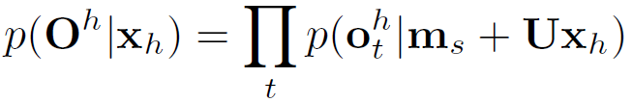
Eigenchannel adaptation for GMM
Speaker model (mean supervector) m_{s} obtained in usual way by MAP-adapting UBM
For verification, adapt speaker model (and UBM) to the channel of test utterance h by moving m_{s} in the eigenchannel subspace U to fit well the test data → find factors x_{h} maximizing likelihood of test data
The score is LLR computed using the adapted speaker model and UBM
μ₁
μ₂
μ₁
μ₂
μ₁
μ₂
m₁
m₂
m₁
m₂
m₁
m₂
u₁₁ u₁₂
u₂₁ u₂₂
u₁₁ u₁₂
u₂₁ u₂₂
u₁₁ u₁₂
u₂₁ u₂₂
u₁₃
u₂₃
u₁₃
u₂₃
u₁₃
u₂₃
x₁
x₂
x₃
=
+
N. Brümmer, Spescom DataVoice NIST 2004 system description, in Proc. NIST Speaker Recognition Evaluation 2004, Toledo, Spain, Jun. 2004
Notes:
29

Slide 30
Identifying high intersession variability directions
supervectors of speaker 1
Take recordings from many speakers each recorded under several different channel conditions. For each recording, derive supervector by MAP adapting UBM.
From each supervector, subtract mean computed over supervectors of corresponding speaker.
Find directions with the largest intersession variability using PCA (eigen vectors of the average within speaker covariance matrix).
speaker 2
speaker 3
Eigenchannel U

Slide 31
Eigenchannel adaptation performance
Baseline system is
  UBM with 2048 Gaussians
  13 MFCC + up to third order derivatives
  HLDA
  Speaker model is relevance MAP adapted UBM.
Eigenchannel adaptation much more effective than previous class-based channel compensation techniques such as Feature Mapping (e.g. at false alarm rate of 5%, miss probability drops from 10% to below 5%).
NIST SRE 2005 all trials
Miss probability [%]
baseline
+ Feature Mapping
+ Eigenchannel adaptation
(50 eigenchannels)
False Alarm Probability (in%)

Slide 32
Quiz
Lets make a small quiz, for better imagination what is the channel effect
I choose different modality since it is easier to show it on – face recognition from picture
Speech quiz will come later in the talk

Slide 33
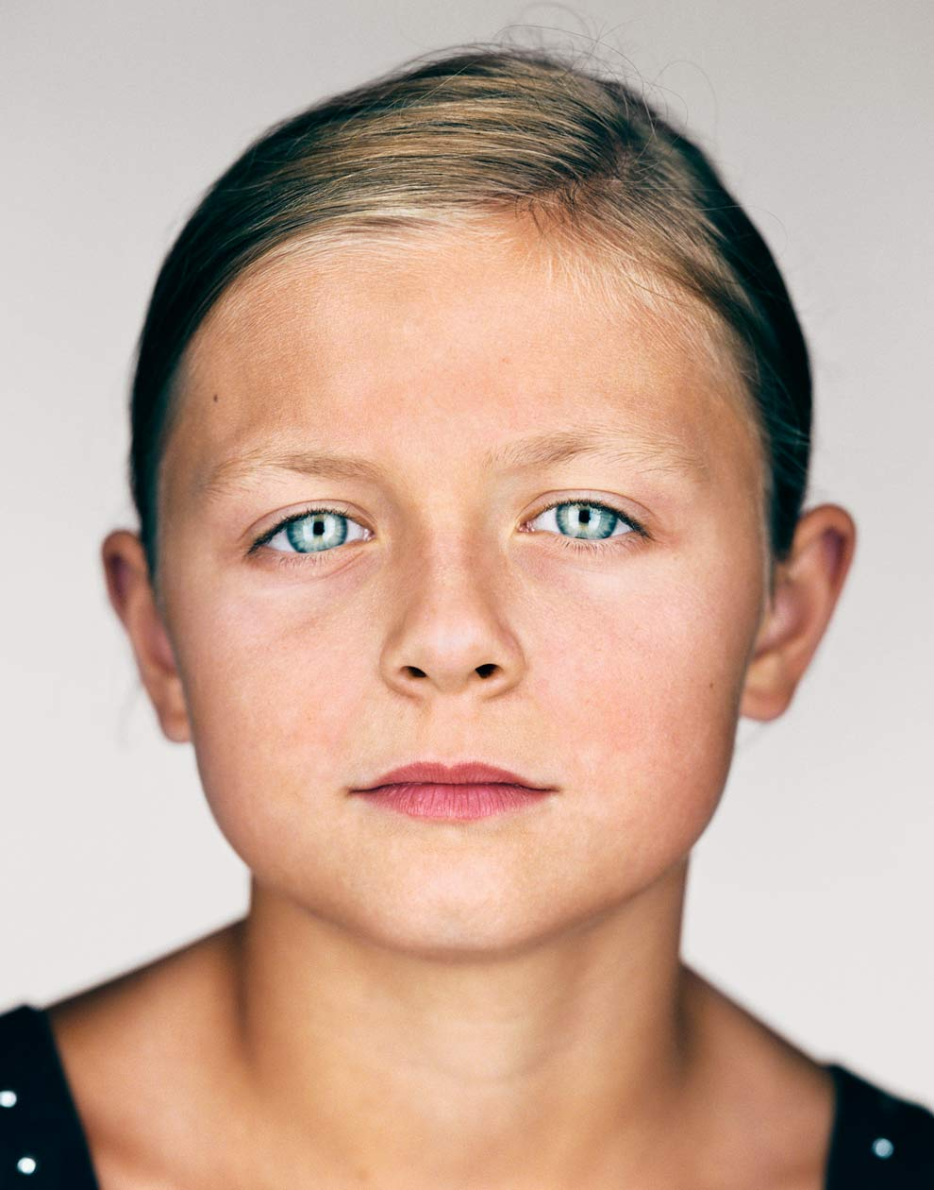
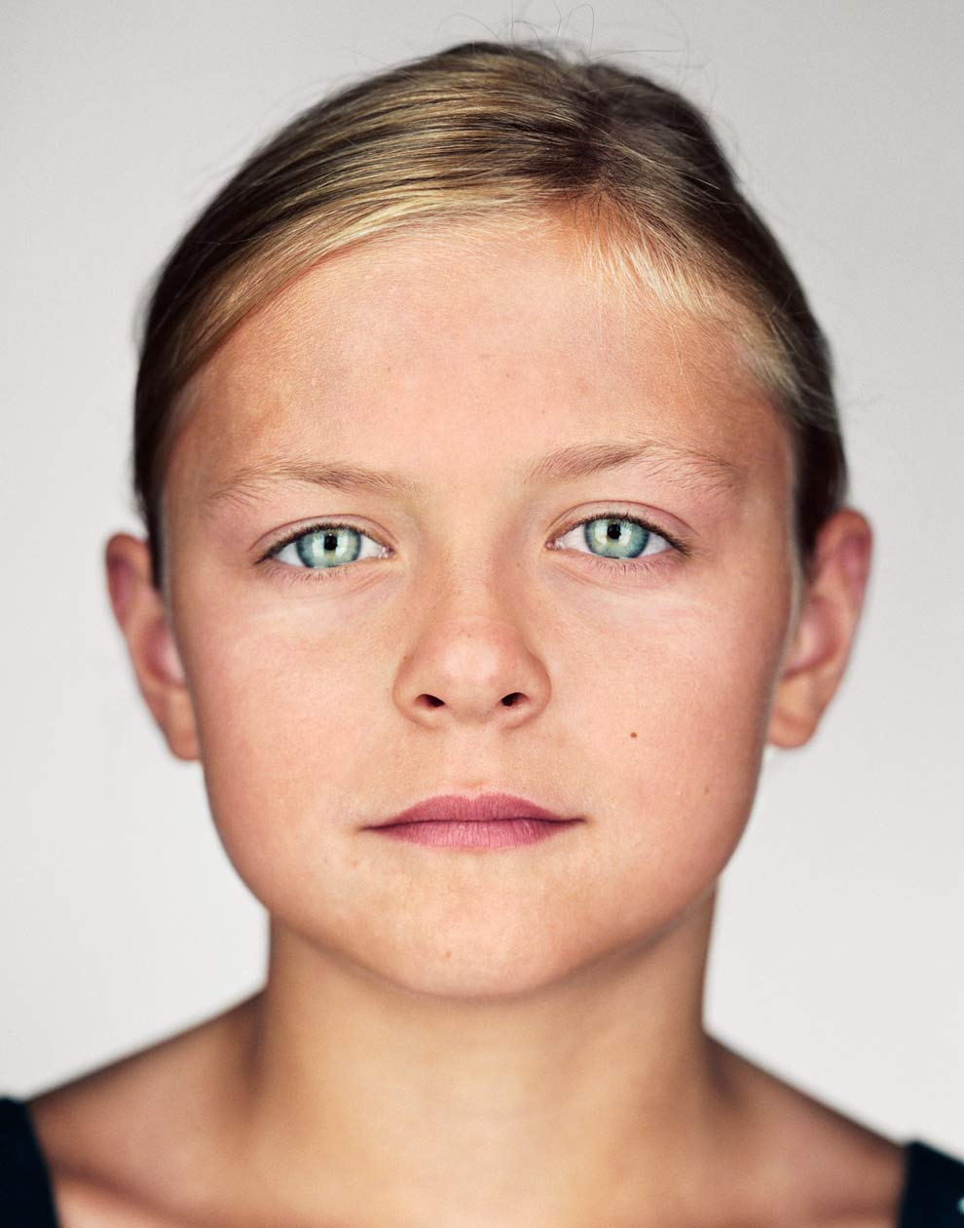
Quiz - Is this a same person?
Is this a same person?
Emily
Kate
http://ngm.nationalgeographic.com/2012/01/twins/schoeller-photography#/5

Slide 34
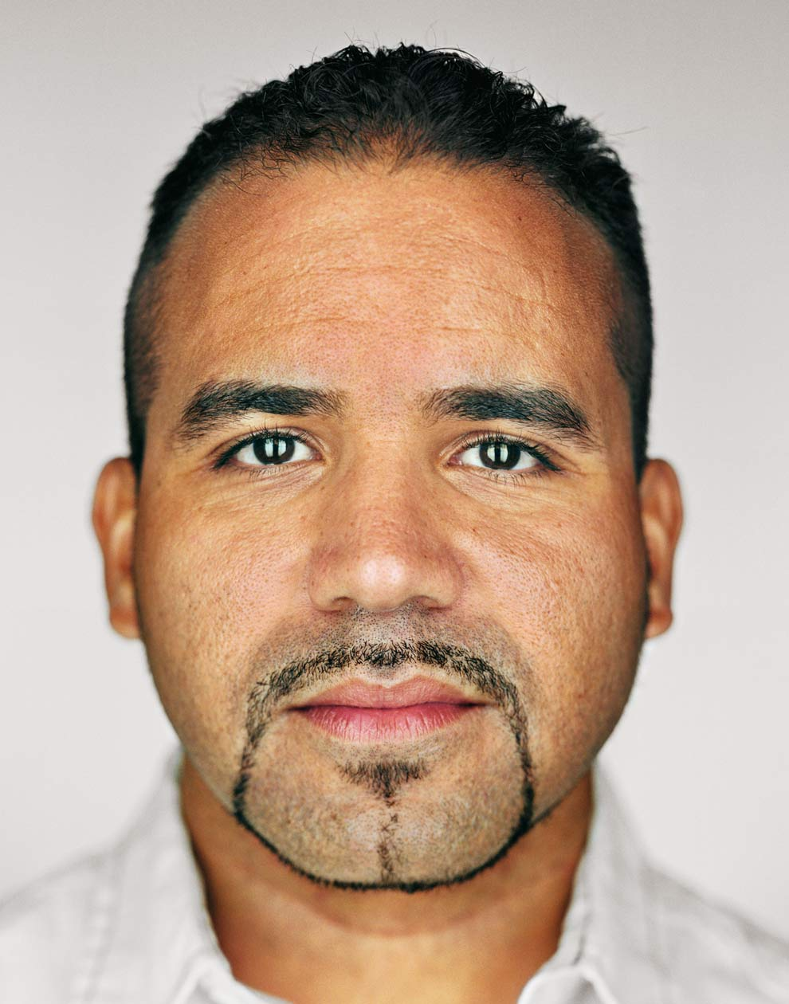
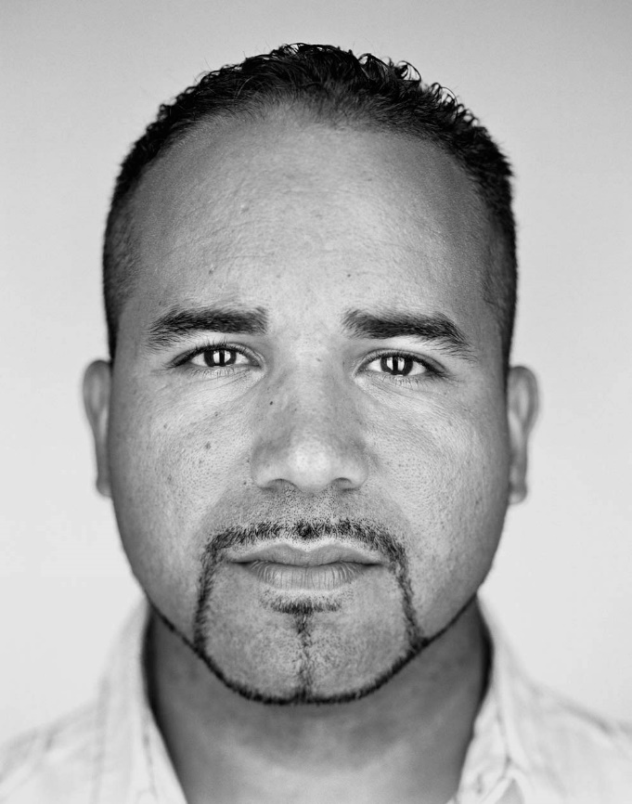
Quiz - Is this a same person?
Lets add one dimensional “channel” effect.
Eurides
Ramon
http://ngm.nationalgeographic.com/2012/01/twins/schoeller-photography#/3

Slide 35
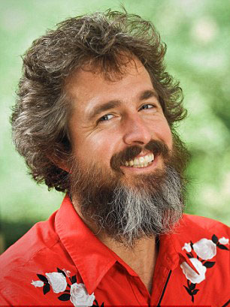
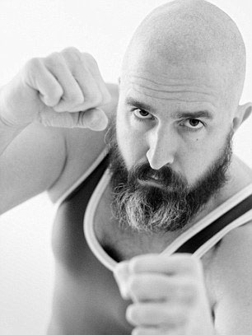
Quiz - Is this a same person?
Lets make it real.
Gordon
Gordon
http://www.dailymail.co.uk/news/article-2173486/How-different-man-look-Hilarious-portraits-photographer-Gordon-Stettinius-lesson-bad-taste.html

Slide 36
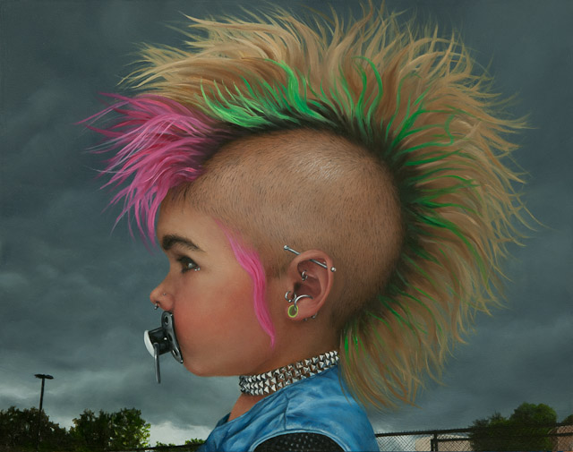
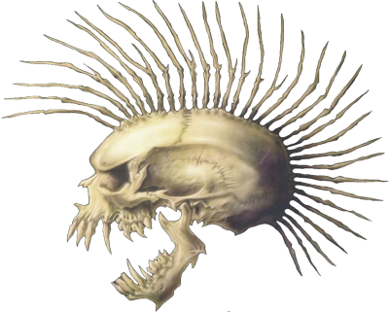
Quiz - Is this a same person?
And even harder – Aging effect – Case for experts only.
????
????
Sorry, I’m NOT that big experts.

Slide 37


Towards Joint Factor Analysis
So far, we have considered only dimensions with high channel variability to adapt a model to the channel of a test utterance…
…how about considering high speaker variability dimensions to appropriately adapt model to a speaker?
Speaker factors
Eigenvoices
Speaker represented by low dimensional vector y_{s}
Similar to eigenvoice adaptation in ASR, but for speaker ID it is effective only together with eigenchannels
Inspiration for Povey’s Subspace GMM for LVCSR
UBM
High speaker variability
High inter-session variability

Slide 38
Towards Joint Factor Analysis (continued)
Speaker verification:
  both speaker factors y and channel factors x are estimated on enrollment data.
  only channel factors x are updated for test data to adapt speaker model to test channel condition
Model parameters {m, V, U, w, Σ} are estimated on recordings of many speakers each recorded in several sessions:
  parameters {m, V, U, w, Σ} and speaker/channel factors y, x are iteratively re-estimated to maximize likelihood of training data
  speaker factors y are constrained to be the same for all recordings of the same speaker; different channel factors x are estimated for each recording

Slide 39

Joint Factor Analysis
So far we have limited the number of free parameters by forcing speaker model parameters μ to live in subspace defined by V and U.
Now, we move to fully probabilistic model describing distribution of μ (in the subspace)
Let y and x be random vectors with standard normal priors. Then
is Gaussian distributed with mean m and VV^{T} and UU^{T} are covariance matrices describing across-speaker and within-speaker variability, respectively (i.e. basis of V and U now also describe amounts of speaker and channel variability in their directions).
To allow μ to live outside of the subspace defined by V and U, we can optionally add one more term:
where z is again normal distributed and D is diagonal matrix describing residual speaker variability in individual dimensions (i.e. we have applied factor analysis to model variability of speaker model parameters μ).
P. Kenny et al.: A Study of Inter-Speaker Variability in Speaker Verification IEEE TASLP, July 2008.

Slide 40
Performance of JFA
NIST SRE 2010, tel-tel (cond. 5)
Baseline (relevance MAP)
Eigenchannel adaptation
JFA

Slide 41
Speaker factors as features
At JHU 2008 summer workshop, Najim Dehak experimented with speaker factors as a features for SVM based speaker verification system: One SVM trained for each target speaker using one positive example and preselected set of negative examples
Performance of SVM based system was poorer than that of JFA, but interestingly, performance was much better than chance even if channel factors were used as features ➔ JFA does not do good job in extracting all the speaker related information into y.
We can train simpler model:
  Eigenvoices V and eigenchannels U are replaced by single subspace T representing both speaker and channel variability.
  Speaker and channel factors y and x are replaced by single vector i (so called iVector) being a low-dimensional representation of the corresponding recording.
System | EER
JFA | 1.95%
SVM- speaker factors | 2.74%
SVM- channel factors | 20%
SVM- iVectors | 2.19%
NIST 2006 SRE, core condition, English trials, female part

Slide 42

iVectors – low-dimensional recording representation
iVector extractor is model similar to JFA
  with single subspace T ➔ easier to train
  no need for speaker labels ➔ the subspace can be trained on large amount of unlabeled recordings
low-dimensional (typically 200-600 dimensions)
i-vector is fixed-length representation of variable length audio
i-vector is information rich
  contains information about speaker, language, emotion, … and also channel ➔ needs to be considered by the following classifier.
We assume standard normal prior for factors i.
MAP point estimate of i
Dehak, N., et al., Support Vector Machines versus Fast Scoring in the Low-Dimensional Total Variability Space for Speaker Verification, In Proc Interspeech 2009, Brighton, UK, September 2009

Slide 43

Probabilistic Linear Discriminant Analysis (PLDA)
What would be now the appropriate probabilistic model for verification?
  i-vector still contains channel information ➔ our model should consider both speaker and channel variability, just like in JFA.
Natural choice is simplified JFA model with only single Gaussian. Such model is known as PLDA and is described by familiar equation:
However, this equation now describes directly the variability of observed data – i-vectors (not variability of mean supervectors like in JFA).
Parameters μ, V, U and diagonal covariance matrix of residual noise vector є can be estimated using EM algorithm.
Notes:
43

Slide 44
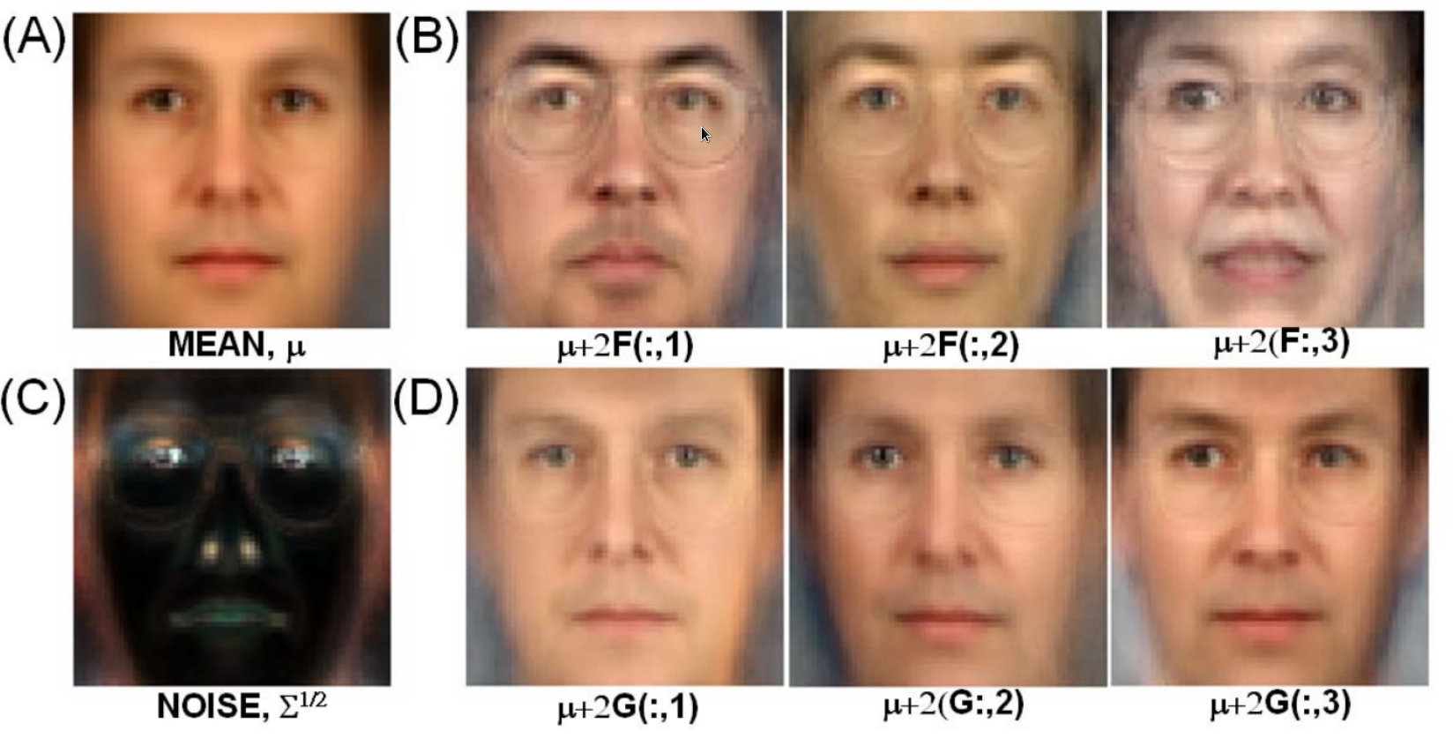
PLDA continued
  PLDA has nice interpretation in face verification where it was introduced by Simon J.D. Prince
  Each face image i can be constructed by adding
    (A) mean face μ
    (B) linear combination of basis V corresponding to between-individual variability (moving from μ in these directions gives us images that look like different people)
    (D) linear combination of basis U corresponding to within-individual variability (moving from μ in these directions gives us images that look like the same person under different condition – e.g. lighting)
    (C) residual noise vector є
Picture taken from: S.J.D. Prince and J.H. Elder, “Probabilistic linear discriminant analysis for inferences about identity,” ICCV, 2007
Notes:
44

Slide 45
PLDA based verification
Verification based on Bayesian model comparison
Compare likelihoods for two hypothesis:
    H_{s} – both recordings come from the same speaker
    H_{d} – recordings come from different speakers
Feature
Extraction
Same Speaker
Model
Feature
Extraction
Speaker
Model
recording 1
Decision
Decision
Feature
Extraction
Different Speakers Model
Feature
Extraction
Different Speakr Model
recording 2
It is symmetrical problem
We do not need to train explicitly the speaker model and compare to each test recording which was done before
Scoring with PLDA is FAST!!

Slide 46
iVector+PLDA
NIST SRE 2010, tel-tel (cond. 5)
Baseline (relevane MAP)
Eigenchannel adapt.
JFA
iVector+PLDA
iVector+PLDA system:
Implementation simpler than for JFA
Allows for extremely fast verification
Provides significant improvements especially in important low False Alarm region

Slide 47
iVector+PLDA
NIST SRE 2010, tel-tel (cond. 5)
Baseline (relevane MAP)
Eigenchannel adapt.
JFA
iVector+PLDA
iVector+PLDA - current BUT system
Additional significant recent improvements obtained with:
  full covariance UBM
  additional iVector pre-processing (LDA dim. reduction, length normalization,…)

Slide 48
Channel/session variability
The largest challenge to practical use of speaker detection systems is channel/session variability
Variability – refers to changes in channel between the two recordings forming a detection trial
Channel/session
  Microphones
    Carbon-button, electret, hands-free, array, …
  Acoustic environment
    Office, car, airport, street, restaurant, …
  Transmission channel
    Landline, cellular, VoIP,…
  Speaker emotion state
    Calm, nervous, stress, drunk, ill, …
  Length of recording

Slide 49
Quiz
Lets make another quiz, now with speech modality
The data come from NIST SRE HASR 2012 challenge
HASR = Human assisted speaker recognition
20 trials = pairs of recording to be judge if they come from the same or different speaker
One is telephone speech, second interview recorded by microphone on the table
I will present 3 trials – files with duration of 10sec
  Original duration was more then 2 minutes

Slide 50
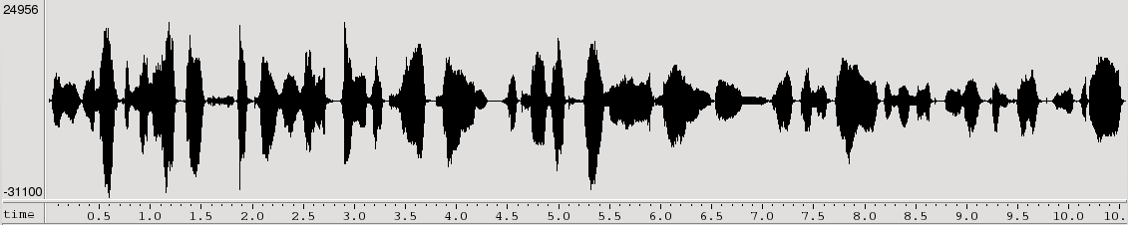

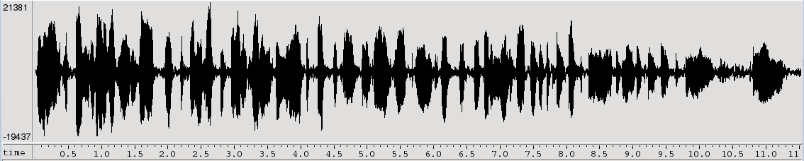
Quiz - Is this a same person?
Does these 2 recordings come from the same person?
SAME
Automatic system gives LLR=3.97
Audio excerpts come from NIST HASR 2012 trial 02

Slide 51
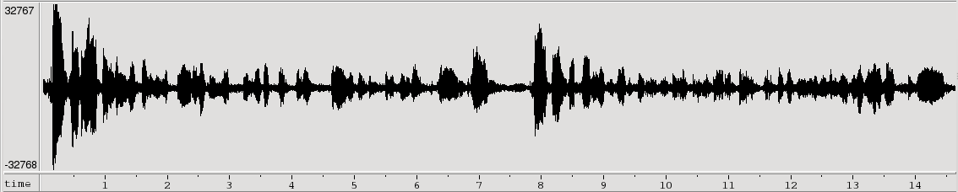
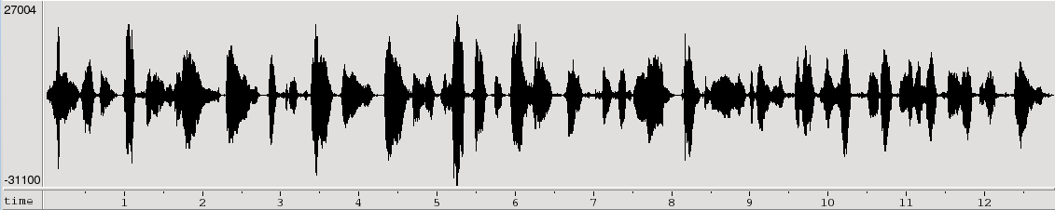
Quiz - Is this a same person?
Does these 2 recordings come from the same person?
Different
Automatic system gives LLR=2.50
Audio excerpts come from NIST HASR 2012 trial 04

Slide 52
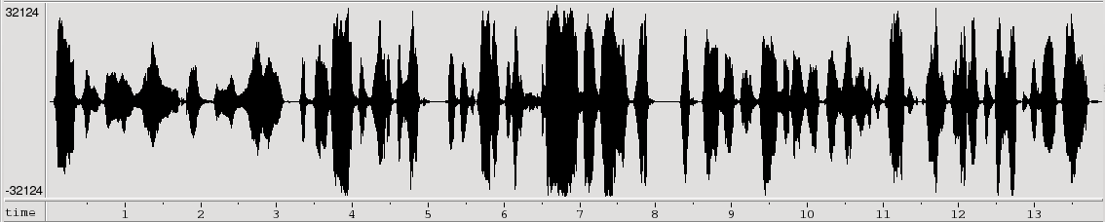
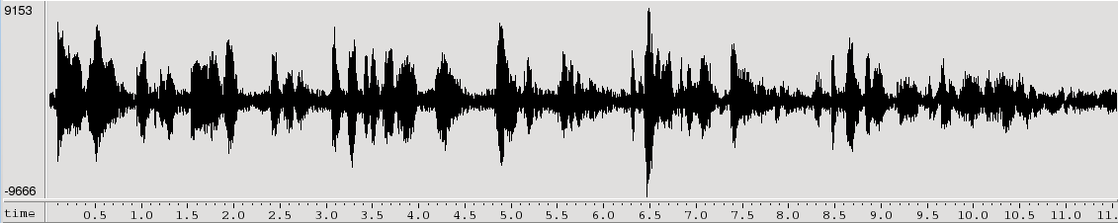
Quiz - Is this a same person?
Does these 2 recordings come from the same person?
SAME
Automatic system gives LLR=1.3
Audio excerpts come from NIST HASR 2012 trial 18

Slide 53
Conclusions
Over the past few years
  error rates have decreased 5 times or more thanks to advances in channel compensation techniques
  the new techniques have resulted in massive speed-ups
    i-vector is extracted for each recording (about 100 times faster than RT)
    With i-vectors, billions of verification trials can be tested in few seconds
i-vectors paradigm opened new direction:
  Easy transfer of audio footprint without its content
  Easier adaptation of the system to target/customer data
  Application to other problems such as identification of language, emotion, age, gender, music, ...
Channel distortion is still the big issues for correct recognition

Slide 54
Thank you

