Slide 1
From research to products
3–5–2017

Slide 2

Helps clients to extract automatically maximum of valuable information from spoken speech. Turns speech to knowledge.
Based in 2006 as spin-off of Brno University of Technology
Seat and main office in Brno
Customers worldwide - governmental agencies, call centers, banks, telco operators, broadcast service companies
The main focus on platform and developer tools
Profitable, no external funding

Slide 3


From research to products
Scientific papers, reports, experimental code (Matlab, Python, C++, lots of glue (shell scripts), data files
The goal is accuracy
Stability, speed, reproducibility and documentation less important
Openness
Research
text
The goal is stability (error handling, code verification, testing cycles at various levels) and speed
Regular development cycles and planning
Well defined application interfaces (API)
Documentation, licensing
Technologies
Products
Development of new applications
Integration with client’s technologies and systems
The goal is functionality o integrated solution
User interfaces

Slide 4
Speaker
Gender, age
Speaker identity
Emotion, speaker origin
Education, relation
When speaker speaks
Environment
Where speakers speaks
To whom speakers speaks
(dialog, reading, public talk)
Other sounds
(music, vehicles, animals…)
Content
Language, dialect
Keywords, phrases
Speech transcription
Topic
Data mining
Equipment
Device (phone/mike/...)
Transmit channels
(landline/cell phone/Skype)
Codecs (gsm/mp3/…)
Speech quality
What is in speech?

Slide 5
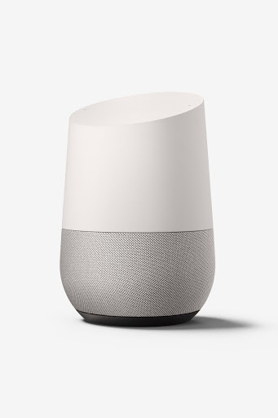
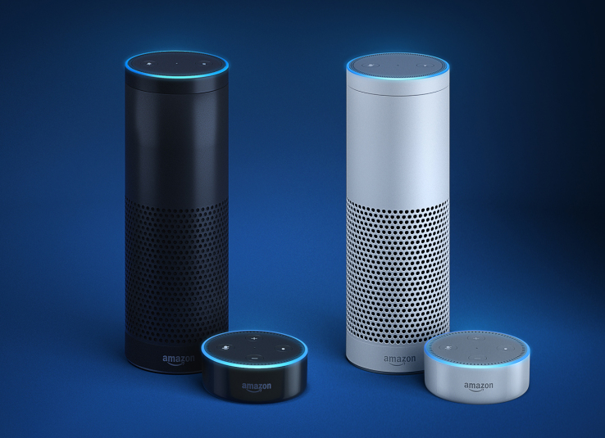
Voice interfaces – potential or thread?

Slide 6
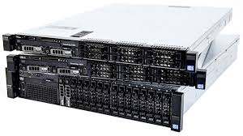
Technologies
Voice activity detection
Language identification
Gender recognition
Speaker identification
Diarization
Keyword spotting
Speech transcription
Dialog analysis
Emotion recognition
Sentiment analysis

Slide 7

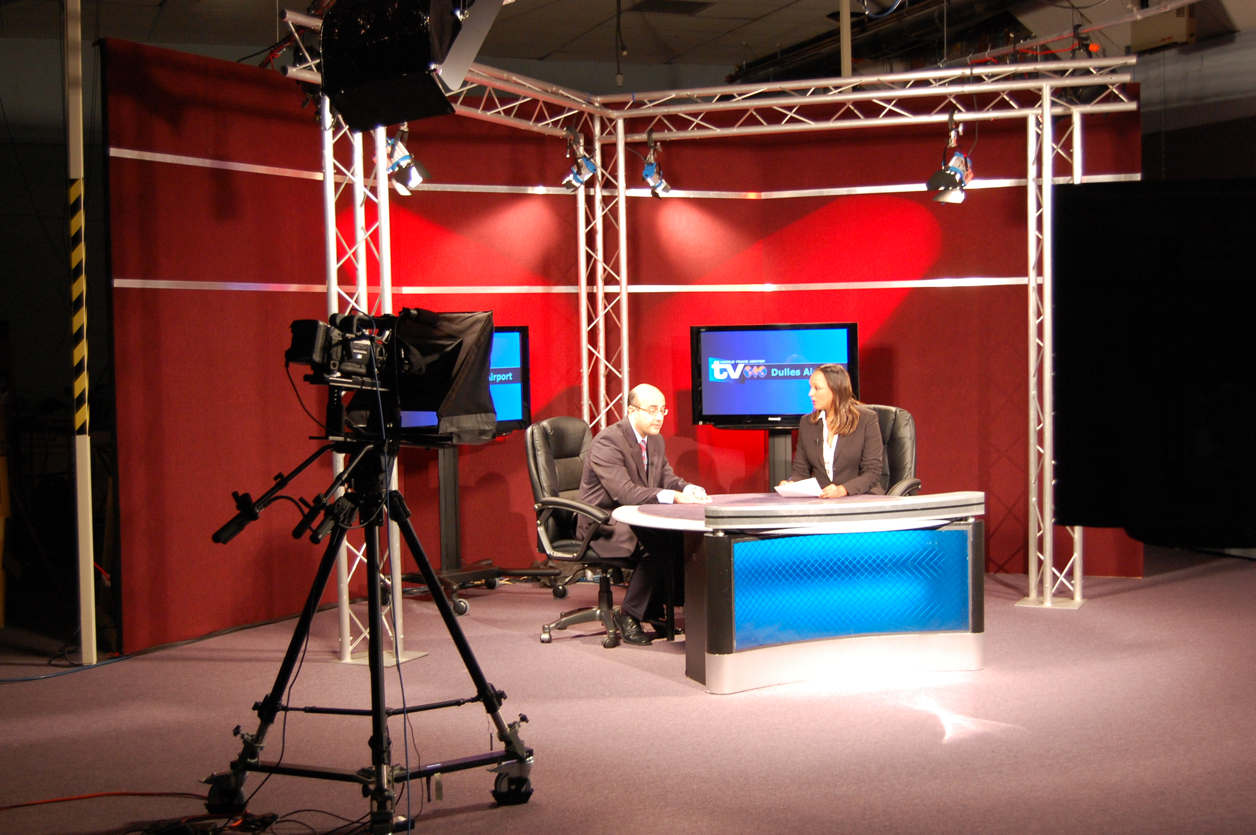


Call centers - quality control
/ business inteligence
News agencies
- search for some information
Use
cases
Intelligence agencies - search
for some information in a haystack,
forensic expertise
Banks - fraud detection
/ voice as a password

Slide 8
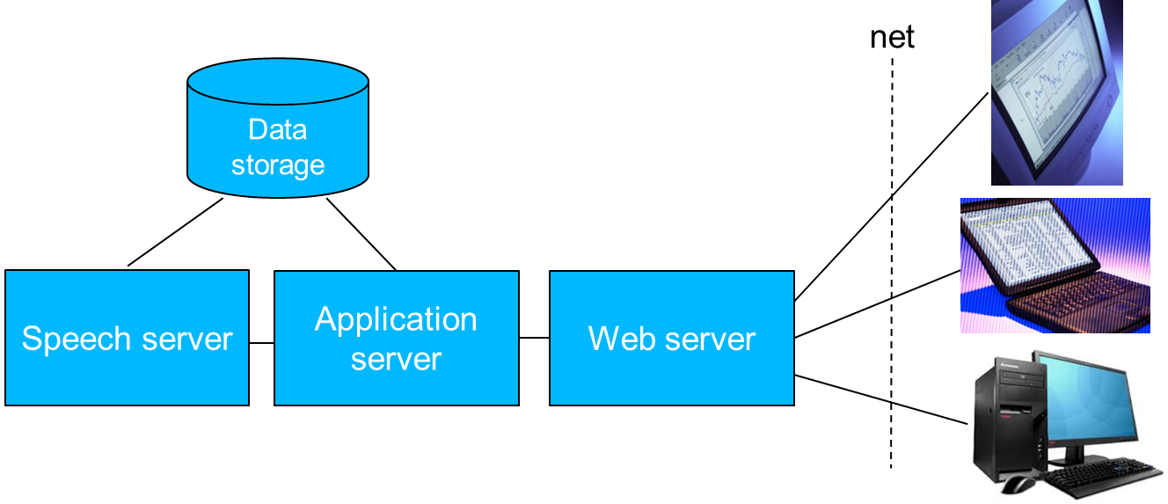
Speech platform
      We are delivering tools for developers
        One interface for all technologies – REST + HTTP/RTP streams
        Simple installation, integration and scalability
        Partnering with developers and integrators all around world

Slide 9
Hot
tasks

Slide 10
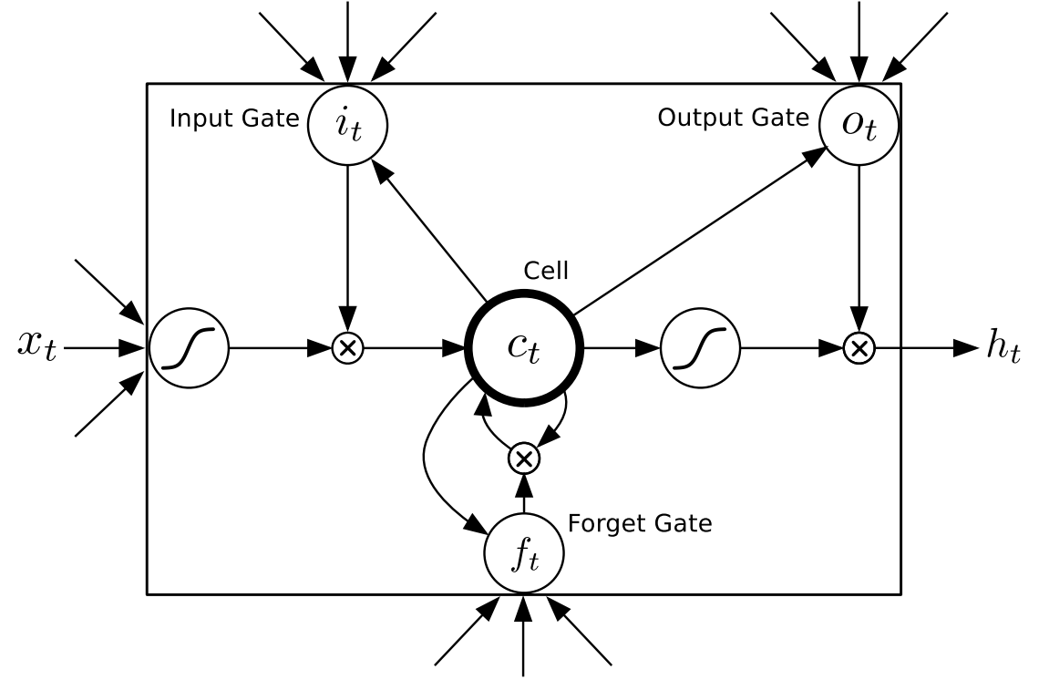
Neural networks
      Current systems are deep neural network based
        Recurrent neural network are more powerful but gradient vanish too quickly -> move to Long Short Term Memories (LSTM) or BLSTM

Slide 11
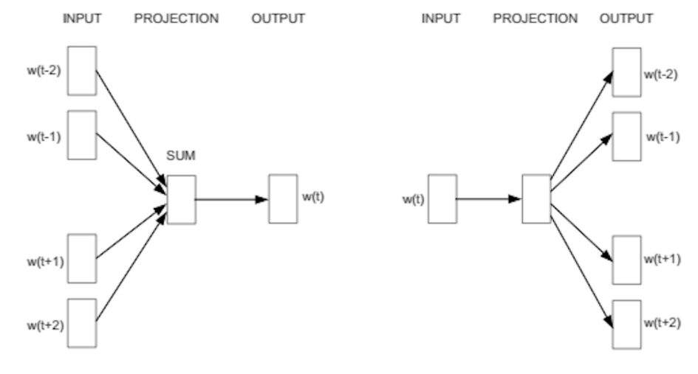
Vector representation of words – from words to meaning
      Word2vec algorithm proposed by Tomaš Mikolov
      Word in some context is mapped to short N-dimensional vector
      Similar words are mapped to the same place in the N-dimensional space

Slide 12
Punctuation and capitalization
        ben is asked to wait for amy but he does not wait he continues to run so amy's request is changed now ben is asked to help amy ben stops and amy is helped
        Ben is asked to wait for Amy, but he does not wait. He continues to run. So Amy's request is changed. Now Ben is asked to help Amy. Ben stops and Amy is helped.
        A neural network is trained to predict upper/lower case and punctuation. The input is a vector representation of words.
        Similar technique can be trained to detect POS tags, name entities, other key information etc.

Slide 13


Sentiment analysis
        -0.981 very poor service totally unprofessional
        -0.971 cost too much money to do
        -0.962 i wish it didn't cost so much
        -0.940 and we're really really disappointed
        0.946 my agent was very very helpful and informative
        0.995 excellent service good job thank you
        0.996 everyone was extremely happy and very nice thank you
        0.996 had great courtesy fast service with a smile
        Again, neural network can be trained for this task. The input is a vector representation of words.

Slide 14
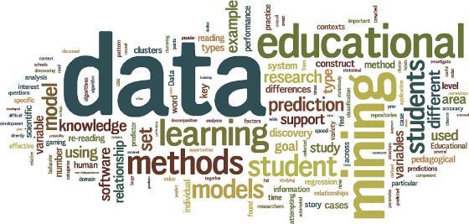
Training data preparation and cleaning
      Each speech recognizer needs word transcribed speech recordings for training, 100h and more, 1h ~ 15h of human time
      Transcription can be done by crowd-sourcing, but good quality control is necessary
      The goal is to develop speech recognizers in just days
      A confidence score based on comparison of a sentence model and an arbitrary word sequence model can be used.

Slide 15
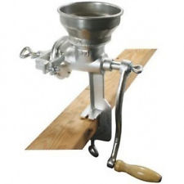
Dynamic decoder for lower memory consumption and embedding
      A decoder is a key part of each speech recognizer
      Static decoder uses a precompiled recognition network but it is very memory consuming
      M = H * C * L * G
      3 Dynamic decoder does the composition on-fly, so it needs only a little of memory. The whole recognizer can fit to some embedded devices.

Slide 16
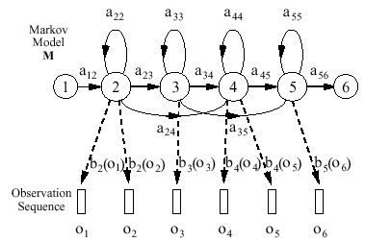
One state Hidden Markov Models
        Classical concept uses more states per phoneme in HMM
        Neural networks and long temporal context modelling makes is possible to use just 1 state per phoneme
        1 state phoneme models increases the recognition speed 3x

Slide 17

Knowing more about speech source
        The recognition result is given by audio quality
        Speech can be degraded noise, reverberation, or any loss compression
        The audio can pass many codecs
        Detection of audio codecs and bit rates is key to predict the quality of output data
        It is important for any forensic expertise
        It is important to prevent spoofing attacks to voice biometry

Slide 18
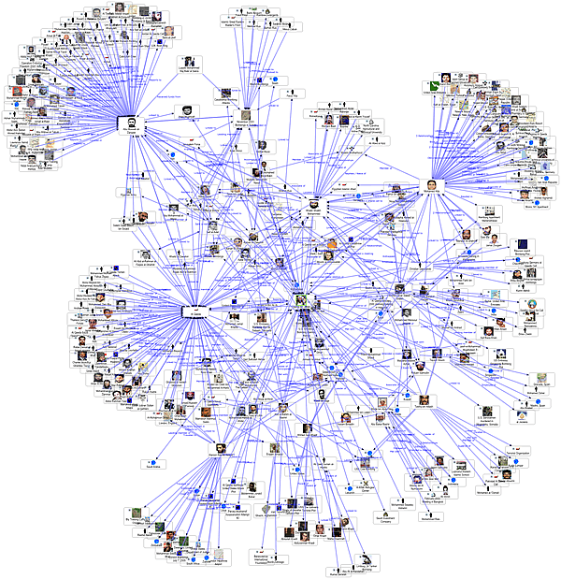
Social network / link analysis
        There is a lot of metadata in speech recordings
        Making relations among metadata inside recording or across recordings makes particular pieces of information easier to find
        The current searching capabilities can be improved by few orders
        The same happened with text when Google came
        There are well known algorithms from text

Slide 19
Some technologies

Slide 20
Voice activity detector
Higher accuracy, lower speed
energy based VAD
technical signal removal
VAD based on
f0 tracking
neural network VAD
Energy based VAD – fast removal of low energy parts
Technical signal removal and noise filtering - removal of tones, removal of flat spectra signal, removal of stationary signals, filtering of pulse noise
VAD based on f0 tracking – removal of other non-speech signals
neural network VAD – very accurate VAD based on phoneme recognition

Slide 21
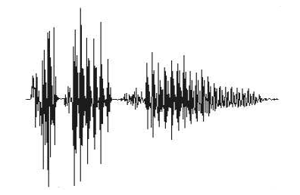
Language identification
UBM
Projection parameters
Language parameters
Calibration
parameters
feature extraction
collection of UBM statistics
projection to iVectors
language classifier - MLR
score calib. / transform
language scores
Prepared by Phonexia
Fully trainable by client
Language prints (iVectors) can be
easily transferred over low capacity links

Slide 22
Speaker identification – voice print extraction
UBM
Projection parameters
Projection parameters
Norm.
parameters
feature extraction
collection of UBM statistics
projection to iVectors
extraction of spk info. - LDA
user normalization
voiceprint
prepared by Phonexia
iVector describes total variability inside speech record
LDA removes non-speaker variability
User normalization helps user to normalize to unseen channels (mean subtraction)

Slide 23
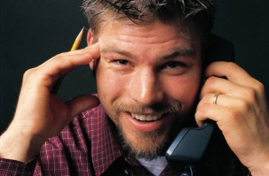

Speaker identification – voice print comparison
Model parameters
Calibration parameters
voiceprint 1
voiceprint comparator
WCCN+PLDA
length dep. calibration
piecewise LR
score transform
Logistic func.
score
trainable by user
voiceprint 2
Voiceprint comparer returns log likelihood
Calibration ensures probabilistic interpretation of the score under different speech lengths
Score transform enables to selects log likelihood ratio or percentage score

Slide 24
Thanks for your attention
Petr Schwarz
CTO
T +420 733 532 891
E petr.schwarz@phonexia.com
phonexia.com

