Slide 1

History
And sometimes repeting history may be desirable ☺

Slide 2
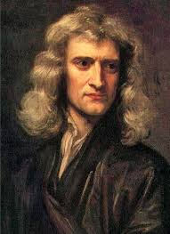
Isaac Newton as alchemist
break body fluids
into stone + water
from Isaac Newton’s notebooks
http://webapp1.dlib.indiana.edu/newton/browse
Let the old man drink wine till he piss
The means to the blest stone is.
And in that Menstruous water drown
The radiant brightness of the Moon
then cast the Sun into her lap
That both may perish at a clap.
So shall you have your full desire
When you revive them both by fire
The glass with the medicine must stand in the fire
Forty days till it be black in sight.
Forty days in blackness to stand he will desire
And then forty days more till it be white.
After the first & second right fermentation
Of mercury crude turneth it to fine gold.
∂=
40 days
in fire
black matter
40 days
in fire
white matter
&
mercury
ferment
twice
gold ?
Notes:
Alchemist such as Newton believed that substances nan be broken to individual components and new substance restructured from the primary components.
One recepie for an experiment from Newton’s notes suggest “special” stone and “special” water to be boiled for a particula time while observing emergency of “black matter” and :white matter”. After “fermentatiuon” of the resulting white matter with mercury, gold is produced.
What we see her is the description what needs to be done and how. We do not know why

Slide 3
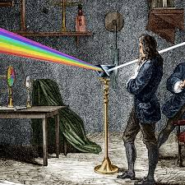
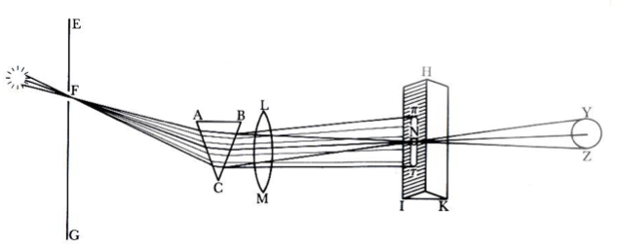
Substances could be broken down into their constituent parts and be transmuted into other.
white light
spectrum
colored light
from Alan Shapiro, The Optical Papers of Isaac Newton (Cambridge: Cambridge University Press, 1984), p. 456
Sunlight contains light rays of differing colours and unequal refrangibility.
ALCHEMY
(what & how)
SCIENCE
(why)
Notes:
Even when Newton probably did not succeded in breaking body fluids into fundamental componets and restructure then into gold, his principle of “breaking up” and ”restructuring”
allowed him to break the white light into different spectral componets and “restruring” some of the spectral components into a particularly colored new light.
So here he also succeded to understand the this happened, the lihght consists of elements with various properties (he may not known about the wavelenghts) but understood enough
to form his theory of light which remains until today. Newton’s alchemy turned into Newton’s science.

Slide 4


What are „constituent parts“ of speech?
/u/ /o/ /a/ /ε/ /iy/
/u/ f1 = 300 Hz,
λ/4
λ/4
= 25 CM
beer
/iy/ f2’ = 3000 Hz
λ/4
= 2.5 CM
Notes:
A short calculation indicated that to get /u/ he needed his glass to be at least 25 cm high. This probably involved a lot of beer drinking, since to start with the vowel /u/ the glass needed to be entirely full and since Newton did not drink at all, he must have used his friend.
Newton’s appologies to his friend after the experiments were also recorded and are shown here.

Slide 5
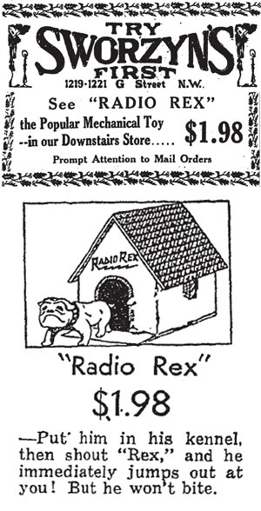
Radio Rex
The first “knowledge-based” speech recognizer
Speech recognition
tuned to
500 Hz
speech
/r/
/e/
/k/
/s/
time
Notes:
When it comes to speech recogntions we need to know the first succesful commercial product. The dog house forms an acoustic resonator (remember our speech production lecture) which resonates around 500 Hz where the vowel /e/ in Rex has concentration of spectral energy. The house walls resonate when the name of the Dox is called, a small contact on the side of the house disconnets, electromagnet stopd holding the spring and the dox ois pushed out. The machine was first patented in 1913.

Slide 6
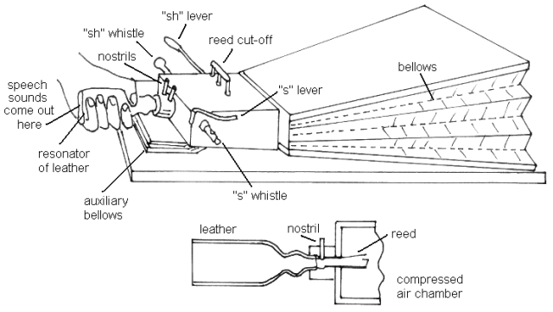
Producing speech
Johann Wolfgang Ritter von Kempelen de Pázmánd
Notes:
Historically, one of the first machines which emulated human speech production was mechanical synthesize of Hungarian (living in today’s Bratislave-Slovakia) von Kempelen. It was very reasonable machine. Frequency rich sound was generated by vibrating reads and its spectrum was modifies by leather tube which was shaped by the hand of the operatos, just as it is modified by changes in the shape of human vocal tract.

Slide 7
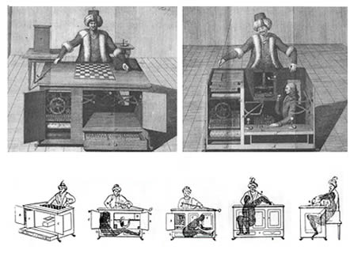
Mechanical Turk
Johann Wolfgang Ritter von Kempelen de Pázmánd
Notes:
The problem was that von Kempelend was a bit shady figure. Not only that he was not noble (as trying to imply by Ritter von..) but he also used his considerable intelligence for building other interesting device, such as the chess-playing Mechanical Turk (playing and often defeating among others Napoleon Bonaparte and Benjamin Franklin) which had a skilled chess-player infide the machine ☺

Slide 8
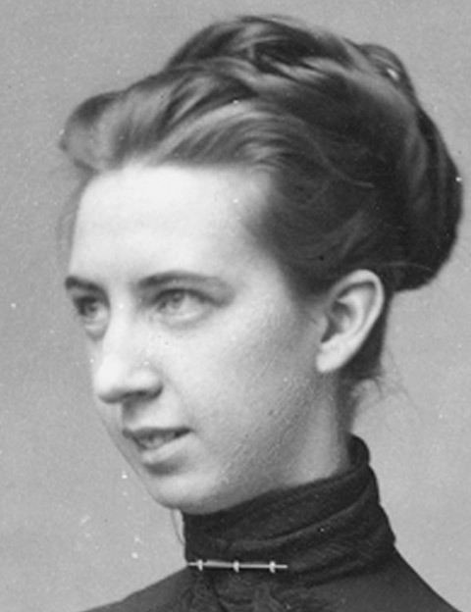
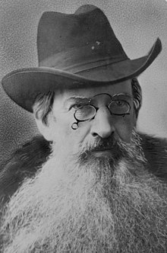
Love is all you need …..
Alexander Graham Bell
Mabel Hubbart
Gardiner Greene Hubbard
Notes:
Vin Helmholtz/s experiments with remote music synthesis were known to the first actor of our love story, Alxander Graham Bell. He must have hoped that if one can remotely control the music syntesizer, breaking speech into the individual frequency componets (that is doing Fourier analysis) and restructuring it on the other end must be possible. However, love to his deaf student Mabel Hubbart slowed Bell’s progres. Mabel’s father, lawyer and money-man Gardined Humbbard asked Bell that if he wants Mabel as his wife, he should work on something more practical than telephone.

Slide 9
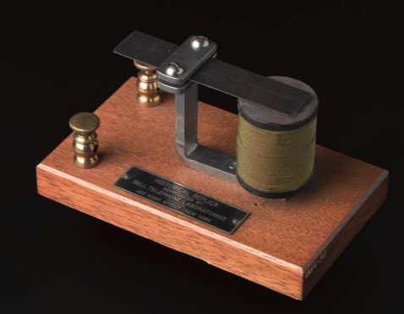
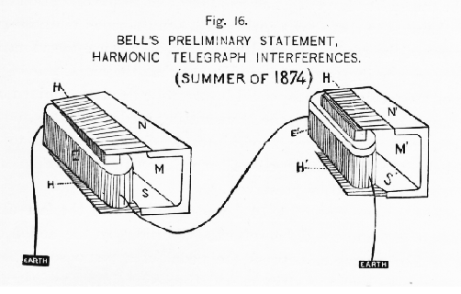
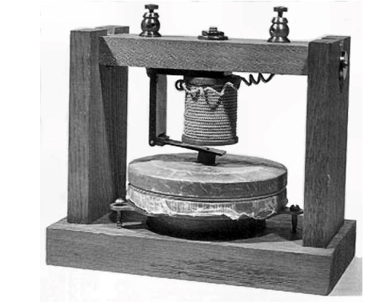
Alexander Graham Bell
Emulate spectral analysis done by hearing
Until one of the reeds got stuck and transmitted signal waveform …
Notes:
So as many other leading inventors of his times, Bell started to work on harmonic telegraph, which used principles of spectral analysis to attempt to transmit more telegraph messages on a single wire
(in today’s term on frequency multiplexing). Of course Bell could not stop thinking about tranmitting voice (after all, he as his father were primarily phoneticians and both knew a lot about speech).
He could separate different frequency componets of the multiple telegraph messages and reconstruct then in the receiver using mechanical resonators shown here.
Accidetaly, while trying to fix one of the reeds on the sending side, his assitant have heard the click of of the released reed on the other side. The spectral analysis was (maybe unfortunatelly) forgotten and Bell
started to think about how to make the electric signal to change as change the acosutic pressure at speaker’s mouth.

Slide 10
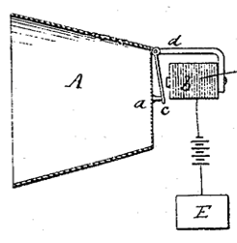
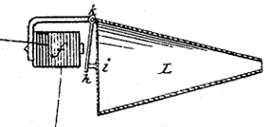
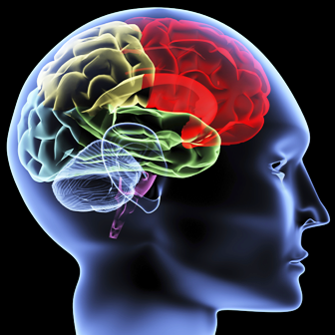
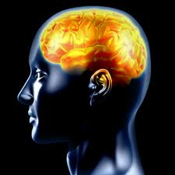
Western Electric Bell Telephone Laboratories
How to transmit messages in speech efficiently (i.e., inexpensively) <
message
message
message-encoding-production
perception-decoding-message
Efficient transmission requires reducing speech signal entropy.
Reduction of entropy requires knowledge.
Hearing science
Threshold of hearing, iso-loudness curves, power law of loudness, perception of modulations, pitch perception, critical bands of hearing, articulatory bands, carrier nature of speech, ...
Engineering
Vacuum tube, filters, transistor, information theory, satellite communication, radio astronomy, laser, photovoltaic cell, UNIX, C-language, electret microphone, optical networks, …
Notes:
The American Bell telephone company aim was to make as much money as possible on voice telephony and they need to transmit speech as cheaply as possible.
Very quickly they started Bell Laboratories which generated many new engineering advances used in the telephony.
They knew well that so far they only managed to emulate a very small part of the human speech communication chain, the transmission of changes in acoustic pressure while speaking.
They also knew there is more to human speech communication than only speech sound.
For the efficient transmission of voice, which contains a lot of redundant elements, the reductipn of this redundancy was one of the goals and
one cannot efficiently reduce the signal redundancy without knowing what one is doing
So important (if not the most important) goal Bell Labs was understanding the whole communication chain.
Subsequently, a lot of speech and hearing knowledge we use tday came from Bell Labs.

Slide 11
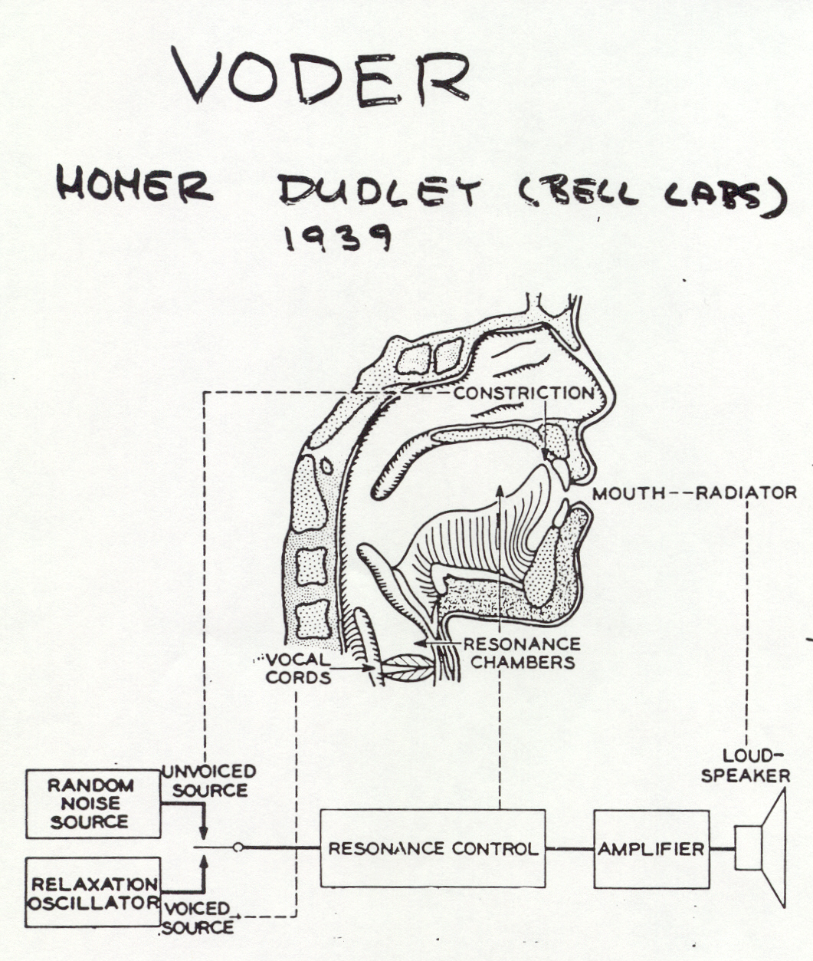
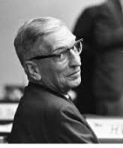
Message is carried in changes in vocal tract shape, which modulate spectral components of speech
H. Dudley: The Carrier Nature of Speech, BSTJ 1940
Homer Dudley
Notes:
One important concept was the concept of carrier nature of speech. It says that the bulk of the information about the message in speech is in changes of vocal tract shape, i.e. in slow movements of
vocal organd such as tongue or lips. These movement are made audible by exciting the vocal tract by the source which is ring in overtones (vibration of vocal cords, air friction in tract costrictions, sudden release of air after the constriction release, ,,,). Noticethere was no mentioning of vocal tractr resonaces (formants) in Dudley’s concept.

Slide 12
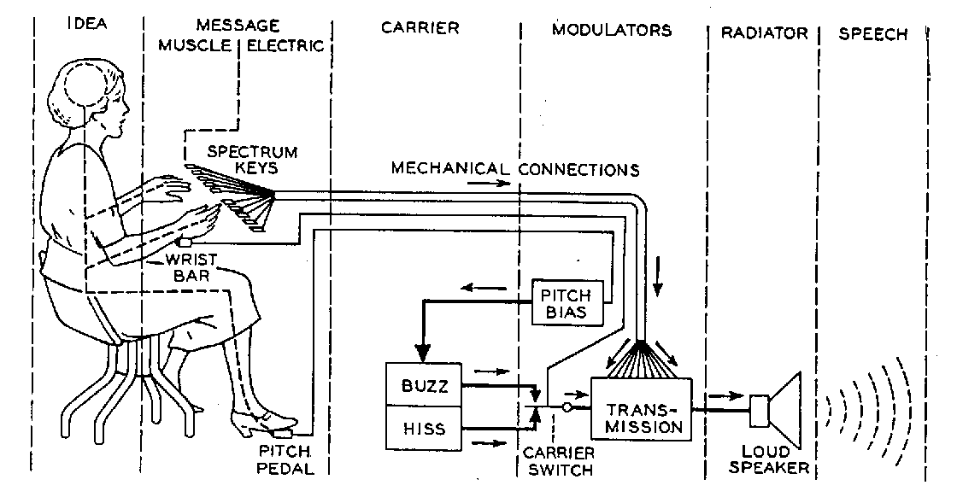
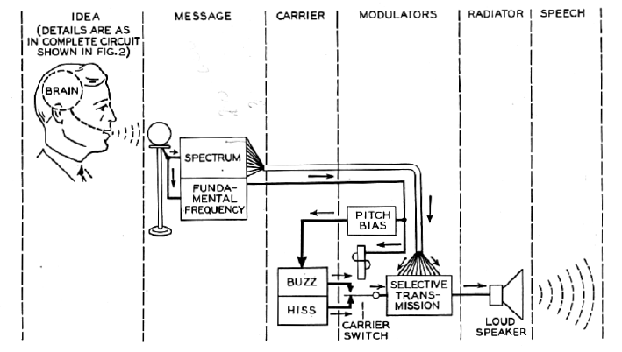
Speech – message coded in muscle movements made audible by modulating the career (vocal source) by vocal tract movements
VODER
message coded in movements of fingers and legs
VOCODER
message coded in movements of vocal tract muscles
Notes:
Dudley first proposed a way of nenerating human voice using a specially trained operator (she took a year to learn to operate it), who could control by hands spectral properties of the filter which shaped speech spectral envelope
and by feet the voice source which provided rich acoustic excitation signal. This snthesized was demonstrated in the Chicago World Fair in 1939. Another step from the VODER where the message was created by movements of fingers and legs, was to elminate the operator and substutute it by speech analyzer, where the message was derived from the actual movements of the vocal tract.

Slide 13
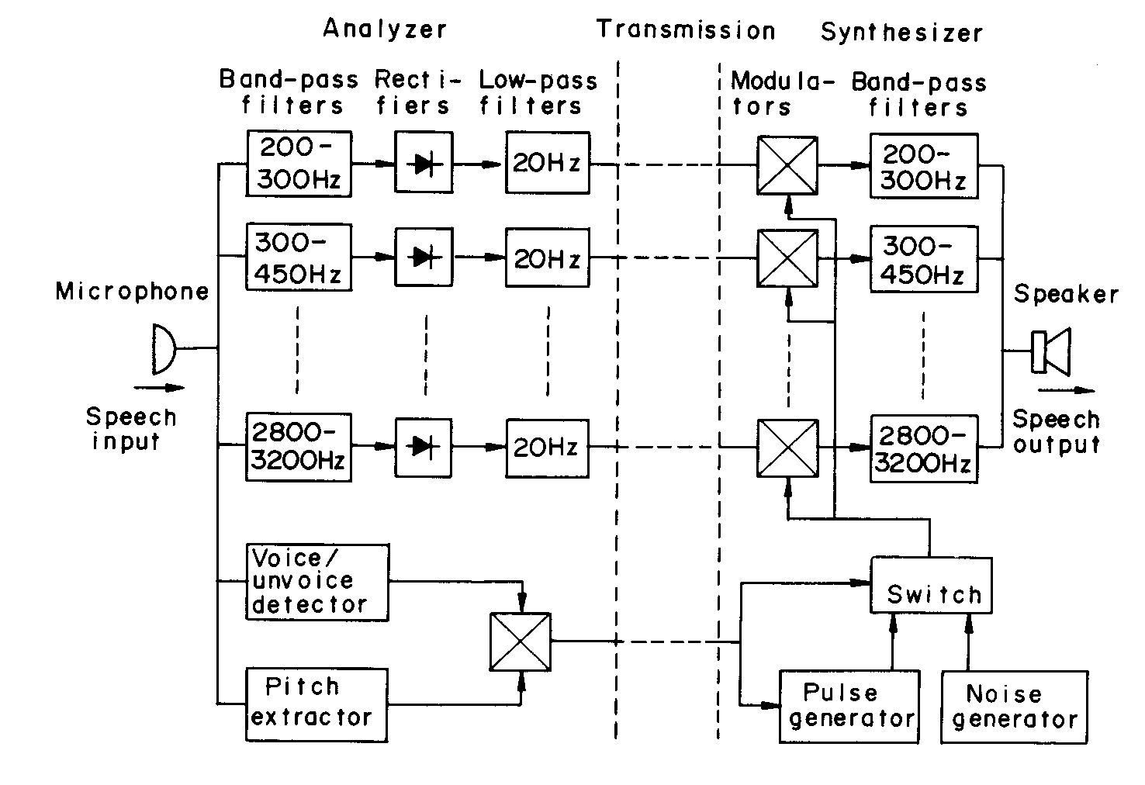
VOCODER
(Homer Dudley 1939)
Predictability (production)
  speech waveform changes “slowly” (inertia of air mass in vocal tract cavities)
  spectral envelope changes slowly
    20 Hz low-pass
  voiced speech is periodic
    pulse generator for excitation
Hearing properties (perception)
  spectral resolution of hearing
    wider band-pass filters at higher frequencies
Many of these concepts ignored for a long time in ASR ☹.
Notes:
It is worthwihel to spenda a bit of time on the VOCODER since the VOCODER contaied many advanced concepts.
The tract movements were derived from slow (up to 20 Hz) spectral changes in freuency bands, which were gradually increasing in bandwidth with frequency as they do in human hearing accoriding to the critical band concept (also discovered in Bell labs by Harvey Fletcher) . Many of these concepts from hearing were subsequently ignored for quite a long time by ASR researchers.

Slide 14
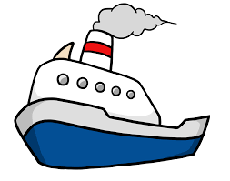


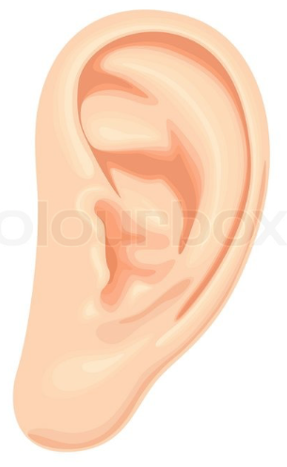
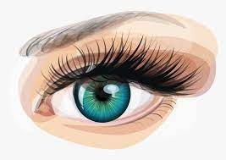
bad submarine!
no idea
It its search for a way to counter the new submarine threat, the U.S. Navy turned to AT&T, which had been doing pioneering work with a sound spectrograph. Some believed this device could be used to distinguish between sounds made by submarines and background ocean noise. If so, that would allow classes of submarines to be identified by their inmistakable “acoustic fingerprints”.
  Mike H. Rindskopf: Steel Boats, Iron Men:
Notes:
A critical device, also developed primarily at Bell Labs, was the spectrograph. It was developed to make sounds more visible by creating 2-D time-spectral picture of acoustic signal by
tracing energies in the individual frequency bands of the signal and was used during the 2nd WW to display underwater sounds in a hunts for enemy submarines.
At that time, it was well understood that ear is doinf frequency analysis.

Slide 15
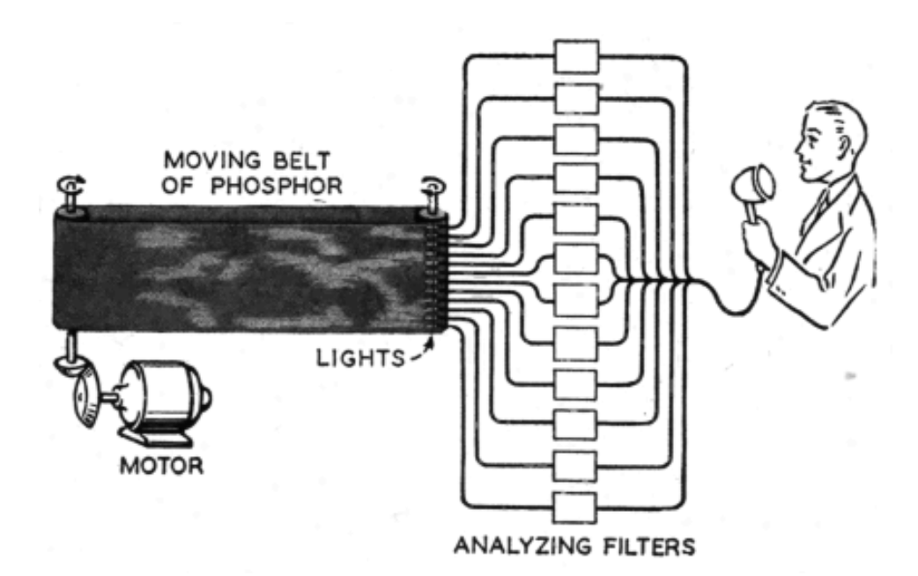
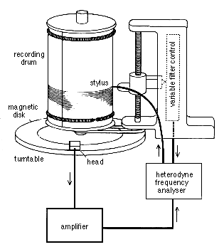
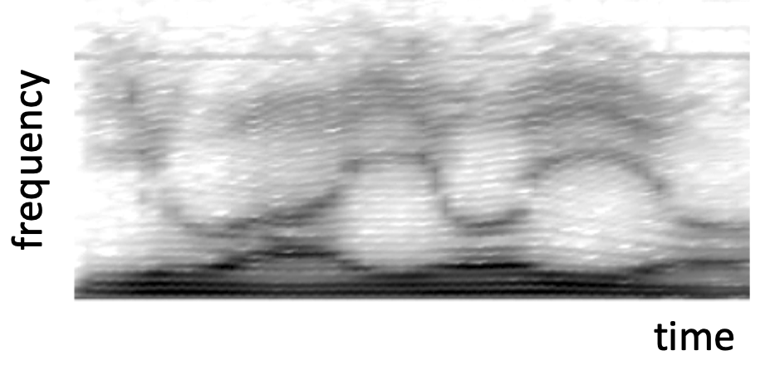
frequency
time
time
Dudley and Gruenz: JASA 1946
SPECTROGRAPH
/j/ /u/ /a_{r}/ /j/ /o/ /j/ /o/
Notes:
A critical device, also developed primarily at Bell Labs, was the spectrograph. It was developed to make sounds more visible by creating 2-D time-spectral picture of acoustic signal by
tracing energies in the individual frequency bands of the signal and was used during the 2nd WW to dispay underwted sounds in a hunts for enemy submarines. After the war it was declassifier,
To avoid the need for a lot of electronics (expensive at that time) mpre mechanically-based Spectrograph was developed amd marketed. When in got in hands of speech people,
they quickly realized that messages in spectrograms of speech could be “almost: decoded. The most visible are the dark areas which represent changing resonance frequencies of the vocal tract.
The formants were born!
Unfortunately, due to implementation details of the Spectrograph, the spectral resultion of the Spectrograph is constant at all frequencies (unlike the VOCODER analysis and inlike the spectral resolution of human hearing).

Slide 16
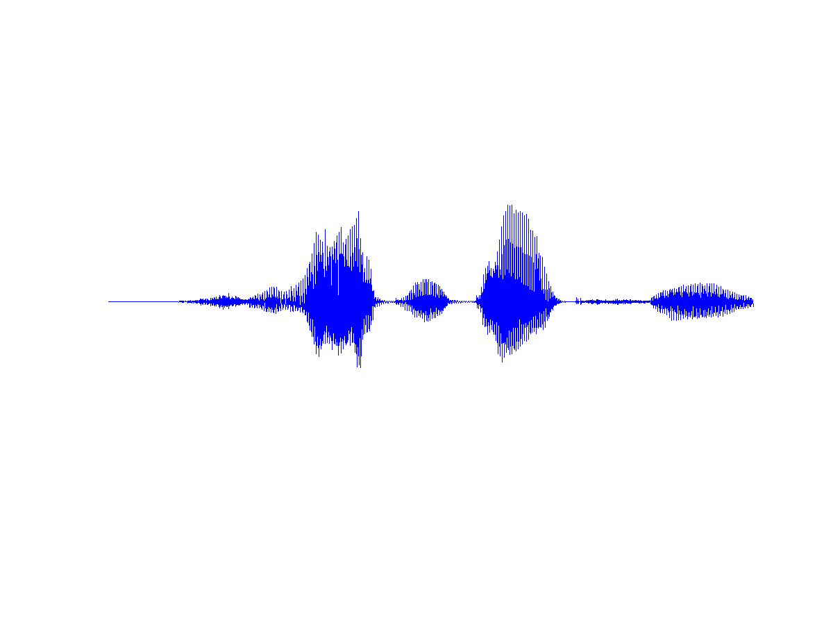
Automatic Speech Recognition (ASR)
The ultimate reduction of entropy of speech
> 50 kb/s
speech signal
C= Wlog₂(S/N+1), W=5kHz, S/N+1>10³
machine
KNOWLEDGE
< 50 b/s
message
linguistic message
< 3bits/phoneme, < 15 phonemes/s
Notes:
The time was set for the attach on the ultimate redundancy reduction of information if messages in speech, for the more than three-orders-of-magintode reduction in speech recogntion.
Clearly, to reducethe redundancy that much, a lot of knowledge is required.

Slide 17
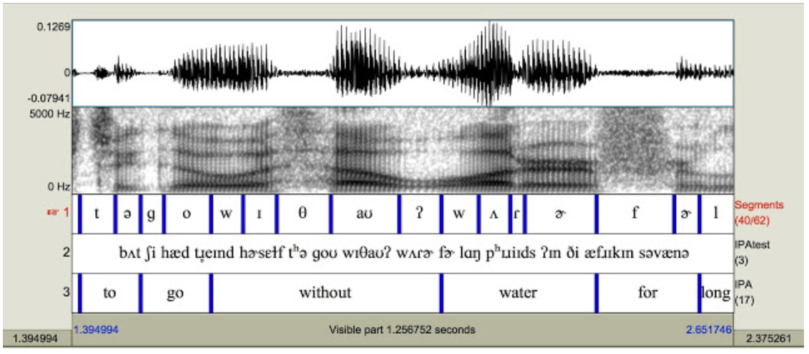
courtessy of blogger “Buffalo LInguist”
http://christiandicanio.blogspot.com/2018/12/what-is-phonetics-20-minute-guide-for.html
Notes:
Spectrograms are just too tempting as a source of knowledge. WIth some (considerable) training, one can learn how to read spectrgram of single adult speakers, so one can make a case that there is enoufg information to decode the speech messages from such spectral represnations. In spite of the early failure of speech recogntion based on spectrograms, the short-time spectra and the associated spectrograms still in some forms with us.

Slide 18
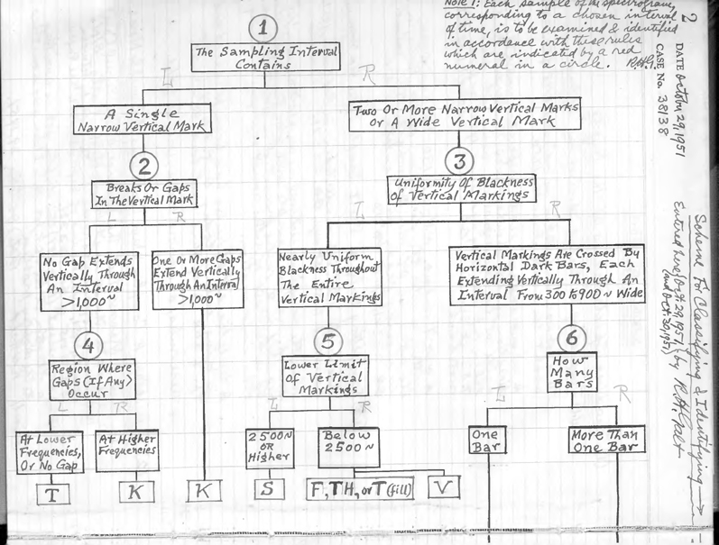
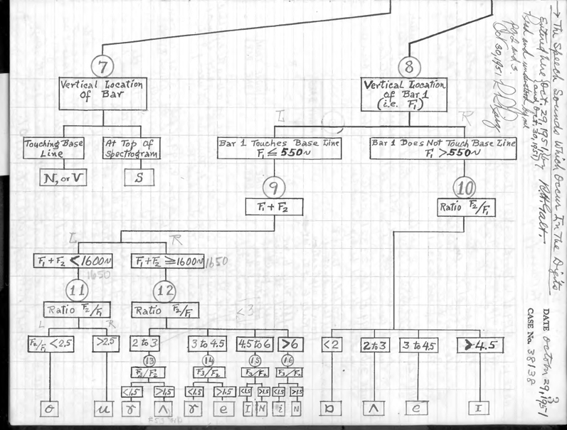
VOICE OPERATED TYPEWRITER
The first “real”
automatic speech recognizer
        R.H. Galt 1951
Rules to interpret short-time spectra of speech sounds
Notes:
.
R. Galt of Bell Labs collected a lot of knowledge how his colleagues read the spectrograms and attempted to build
the first decision-tree based “knowledge-based” recognizer. One can only admire the maouhnt of work put into this design.

Slide 19
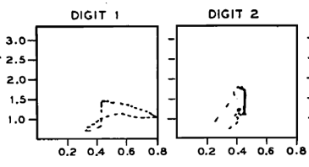
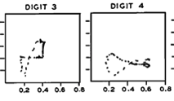
More successful concept
(Davis, Biddulph, Balashek 1952) digits 95-99% correct (single speaker)
Trajectories of estimates of dominant spectral components at high and low frequencies
Create templates during the recognizer training and match them during the inverence)
Closed set recogntion (recognize which of the ten digits was uttered)
Use complete (and crude) description of the signal rather than just formants
Notes:
Competing group at Bell Labs took different approach. The only “knowledge” applied here was the fact that human hearing is analyzing sounds onto its spectral componets (remember Newton?)
and crudely measured main clusters of energies (zero-crossings) in the low part and the high part of speech spectrum. Displaying paterns of these measurements for each of ten digits they traied to recognizer
on the 2-D plane, creating the digit templates. Using rather ingenious electronics (not shown here) for remembering the templates and for matching during the inference,
the recognizer achieved > 98% accuracy on a single speaker for whom it was trained.
Several concepts, which in some forms carry over all the way to the current ASR technologies were introduced.
Template matching (create templates during the recognizer training and match them during the inverence)
Closed set recogntion (recognize which of the ten digits was uttered, do not allow for extraneous sounds)
Use complete (although crude) description of the signal rather than just formants

Slide 20
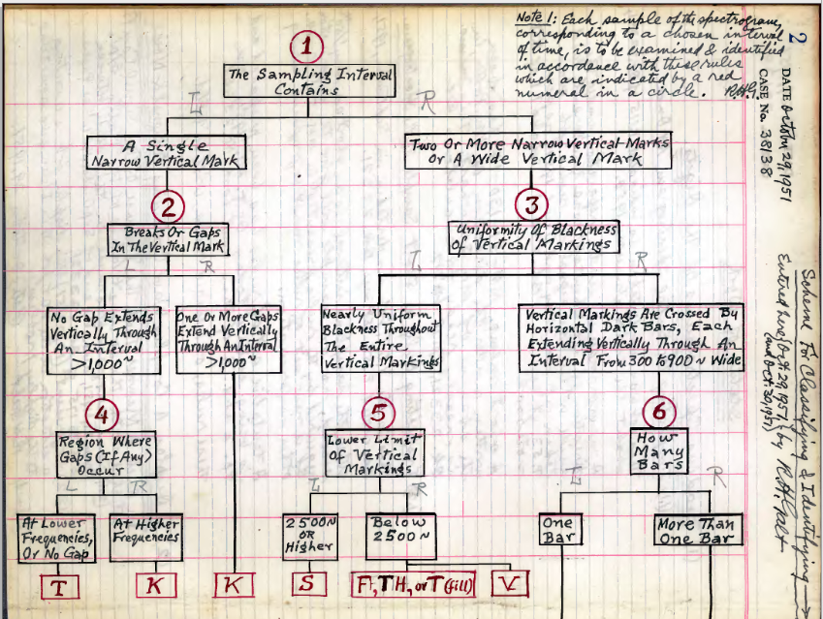
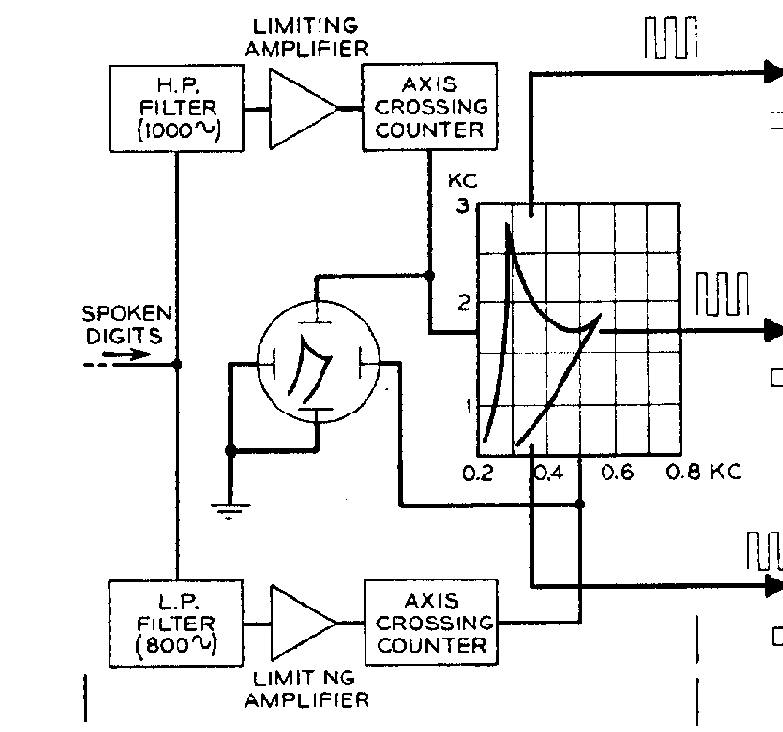
TASK: Recognize closed set of ten digits (important for Bell System)
DATA: DIGIT RECOGNIZER
RULES: VOICE OPERATED TYPEWRITER
WINNER
LOOSER
Close set recogntion
Speaker-specific
High and low frequency signal energy
Word templates
Open vocabulary
Speaker-independent
Spectrogram-based (formant patterns)
Phoneme string spotting
good:
build tools (digit recognizer) and not artificial human listeners
what you see (spectrogram) is not what we listen for (spectral dynamics)
maybe bad:
Implicit assumption that training data represent the present situation
focus on pattern matching (expected) and not on information (unexpected)
Notes:
No surprise, the template matching concept was the winner (it was eventually even produced in small numbers under the name of Audrey).
Important lessons were learned. Some of the concepts applied in the winning system carry over to current ASR.
One can only wonder if the task Bell Labs set up first was to recognize a single word (keyword spotting) in the background of all possible sounds,
This would have been more relevant to human speech communication and our recognizers could have looked different.

Slide 21
Speech recognition 1960-1970
Small vocabulary closed set word recognizers based on simplified spectral representations (Bell Labs 1952 digit recognizer)
Bell Labs Audrey, IBM Shoebox, IBM Automatic Call Identification System, NEC digit recognizer, …
Sound pattern spotting from speech spectrograms (Bell Labs rule based system)
UCL phoneme spotting, Kyoto University phoneme recognizer, RCA phonetic typewriter, ….
Rosenblatt’s Tomermory Percepton (artificial neural net ASR)
  45 band-pass filters, 80 difference detectors, 20 signal-driven delays yield binary descriptio of the signal over up to 2 sec
  1600 input nodes, 1000 hidden nodes, 12 binary output nodes
    (2¹² words can be recognized)
  12,000 adaptive weights between the hidden and ouput nodes
Ideas well ahead of the analog hardware available at that time

Slide 22
Speech recognition 1960-1980
Mostly variants of rule-based phoneme recognition from spectrograms
or close set recognion based on template-matching.
DIgital signal processing (digital spectrograms)
Linear Prediction.
Dynamic Time Warping template matching (Soviet Union 1967, Japan 1970)
ARPA SUR (Speech Understanding Research) activity
Notes:
Speech recogntion efforts after the first pioneering systems were much in the spirit of following more or less the speech science, characterized here by ther quote from Roman Jakobson
(Prague linguistic circle, later Harward and MIT). Most were were some variants on either the small vocabulary template matching or rule-based approach in phonetic typewriter efforts.
Notable effort (not ever finished) was the first ever recognizer based on Rosenblatt’s perceptron
An important techniques developed during Sixties were the Digital Signal Processing (FFT-based sopectrograms) and Linear Prediction,
both further sealing constant frequency resolution analysis and spectral envelope use in ASR.
Dynamic Time Warping was introdused to ASR independently in Japan and in Soviet Union, eventually saving ASR efforts in Bell Labs.
John Pierce, an importand Bell Labs researcher and executive, severly criticize ASR research.
Advanced Research Project Agency Speech Understanding Resarech (ARPA SUR) activity which ensured data-dominated ASR approaces

Slide 23
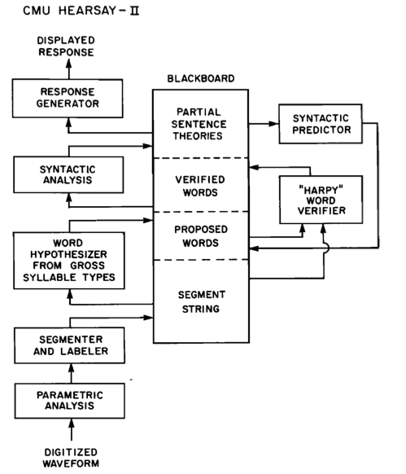
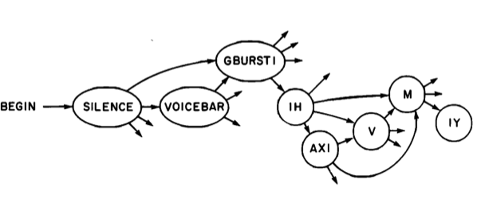
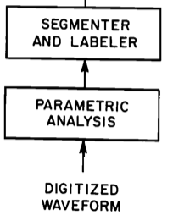
ARPA large vocabulary continuous speech system
(1000 word speaker-dependent)
HEARSAY
rule based Blackboard architecture
HARPY
Markov chain with beam search
state transition network with 15 000 states
HARPY had lower word error rate
Notes:
ARPA SUR project worked towards recogntionspeaker-dependent medium vocabulary of 100o words and continuous speech. Two main research directuion are here
characterized by two CMU systems, the knowledge-based HEARSAY system and the data-derived HARPY state transition based system. HARPY was shown better.
This discouraged further attempts for the knowledge-based systems.
It was believed that to make the system speaker-independent, more templates were required. This made people to think about alternatives to simple template matching.

Slide 24
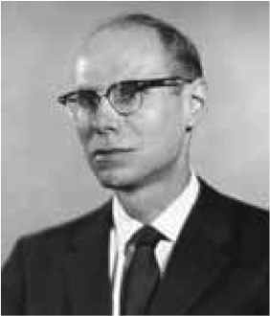
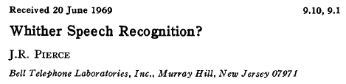
Letter to Editor
J.Acoust.Soc.Am.
Research field of “mad inventors or untrustworthy engineers”
Funding artificial intelligence is real stupidity”
supervised the Bell Labs team which built the first transistor
President’s Science Advisory Committee
developed the concept of pulse code modulation
designed and launched the first active communications satellite
.... should people continue work towards speech recognition by machine ? Perhaps it is for people in the field to decide.
To implement ASR, we need to apply …. intelligence and knowledge of language comparable to those of a native speaker !
Notes:
A short letter to editor of the Acoustical Society of America from the very influential researcher at Bell Labs almost stopped speech recogntion research in USA. Read ithe letter by yourself, I believe that Dr. Pierce had some good advice, still valid even today.

Slide 25
Template matching
Bell Labs 1952
Compare sequences 2-D parameters
Derive examples of expected utterances from training data
Find the best match of your test data with the previously derived examples
Bell Labs (Fumidata Itakura from NTT) 1974
Compare sequences of muti-dimensional parameters
Notes:
However, to deal with differences in timings, more powerful soulution is offered by dynamic time warping, introduced in seventies independently in Japan and in Soviet Union

Slide 26
Since 1969
Better speech features (linear prediction, cepstrum, auditory-like techniques…)
Better pattern matching (dynamic time warping, Viterbi search)
Stochastic models allowing for using huge amounts of speech data
Iterative expectation-maximization (EM based training only from transcribed speech data (no need for data labeling)
Explicit use of Bayes rule combining the evidence from the signal together with prior expectations form the language
Notes:
The recognitions field fiortunately did not stop altogether and gradually it recovered to the point weher we are today. Several reasons for its recovery are listed here.

Slide 27
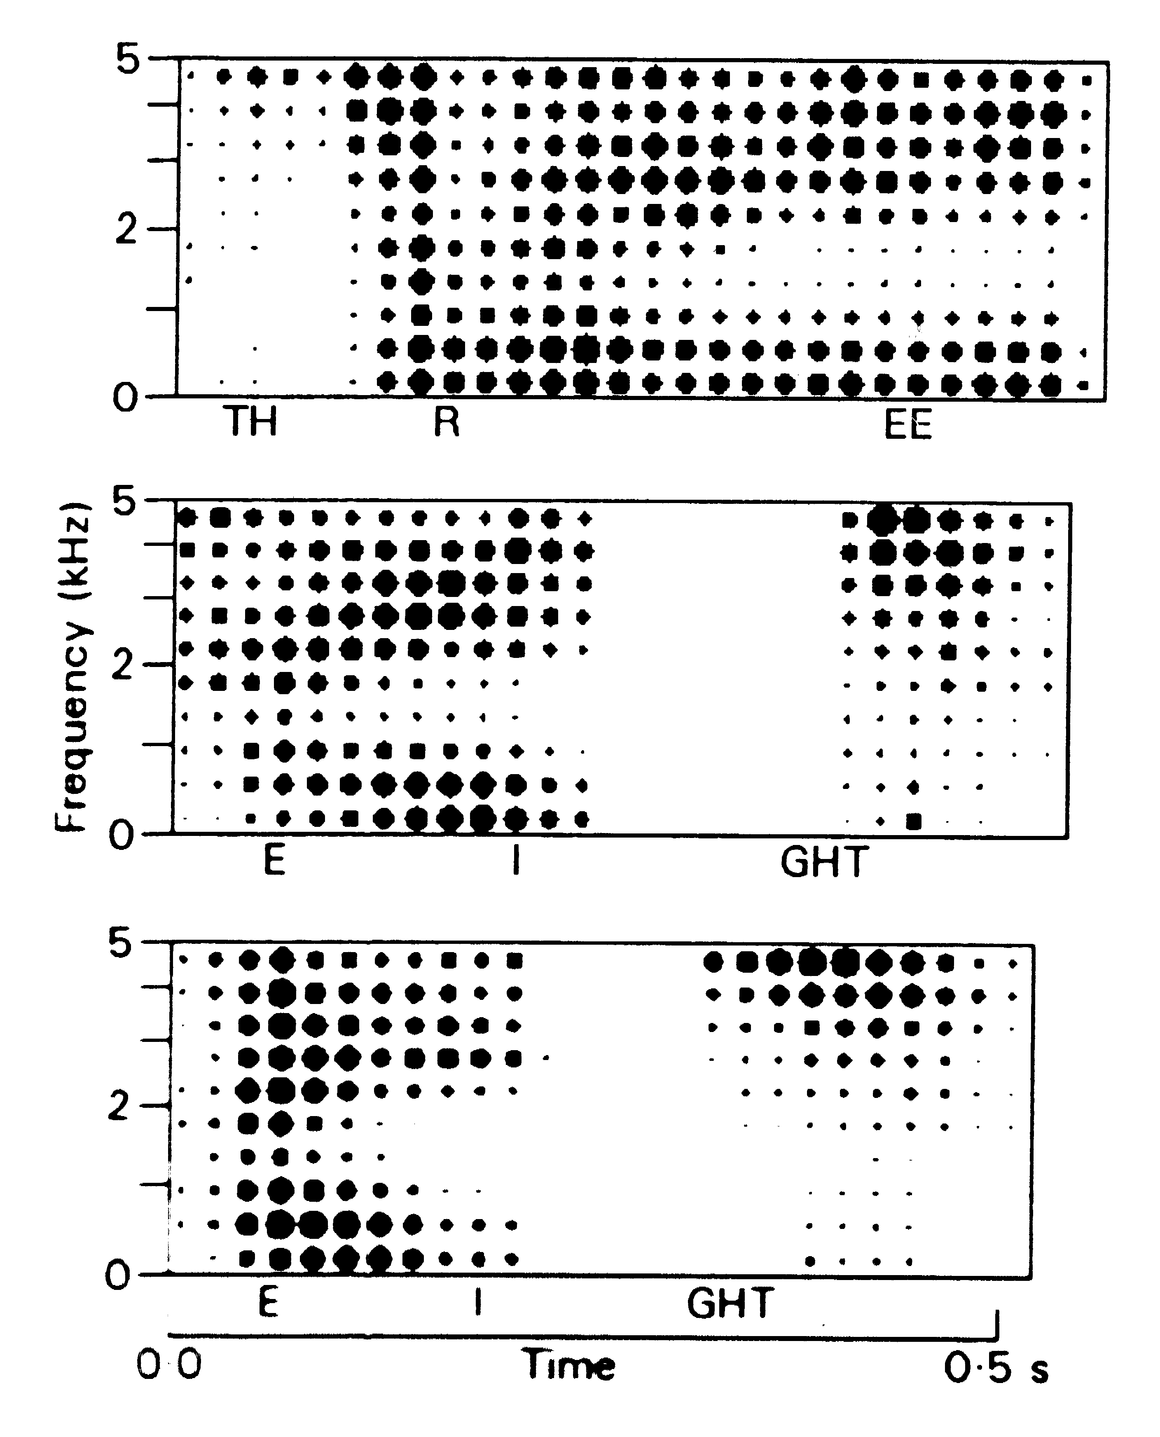
Short-term features
10-20 ms
time
derive features
features
time
Notes:
To get more information, we may want to move to more dimensions but the two provided by the high and low zerocrossing frequencies.

Slide 28
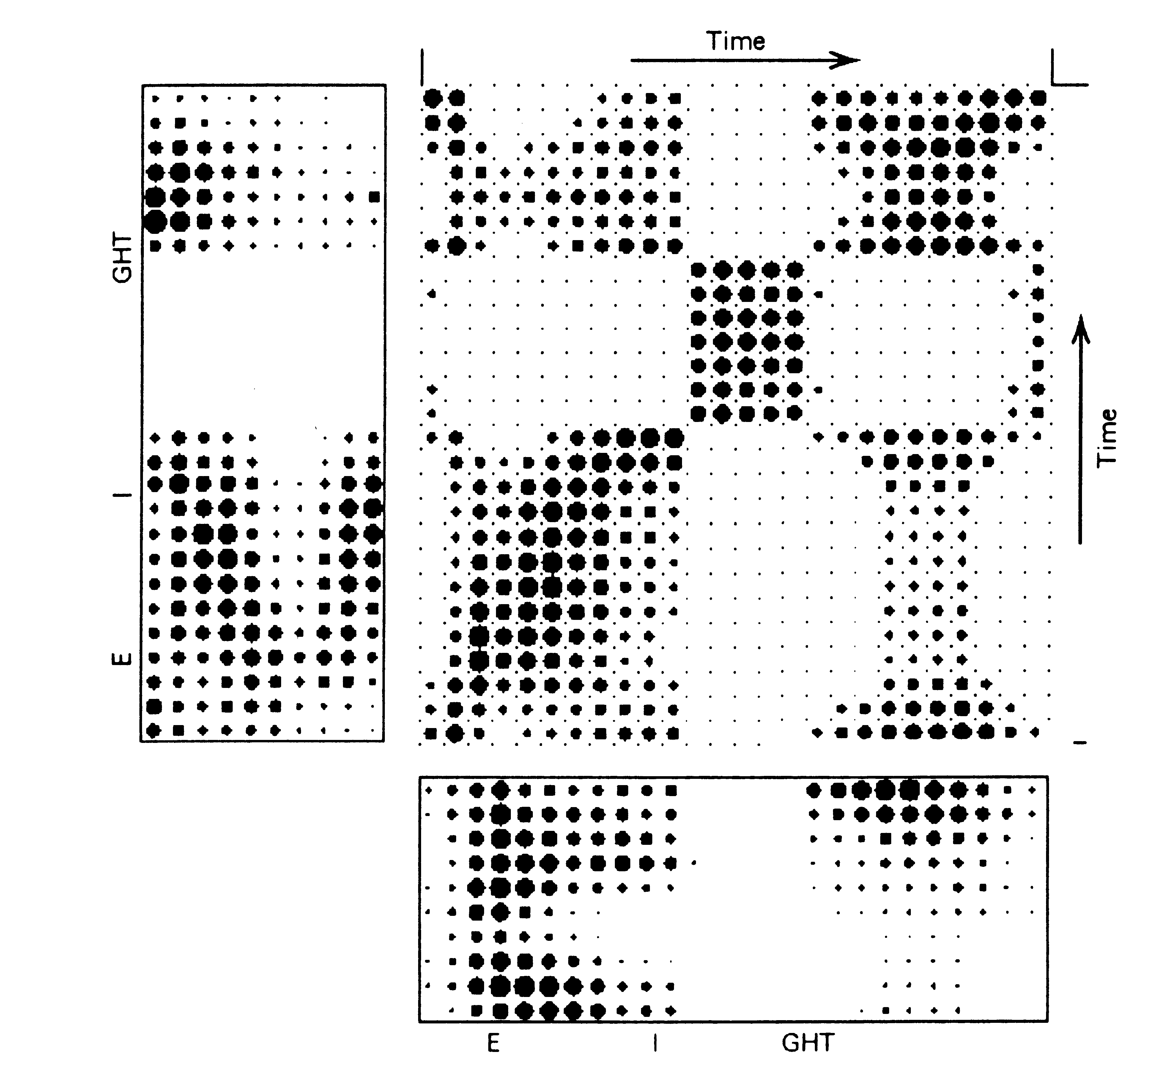
template matching with dynamic time warping
template
Compute similarities among all feature vectors
Find the path that yields the highest overall similarity
Every instant of the signal is considered
Dynamics of the object (word) can be severely distorted
unknown utterance
Notes:
To account for the fact that different people may have different speaking habits and the utterances with identical linguistic messages may have different timing, the dunamic time warting technique was introduces to speech recogntion. The two utterances are compared so that the minimum distance (the maximum similarity) between them is achieved while allowing for local adjustments of the path along which the utterances are compared. MATLAB program from the signal processing toolbox dist = dtw(x,y) stretches two vectors, x and y, onto a common set of instants such that dist, the sum of the Euclidean distances between corresponding points, is smallest. To stretch the inputs, dtw repeats each element of x and y as many times as necessary. If x and y are matrices, then dist stretches them by repeating their columns. In that case, x and y must have the same number of rows.

Slide 29
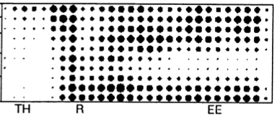
Model ?
Examples of utterances (templates)
similarity by evaluating “distances”
Generative stochastic model (hidden markov)
similarity by evaluating likelihoods of models
distribution
of emitted
parameter
p_{stay}
p_{transit}
/th/
/r/
/ee/

Slide 30
Stochastic Recognition of Speech
unknown
speech
utterance
x
stochastic
pattern
matching
recognized
utterance
training
data
(acoustic and language)
Find such a model of speech, which most likely produced the data
how to obtain acoustic and language models? (training)
how to search for the most likely models? (search)
what are the most appropriate features x ? (feature engineering)
Notes:
The stochastic recognizer finds the best model which could produce the unknown data x. The stochastic matching module needs to generate all possible uttereances which could produce the data. This is done using acoustic and language models derived from data. There are three main issues with this approach. 1) How to define the input data x (the features), 2) how to train the acoustic and the language models, 3) how to search for the most liklely models. SInce models are build from training data, the implicit assumption is that training data represent the present situation

Slide 31
Hidden Markov Model
Two dominant sources of variability in speech
    different people sound different, communication environment different,… (feature variability)
    people say the same thing with different speeds (temporal variability)
“Doubly stochastic” process (Hidden Markov Model)
  Speech as a sequence of hidden states (phonemes) - recover the sequence
    never know for sure which data will be generated from a given state
    never know for sure in which state we are

Slide 32
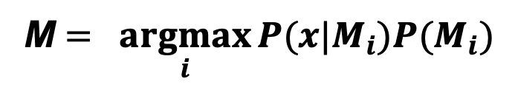
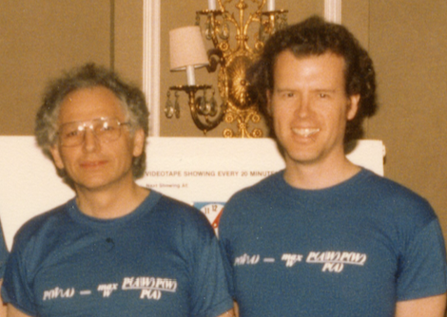
How to get good models ?
The model architecture and DATA !
There is no data like more data
  attributed to Bob Mercer
More data is always better than more thinking
  attributed to Eric Brill
No knowledge is better than wrong knowledge
Notes:
To get good model of speech, we need good model architecture and good data for the model training. The architecture largerly stabilized as a sequence of speech sounds. What represents the is dependent on amount of training data which is available for the model training. More detailed models of sounds require more data. Similarly, more complex language models may require more data. So to get better models needs more data,

Slide 33
Speech recognition since 1990
Artificial neural nets (ANNs) to estimate probabilities for statistical pattern recognition Morgan and Bourlard 1990
ANN/HMM hybrid system
features
likelihoods
phonemes
words
signal
analysis
artificial neural
network
search
sound to letter
language model
Can use huge numbers of trainable parameters (regularization, cross-validation)
Can form complex class boundaries
Hierarchical layer-by-layer processing
Accept correlated and arbitrarily distributed features
  From cepstrum to concatenated spectral vectors (increasing context)
  Extreme case of TRAP (1 sec long individual temporal trajectories of spectrum)
Making friends with HMM community
  TANDEM features for HMM (gaussianized and decorrelated posteriors from ANN)
Notes:
Late eighties and early nineties brought back the Rosenblatt’s perceptron, this time with nonlinearities on each processing layer and with straigtforward adaptation of net weights.
Initially, beasuse of the lack of data and computing resources, it was difficult to use large ANN models and the nets were competetive only in simple archtectures such as single-state phoneme model based ASR.
However, the ANN advanteges such as the ability of forming a complex class boundaries, hiearchical layer-by-layer processing, and finaly the ability to deal with wide class of input features, were always there.
It encourage us to inttroduce larger and larger temporal contexts, to abandon the cepstrum based envelope for the individual spectral energy trajectories, sometimes as long as 1 second,
ANN people also contributed to the competetive GMM/HMM sustems by providing them TANDEM features derived by ANN, which were fordced by ETSI (European Telecommunications Standards Institute) requirement of using HMM/GMM based classifier in the competition.

Slide 34
Recent developments
Many capable people work with increasingly larger (and deeper) nets training on very large datasets using powerful hardware.
From locally optimized modules (features extraction, likelihood estimation, time alightment, sound-to-letter, …) to global optimization of the whole system.
signal x
deep neural
network
words
Very powerful paradigm, but still
  needs labeled data,
  assumes that present is similar to past (generalization),
  prefers recogntion of more likely items rather than information rich rare items.
Ever increasing amounts of training data may obliviate true progress and disadvatages less “fortunate” groups.
Work towards decreasing the necessary amounts of training data !
Notes:
I would like to stop this brief and necessarily incomplete history description at the point where most papers in this conference will probablyt be,
that is at the current explosive development in use of ANN in their current deep-learing form.
Many very competents and capable researchers are introducing complex
huge net archirtectures trained on unbelievable amounts of training data using more and more powerful hardware.
The most important advance is that the module-by-module optimization is gradually replaced by the global optimozation.
The end-to-end approaches take the input data, sometimes even in the original raw signal form and directly deliver a sequence of letters describing the message.
Still, some issues from the early days of ASR remain: the need for some labeled data is here, the assumption that the operation domain is similar to the domain on which the system was trained,
and the preference of frequenct and therefore expected words ovwer the information rich infrequent words is still here.
The need for training data is still exponentially increasing and the system performance is increasing with it.
We may not know anymore if the improvements come from some fundamental improvement of the underlying principles or from more data.
~ 300 days of labeled data
~ 100 years of unlabeled data
Parthasarati et al 2019
137 billion free parameters
100 billion words in training
Shazer et al 2017

Slide 35
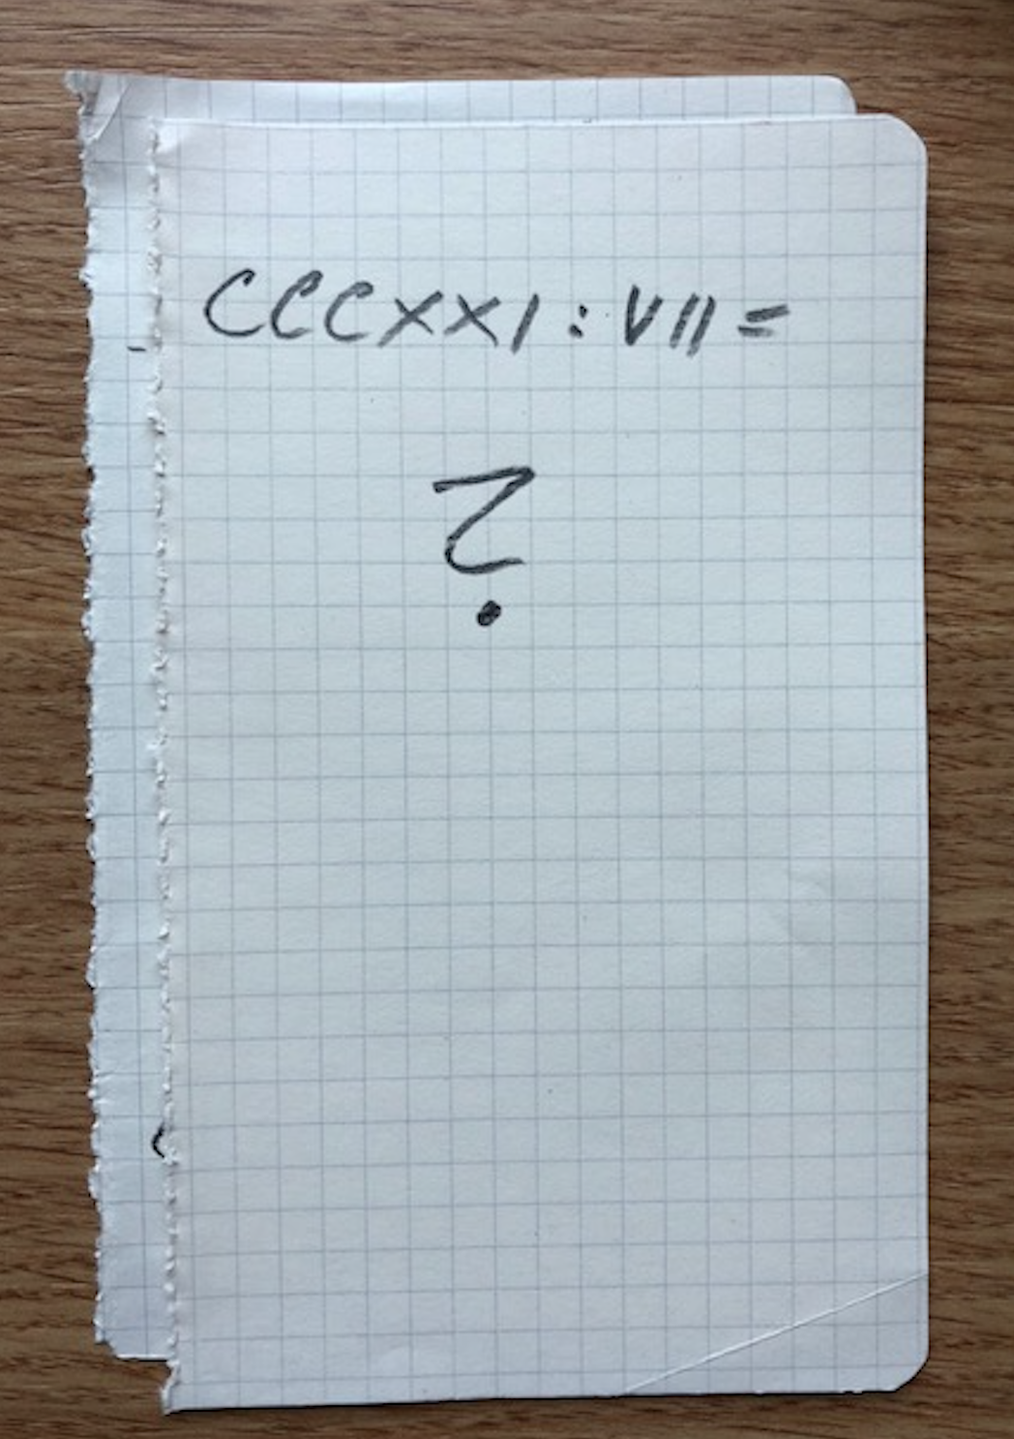
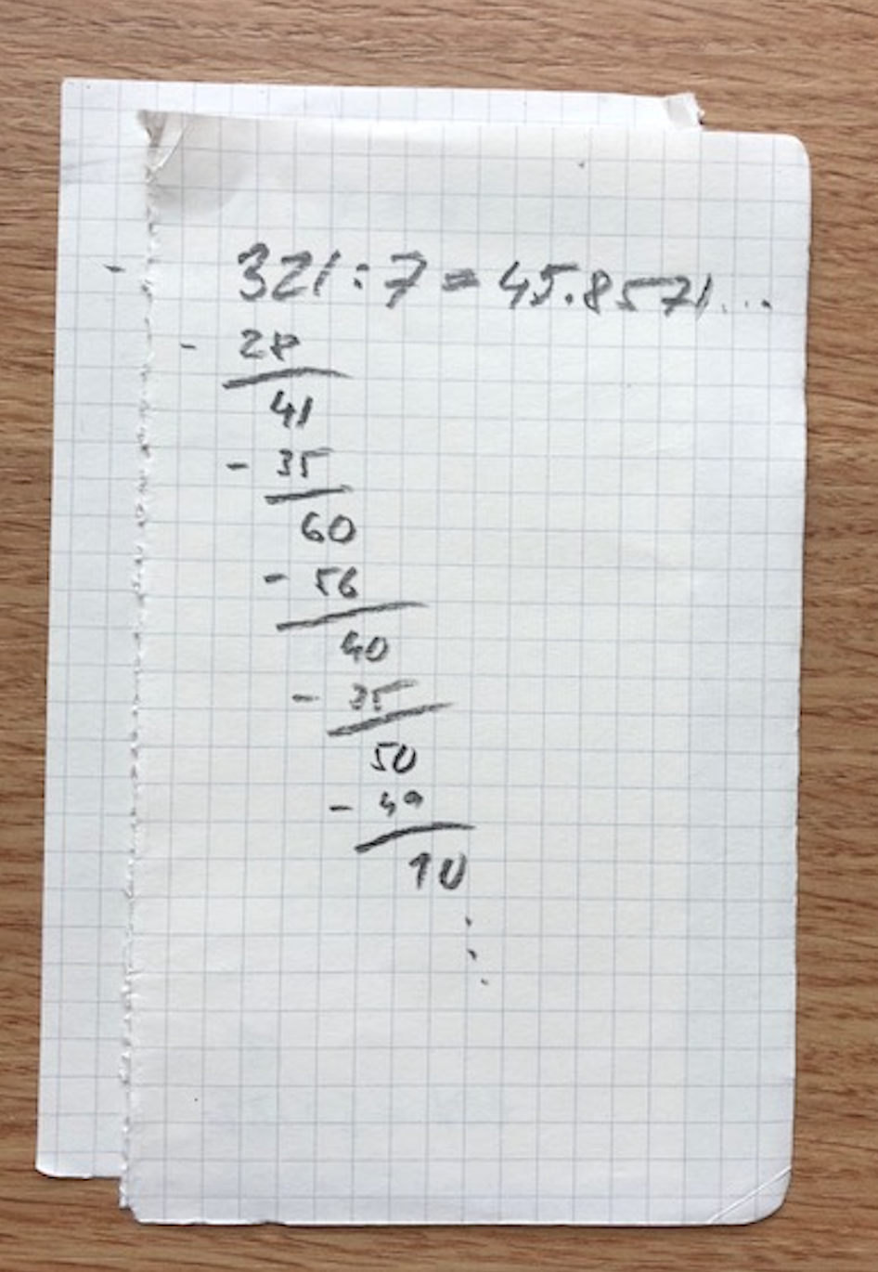
Why is speech recogntion hard?
  languages are different, speaker knowledge is different, people are different, acoustsic environments are different, sounds are coarticulated,….
  or
  ?
Why is long division hard?
`

Slide 36
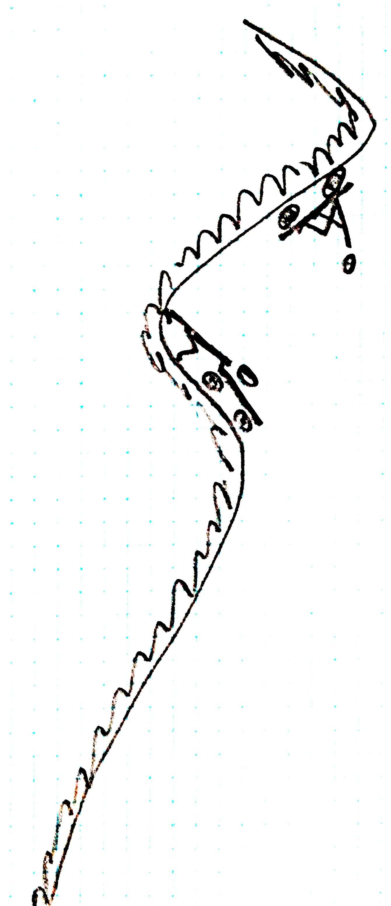
Why to rock the boat?
We have good thing going.
error
rates

Slide 37
Geocentric (Ptolemy)
Heliocentric (Copernicus)
40 epicycles
48 epicycles !!

Slide 38

Kepler
not circles
ellipses
WHY ? - Isaac Newton

Slide 39
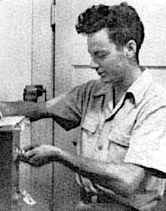
You do not know what works until you are done
– until then you only know what does not work

Slide 40
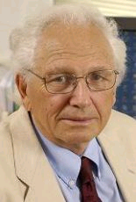
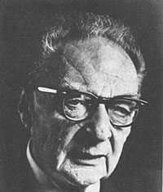

How to Get There ?
Fred Jelinek
Speech recognition
…a problem of maximum likelihood decoding
Roman Jakobson
We speak, in order to be heard, in order to be understood
information and communication theory, machine learning, large data,….
human communication, speech production, perception, neuroscience, cognitive science,..
Gordon Moore
John Pierce
The complexity for minimum component costs has increased at a rate of roughly a factor of two per year…
..devise a clear, simple, definitive experiments. So a science of speech can grow, certain step by certain step.
Signal processing, information theory, machine learning, …
neural information processing, psychophysics, physiology, cognitive science, phonetics and linguistics, ...
&
Engineering and Life Sciences together !
Notes:
Speech processing – dominated by data (Fred-stochastic approaches).
Strive for more permanent knowledge (oldfashioned speech science – can be derived from data).
Get help from powerful tools (GPUs)
Remember John Pierce – step-by-step incremental knowledge acquisition
(hypothesis does not always be – things will get better)
Why not to strive for emulation of knowledge of a native speaker?
Impossible may become possible.

